Slide 1
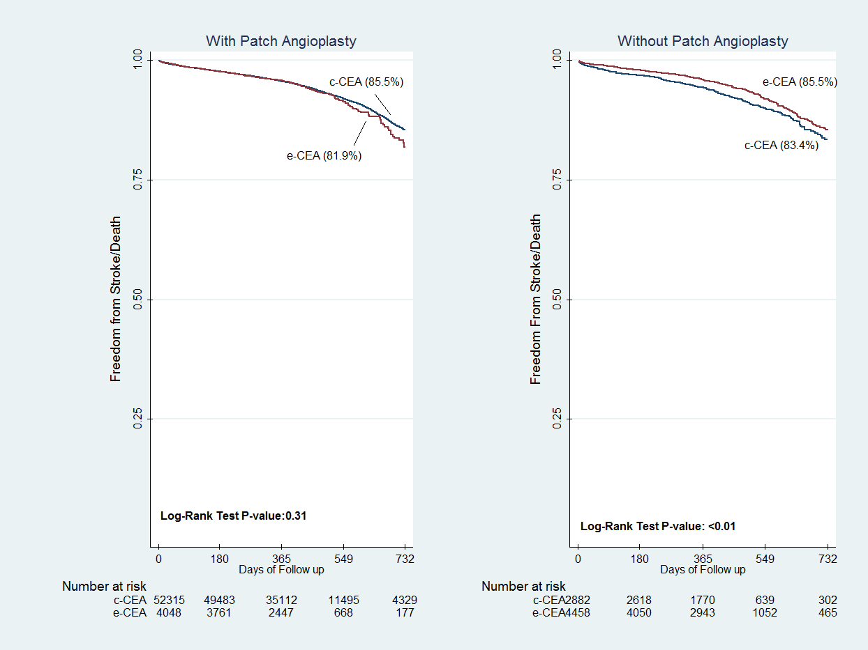
Outcomes following Eversion vs. Conventional Endarterect8omy in the Vascular Quality Initiative
Dakour-Aridi H¹, Ou M², Locham S¹, AbuRahma A³, Schneider JR⁴, Malas M ¹
¹University of California San Diego; ²Johns Hopkins Medical Institutions; ³West Virginia University; ⁴ Northwestern University
BACKGROUND
STATISTICAL ANALYSIS
Figure 2. Comparison of Stroke/Death Rates between different CEA approaches
Several randomized clinical trials and observational studies have compared the outcomes of e-CEA and c-CEA. However, the results have been contradictory
Multivariable logistic and Cox-regression analyses used to compare risk-adjusted peri-operative and 2-year outcomes (stroke, death, and high-grade restenosis (>70%) between c-CEA (using direct closure or patch angioplasty) and e-CEA.
Conventional CEA
RESULTS
Table 1: Baseline and Operative Variables
 | Conventional CEA | Eversion | P value
 | (N=83,726) | (N=12,050)
Age, years | 71 (64-77) | 72 (65-78) | <0.001
Female Gender | 32,940 (39.3) | 4,825 (40.0) | 0.14
White Race | 76,830 (91.8) | 10,854 (90.1) | <0.001
ASA class |  |  | <0.001
I/II: Normal/Mild | 4,650 (5.9) | 990 (8.6)
III: Moderate | 59,486 (75.1) | 8,541 (74.3)
IV/V: Severe | 15,112 (19.1) | 1,962 (17.1)
Comorbidities
Symptomatic Carotid Stenosis | 18,989 (22.7) | 2,458 (20.4) | <0.001
Diabetes | 29,656 (35.4) | 4,162 (34.6) | 0.05
HTN | 74,515 (89.0) | 10,654 (88.4) | 0.05
CAD | 22,772 (27.2) | 3,249 (27.0) | 0.55
CHF | 8,552 (10.2) | 1,313 (10.9) | 0.02
COPD | 18,618 (22.3) | 2,646 (22.0) | 0.48
CKD | 28,412 (34.7) | 4,244 (35.9) | 0.02
Pre-operative medications
Aspirin | 69,556 (83.1) | 10,106 (83.9) | 0.03
Anticoagulant | 6,781 (9.6) | 1,092 (10.4) | <0.01
Beta blocker | 48,708 (58.2) | 6,937 (57.7) | 0.23
Statin | 67,819 (81.1) | 9,580 (79.5) | <0.001
ACE inhibitors | 36,961 (52.2) | 5,610 (53.4) | 0.02
P2Y12 Inhibitors | 25,217 (30.1) | 3,635 (30.2) | 0.94
Elective Procedures | 73,424 (87.7) | 10,611 (88.1) | 0.39
Local/Regional Anesthesia | 6,058 (7.2) | 2,151 (17.9) | <0.001
Shunting |  |  | <0.001
Routine | 44,559 (53.3) | 3,201 (26.6)
Selective | 3,634 (4.4) | 462 (3.8)
Patching | 79,351 (94.9) | 5,992 (49.7) | <0.001
Table 3. Adjusted Outcomes in e-CEA vs. c-CEA in the Overall Cohort and Stratifying w.r.t Patch Use
 | Overall Cohort*
 | c-CEA | e-CEA
 | N=83,726 | N=12,050
 | OR/HR (95%CI) | OR/HR (95%CI) | OR/HR (95%CI) | p-value
Return to OR for bleeding | Ref. | 1.32 (1.04-1.67) |  | 0.02
30-day Stroke/Death | Ref. | 0.87 (0.73-1.04) |  | 0.12
2-Year Stroke/Death | Ref. | 0.94 (0.82-1.10) |  | 0.50
2-Year Restenosis | Ref. | 0.92 (0.76-1.11) |  | 0.36
 | Without Patching
 | c-CEA | e-CEA
 | N=4,288 | N=6,055
Return to OR for bleeding | Ref. | 1.43 (0.89-2.29) |  | 0.14
30-day Stroke/Death | Ref. | 0.72 (0.54-0.95) |  | 0.02
2-Year Stroke/Death | Ref. | 0.77 (0.61-0.97) |  | 0.03
2-Year Restenosis | Ref. | 0.94 (0.70-1.27) |  | 0.70
 | With Patching
 | c-CEA | e-CEA | e-CEA
 | N=79,351 | N=5,992 | N=5,992
Return to OR for bleeding | Ref. | 1.30 (0.98-1.73) | 1.30 (0.98-1.73) | 0.07
30-day Stroke/Death | Ref. | 0.94 (0.76-1.16) | 0.94 (0.76-1.16) | 0.58
2-Year Stroke/Death | Ref. | 1.05 (0.87-1.25) | 1.05 (0.87-1.25) | 0.63
2-Year Restenosis | Ref. | 0.93 (0.73-1.19) | 0.93 (0.73-1.19) | 0.56
 | c-CEA with Patching | e-CEA without Patching | e-CEA without Patching
 | N=79,351 | N=6,055 | N=6,055
Return to OR for bleeding | Ref. | 1.42 (1.06-1.91) | 1.42 (1.06-1.91) | 0.02
30-day Stroke/Death | Ref. | 1.27 (0.99-1.64) | 1.27 (0.99-1.64) | 0.06
2-Year Stroke/Death | Ref. | 0.98 (0.82-1.18) | 0.98 (0.82-1.18) | 0.85
2-Year Restenosis | Ref. | 1.14 (0.94-1.39) | 1.14 (0.94-1.39) | 0.19
Eversion CEA
Table 2: In-Hospital and 30-Day Outcomes
OBJECTIVES
 | Conventional CEA | Conventional CEA | Eversion CEA | P Value
In-Hospital Outcomes
Death |  | 232 (0.3) | 31 (0.3) | 0.70
Stroke |  | 826 (1.2) | 124 (1.2) | 0.90
Stroke/Death |  | 987 (1.2) | 145 (1.2) | 0.82
Stroke/Death/MI |  | 1,556 (1.9) | 221 (1.8) | 0.85
Post-procedural Hemodynamic Instability |  | 22,777 (27.3) | 2,922 (24.3) | <0.001
Surgical Site Infection |  | 42 (0.1) | 7 (0.1) | 0.72
Reperfusion Syndrome |  | 127 (0.2) | 26 (0.2) | 0.10
Return OR for Bleeding |  | 763 (0.9) | 157 (1.3) | <0.001
Return OR for Neurologic Causes |  | 341 (0.4) | 60 (0.5) | 0.15
Operative time in minutes, Mean (SD) |  | 116.0 (43.5) | 109.3 (46.0) | <0.001
Length of Stay for more than one day |  | 26,943 (32.2) | 3,567 (29.6) | <0.001
Thirty-Day Outcomes
Ipsilateral Stroke |  | 713 (1.4) | 89 (1.2) | 0.06
Stroke |  | 950 (1.9) | 138 (1.8) | 0.51
Death |  | 550 (0.7) | 76 (0.6) | 0.74
Stroke/Death |  | 1,393 (1.7) | 198 (1.6) | 0.87
Any Neuro Event (Stroke/Death) |  | 1,548 (3.1) | 227 (2.9) | 0.48
Compare the postoperative outcomes and durability of c-CEA vs. e-CEA in real-world practice using a nationally representative cohort.
*Adjusting for age, gender, diabetes, CAD, CHF, CKD, symptomatic status, ASA Class, prior vascular procedures, preoperative medications, shunting, patch, and protamine use
METHODS
CONCLUSION
Retrospective Analysis of all CEA cases in VQI (2003-2018).
Patients with prior ipsilateral carotid intervention (CEA and CAS) and those undergoing concomitant procedures were excluded
Both e-CEA and c-CEA are safe and durable techniques with similar stroke/death and restenosis rates up to 2-years of follow up, as long as c-CEA is performed with patch angioplasty.
e-CEA is superior to c-CEA without patch angioplasty
Our findings emphasize the importance of patch angioplasty in c-CEA and demonstrate that this technique is commensurate to e-CEA.
Notes:
Add immediate reepl in table
Double check figures, and odds for practice

