Slide 1
Effect of Nonadherence to Instructions For Use on Outcomes of Endovascular Treatment of Ruptured Abdominal Aortic Aneurysms
Linda J. Wang, MD, MBA
Massachusetts General Hospital
Notes:
Good afternoon and thank you for the opportunity to present our work

Slide 2
Disclosures
None
Notes:
We have no disclosures

Slide 3
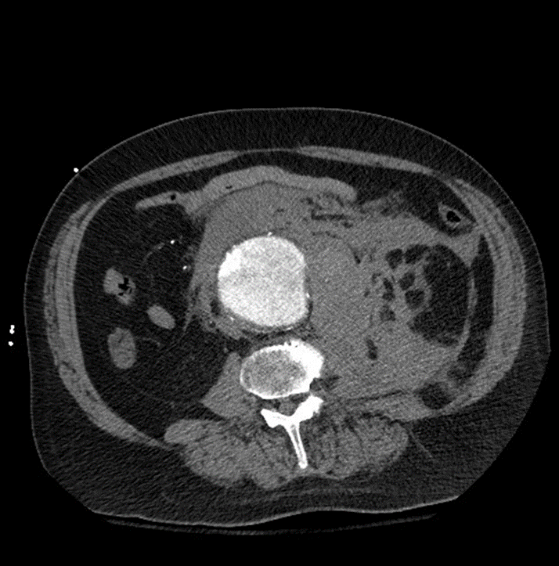
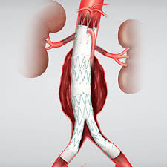
Ruptured AAA (rAAA)
Notes:
For the treatment of ruptured abdominal aortic aneurysms, endovascular repair has become the preferred modality.

Slide 4
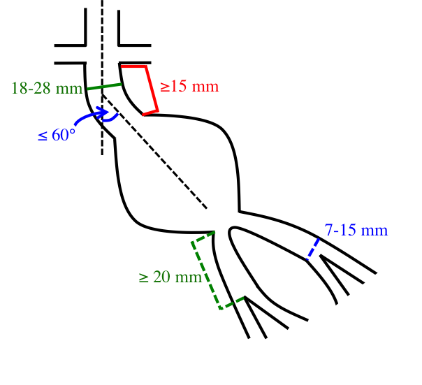
EVAR Anatomic Constraints
Notes:
However, anatomic constraints, can limit EVAR utilization and compromise performance.

Slide 5
IFU Nonadherence
IFU non-adherence rates: 38% to 69%
Notes:
High rates of IFU nonadherence have been reported in elective AAA repair, ranging from 38 to 69%

Slide 6
Objectives
Assess rates of IFU nonadherence in rAAA patients treated with EVAR
Assess effect of IFU nonadherence on rAAA outcomes
Notes:
However EVAR IFU nonadherence has not been studied in ruptured populations. Furthermore, the effect of IFU nonadherence on outcomes has yet to be assessed.
To that end this study sought to assess…

Slide 7
Methods
Review of all rAAA repairs in the VQI, 2003-2018
Neck-specific IFU violations assessed:
Diameter >28mm
Length <15mm
Angulation >60°
Cohorts:
rEVAR
IFU compliant (cIFU)
IFU non-compliant (nIFU)
Notes:
All open and endovascular repairs in the Vascular Quality Initiative from 2003-2018 were reviewed. Neck-specific IFU violations were assessed and included diameter >28mm, length <15mm, and angulation >60°.

Slide 8
Methods
Review of all rAAA repairs in the VQI, 2003-2018
Neck-specific IFU violations assessed:
Diameter >28mm
Length <15mm
Angulation >60°
Cohorts:
rEVAR
IFU compliant (cIFU)
VS
IFU non-compliant (nIFU)
Notes:
Among ruptured patients treated with EVAR, those with at least one IFU violation were compared to IFU compliant patients

Slide 9
Methods
Review of all rAAA repairs in the VQI, 2003-2018
Neck-specific IFU violations assessed:
Diameter >28mm
Length <15mm
Angulation >60°
Cohorts:
Propensity-matched
rOSR
rEVAR
p-rOSR
vs
IFU non-compliant (nIFU)
IFU compliant (cIFU)
VS
p-nIFU
Notes:
This non-IFU compliant EVAR cohort was also compared to a propensity matched cohort of ruptured patients who underwent open repair

Slide 10
Methods
Primary outcomes:
Perioperative complications: CV, pulmonary, renal, bowel/limb ischemia, reoperation
30-day mortality
1-year mortality
Univariate analysis, Cox regression, Kaplan-Meier analysis
Notes:
Primary outcomes included perioperative major complications and 30-day and 1-year mortality. Univariate analysis, Cox regression, and Kaplan-Meier analysis were performed.

Slide 11
rEVAR: cIFU vs nIFU
Demographics | cIFU n=595 | nIFU n=317 | p
Age, years | 73 ± 10 | 73 ± 10 | .47
Sex, female | 105 (18%) | 73 (23%) | .051
Caucasian race | 520 (87%) | 282 (89%) | .49
Comorbidities
Hypertension | 448 (75%) | 241 (77%) | .66
CHF | 83 (14%) | 40 (13%) | .60
Smoking history | 452 (77%) | 245 (77%) | .78
COPD | 156 (26%) | 82 (26%) | .97
Diabetes | 107 (18%) | 50 (16%) | .40
Max AAA dia, mm* | 70 (58,85) | 76 (61,90) | .002
* median (IQR)
Notes:
Among EVAR patients, the compliant and noncompliant cohorts were similar with respect to demographics

Slide 12
rEVAR: cIFU vs nIFU
Demographics | cIFU n=595 | nIFU n=317 | p
Age, years | 73 ± 10 | 73 ± 10 | .47
Sex, female | 105 (18%) | 73 (23%) | .051
Caucasian race | 520 (87%) | 282 (89%) | .49
Comorbidities
Hypertension | 448 (75%) | 241 (77%) | .66
CHF | 83 (14%) | 40 (13%) | .60
Smoking history | 452 (77%) | 245 (77%) | .78
COPD | 156 (26%) | 82 (26%) | .97
Diabetes | 107 (18%) | 50 (16%) | .40
Max AAA dia, mm* | 70 (58,85) | 76 (61,90) | .002
* median (IQR)
Notes:
Except nIFU tended to have larger maximal aortic diameters

Slide 13
rEVAR: cIFU vs nIFU
Perioperative Outcomes | cIFU n=595 | nIFU n=317 | p
MI | 34 (6%) | 30 (10%) | .03
Respiratory complication | 74 (13%) | 69 (22%) | <.001
Stroke | 13 (2%) | 9 (3%) | .54
Death | 45 (14%) | 42 (22%) | .01
Major complication, any | 158 (27%) | 107 (34%) | .03

Slide 14
rEVAR: 1-Year Survival
p=.06

Slide 15
P-matched: nIFU EVAR vs OSR
Demographics | nIFU n=172 | OSR n=172 | p
Age, years | 74 ± 9 | 74 ± 9 | 1
Sex, female | 40 (23%) | 38 (22%) | .80
Caucasian race | 156 (91%) | 165 (96%) | .052
Comorbidities
Hypertension | 134 (78%) | 130 (77%) | .75
CHF | 15 (9%) | 15 (9%) | .96
Smoking history | 136 (79%) | 136 (79%) | 1
COPD | 42 (4%) | 42 (24%) | 1
Diabetes | 25 (15%) | 27 (16%) | .76
Max AAA dia, mm | 74 ± 22 | 75 ± 20 | .87
Notes:
The propensity matched open and noncompliant EVAR cohorts were similar with respect to demographics

Slide 16
P-matched: nIFU EVAR vs OSR
Perioperative Outcomes | nIFU n=172 | OSR n=172 | p
MI | 16 (9%) | 29 (18%) | .02
Respiratory complication | 35 (21%) | 70 (44%) | <.001
Stroke | 4 (2%) | 2 (4%) | .54
Death | 37 (22%) | 55 (32%) | .03
Major complication, any | 57 (33%) | 110 (68%) | <.001

Slide 17
P-matched: 1-Year Survival
p=.08

Slide 18
Predictors 30-day Mortality

Slide 19
Conclusion
>1/3 rAAA EVAR patients fall outside of IFU guidelines
Among EVAR, non-compliant IFU patients have worse outcomes than compliant IFU patients
After matching, non-compliant IFU EVAR patients have better perioperative morbidity than patients undergoing open repair
Notes:
This analysis demonstrated that over one-third of ruptured AAA patients who undergo EVAR fall outside of IFU guidelines. This nonadherent IFU cohort has worse outcomes when compared to IFU-compliant rEVAR patients. However, when comparing these patients to those undergoing open repair, nonadherent IFU rEVAR patients have lower perioperative morbidity and mortality. This study suggests that IFU nonadherence rates are high in patients undergoing rEVAR, but neck-specific IFU violations are not necessarily an absolute contraindication for stent graft repair. Endovascular treatment in patients with less favorable anatomy has significantly lower morbidity compared to open repair.

Slide 20
Thank you
Questions?

