Slide 2
Transcarotid Artery Revascularization
Technique : Preventing Dissection Complications
Dr.Raghu Motaganahalli MD FRCS FACS
Associate Professor of Surgery
Division of Vascular Surgery
Indiana University School of Medicine

Slide 3
Disclosures
Consultant- Silk Road Medical inc .
Teaching , Proctor- Do not receive any direct remuneration

Slide 4
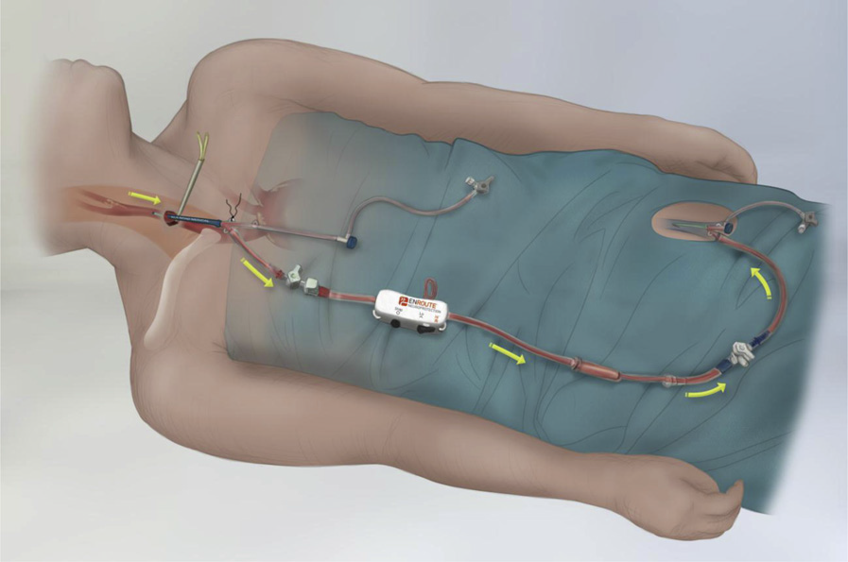
Emerging Role for TCAR
TCAR has emerged as an alternative option for carotid revascularization
Early results from single center , Multicenter, outcomes using VQI data base (TCAR- Surveillance Project ) , Clinical trials ( Roadster-1, Roadster-2 ) have consistent results
Superior to CAS in terms of Stroke
Comparable results to those derived from CEA
Reduced length of procedure, contrast use,
Low risk for cranial nerve injuries
J Vasc Surg 2015;62:1227-35.

Slide 5
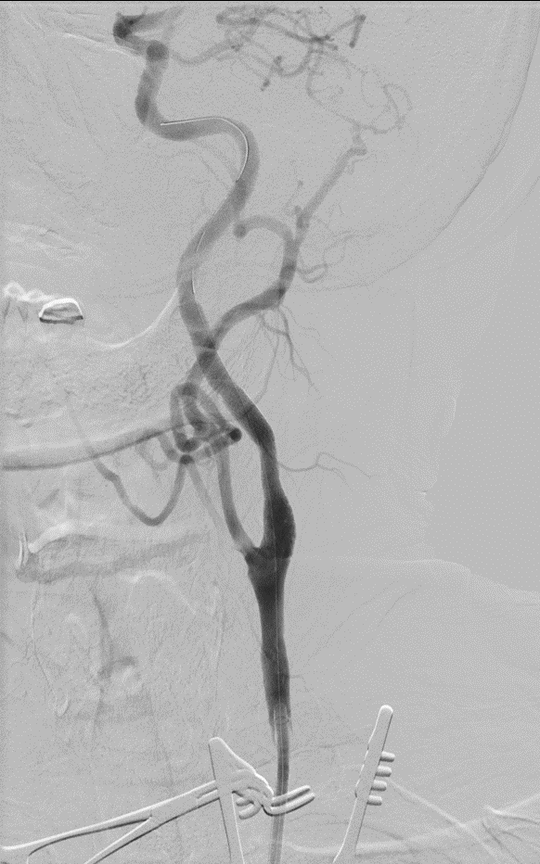
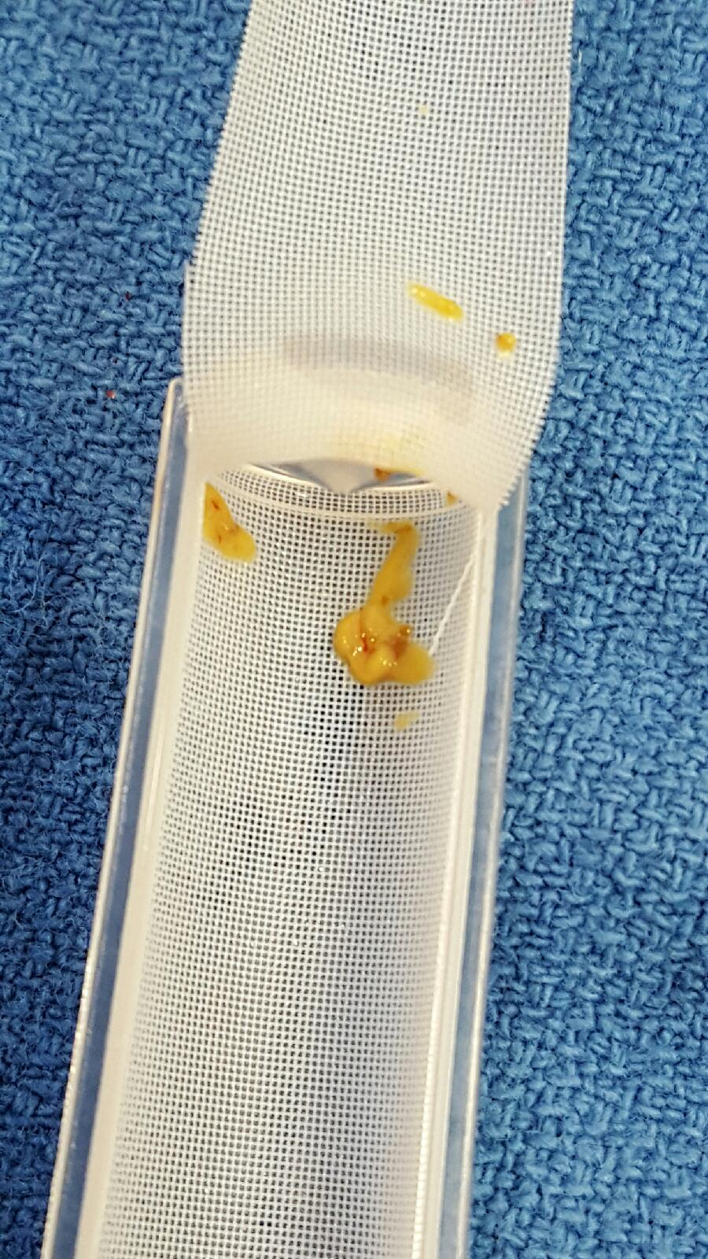

Slide 6
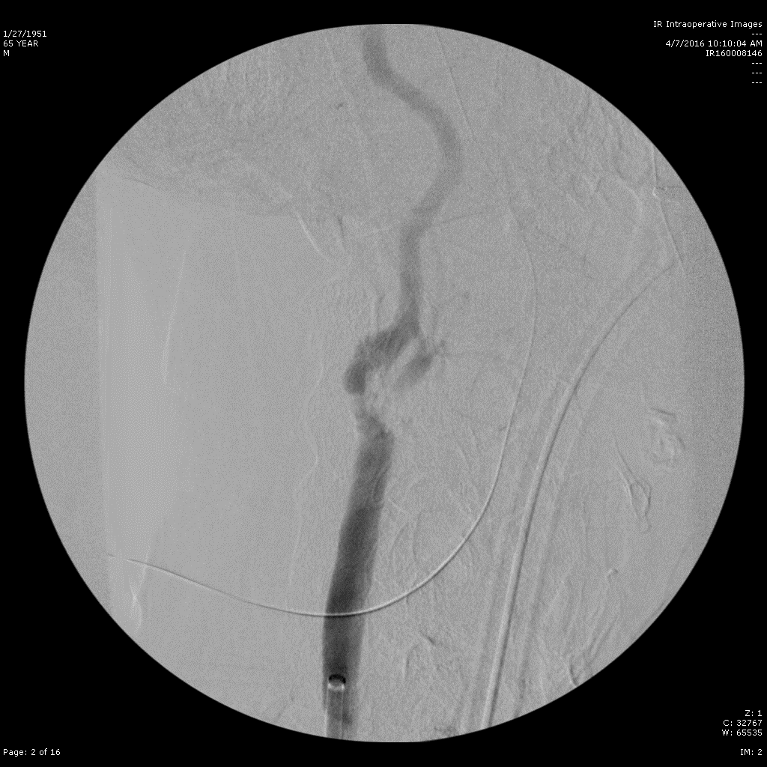

Slide 7
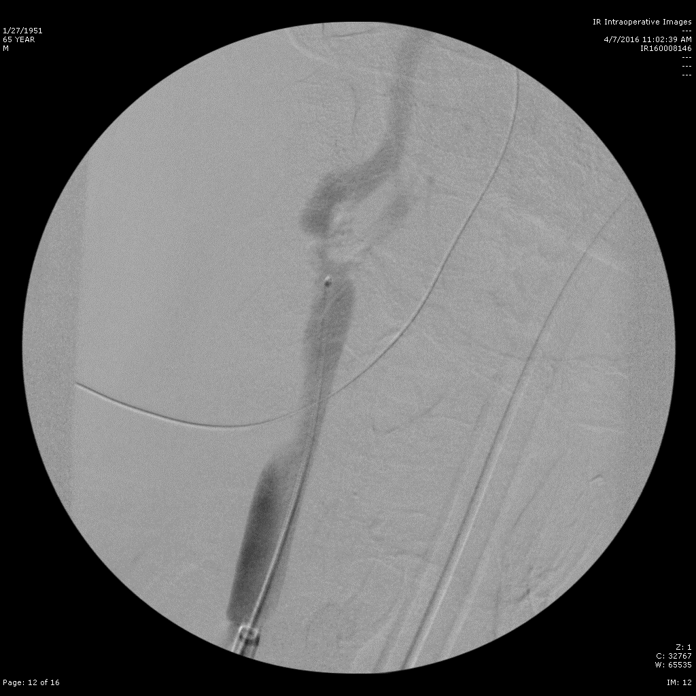

Slide 8
CCA- Dissection Rates- ROADSTER1 Study
 | R1 Site Reported (12/286) | R1 Plus Core Lab (21/286)
All | 4.2% | 7.3%
Serious | 2.1% | 2.1%
Convert to CEA | 0.3% | 0.3%
Note: Conversion to CEA is a sub-set of serious dissections.

Slide 9
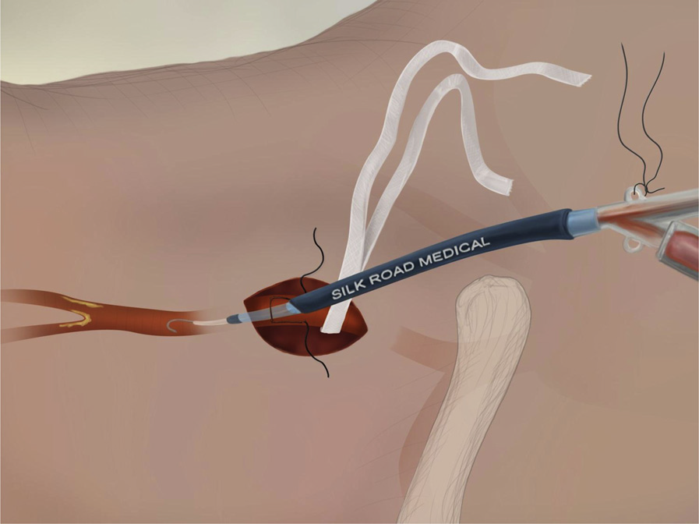
Optimizing Results from TCAR
Technical success hinges upon obtaining a safe and secure access to common carotid artery
Acceptable CCA = Stable sheath placement
Stable sheath = robust flow reversal
Robust flow reversal = Embolic protection
Embolic protection = reduced risk of stroke
J Vasc Surg 2015;62:1227-35.

Slide 10
CCA Evaluation
Anatomical Considerations

Slide 11
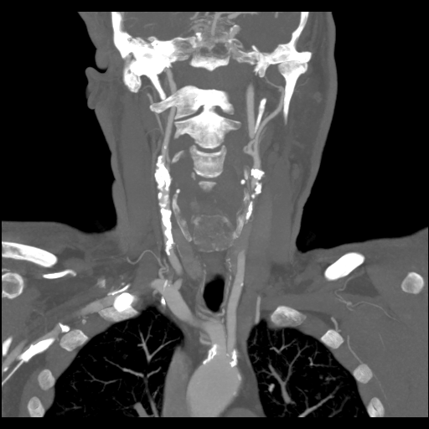
Anatomical Considerations

Slide 13
Additional Tips for Technical Success
Choose incision you are comfortable with Vertical or horizontal incision
Adequate heparinization – Anticoagulate when you start exposure of CCA
Accessing the common carotid artery – Fresh needle, marker wire, micro sheath
Vascular control –
Umbilical tape v/s vessel loop v/s Clamp
Stabilizing the vessel during access
Sustained counter traction when inserting sheath
No tourniquets

Slide 14
Additional Tips for Technical Success
Adequate Pre dilatation
Appropriate stent size selection
DAPT – Pre and Post Procedure
Intra op hemodynamics – Atropine and Glycopyrolate
Continue Active and Passive flow reversal after procedure
Ensure no air embolization during the injections
Protamine at the completion of the procedure

Slide 15
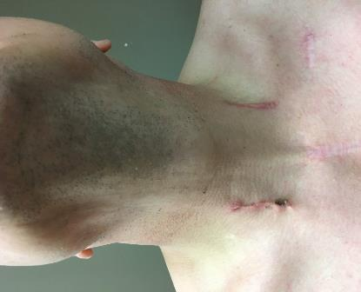
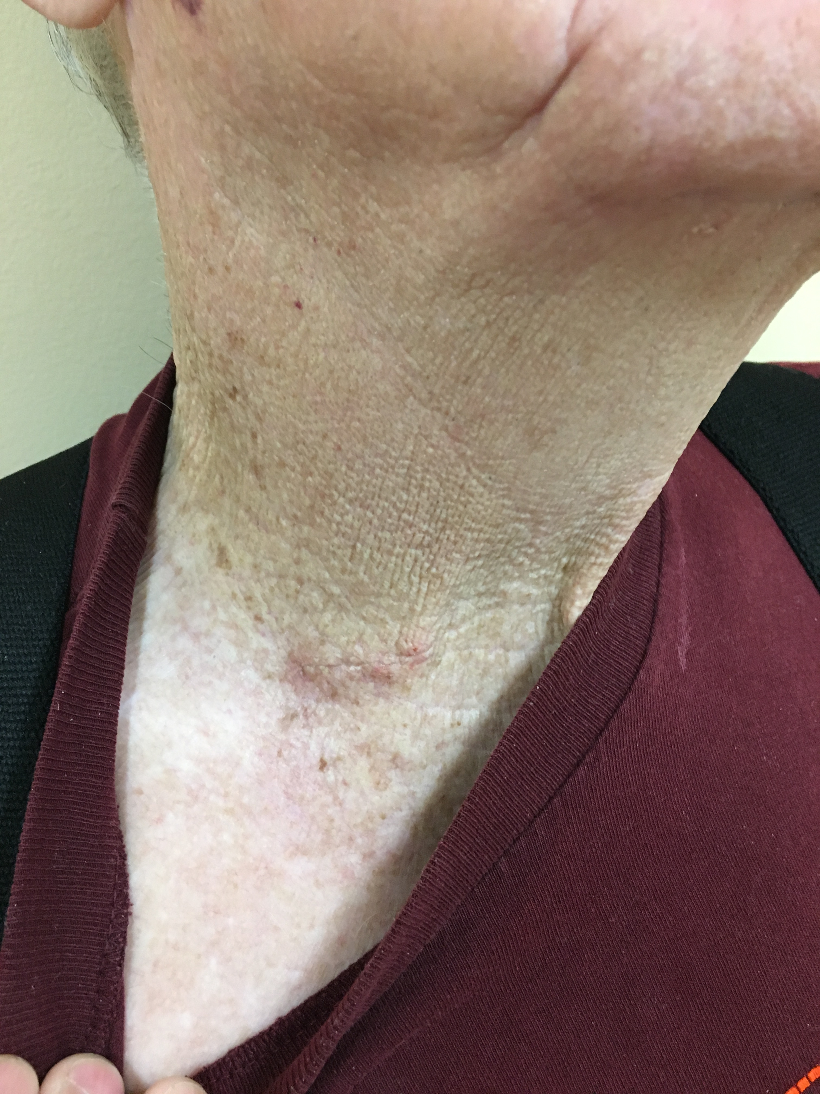
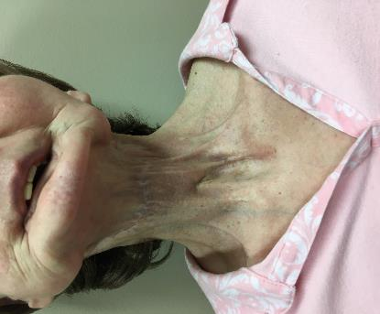

Slide 16
What if you dissect the CCA ?
What if you end up in dissection
Abandon the access if only a micro sheath and re access the vessel fresh
Getting back to true lumen and maintain a wire access
Stent across the dissection
When you cannot get back to true lumen- open conversion

Slide 17
Summary
Dissection of CCA is unique , unusual complication for TCAR
Limits technical success
Mitigated by proper patient selection, attention to details during sheath placement
Be prepared to manage dissection complication by additional stent placement

