Slide 1
Overview of the SVS TCAR Surveillance Project
MAHMOUD MALAS, MD, MHS, RPVI, FACS
Professor In Residence
Chief Vascular and Endovascular Surgery
Vice Chair For Research
University of California San Diego

Slide 2
Disclosures
Principle investigator for: CREST I, II, ROADSTER I and II, SAPHIRE W, CHOICE, CAPTUREII
International Principal Investigator for “The ROADSTER Long Term Follow Up”
Proctor to train surgeons on how to perform safe TCAR (Silk Road Medical)
Notes:
2

Slide 3
Stroke
Stroke kills about 140,000 Americans each year—that’s 1 out of every 20 deaths
Someone in the United States has a stroke every 40 seconds.
Every 4 minutes, someone dies of stroke.
About 87% of all strokes are ischemic strokes.
Stroke costs the United States an estimated $34 billion each year.
Vital Signs: Recent trends in stroke death rates – United States, 2000-2015. MMWR 2017;66.
Benjamin EJ, Blaha MJ, Chiuve SE, et al. on behalf of the American Heart Association Statistics Committee and Stroke Statistics Subcommittee. Heart disease and stroke statistics—2017 update: a report from the American Heart Association. Circulation. 2017;135:e229-e445.
Notes:
This total includes the cost of health care services, medicines to treat stroke, and missed days of work.
Stroke reduces mobility in more than half of stroke survivors age 65 and over.²

Slide 4
Stroke
Second leading cause of death globally
Fifth in the United States

Slide 5
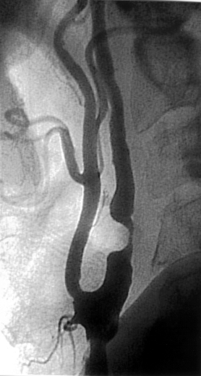
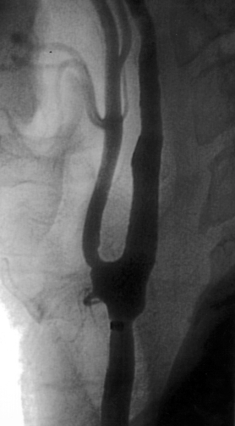
Stroke
Extracranial atherosclerotic disease is responsible for 15% to 20% of all ischemic strokes
~ 140,000 carotid revascularizations yearly in the US
Annual US costs for CEA ~ $21 Billion

Slide 6
 | Peri-Procedural Period
 | CAS vs. CEA | Hazard Ratio (95% CI) | P-Value
Stroke | 4.1 vs. 2.3% | HR = 1.79 (1.14-2.82) | 0.01
MI | 1.1 vs. 2.3% | HR = 0.50 (0.26-0.94) | 0.03
Primary Endpoint (stroke, Death and MI) ≤ 10 years
CAS vs. CEA | Hazard Ratio, 95% CI | P-Value
11.8 vs. 9.9% | HR = 1.10 (0.83-1.44) | 0.51

Slide 7
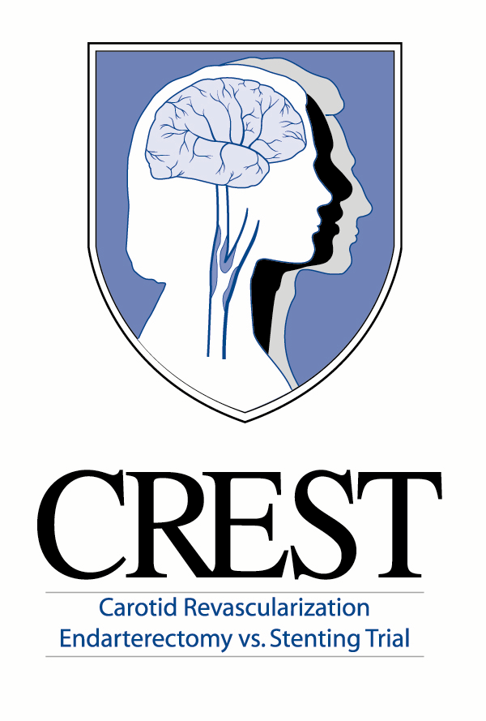
Stroke Timing for Transfemoral CAS and CEA
Number of Strokes
Day 0 Stroke is the Culprit
Notes:
It is well understood that day 0 transfemoral CAS stroke rates are significantly higher than CEA. But from day 1 post procedure and beyond, the rates are statistically equivalent through 30 days in CREST. Clearly, getting beyond the peri-procedural stroke risk of transfemoral carotid revascularization is of critical importance.

Slide 8
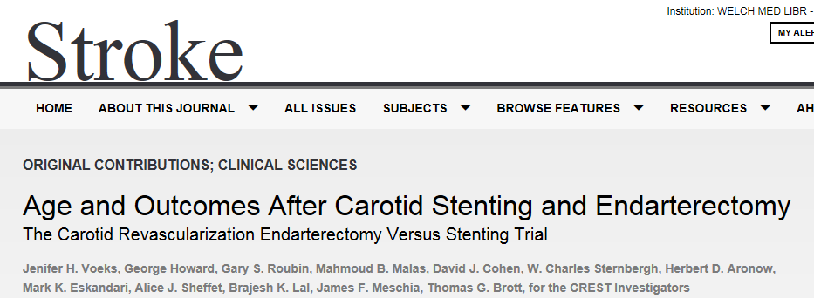

Slide 9
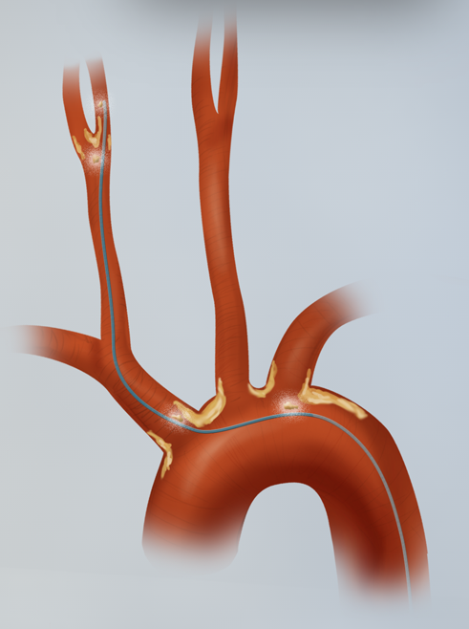
Peri-procedural Stroke after TFCAS
Traditional Transfemoral CAS requires 3 steps that create embolic risk
  Advancing a catheter through the aortic arch
    18% Non-Ipsilateral stroke rate in CAPTURE Study*
  Navigating the lesion before neuroprotection established
  Inadequate neuroprotection from misaligned filters and inadequate manual aspiration of emboli
Crossing the lesion
Crossing the aortic arch
1. Ann Surg 2007;246: 551–558.
Notes:
3 primary causes for Peri-procedural stroke in a transfemoral approach to carotid revascularization:
1) Advancing a catheter through the aortic arch
2) Navigating the lesion before neuroprotection established
3) Inadequate neuroprotection from misaligned filters and inadequate manual aspiration of emboli

Slide 10
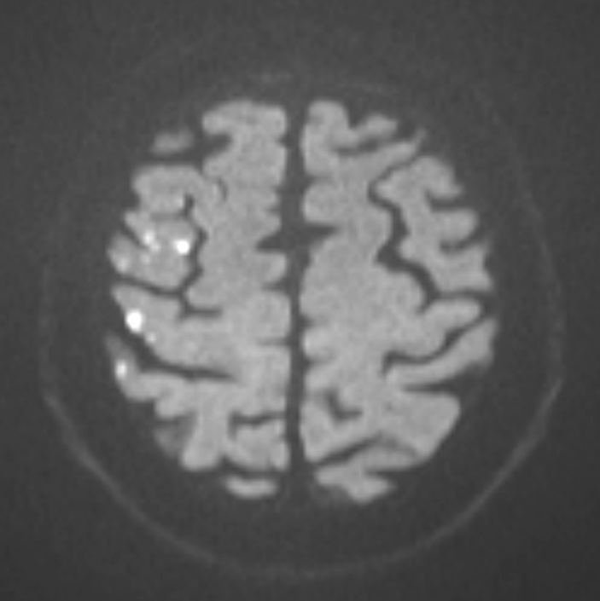
ICSS Silent DWI Lesions After CAS
MRI Diffusion Weighted Abnormalities Assessed 1 to 7 days after the procedure
 | CAS (n = 108) | CEA (n = 92) | HR (95% CI) | P
DWI lesions | 50 (46.3%) | 13 (14.1%) | 5.24 (2.61-10.3) | 0.001

Slide 11
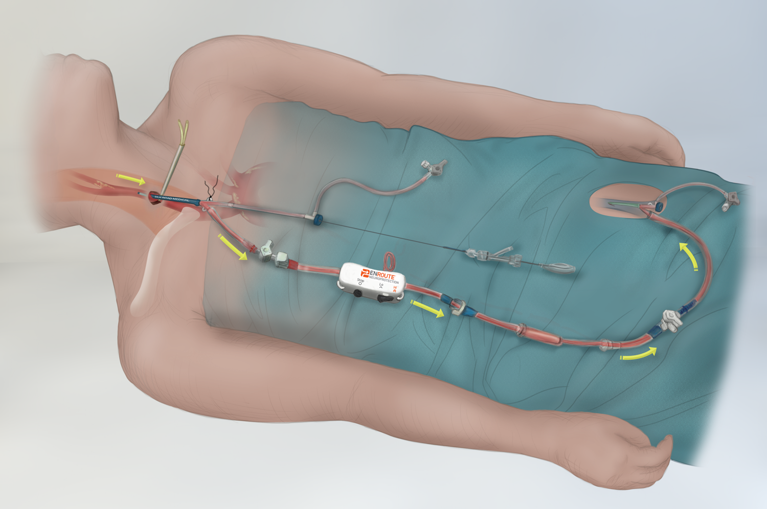
TransCarotid Stenting with Dynamic Flow Reversal
Low Pressure Venous System
Avoid the arch
“CEA-like” neuroprotection
Less manipulation
Predictable, efficient
High Pressure Arterial System
CAUTION: Investigational device. Limited by federal (USA) law to investigational use.
The ENROUTE™ Transcarotid Stent and Neuroprotection Systems bear the CE mark of conformity and are available for sale in EU and EFTA countries.

Slide 12
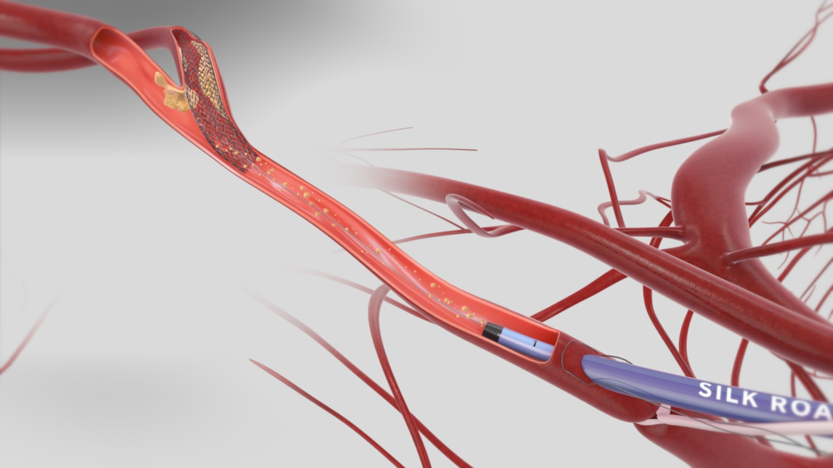
Dynamic Flow Reversal For ROBUST Neuroprotection
Direct carotid access reduces embolic risks of transfemoral catheter advancement
Continuous high rate of flow reversal to remove debris throughout intervention
CAUTION: Investigational device. Limited by federal (USA) law to investigational use.
The ENROUTE™ Transcarotid Stent and Neuroprotection Systems bear the CE mark of conformity and are available for sale in EU and EFTA countries.
Notes:
A new, surgically inspired, endovascular solution for carotid artery revascularization comes to us from Silk Road Medical. Through a small surgical cutdown, the ENROUTE Transcarotid Stent and Neuroprotection Systems deliver an endovascular dynamic flow reversal system for continuous, robust stroke protection. This new, direct carotid access method provides surgical patient outcomes with unique transcarotid speed and control. The avoiding the more critical crainial nerve bundle in the typical longer CEA incision.

Slide 13

TCAR Best Practices and Techniques

Slide 14
ROADSTER Study Overview
High Surgical Risk
Symptomatic, ≥ 50% stenosis
Asymptomatic, ≥70% stenosis
18 sites
DESIGN: IDE study with OPC of 11% S/D/MI at 30 days
OBJECTIVE: Evaluate safety and efficacy of CAS with ENROUTE Transcarotid Neuroprotection System
  direct carotid access
  high rate flow reversal
  FDA-approved carotid stents
CO-PRINCIPAL INVESTIGATORS: Richard Cambria, MD, Christopher Kwolek, MD ; Massachusetts General Hospital
INDEPENDENT REVIEW: CEC, DSMB, Core labs (angiography, duplex ultrasound, cardiology)
N=67 Lead-in
N=141 Pivotal
N=78 Continued Access
30 Day Follow Up

Slide 15
ROADSTER Patient Population
Physiologic HSR Inclusion
Exclusion: Common to CAS
Severe cardiac disease; severe COPD; chronic renal insufficiency
Permanent contralateral CNI
Age ≥75
Anatomic HSR Inclusion
Contralateral occlusion; bilateral or high or tandem stenosis
Restenosis post CEA
Hostile neck
  Irradiation
  Radical neck dissection
  Cervical spine immobility
Afib; recent valve or MI; bleeding
Evolving stroke; neuro disorders
Occlusion; ostial CCA or intracranial stenosis; string sign; previous stent
Exclusion: Transcarotid
CCA disease at entry site
<5cm clavicle to bifurcation

Slide 16
ROADSTER
High Surgical Risk | Pivotal Group, ITT (N=141) |  | Pivotal Group Per Protocol (N=136)
S/D/MI* | 5 | 3.5% | 4 | 2.9%
Major Stroke | 0 | 0% | 0 | 0%
Minor Stroke | 2 | 1.4% | 1 | 0.7%
Death | 2 | 1.4% | 2 | 1.5%
MI | 1 | 0.7% | 1 | 0.7%
Stroke & Death | 4 | 2.8% | 3 | 2.2%
Cranial Nerve Injury (CNI) | 1 | 0.7% | 1 | 0.7%
CNI Unresolved at 6 Months | 0 | 0% | 0 | 0%

Slide 17
One-year outcomes

Slide 18
Procedure Time
ROADSTER vs CREST – Mean Procedure Times (minutes)^{1,2}
Minutes
1. ROADSTER Presentation – Late Breaking Trials, VIVA 2014, C. Kwolek, MD
2. Stroke. 2012;43:00-00.
Notes:
CREST delivered mean CEA procedure times of 171min +/-55min. Mean procedure time (skin to skin) for the Silk Road cases in ROADSTER were 76min +/-27min. (Vilain, Stroke, Sept 2012)

Slide 19
Reverse Flow Vs. CEA Clamp Time
ROADSTER vs NASCET ^{1,2}
Minutes
1. ROADSTER Presentation – Late Breaking Trials, VIVA 2014, C. Kwolek, MD
2. Stroke. 1999;30:1751-1758
Notes:
CREST delivered mean CEA procedure times of 171min +/-55min. Mean procedure time (skin to skin) for the Silk Road cases in ROADSTER were 76min +/-27min. (Vilain, Stroke, Sept 2012)

Slide 20
TFCAS vs CEA vs TCAR
TCD HITS During Procedure
CAS
TCAR
CEA
TCAR: avoids the arch, offers complete proximal protection.
Similar to CEA.
Plessers et al.J Endovasc Ther 2016;23:249

Slide 21
The PROOF Study:
DW-MRI HITS Similar to CEA
Study | Procedure | Embolic Protection | Patients | New Ipsilateral DWI Lesions
ICSS² | CEA | Clamp, backbleed | 107 | 17%
PROOF³ | TCAR | Proximal clamp, reversed flow | 56 | 18%
PROFI¹ | Transfemoral CAS | Proximal occlusion (MoMA) | 31 | 45%
ICSS² | Transfemoral CAS | Distal filter (various) | 51 | 73%
PROFI¹ | Transfemoral CAS | Distal filter (Emboshield) | 31 | 87%
1 J Am Coll Cardiol. 2012 Jan 19. [Epub ahead of print]
2 Lancet Neurol. 2010 Apr;9(4):353-62
3 Alpaslan, Wintermark, Pinter, Macdonald, Ruedy, Kolvenbach. TransCarotid Artery Revascularization with Flow Reversal:
The PROOF Study. J Endovasc Ther. 2016. (In Press)
Notes:
The DW-MRI incidence of 19% as reported in PROOF compares very favorably with the results from other prospective studies.
An ICSS substudy looking at new ischemic brain lesions detectable on DWI found 50% in the CAS arm and 17% in the CEA arm.
Thus, the new transcarotid stenting approach with the ENROUTE Neuroprotection system may offer the benefit of CEA like neuroprotection.

Slide 22
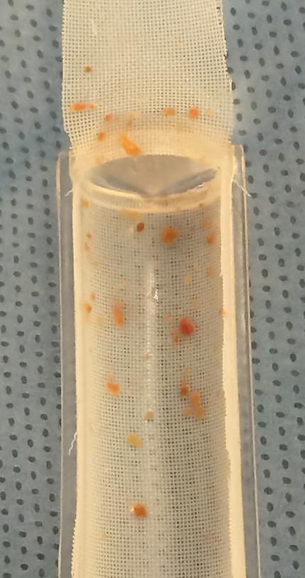
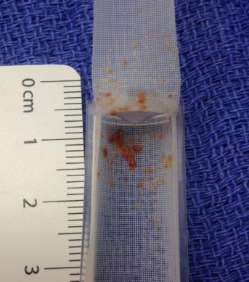
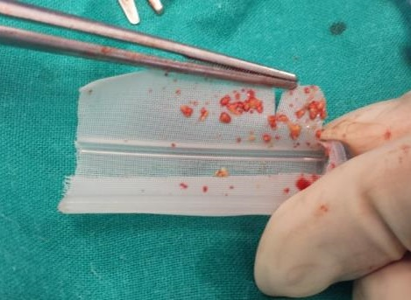
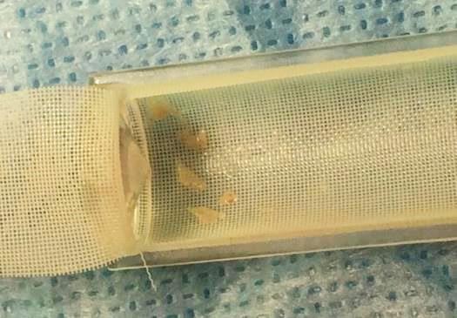
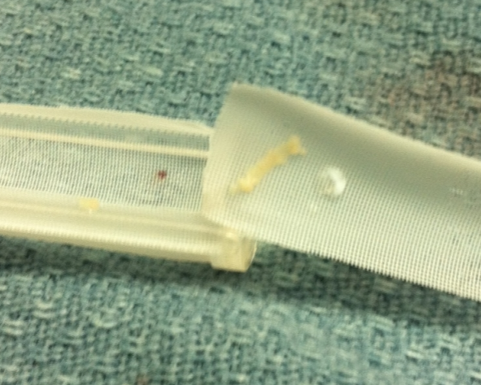
THE PROOF IS IN THE FILTER
Macro & Micro emboli in ENROUTE™ NPS FILTERS

Slide 23
SVS Vascular Quality Initiative

Slide 24
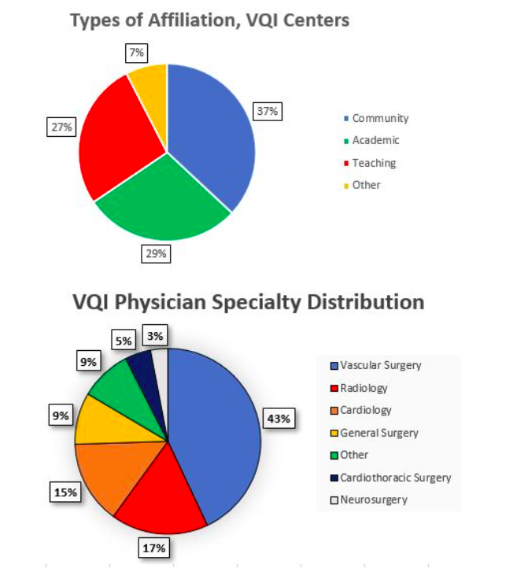
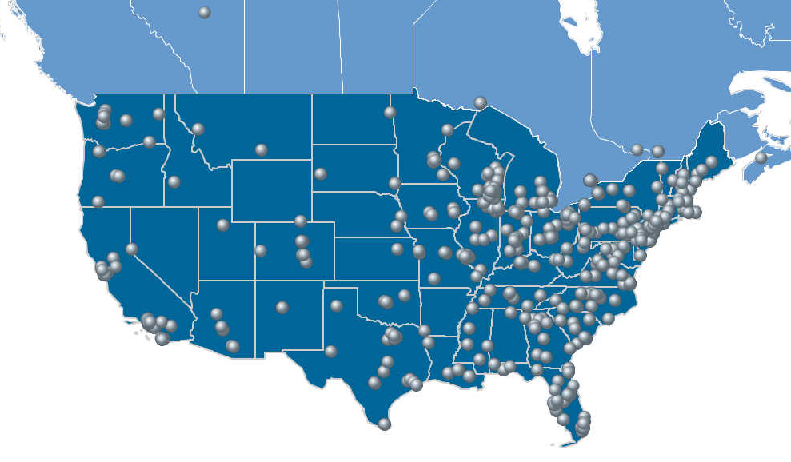
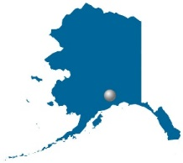
Vascular Quality Initiative (VQI)
Number of Participating Centers
Location of VQI Participating Centers
VQI
571 Centers, 3,000 physicians, 46 States + Canada
Notes:
VQI consists of > 1/3 academic hospitals, 1/3 teaching hospitals and 1/3 community hospitals. \The majority of CAS cases registered in the VQI are performed by vascular surgeons, followed by interventional radiologists (and cardiologists The rest are performed by other specialties such as neurosurgery (7%), general surgery (5%), cardiothoracic surgery or non-specified specialties.

Slide 25
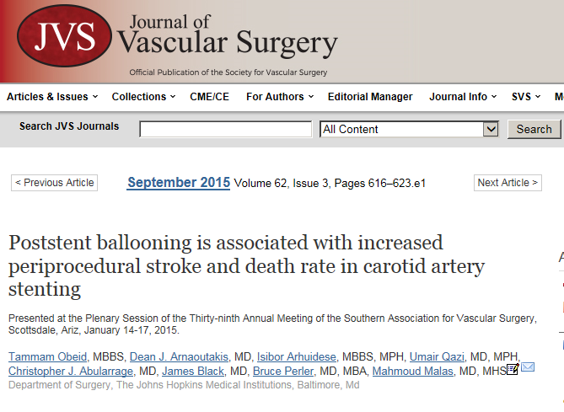
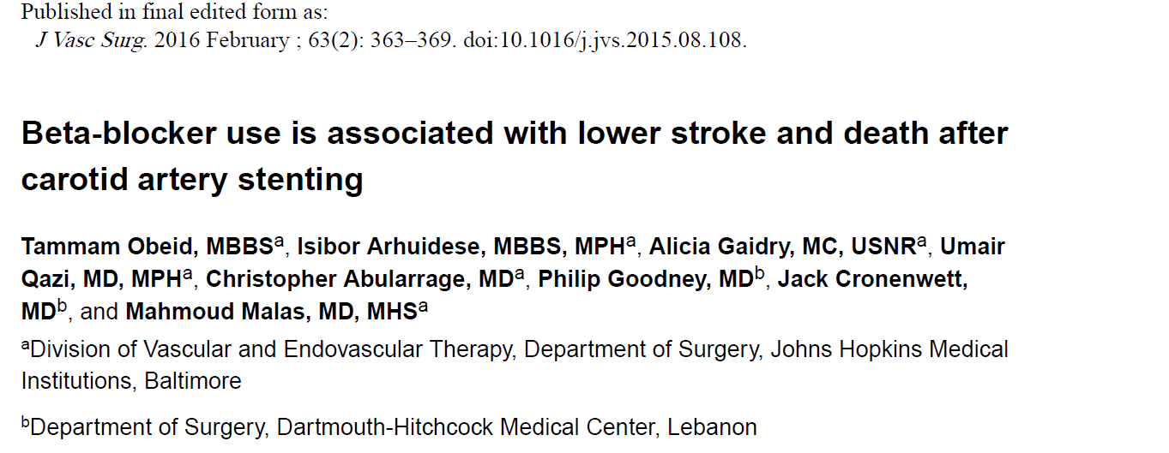
Some of Our VQI publications

Slide 26
VQI TCAR Surveillance Project (TSP)

Slide 27
Objectives of TSP
Monitor the safety and effectiveness of stents placed directly into the carotid artery while reversing blood flow within the carotid artery to reduce stroke risk.
Compare this less-invasive surgical procedure with standard carotid endarterectomy in centers that participate in the Society for Vascular Surgery Vascular Quality Initiative.
Provide “REAL-WORLD” Outcomes
Notes:
the Society for Vascular Surgery (SVS) in collaboration with the US Food and Drug Administration (FDA) and the Centers for Medicare and Medicaid Services (CMS) established the TCAR surveillance project (TSP) in an attempt to obtain more real-world data about the safety and effectiveness of TCAR performed by centers participating in the Vascular Quality Initiative (VQI

Slide 30
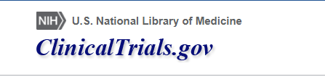
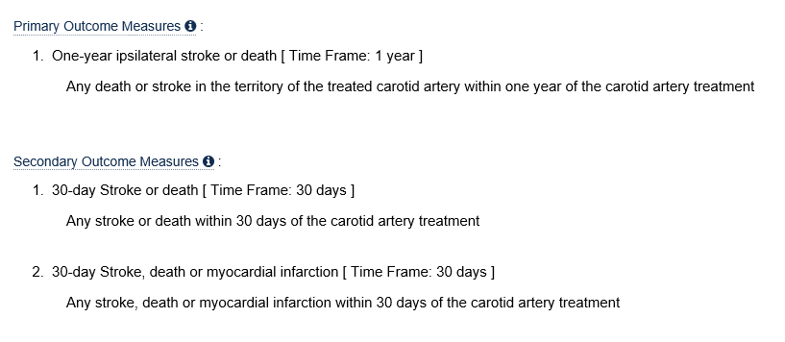
Outcomes
https://clinicaltrials.gov/ct2/show/NCT02850588?term=TCAR+%2C+Surveillance&rank=1

Slide 32
TCAR Indications and Contraindications :
Focus on Safe Access

Slide 33
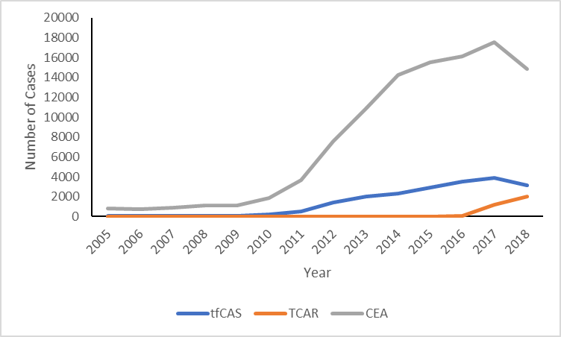
TSP CEA CAS Capture
Year | CEA | TCAR | TFCAS
September 2016 | 5207 | 85 | 947
2017 | 17706 | 1259 | 3,154
December 2018 | 17670 | 3075 | 2,964

Slide 34
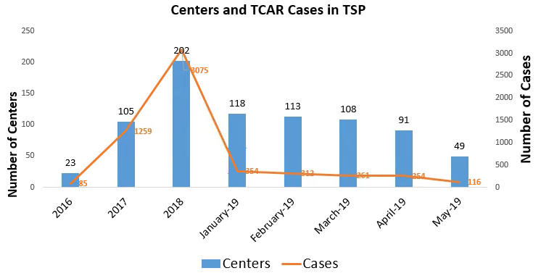
VQI TSP

Slide 35
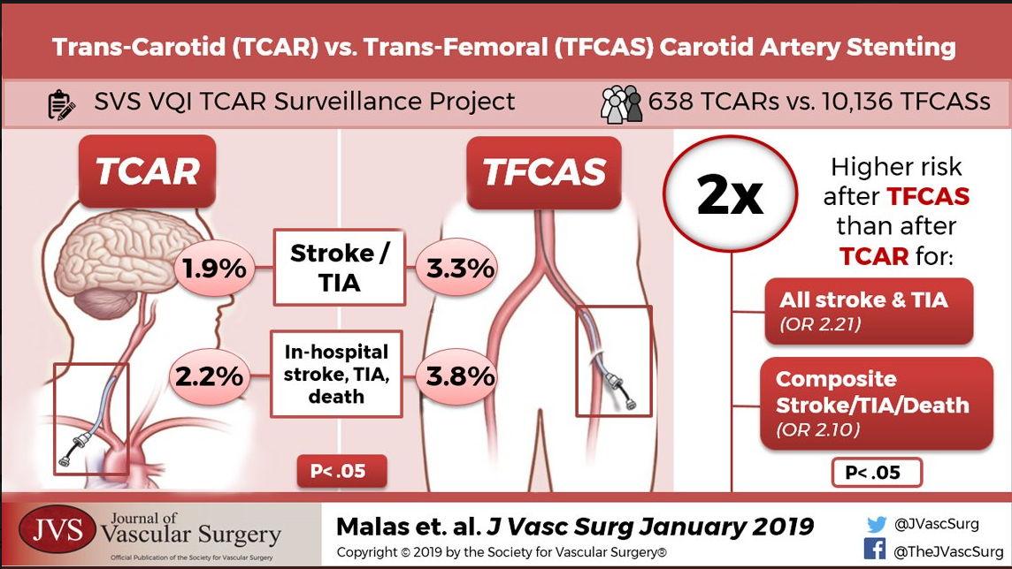
Notes:
You can say that Patric will be talking about this later

Slide 36
VESS 2018
In-Hospital Outcomes of TransCarotid Artery Revascularization and Carotid Endarterectomy in the Society of Vascular Surgery Vascular Quality Initiative.
Schermerhorn ML, Liang P, Dakour Aridi H, Kashyap VS, Wang GJ, Nolan BW, Cronenwett JL, Eldrup-Jorgensen J Malas MB
Notes:
You can say that Hanaa will be talking about this later

Slide 37
Strengths of the TSP
VQI practitioners as well as patients enrolled in the TSP represent the real-world alternative for the ROADSTER trial which has stricter inclusion/exclusion criteria.
Data from different specialties are pooled together and analyzed which allows a real-world and uniform comparison between the two procedures and avoids the confounding bias of operator specialty.

Slide 38

Thank you

