Slide 1
Meaningful Use: Linking Physician Compensation to Vascular Quality Initiative Metrics
Scott S. Berman, MD, MHA, RVT, FACS, DFSVS
Megon L. Berman, BS
Pima Heart and Vascular
Tucson, Arizona

Slide 2
Disclosures: None

Slide 3
Challenges
Improve provider engagement in VQI
Incentivize vascular providers with meaningful metrics

Slide 4
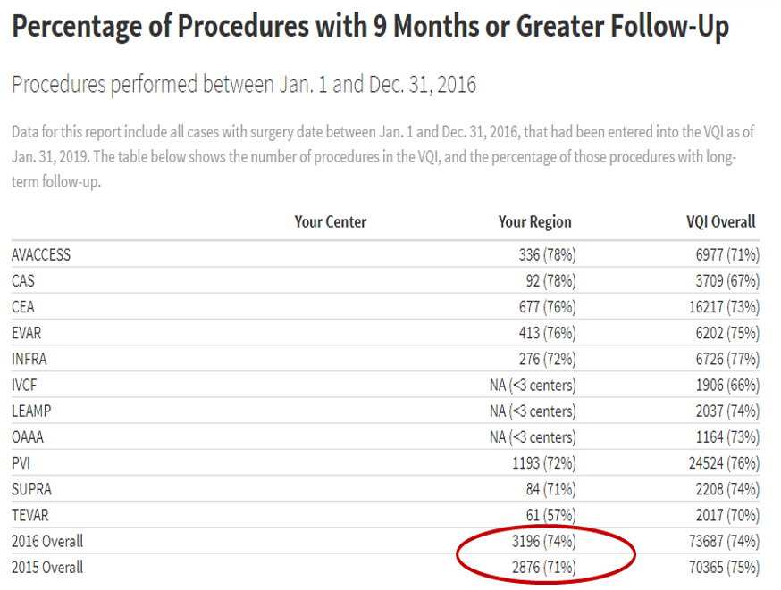
Challenges

Slide 5
Challenges

Slide 6
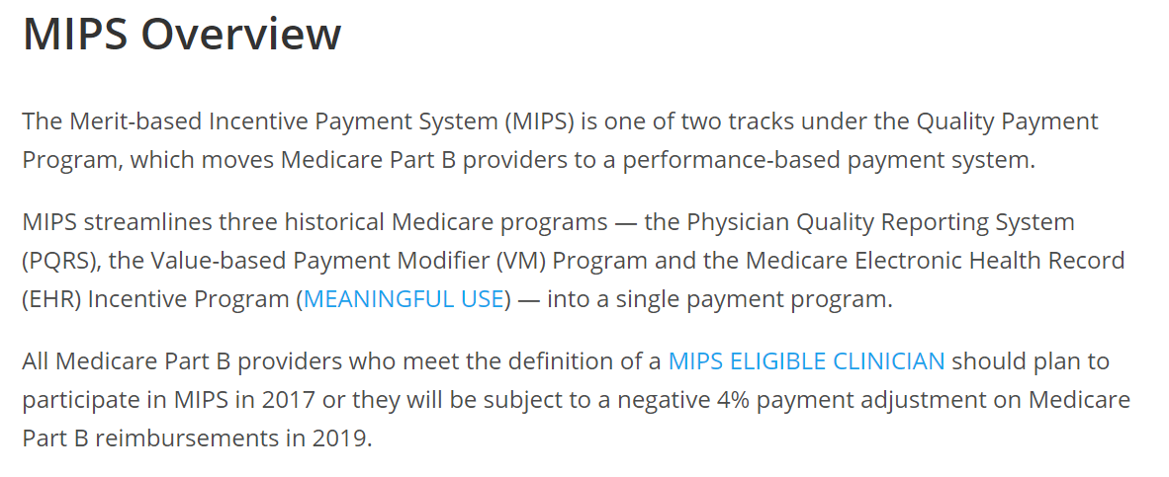
Challenges

Slide 7
Challenges
https://qpp.cms.gov/mips/quality-measures

Slide 8
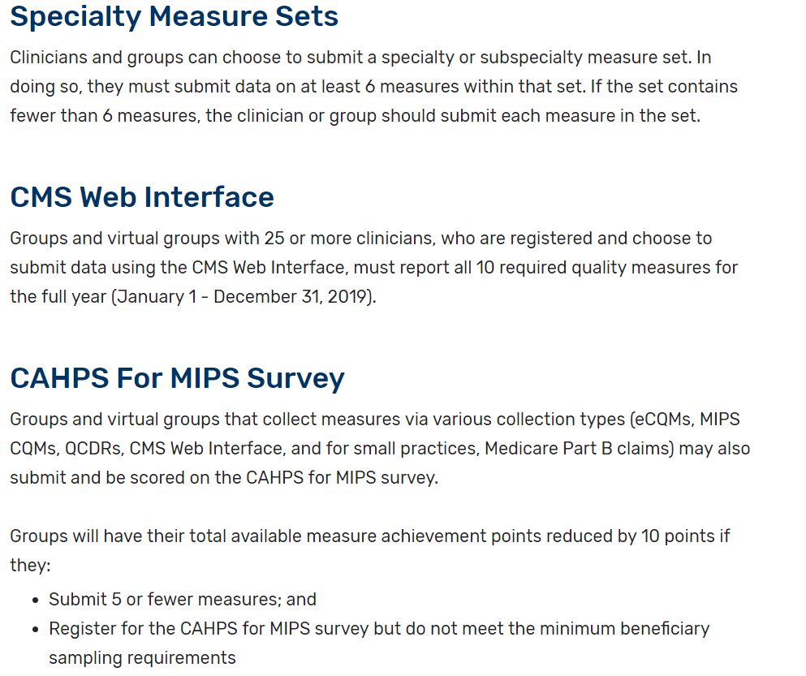
Challenges

Slide 9
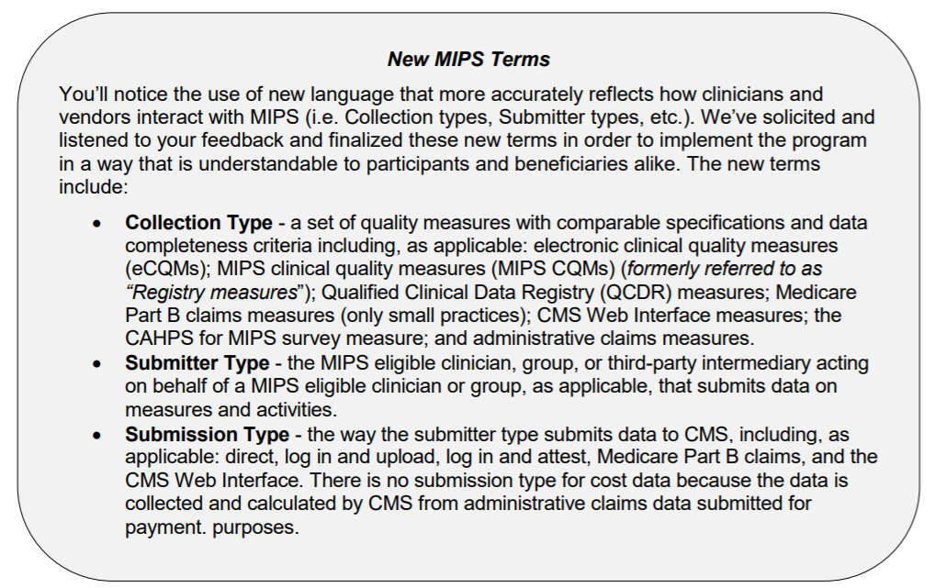
Challenges

Slide 10
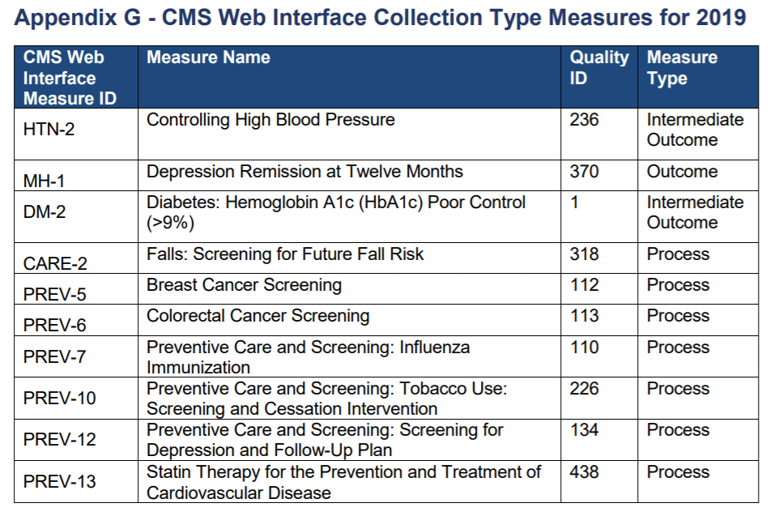
Challenges

Slide 11
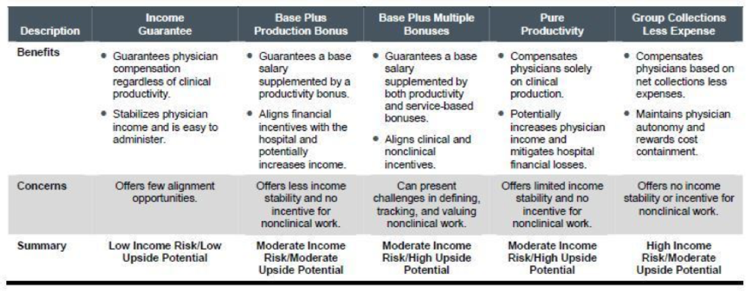
Opportunities

Slide 12
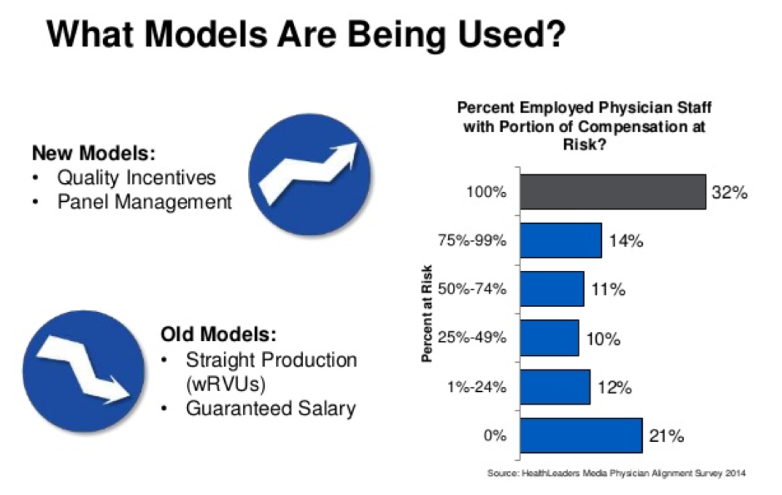
Opportunities

Slide 13
Objective
To evaluate the impact of incorporating Vascular Quality Initiative (VQI) metrics into a vascular surgery compensation package.

Slide 14
Methods
A retrospective review of VQI data was performed for a single group of vascular surgeons for 2 years beginning January 2017 through December 2018. Long-term follow-up data acquired in this interval was entered for cases performed from January 2016 through December 2017. In year 1, there was no financial incentive tied to the VQI metrics. In year 2, the providers’ end of year quality bonus was dependent upon and equally divided between 7 VQI metrics that the providers themselves chose to include in their employment agreement.

Slide 15
Methods
Metric | Performance Level Required for Bonus
LTFU for all VQI procedures | >86%
Patient discharged on statin and antiplatelet | >85%
% of CEA LOS > 1 day | ≤7% or below risk adjusted expected
% of EVAR LOS > 2 day | ≤3% or below risk adjusted expected
EVAR Sac diameter reported on LTFU | >71%
Use of ultrasound guidance for PVI | ≥99%
Use of chlorhexidine | 100%
LTFU, long-term follow-up; CEA, carotid endarterectomy; LOS, length of stay; PVI, peripheral vascular intervention.

Slide 16
Background
The group is a multi-specialty group consisting of:
90 primary care providers
10 cardiologists
2 general surgeons
1 cardiothoracic surgeon
2 urologists
4 vascular surgeons

Slide 17
Background
Year 1 of the review, only primary care provider contracts had bonus compensation linked to quality measures through MIPS. Vascular surgery compensation was purely RVU-based.
Year 2 of the review, vascular surgery was under a new contract which employer required to include quality-based compensation. The vascular providers were able to define the quality metrics and chose to use VQI data.

Slide 18
Background
VQI participation
The vascular group has been a VQI participant since 2010
The providers do a significant portion of the data input
Data manager oversees completion and coordinates follow-ups
Modules:
CEA
CAS
PVI
EVAR
Hemodialysis
Open AAA
TEVAR
Infrainguinal
Suprainguinal

Slide 19
Results
Year 1 | 2016 | 2016 | 2017 | 2017 | 2017 | 2017 | 2017
 | LTFU | EVAR Sack | CEA LOS >1 | EVAR LOS >2 | Statin/Plt | US Guid | Skin prep
#1 |  |  | 7 | 0 | 86 | 100 | 100
#2 |  |  | 6 | 0 | 95 | 100 | 100
#3 |  |  | 50 | 25 | 85 | 100 | 100
#4 |  |  | 50 | 0 | 79 | 78 | 100
overall | 86% | 61%
 | meets the bonus threshold
 | does not meet bonus threshold

Slide 20
Results
Year 2 | 2017 | 2017 | 2018 | 2018 | 2018 | 2018 | 2018
 | LTFU | EVAR Sack | CEA LOS >1 | EVAR LOS >2 | Statin/Plt | US Guid | Skin prep
#1 |  |  | 18 | 67 | 90 | 100 | 100
#2 |  |  | 6 | 5 | 95 | 100 | 100
#3 |  |  | 9 | 0 | 74 | 100 | 100
#4 |  |  | 43 | NA | 100 | 73 | 100
overall | 93% | 95%
 | meets the bonus threshold
 | does not meet bonus threshold
 | provider left during the contract year

Slide 21
Summary
Year 1
16/22 (73%) metrics achieved outcomes that met bonus threshold
15/20 (75%) individual
0/2 group
Year 2
13/17 (76%) metrics achieved outcomes that met bonus threshold
11/15 (73%) individual
2/2 (100%) group

Slide 22
Conclusion
Physician engagement in meeting VQI metrics has remained a challenge since the inception of the registry. LTFU and EVAR sack size are recent national examples with values of 74% and 56%, respectively. Our data suggest that provider engagement in meeting VQI metrics may be influenced by financial incentives.

Slide 23
Discussion
Alternative Scenarios
Hospital is the PSO/VQI contracting entity-independent providers
Can engage vascular providers through service line agreements and include VQI metrics as part of the shared savings incentives
Hospital is the PSO/VQI contracting entity-employed providers
VQI metrics can be included in physician employment agreements as bonus benchmarks or as part of shared savings programs for value-based insurance contracts

Slide 24
Discussion
Alternative Scenarios
Physician group is the contracted PSO/VQI entity and work at multiple independent hospitals
Limits the use of the data to within the physicians’ practice group e.g. designated benchmarks for shared savings insurance contracts

Slide 25
Thank you
scott.berman@pimaheart.com

