Slide 1
Making your EMR work for you! (and the VQI)
Jason K. Wagner, MD
Mohammad H. Eslami MD, Fern Schwartz, Ali Arak BS,
Michael J. Singh MD, Michel Makaroun MD
UPMC

Slide 2
Disclosures
-None

Slide 3
Current Issues with Data Entry
Delays in entering and capturing completed procedures
  Retrospective vs. Prospective Entry
    Data quality degrades as time elapses from initial event
Redundant Effort?
  VQI Entry
  Immediate Post-Op Note
  Dictated Operative Note
  M&M List
(Each with their own modality and setting…)

Slide 4
Proposed Solutions
Automate Data Extraction from Cerner:
Automate “report” creation for appropriate cases/patients
  Procedure data
  Demographics, medications, labs, etc…
    Organized for efficient entry into the webform by abstractors
Can be done anytime post-procedure

Slide 5
Proposed Solutions
Procedural Data:
Hardest Specific Data to Abstract
  Vessel Diameters
  Graft type, heparinization type, anastamotic configuration
  Device Sizes/Types/Configurations

Slide 6
Proposed Solutions
Options for Improvement:
  Expand the Immediate Post-Op Notes?
    Other centers are doing this.
    Is future-proof with regards to eventual data abstraction
  Takes something short, and makes it long...

Slide 7
Proposed Solutions
VQI Procedure-Specific Templated Operative Notes
  Is future-proof with regards to eventual data abstraction
  Expeditites multiple repetitive and time-consuming tasks
  Other benefits?
    Reduces delays for signed operative notes
    Can be customized by/for each provider and situation
    Improved capture of key phrasing for procedure coding

Slide 8
Process
Identify and Recruit Stakeholders
  Vascular Surgeons (Attendings and Trainees)
  VQI Data Administrator
  Health-System Information Services (EMR)
  Billing and Coding Compliance Specialists
  Department of Quality and Safety
  Related Service Lines:
    CT Surgery
    Interventional Neurology
    Interventional Radiology
    Interventional Cardiology

Slide 9
Process
Identify Target Modules
  Carotid Endarterectomy (Open)
  IVC Filter Insertion (Endovascular)
  Carotid Stenting (Endovascular)
  Hemodialysis Access (Open)

Slide 10
Process
Identify Target Modules
  Carotid Endarterectomy (Open)
  IVC Filter Insertion (Endovascular)
  Carotid Stenting (Endovascular)
  Hemodialysis Access (Open)

Slide 11
Process
Identify Target Data: Means of Data Capture and Export
Match data elements from VQI and the EMR
  Identify data that can be imported from the EMR:
    Labs
    Demographics
    Medications
  Create new data fields in the EMR for VQI variables
Determine Ideal Output Modalities (xls, pdf)

Slide 12
Process
Create a Standardized Operative Report
  Review existing operative notes from multiple surgeons
  Create a generic note that assimilates common phrases and steps
  Review and revise this note with the surgeons
  Review the verbiage with billing and coding specialists

Slide 13
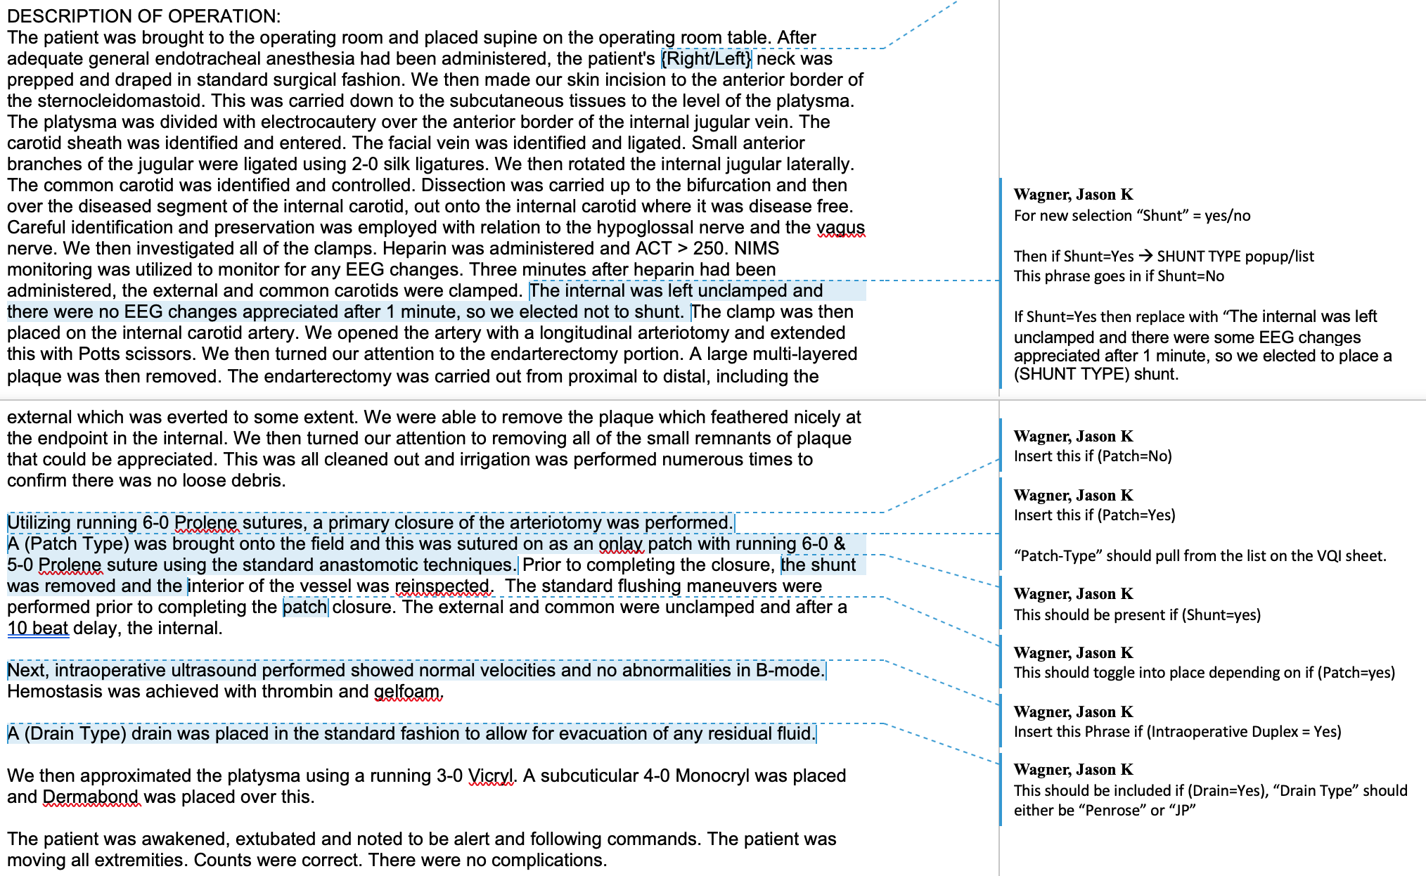
Process
Create a Standardized Operative Report

Slide 14
Process
Create "click" and "dropdown" templated operative notes
  Test the notes for completeness in:
    Text encoding (the resultant document)
    Data capture (the variables being represented)
  Re-engage clinician stakeholders to test the templated notes

Slide 15
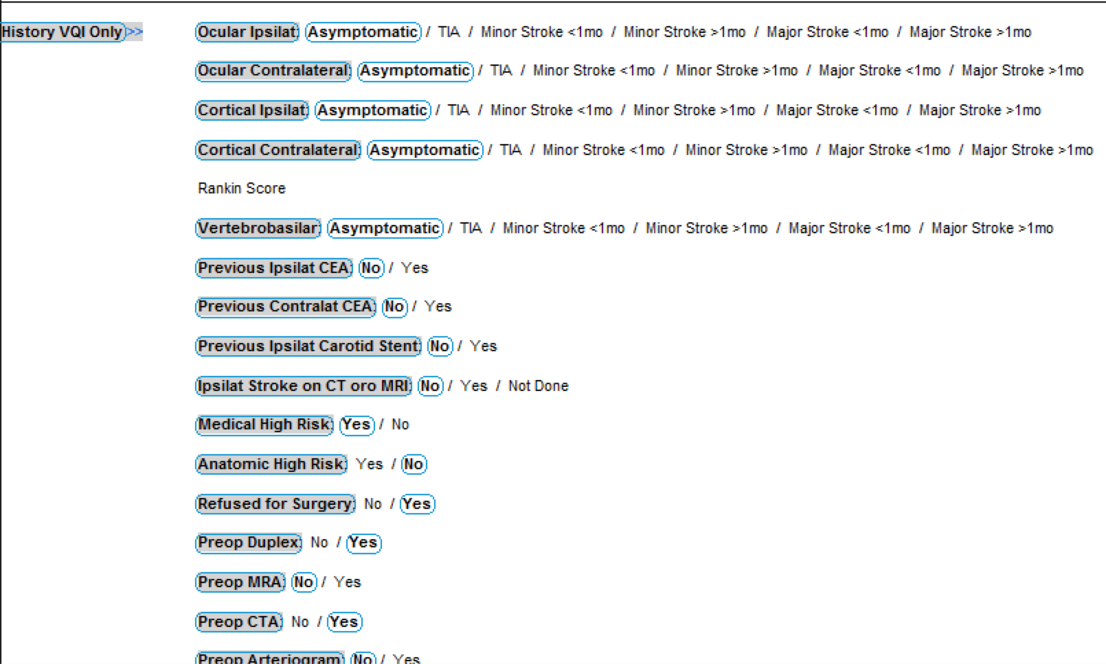
Process
Create "click" and "dropdown" templated operative notes

Slide 16
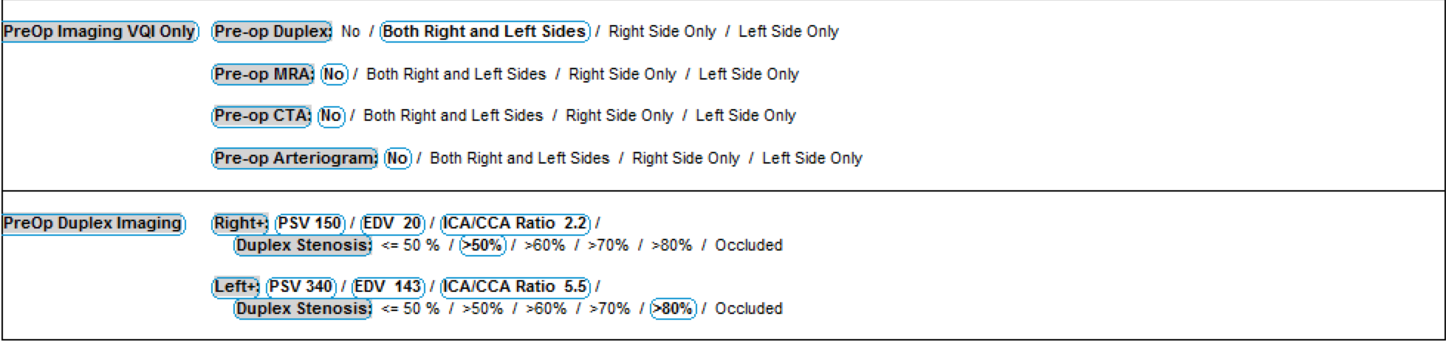
Process
Create "click" and "dropdown" templated operative notes

Slide 17
Process
Create "click" and "dropdown" templated operative notes

Slide 18
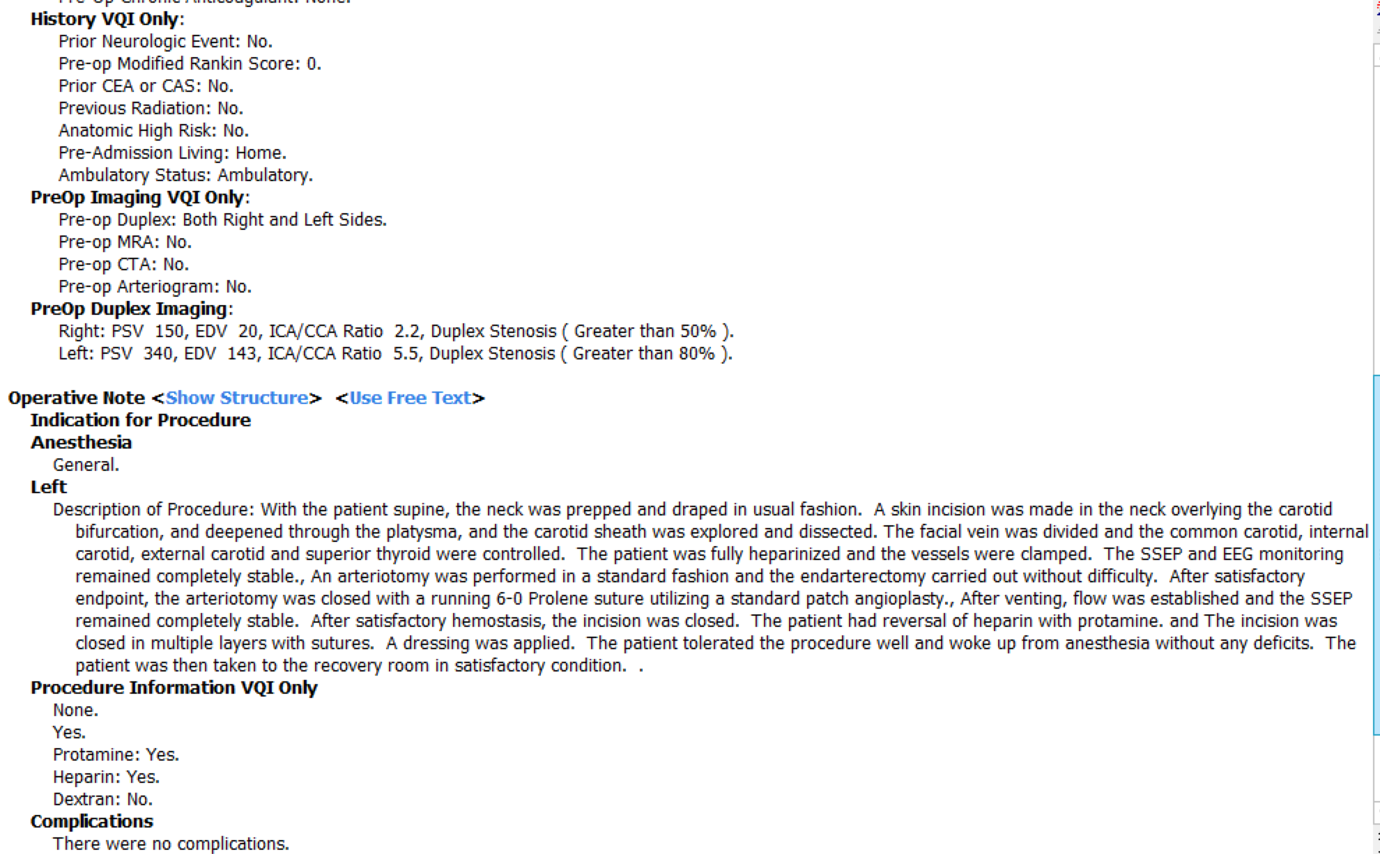
Process
Create "click" and "dropdown" templated operative notes

Slide 19
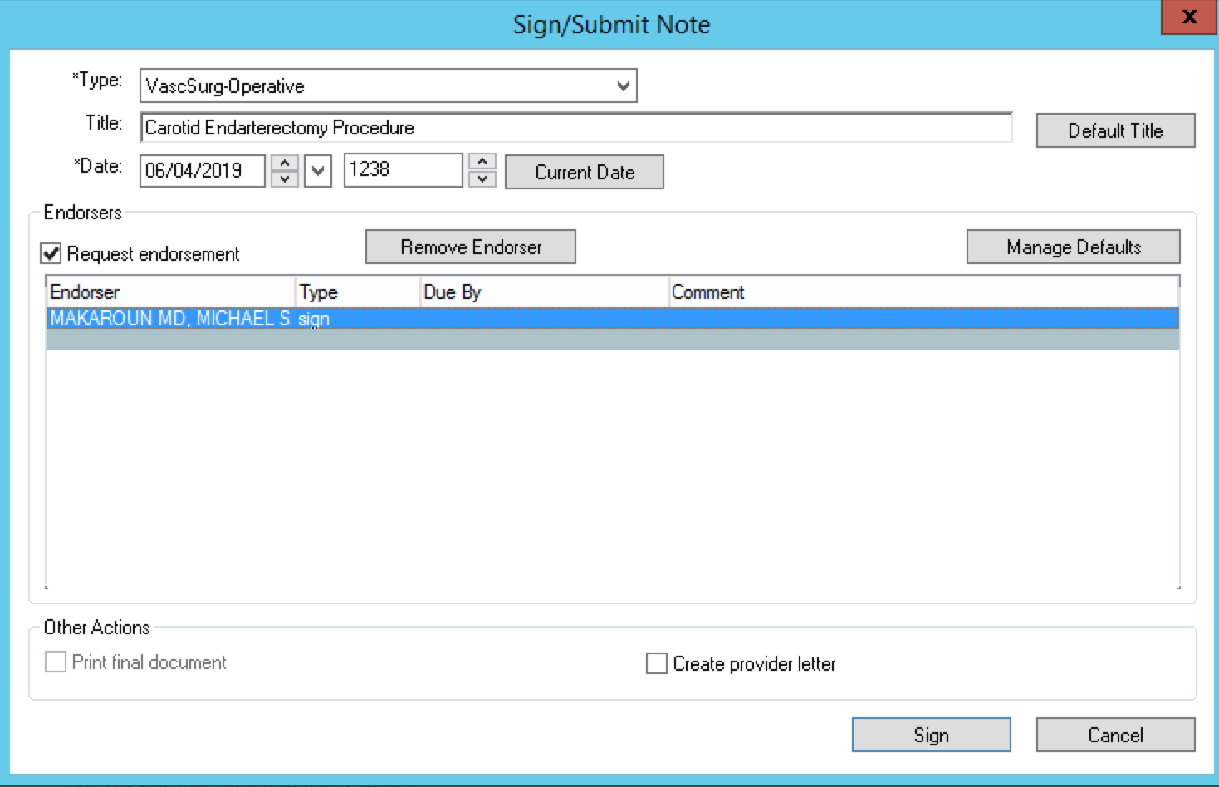
Process
Create "click" and "dropdown" templated operative notes

Slide 20
Process
Determine recipients, format, and frequency of data export and review
  Test data for validity
  Test data export process

Slide 21
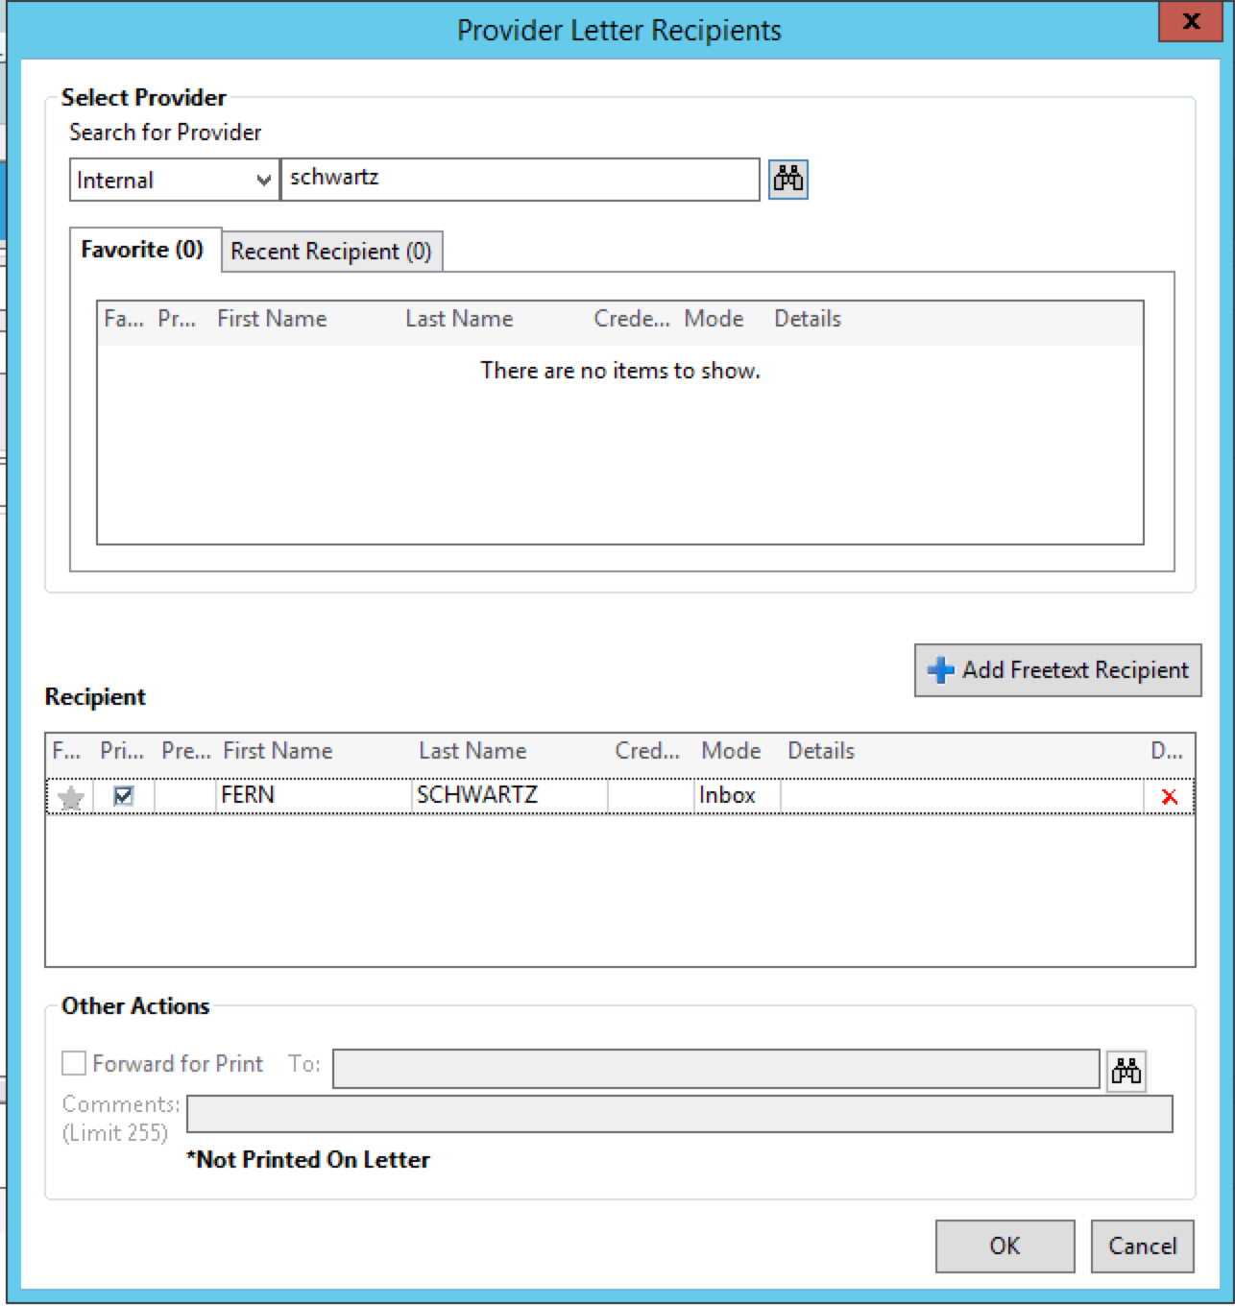
Process

Slide 22
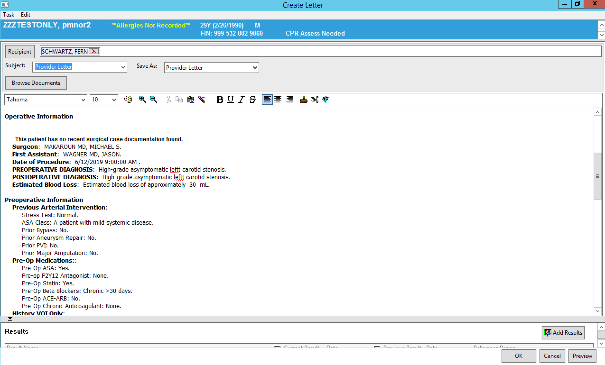
Process

Slide 23
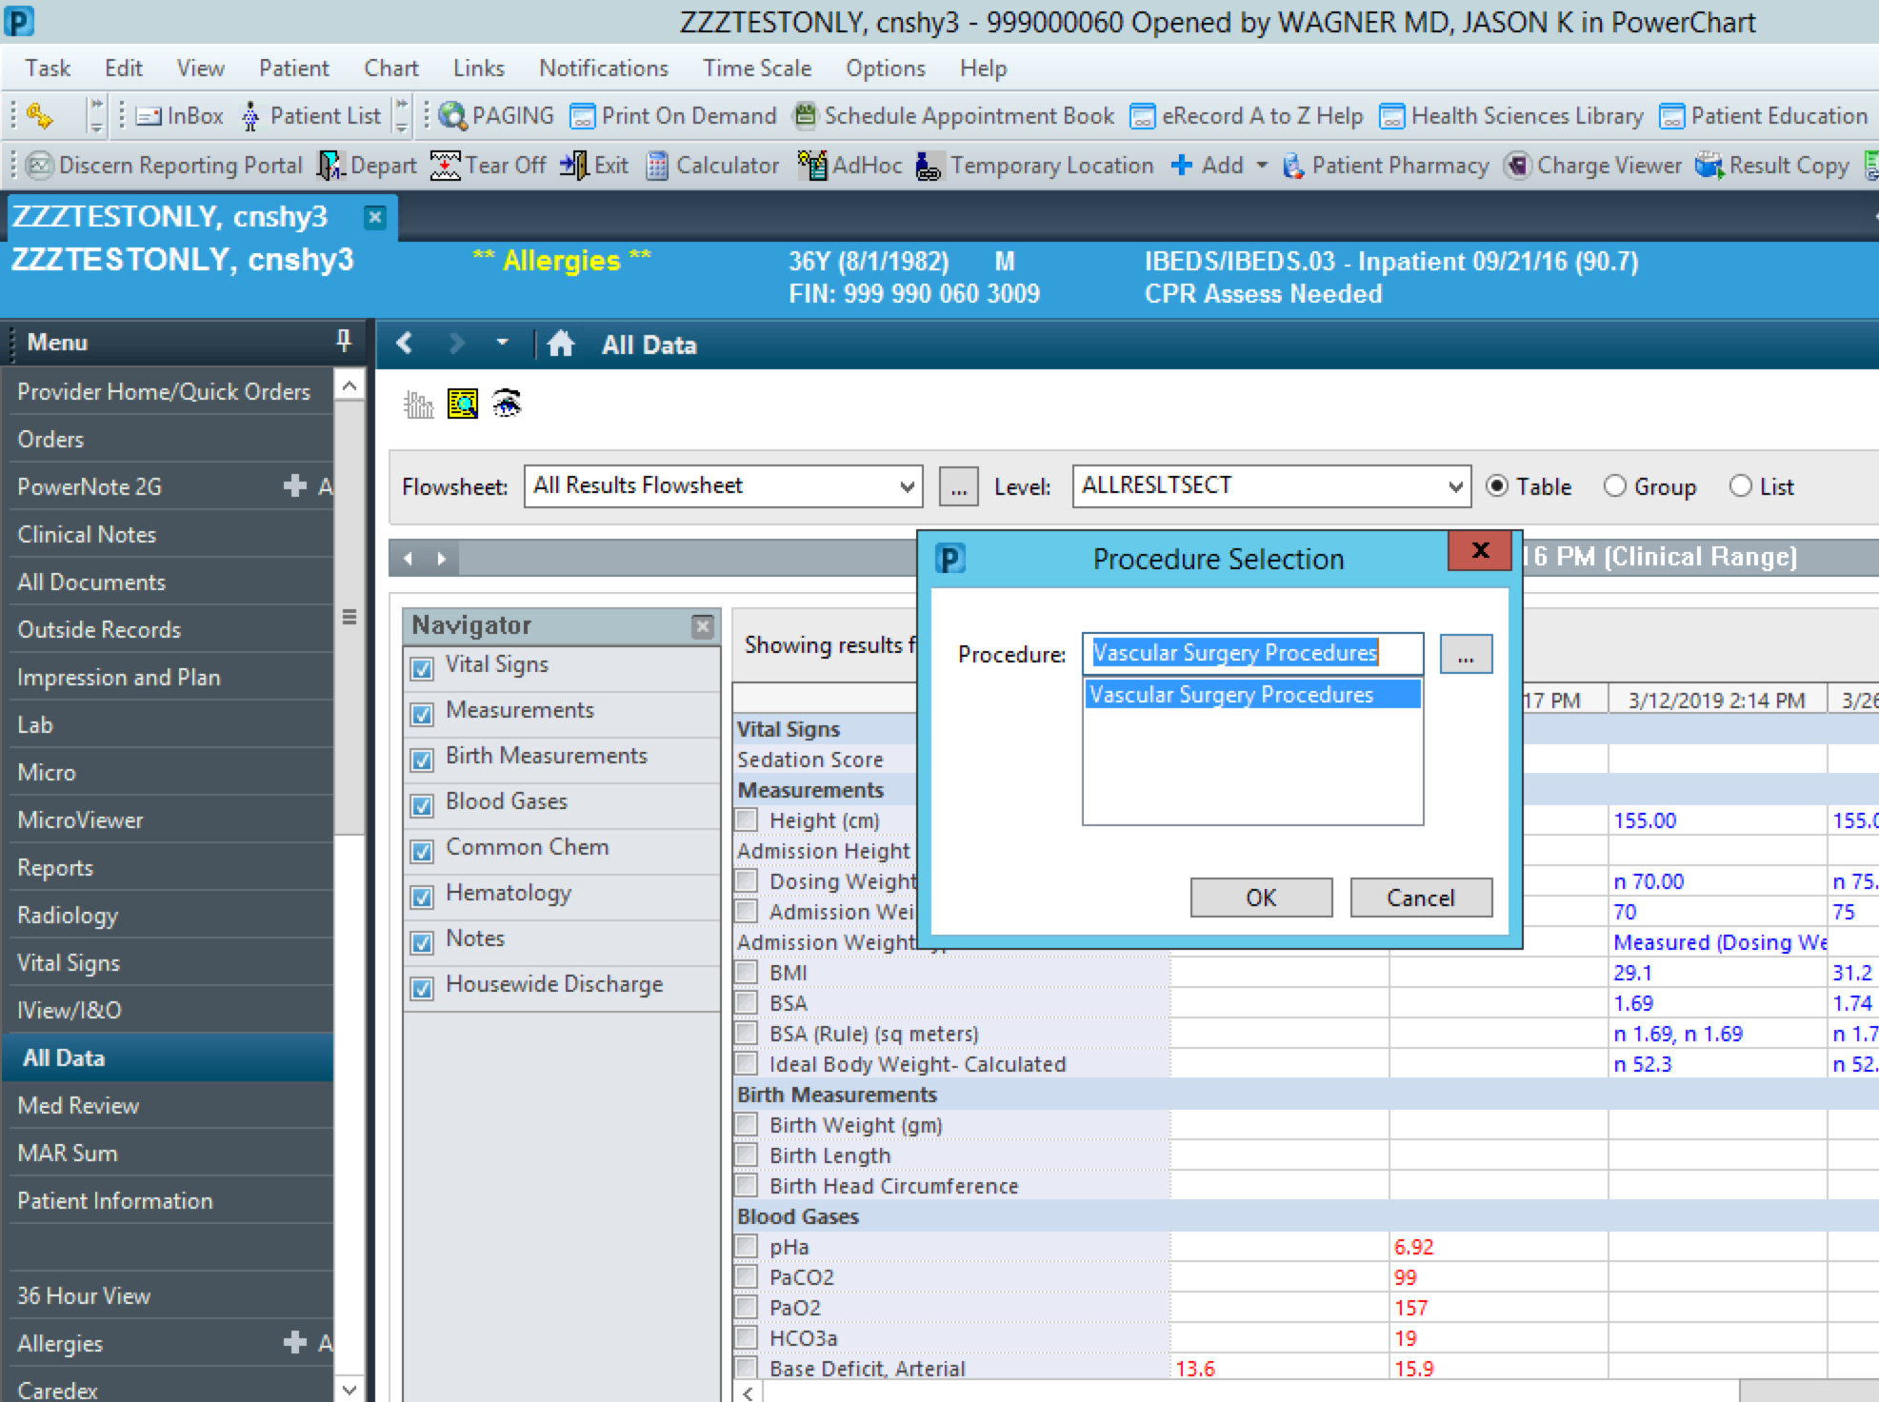
Process
Determine recipients, format, and frequency of data export and review

Slide 24
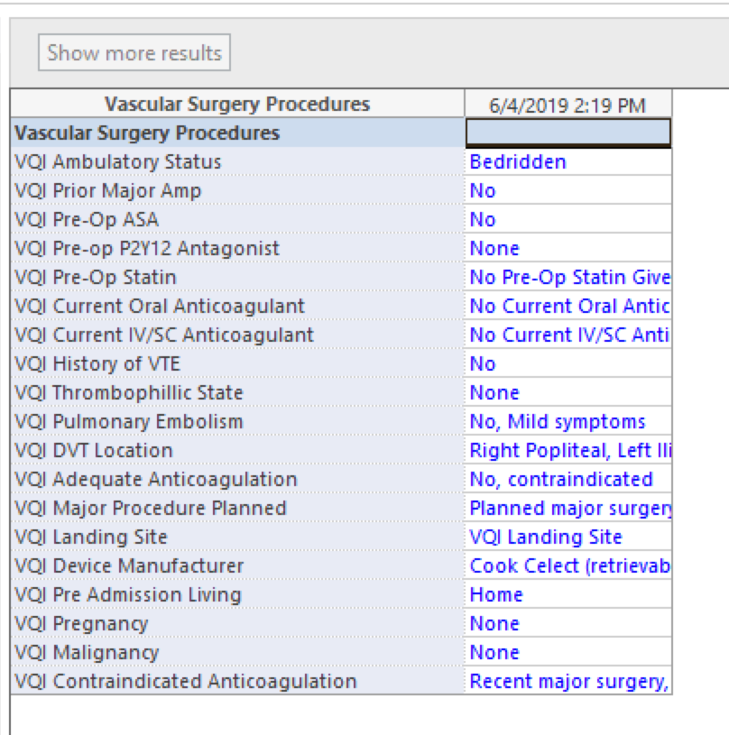
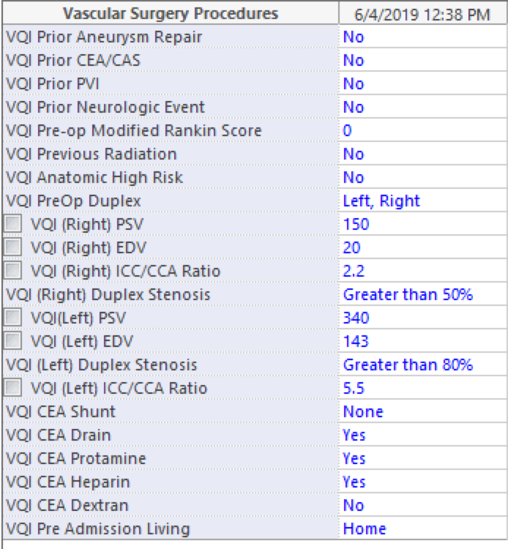

Slide 25
Process
Initiate "Soft" rollout of note within the EMR
  Troubleshoot note completion and data export issues
  Refine approach to end-user training
Initiate widespread in-servicing and promotion
  Assist with customizing and generating partially pre-completed versions of users' template notes
  Recruit additional stakeholders for new modules

