Slide 1
Improving Follow-up Imaging Compliance Rate after Endovascular Aortic Repairs
Priya Padmanabhan, MHA, LSSYB
Baylor Scott & White Heart and Vascular Hospital - Dallas
621 North Hall | Suite H-389 | Dallas, TX 75226
Office: 214.820.0698 | Fax: 214.820.6246 | Email: Priya.Padmanabhan@bswhealth.org
VQI at Vascular Annual Meeting
6/12/2019

Slide 2
Background
Life-long postoperative surveillance following an endovascular abdominal aortic aneurysm repair (EVAR) is recommended to optimize long-term outcomes
A key performance measure of the VQI is the rate of compliance with long-term follow-up (LTFU) imaging at one year (captured between 9 to 21 months) after the index procedure
In 2015, the VQI national rate of LTFU imaging was 56%. In our center however, only 44% of patients had annual follow-up imaging
We hypothesized that a structured follow-up strategy would improve LTFU after EVAR

Slide 3
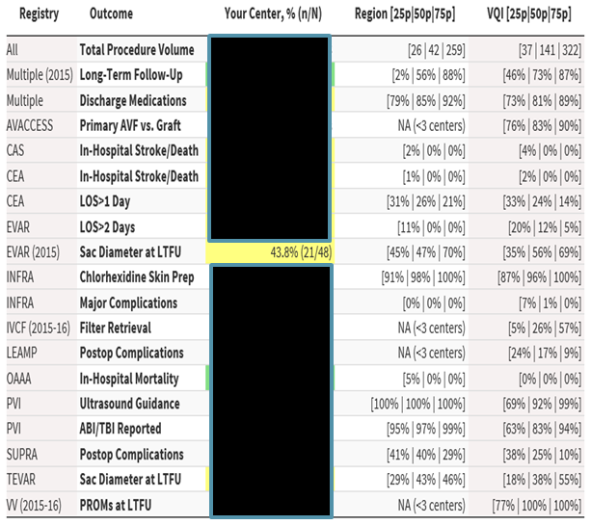
Baseline - CY 2015
BHVH at 43.8%
National: Below 50th percentile

Slide 4
Goal
Optimize current follow-up scheduling process and identify opportunities for improving LTFU imaging rate
Develop a structured follow-up strategy to improve adherence to recommended surveillance guidelines
Increase one year follow-up imaging rate for endovascular aortic repair patients by 20%
44% to 53%

Slide 5
Team
Executive Sponsor: John Eidt, MD – Vascular Surgery
Sponsor: Trent Witt, Director Clinical Performance Measures
Process Owner: Priya Padmanabhan – Supervisor Clinical Performance Measures
Other Team Members:
Ashley Moore – Nurse Practitioner (Texas Vascular Associates)
Liza Gustafson – Practice Manager (Texas Vascular Associates)
Aleecia E – Scheduling (Texas Vascular Associates)

Slide 6
Improvement Strategy
Identify team members responsible for long-term follow-up
Root cause analysis to identify barriers
Improve physician and clinic engagement
Develop interventions to target root causes
Establish structured long-term follow-up process

Slide 7
Identified Issues and Concerns
Lack of standard follow-up scheduling process
Inconsistent communication of when follow-ups are due
Separate EMR systems preventing access to vascular clinic records/images
Inability to track missed visits
Lack of appropriate patient education

Slide 8
Interventions
KEY AREA | IMPROVEMENT STEP | OWNER
Standardize follow-up process work flow | Identify patients with completed annual follow-up imaging Send list of follow-ups due to vascular clinic Share monthly status report with team | VQI coordinator
Scheduling | Timely scheduling of patients due for follow-up Track missed visits Send reminders to patients with upcoming appointments | Scheduling/Nurse Practitioner/VQI coordinator
Patient records and images | 1. Establish access to vascular clinic EMR system | Clinic Practice Manager/Information Technology (IT)
Patient education | Set postoperative expectations during preadmission testing Close gap in knowledge by emphasizing importance of lifelong post-EVAR surveillance | Surgeons/Nursing

Slide 9
Plan-Do-Check-Act (PDCA)
Plan
Do
Check
Act

Slide 10
PDCA
Plan Protocol for long term follow-up beginning at 9 months to 21 months post endovascular aortic repairs
Create list of procedures that require follow-up
Identify which follow-ups are complete
Track missed visits
Do Develop standardized process for timely and consistent communication of follow-ups due
Send monthly report of follow-ups due to clinic
Access to clinic EMR system
Patient education
Check Consistent monthly reporting to assess status and track progress
Act Continued engagement, awareness and transparency

Slide 11
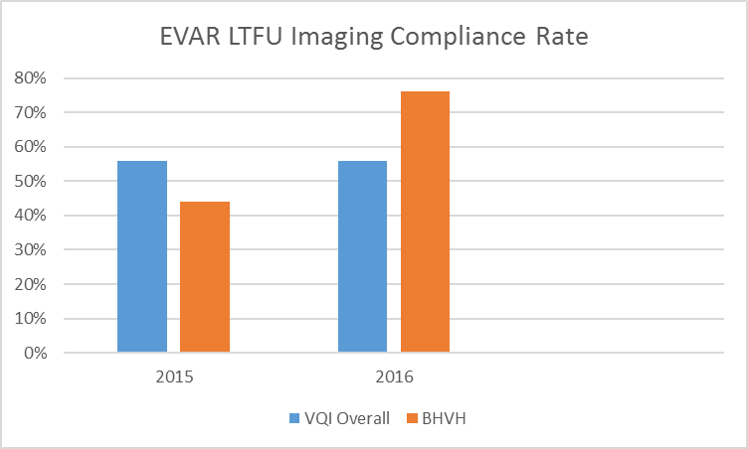
Results

Slide 12
Challenges
Geographic factors
Tracking out of state patients
Travel distance to clinic
Advanced patient age
IT support

Slide 13
Key Learnings
Development of monthly report to TVA clinic aided in improving and sustaining compliance rate
Physician and staff engagement is crucial to successful implementation of any new process
Report out at quarterly Vascular Section Meetings
Celebrate wins
Awareness, transparency and communication with TVA assisted in cross departmental collaboration and improvement efforts

Slide 14
Questions?

