Slide 1
EVAR
Dr. Sal Scali
University of Florida, Gainesville

Slide 2
Agenda
I. Overview of Inclusion/Exclusion Criteria
II. A & P Overview
III. Pertinent Device and Variable Overview
IV. Live abstraction

Slide 3
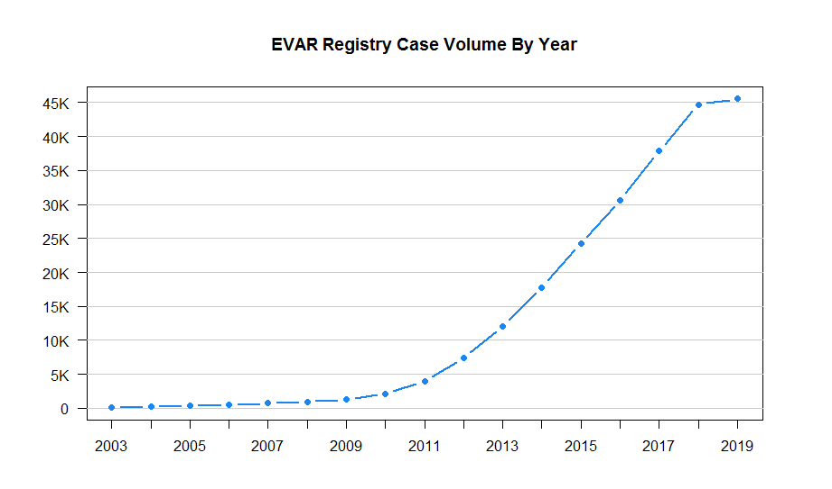
EVAR Annual Case Volumes
Over 300 centers and 1600 physicians contribute data per year

Slide 4
Inclusion/Exclusion Criteria
Inclusion:
Primary endovascular repair of degenerative infrarenal aortic aneurysms that may include iliac aneurysms. Uncovered stent grafts (suprarenal fixation devices) extending above the renal arteries are included. This includes failed endovascular AAA repairs that convert to open AAA repair during the index procedure.
Exclusions:
  Revision of previous endografts (which is captured on the follow-up form for that procedure).
  Supra-renal covered stent grafts with renal fenestrations or branches (which are entered under TEVAR/Complex EVAR).
  Isolated iliac aneurysms.
  Operations done for infected aneurysms.
  Operations done for anastomotic aneurysm (Pseudoaneurysm)
  EVAR performed for non-aneurysmal infrarenal pathology, such as isolated dissection or
  Atherosclerotic occlusive disease (the latter is captured under PVI, the former is not captured in the VQI registry).
  Repair done for trauma

Slide 5
Infrarenal Abdominal Aortic Aneurysm (AAA)

Slide 6
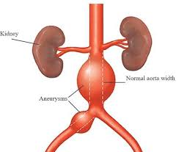
Endovascular AAA Repair

Slide 7
Anatomic Considerations
YES
NO

Slide 8
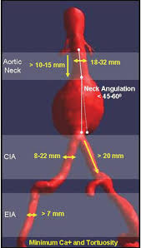
Ideal EVAR Anatomy

Slide 9
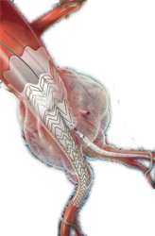
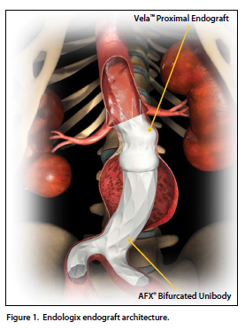
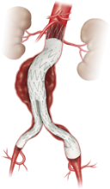
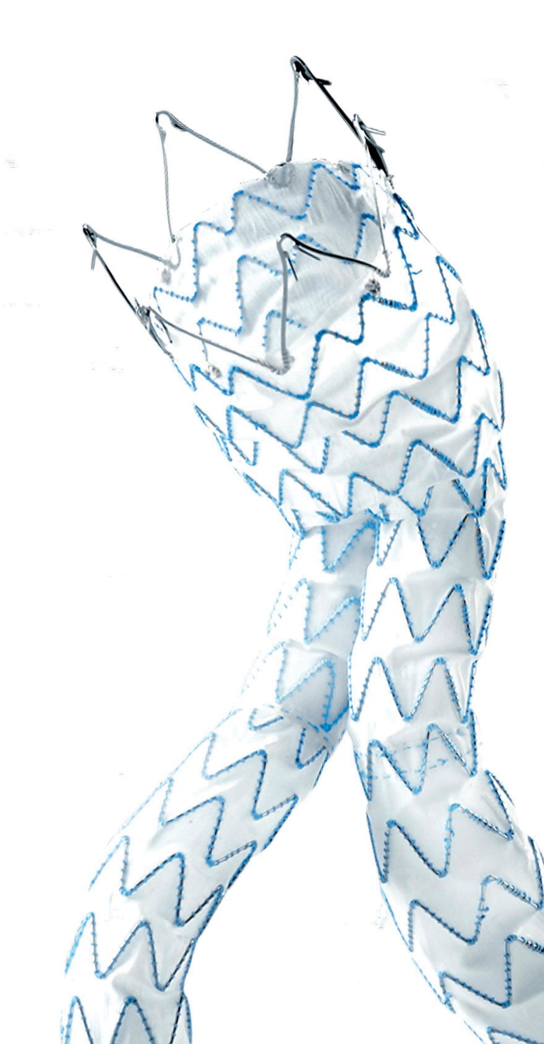
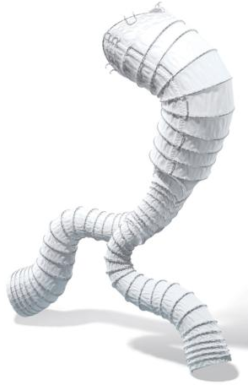
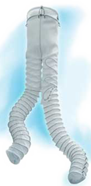
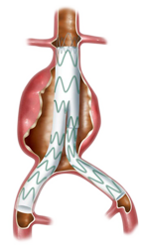
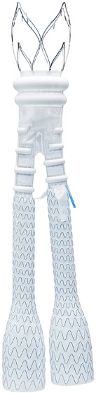
Infrarenal AAA Stent-Grafts
Gore
Endologix
Cook
Medtronic
AorFix
Anaconda/Terumo
Talent
Ovation

Slide 10
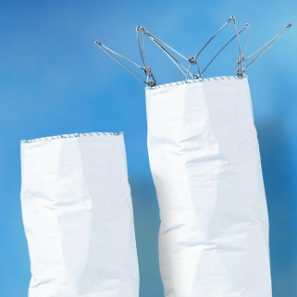
Infrarenal vs Suprarenal Fixation
Suprarenal fixation
Infrarenal fixation

Slide 11
Graft Configurations
1 = Bifurcated infra-renal,2 = Bifurcated supra-renal fixation,3 = Aorto-uni-iliac, right,4 = Aorto-uni-iliac, left,5 = Bilateral aorto-iliac limbs, 6 = Aorto-aortic

Slide 12
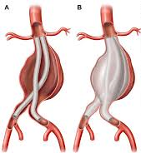
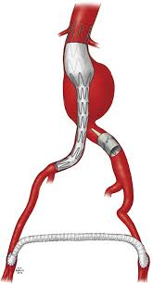
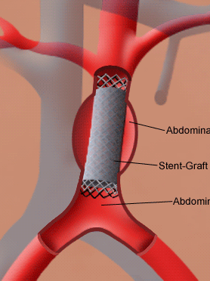
Graft Configurations
Bifurcated Infrarenal Fixation
Bifurcated Suprarenal Fixation
Bilateral Aorto-iliac limbs
Aorto-uni R iliac
Aorto-Aortic

Slide 13
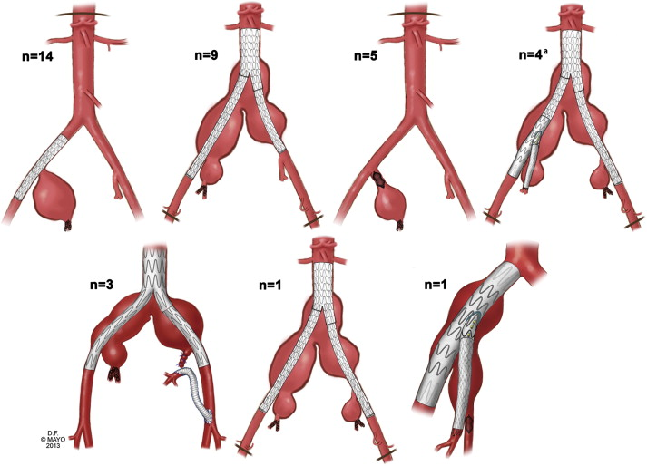
Treatment of Iliac Aneurysm
Does not capture isolated iliac aneurysm repair
Does include iliac aneurysm repaired concurrently with infrarenal AAA
- Coil embolization, plug occlusion, iliac branch endoprosthesis, hypogastric bypass
Coil embolization
Vascular Plug

Slide 14
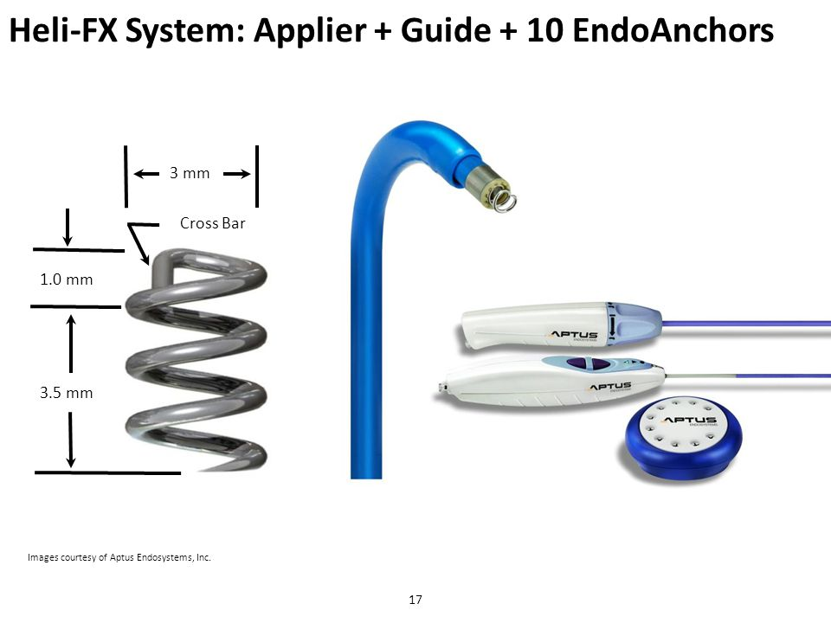
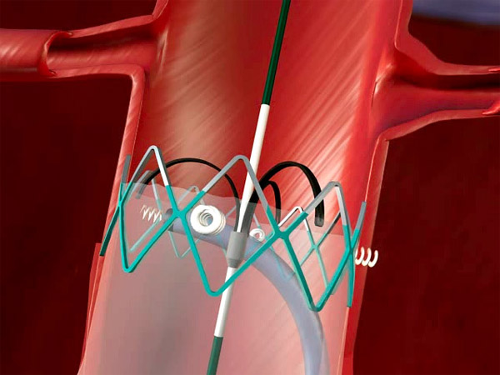
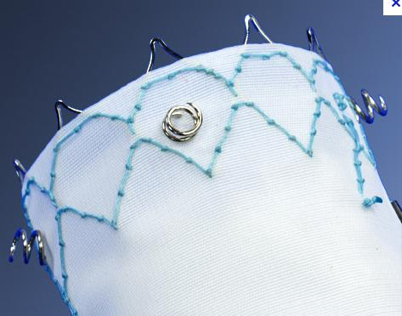
EndoAnchors-Aptus

Slide 15
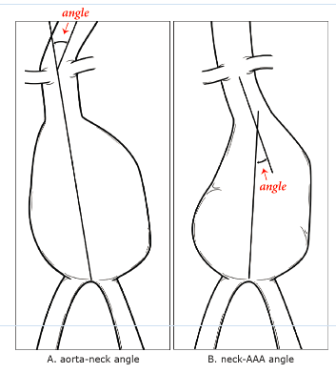
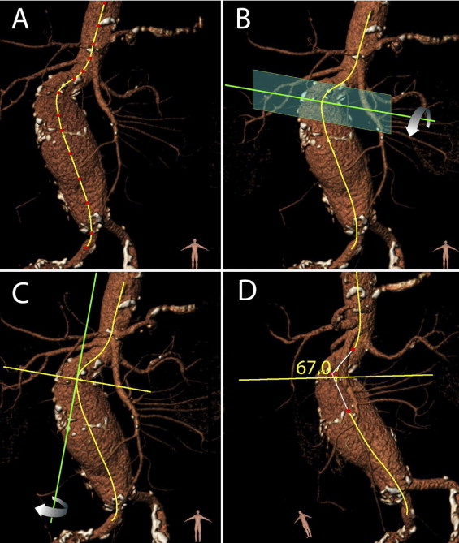
Aortic Neck Angle
Maximum angle between axis of suprarenal aorta and aneurysm neck, optimally measured with 3-D CT imaging software

Slide 16
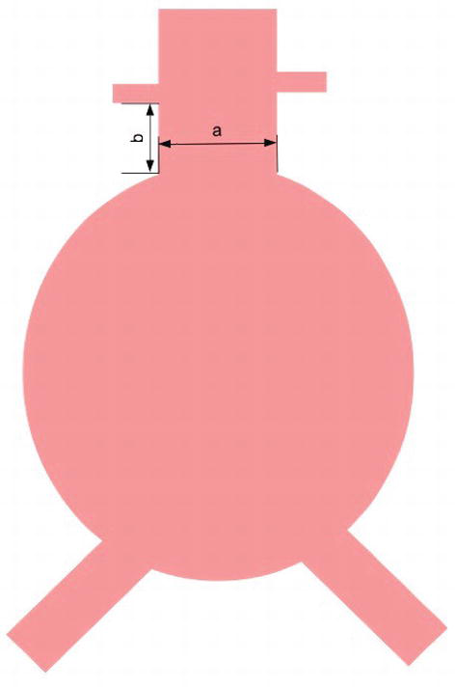
Aortic Neck Length and Diameter
Missing in 40% of cases
Neck Length (mm) =Defined by a 10% change in diameter relative to the diameter adjacent to the lowest renal artery
Largest outer to outer diameter (mm) within the proximal landing zone (within the measured neck length)

Slide 17
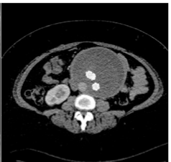
Max AAA Diameter
Missing in 40% of cases
Largest outer to outer diameter of the AAA
Can use CTA, US, MRI
or 3D reconstruction*
Unit = millimeter (mm)
65mm

Slide 18
Case Abstraction:
https://pathways-demo.m2s.com
  USER: VAM2019
  Password: #1registry
  Patient Last Name: EVAR

Slide 19

Questions

