Slide 1
Thoracic and Complex EVAR
Dr. Adam Beck
University of Alabama

Slide 2
Agenda:
I. Overview of Inclusion/Exclusion Criteria
II. A & P Overview
III. Pertinent Device Overview
IV. Live abstraction

Slide 3
Inclusion/Exclusion Criteria:
Inclusion:
Primary endovascular repair of thoracic aortic pathology, including aneurysm, dissection,
aneurysm from dissection, trauma, Penetrating Ulcer (PAU), Intramural Hematoma (IMH), PAU with
IMH or Aortic Thrombus. Also included is thoraco-abdominal (type 1-4/5) and supra-renal and
juxtarenal AAA, including visceral/renal/great vessels managed with fenestration, branch graft, or debranching
bypass.
Exclusions:
o Repairs done for infected aneurysms, pseudoaneurysm, or aberrant subclavian artery
coverage for dysphagia lusoria if not accompanied by thoracic aneurysm
o Infra-renal AAA (captured in EVAR module)
o Revisions of prior open or endovascular thoracic aortic and thoraco-abdominal repairs in the
same zone, with the exception of aneurysmal degeneration of prior visceral or intercostal
patch during open thoracic/thoracoabdominal repair, which should be included.
o All repairs done for infectious etiologies (eg, mycotic aneurysms, aortoesophageal fistula,
aortobronchial fistula, aortogastric fistula)
o TEVAR performed on the same OR date as the Type A repair should be excluded. TEVAR
performed after Type A repair may be included even if it’s during the same admission.

Slide 4
Aortic Anatomy

Slide 5
Infrarenal Aortic Aneurysm

Slide 7
Thoracoabdominal Aneurysm (TAAA)

Slide 8
Open TAAA Repair

Slide 9
Endovascular TAAA repair

Slide 10
Chimneys, Periscopes, Snorkels, Sandwich…ChiMPS..?

Slide 11
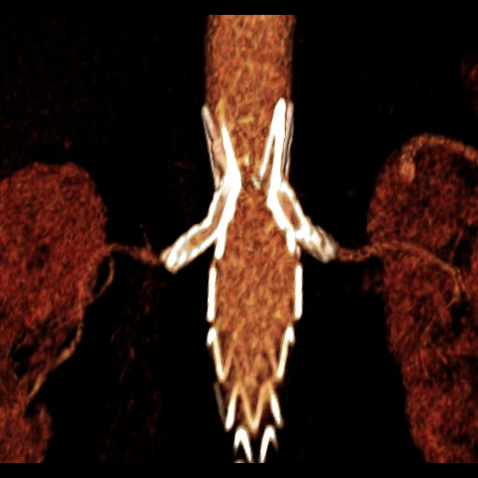
ChiMPS

Slide 12
Branch Vessel Treatment
None
Purposely covered
Unintentionally covered
Occluded – coil
Occluded – plug
Occluded – open
Stent
Stent-graft
Chimney
Scallop
Stented Scallop
Fenestration
Stented-fen
Fen branch
Side-arm branch
Surgical bypass
Thromboembolectomy
liac device Carotid
Unknown (left blank)

Slide 13
Branch Vessel Treatment: Occlusion
Coil Embolization
Plug
Occluded: Open

Slide 14
Branch Vessel Treatment
None
Purposely covered
Unintentionally covered
Occluded – coil
Occluded – plug
Occluded – open
Stent
Stent-graft
Chimney
Scallop
Stented Scallop
Fenestration
Stented-fen
Fen branch
Side-arm branch
Surgical bypass
Thromboembolectomy
liac device Unknown (left blank)

Slide 15
Stents vs. Stentgrafts
Stent
Stentgraft

Slide 16
Branch Vessel Treatment
None
Purposely covered
Unintentionally covered
Occluded – coil
Occluded – plug
Occluded – open
Stent
Stent-graft
Chimney
Scallop
Stented Scallop
Fenestration
Stented-fen
Fen branch
Side-arm branch
Surgical bypass
Thromboembolectomy
liac device Unknown (left blank)

Slide 17
Branch Vessel Treatment: Chimney
Chimney

Slide 18
Select A9: Treatment Left Subclavian
None
Purposely covered
Unintentionally covered
Occluded – coil
Occluded – plug
Occluded – open
Stent
Stent-graft
Chimney
Scallop
Stented Scallop
Fenestration
Stented-fen
Fen branch
Side-arm branch
Surgical bypass
Thromboembolectomy
liac device Unknown (left blank)

Slide 19
Scallop
Stented Scallop

Slide 20
Select A9: Treatment Left Subclavian
None
Purposely covered
Unintentionally covered
Occluded – coil
Occluded – plug
Occluded – open
Stent
Stent-graft
Chimney
Scallop
Stented Scallop
Fenestration
Stented-fen
Fen branch
Side-arm branch
Surgical bypass
Thromboembolectomy
liac device Unknown (left blank)

Slide 21
Fenestration
Stented Fenestration

Slide 22
Select A9: Treatment Left Subclavian
None
Purposely covered
Unintentionally covered
Occluded – coil
Occluded – plug
Occluded – open
Stent
Stent-graft
Chimney
Scallop
Stented Scallop
Fenestration
Stented-fen
Fen branch
Side-arm branch
Surgical bypass
Thromboembolectomy
liac device Unknown (left blank)

Slide 23
Fen Branch
Side arm Branch

Slide 24
Select A9: Treatment Left Subclavian
None
Purposely covered
Unintentionally covered
Occluded – coil
Occluded – plug
Occluded – open
Stent
Stent-graft
Chimney
Scallop
Stented Scallop
Fenestration
Stented-fen
Fen branch
Side-arm branch
Surgical bypass
Thromboembolectomy
liac device
Unknown (left blank)

Slide 25
Iliac Device

Slide 26
Anatomy and Physiology: Dissection

Slide 27
Aortic Dissection

Slide 28
Anatomy and Physiology: Acute Aortic Syndromes

Slide 29
Aortic Anatomy

Slide 30
Case Abstraction:

Slide 31
Questions

