Slide 1
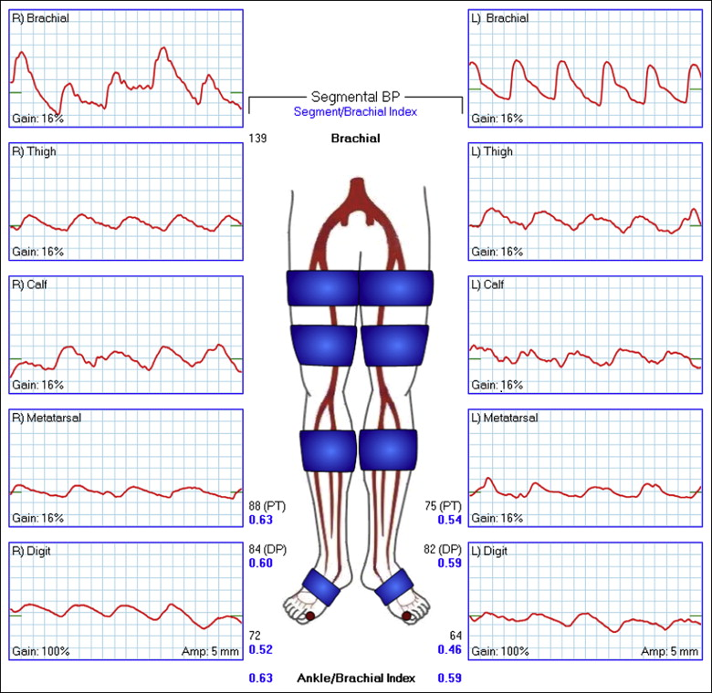
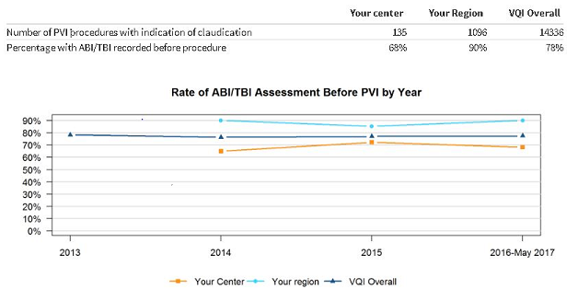
Increasing Compliance of Peripheral Vascular Intervention Pre-procedural ABIs
Megan Pepin, RN- Program Manager, Michelle Farneman, Sr. Quality Manager, Shelby Hamilton, RN, BSN, Dr. Jean Starr, Dr. Cindy Baker, Dr. Kristine Orion
Problem Statement
Improvement Strategies
Challenges/Lessons Learned
According to SVS/AHA/ACC guidelines, an Ankle Brachial Index should be conducted on patients presenting with risk factors for PAD so that therapeutic interventions known to diminish their increased risk of myocardial infarction (MI), stroke, and death may be offered. Looking at our Fall 2017 report, we observed that The Ohio State University Wexner Medical Center pre-procedural ABIs were not only the lowest in our region but also below the national average. Upon further investigation, OSUWMC ABI rates had been lower than national SVS rates since 2014. The 2017 OSUWMC rate was 68% with the VQI regional rate comparison at 90% and VQI national rate at 78%.
Using DMAIC methodology, a process improvement team with project leads and process owners was assembled, and a retrospective analysis of 2016-2017 cases that met criteria was completed. In doing this, we identified several areas for improvement and developed the following plan with the primary focus on education:
Provide education to Interventional Cardiology and Vascular Surgery regarding the importance of ABI studies and potential associated mortality/morbidity, review of current performance, and establish target benchmarks.
Align clinical practice with guidelines within all disciplines.
Performed an internal audit to identify all patients that had pre-procedural ABIs captured as “Not Measured” then contacted appropriate offices to obtain any pre-procedural testing.
Established a patient database that updated monthly with the names of patients that did not have pre-procedure ABIs in order to contact either the physician directly or the office to see if they were available.
Quarterly compliance reports distributed for 1 year and audit of PVI cases to evaluate effectiveness of education, identify challenges, and need for potential changes.
Variation between Vascular Surgery and Interventional Cardiology criteria that dictated whether pre-procedure ABIs were completed within appropriate timeframe.
Limitations on outside hospital transfer patients’ records being scanned into the system.
Records of patients seen at offsite offices not having ABI testing results in the EHR.
Office staff was educated on scanning/importing offsite records and physicians were asked to dictate results in their charting
Results
Success Factors
Goal
After instituting our plan, we saw an overall 29% improvement in acquisition of ABIs in 2018 in comparison to fiscal years 2016-2017. The VQI Spring 2018 summary reported a 97% compliance rate, well above our set goal and national average.
The success of this project is attributed to engaging the participating services and physicians, providing education and standardizing practices to ensure the guidelines were followed.
A continual monthly report outlining current performance and opportunities for improvement ensured the team was kept up to date of the improvement observed as the project progressed.
Finally, a patient database was created to track those patients with pre-procedure ABIs captured as “not measured” so chart could be audited and testing requested if applicable; this is a database that will be used going forward to help maintain our results
Our goal was twofold. First, to educate in a multidisciplinary fashion on why pre-procedural ABIs are important. Second, we sought to improve our overall percentage of pre-procedure ABIs to meet the national rate of 78% by December 31, 2018.

