Slide 1
Carotid Endarterectomy
Benjamin S. Brooke, MD, PhD
Division of Vascular Surgery
University of Utah School of Medicine

Slide 2
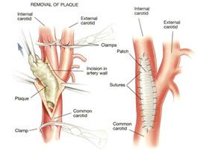
Agenda:
De-identified CEA case review
IRR variable variation discussion
General Q & A for CEA VQI abstraction

Slide 3
Limitations of the IRR project:
Independent audit: Please do not ask for any help from anyone (i.e. other data abstractors/physicians/etc).
No dates included
Instructed if they could not find a data element, it was ok to leave it blank and submit without validation

Slide 4
Q1: Modified Rankin Scale
Score Definitions
0 No symptoms 1 No significant disability (Able to carry out all usual activities, despite some symptoms) 2 Slight disability (Able to look after own affairs without assistance, but unable to carry out all previous activities ) 3 Moderate disability (Requires some help, but able to walk unassisted) 4 Moderately severe disability (Unable to attend to own bodily needs without assistance, and unable to walk unassisted) 5 Severe disability (Requires constant nursing care and attention, bedridden, incontinent)

Slide 5
Select A1: Modified Rankin
No symptoms
No significant disability
Moderate disability
Moderately severe disability
Severe disability
Unknown (leave blank)

Slide 6
A1: Modified Rankin
No symptoms
No significant disability
Moderate disability
Moderately severe disability
Severe disability
Unknown (leave blank)

Slide 7
Q2: Urgency
Elective = planned/scheduled procedure;
Urgent = surgery within 24 hours of admit or patient can't be discharged;
Emergent = surgery within 6 hours of admission

Slide 8
Select A2: Urgency
Elective
Urgent
Emergent
Unknown (leave blank)

Slide 9
A2: Urgency
Elective
Urgent
Emergent
Unknown (leave blank)

Slide 10
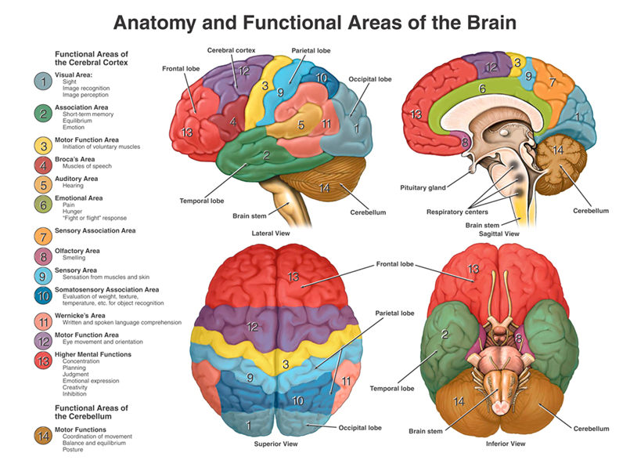
Q3: Prior Left Cortical Event
TIA: symptoms last < 24 hours.
Stroke: symptoms last 24 hours or longer. Symptoms= right motor/sensory loss, speech abnormality or other new neurologic symptoms documented in medical record as being related to the left hemisphere

Slide 11
Select A3: Prior Left Cortical Event
No
TIA
Stroke
Unknown (leave blank)

Slide 12
A3: Prior Left Cortical Event
No
TIA
Stroke
Unknown (leave blank)

Slide 13
Q4: Prior Vertebrobasilar Event
TIA: symptoms last < 24 hours.
Stroke: symptoms lasts 24 hours or longer.
Symptoms include bilateral motor, sensory, or visual loss, diplopia, ataxia, or other symptoms judged to be vertebrobasilar.

Slide 14
Select A4: Prior Vertebrobasilar Event
No
TIA
Stroke
Unknown (leave blank)

Slide 15
A4: Prior Vertebrobasilar Event
No
TIA
Stroke
Unknown (leave blank)

Slide 16
Q5: New Dysrhythmia
New rhythm disturbance requiring treatment with medications or cardioversion

Slide 17
Select A5: New Dysrhythmia
No
Yes
Unknown (leave blank)

Slide 18
A5: New Dysrhythmia
No
Yes
Unknown (leave blank)

Slide 19
Q6: Post Op Complication
Yes, if at least one of the listed complications was documented to occur: Myocardial Infarction, New Dysrhythmia, Congestive Heart Failure, Wound Infection, Reperfusion symptoms and/or any Return to OR.
If No is selected, all listed complications will be recorded as no.

Slide 20
Select A6: Post Op Complication
No
Yes
Unknown (leave blank)

Slide 21
A6: Post Op Complication
No
Yes
Unknown (leave blank)

Slide 22
Q7: Post Op Hypertension
IV meds required: Indicates continuous infusion (>=15 minutes) of anti-HTN IV medication, or more than one dose required greater than one hour after surgery.

Slide 23
Select A7: Post Op Hypertension
No
Yes
Unknown (leave blank)

Slide 24
A7: Post Op Hypertension
No
Yes
Unknown (leave blank)

Slide 25
Q8: Protamine
No help text!!!
Indicate whether protamine sulfate was used to reverse effect of heparin anticoagulation at the conclusion of the procedure.

Slide 26
Select A8: Protamine
No
Yes
Unknown (leave blank)

Slide 27
A8: Protamine
No
Yes
Unknown (leave blank)

Slide 28
Questions

