Slide 1

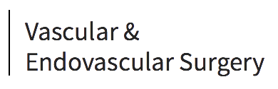
Episode-Based Cost Reduction for Endovascular Aneurysm Repair
Nathan K Itoga, MD¹; Ning Tang, MD²; Diana Patterson²; Raymond Lew²; Rika Ohkuma, MD²; Matthew W. Mell MD, MS¹; Ronald L. Dalman, MD¹
¹Division of Vascular Surgery – Stanford University School of Medicine
²High Value Care, Department of Quality, Stanford Health Care, Stanford, CA

Slide 2
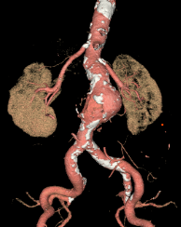
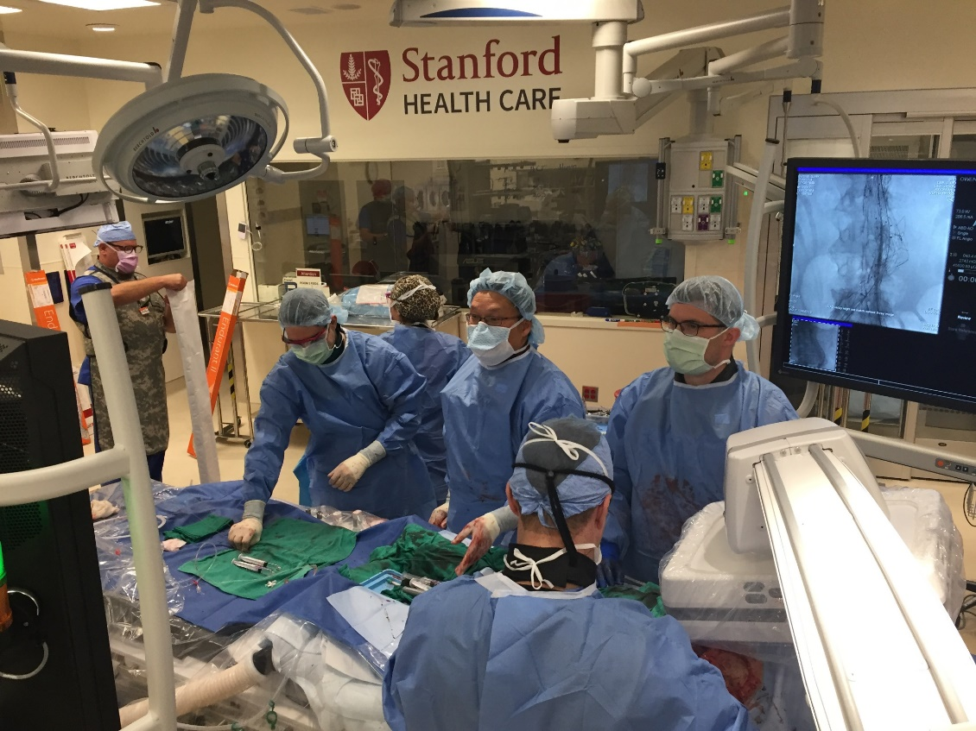
Disclosures
We like to repair AAAs ☺

Slide 3
EVAR dominates AAA repair in the USA
Circulation 2016:134:1948-1958 © AHA

Slide 4
But… costs exceed hospital reimbursements

Slide 5
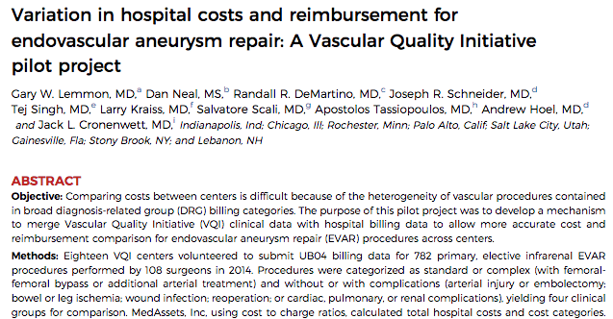
EVAR Cost Demonstration Project
2-3 fold variation in costs between centers
At many centers, costs exceed reimbursements
(J Vasc Surg 2017;66:1073-82. © SVS)

Slide 6
Costs vary by category & center
Standard EVAR without complication
(J Vasc Surg 2017;66:1073-82. © SVS)

Slide 7
Objective
Use guidance from the SVS VQI EVAR Cost Demonstration Project
  Identify improvement opportunities
  Reduce EVAR costs while maintaining quality outcomes.
(J Vasc Surg 2017;66:1073-82. ©)

Slide 8
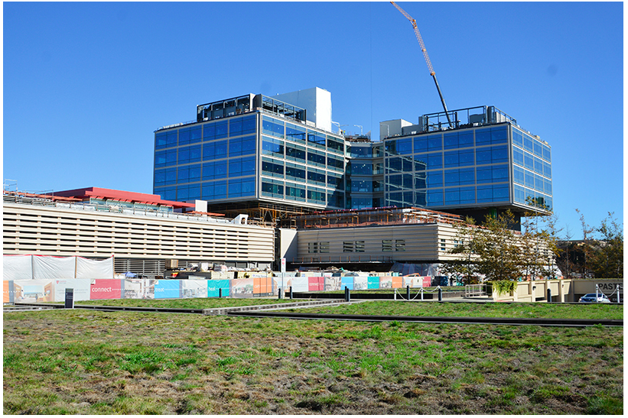
Implementation platforms
High Value Care (HVC) Team
Institution-wide pharmacy cost reduction project

Slide 9
Outcomes
Direct costs
Case mix index (CMI)
Type of repair
  Standard (infrarenal) vs. complex (fEVAR, snEVAR ± IIA preservation)
  Elective vs. non-elective (symptomatic or rupture)
Clinical variables
  Intra-operative details
  Complications (VQI)
  Length of stay, ICU, discharge status

Slide 10
Timeline
Planning/ Implementation
Reference period
Evaluate results
9/2013
7/2015
Start
3/2016
1/2017
PRE
(n=141)
POST
(n=47)

Slide 11
Results – PRE savings opportunities
  1. Endoprostheses
  2. Pre-procedural “boarding”
  3. Inpatient imaging and reformatting

Slide 12
Endoprostheses – 31% reduction
Advisory Board benchmarking
Vendor negotiations
(J Vasc Surg 2017;66:1073-82.)

Slide 13

Boarding – 34% reduction
Limit indications
Facilitate off-site housing and transportation
Use existing lab/image data

Slide 14
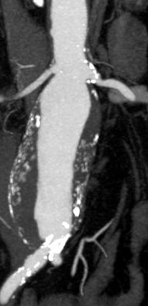
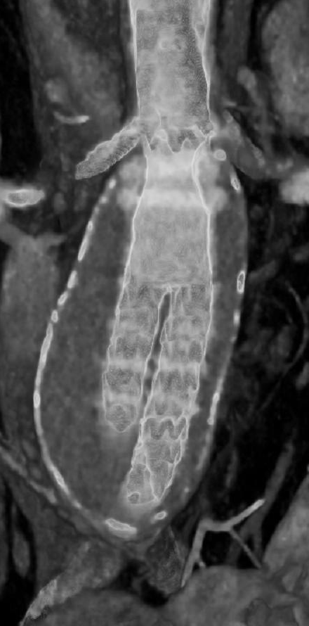
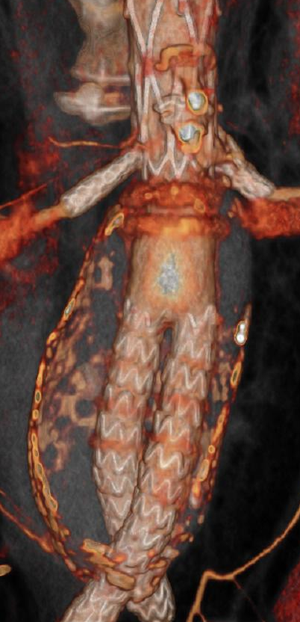
Imaging – 93% reduction
Minimize pre-discharge CTA.
Eliminate (99.1%) post-processing

Slide 15
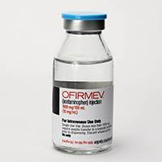

Pharmacy charges – 38% reduction
Focused on generic drug use
Reduced intravenous IV acetaminophen, decreased used of albumin for fluid resuscitation in post-operative period

Slide 16
Patient characteristics
 |  | PRE (n=141) | POST (n=47) | P-value*
Age |  | 73.3±9.4 | 74.9±8.9 | 0.253
Male |  | 80.7% | 90.7% | 0.138
Elective Case |  | 82.1% | 89.4% | 0.249
Case Mix Index |  | 3.60±0.57 | 4.32±0.90 | <0.001
Procedure Type | Standard | 63.1% | 55.3% | 0.343
 | Complex | 36.9% | 44.7% | -
Commercial payer |  | 13.5% | 17.0% | 0.549

Slide 17
Clinical outcomes (Intra-op)
 | PRE (n=141) | POST (n=47) | P-value*
Total Procedure Time (min) | 147.9 ± 75.6 | 160.8±78.2 | 0.316
Iodinated Contrast (ml) | 68.6±36.7 | 79.3±29.9 | 0.072
Estimated blood loss (ml) | 394 ±984 | 260±276 | 0.359
Transfusion - pRBC (units) | 0.6±2.5 | 0.3±0.9 | 0.422

Slide 18
Clinical Outcomes (Complications)
 | PRE (n=141) | POST (n=47) | P-value*
Identified by billing | 12.8% | 17.0% | 0.466
Bowel Ischemia | 1 | 1 | 0.438
Leg Embolism | 0 | 1 | 0.250
Renal Complication | 1 | 2 | 0.155
Dysrhythmia | 4 | 3 | 0.369
Post-op MI | 3 | 3 | 0.166
Respiratory complication | 1 | 0 | 1.00
Return to OR | 3 | 4 | 0.600
Surgical Site Infection | 2 | 0 | 1.00

Slide 19
Clinical Outcomes (Post-op)
 | PRE (n=141) | POST (n=47) | P-value*
Mean LOS +/- SD (days) | 3.0±2.5 | 2.6±2.5 | 0.434
Median LOS (IQR) | 2 (1-11) | 2 (1-7) | 0.185
Procedures requiring ICU stay | 14.1% | 12.7% | 0.807
Discharge Home | 79.7% | 76.2% | 0.628
30d Mortality | 2 | 2 | 0.266

Slide 20
Limitations
Single academic medical center
Hospital accounting practices differ by institution
Costs were not accounted for beyond index hospitalization

Slide 21
Summary
First use of SVS VQI EVAR Cost Reduction Project to lower costs
Coordinated effort between health care system and surgeons
Greatest cost savings for our institution realized in graft costs, pre-procedural admissions, and inpatient radiology costs.

Slide 22
Conclusions
Substantial EVAR cost reductions are achievable
Value of SVS PSO VQI EVAR Cost Demonstration Project
Focused cost reductions can improve sustainability, access & programmatic growth

Slide 23
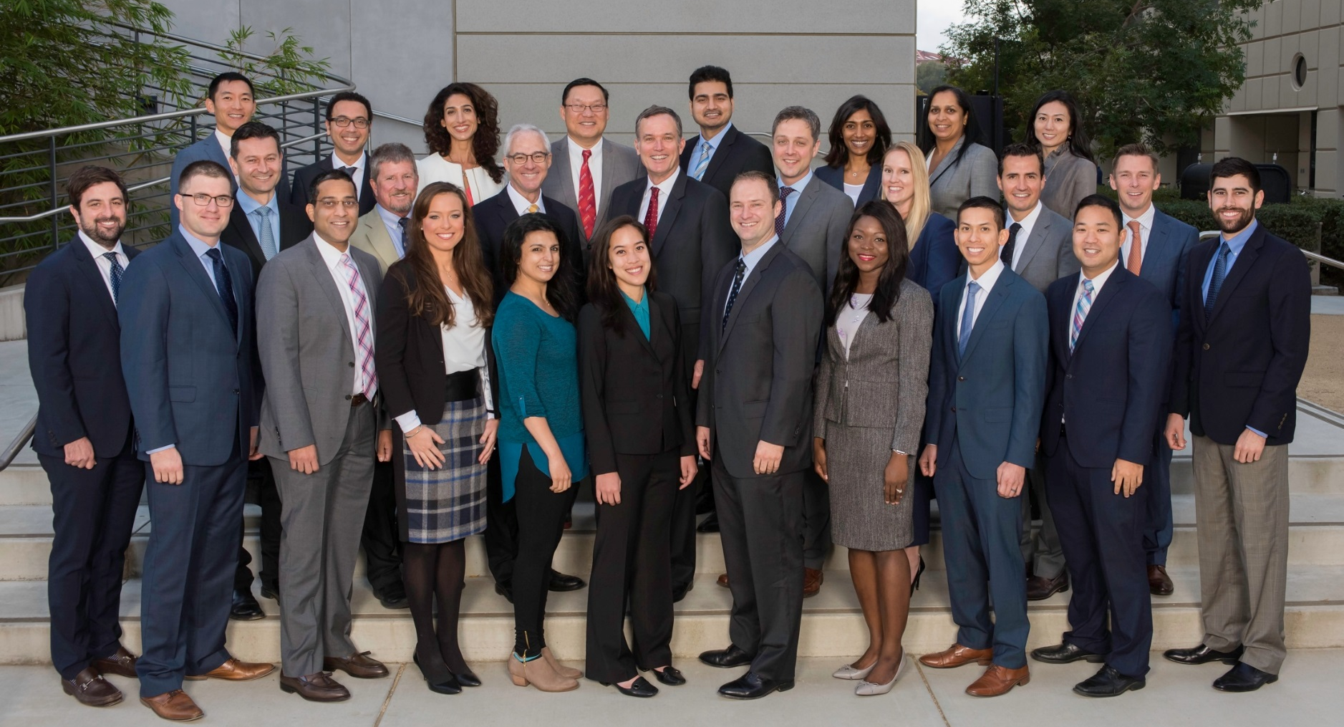
Stanford Vascular Surgery

