Slide 1
Vascular Ultrasound Registry
Pilot Project
David Dawson, MD
UC Davis Health
Gregory L. Moneta, MD
Oregon Health and Sciences University
Co-Chairs, SVS PSO Vascular Ultrasound Registry Committee

Slide 2
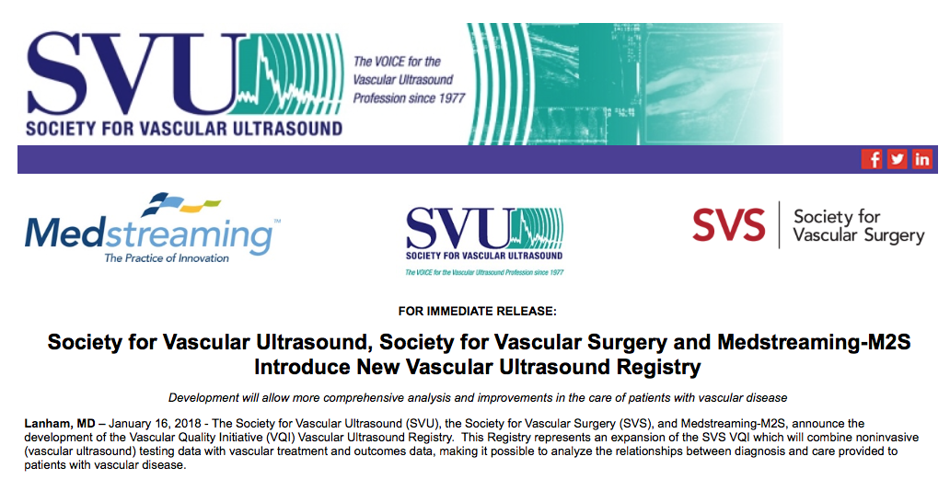
Vascular Ultrasound Registry
New initiative announced January 16, 2018

Slide 3
Registry Collaboration
Formal collaboration between the SVS PSO, Society for Vascular Ultrasound (SVU) and M2S/Medstreaming
Shared interest to pursue a novel approach to incorporate images and structured data into clinical data registries
Vendor neutral tools for direct entry of data and images
Unified goal to improve quality, enhance research, develop education content and support advocacy efforts

Slide 4
History
Concept discussions among leadership of Society for Vascular Ultrasound (SVU) since 2014
SVU established Research Committee chaired by Dr. Douglas Wooster in 2016
SVU Research Committee charged with defining initial project that would serve as foundation of vascular ultrasound registry
Medstreaming customers expressed interest in combining their data to support research
Concept evolved into idea of national registry with SVU taking the lead
Medstreaming acquired M2S
Registry intended to be inclusive of Medstreaming customers and others
Society for Vascular Surgery (SVS) recognized as potential partner
Necessary "infrastructure" in place: Patient Safety Organization
Existing M2S relationship with SVS (through VQI Registry)
Discussions led to plan for a Vascular Ultrasound Registry to be part of VQI

Slide 5
Initial Steps
Steering Committee Established
Co-Chairs
Dr. David Dawson (SVU)
Dr. Gregory Moneta (SVS)
Formalizing Pilot Sites’ Participation
Representatives from contracted pilot sites will serve on the Committee
Kickoff Meeting on June 21st
On-site training for data transfer

Slide 6
Goal of the Pilot
Vascular Ultrasound Registry’s initial efforts are focused on proof-of-concept
Establish technical means to collect and analyze vascular laboratory data
Pilot project focuses on diagnosis and treatment of carotid artery disease
Images will be matched with clinical data in the VQI
Includes sites participating in CEA and CAS registries
Current users of Medstreaming Vascular Information System (VIS)

Slide 7
Digital Imaging and Communication in Medicine
DICOM is both an image format and network protocol
Allows interoperability of imaging and information management systems
Standard implementation by manufacturers
Image data in processed and unprocessed formats
Metadata about the patient, machine, and data acquisition settings

Slide 8
DICOM Structured Reporting
DICOM SR is the standard for exchange of structured data and clinical observations (in imaging environment)
Structured reporting is an extension of DICOM images
Captures measurements, calculations, and other descriptive data in images
Data saved in a structured, customizable form
Data more accessible compared to traditional text-based reporting

Slide 9
Operation Efficiency: VUR
Utilize structured data and reporting capabilities to transfer images to the registry
Minimize impact on current workflow processes
Minimize or eliminate requirements for additional data entry other steps used in clinical setting:
Data acquisition by vascular lab technologist (examination)
Image and data review, reporting (technologist/interpreting physician)

Slide 10
Workflow
Participating site
Examination performed by RVT
Structured Reporting DICOM SR
Measurements, calculations, annotations
Images, videos
Vascular Information System (VIS)
VQI Vascular Ultrasound Registry (VUR)

Slide 11
VUR Pilot Sites
Sites expected to be part of the pilot project:
Froedert Health System, Dr. CJ Lee
Johns Hopkins Bayview Medical Center, Dr. Mahmoud Malas and Alexander Nodel
Northside Hospital, Dr. Siddharth Patel
Norton Healthcare, Kelly Byrnes
Novant Forsyth, Drs. Raymond Workman and Phillip Moore
Oregon Health & Science University, Dr. Greg Moneta
Partners HealthCare (Mass General), Dr. Javier Romero
ProMedica (Jobst Vascular Institute), Dr. Fedor Lurie and Robin Acino
Sarasota Memorial Health System, Dr. Russell Sampson
Sentara Norfolk General Hospital, Carolyn Strek

Slide 12
Workflow
Site 5
Site 6
Site 4
Site 7
Site 3
Site 8
Site 2
Site 9
Site 1
Site 10
VQI Vascular Ultrasound Registry (VUR)
DICOM SR data individual examinations from all registry sites is entered into VUR

Slide 13
VUR Initial Goals
Establish technical capabilities, build database
Identify best practices for standardization of vascular lab data collection
Pilot project limited to cerebrovascular examinations
Carotid duplex scan are common and relatively standardized
Integrate VUR data in VQI to increase the value/capabilities of VQI

Slide 14
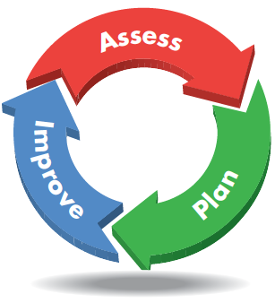
Current Activities
Use test environment to build VUR
Entries from previous carotid examinations in each site’s Medstreaming VIR records
Working group to define what carotid information will be prospectively entered (standardizing fields, images to be entered, maintaining compliance with IAC standards)
Identify variations in standards and procedures at different sites
Suggest modifications to achieve standardization and maximum utility, with minimal workflow impact

Slide 15
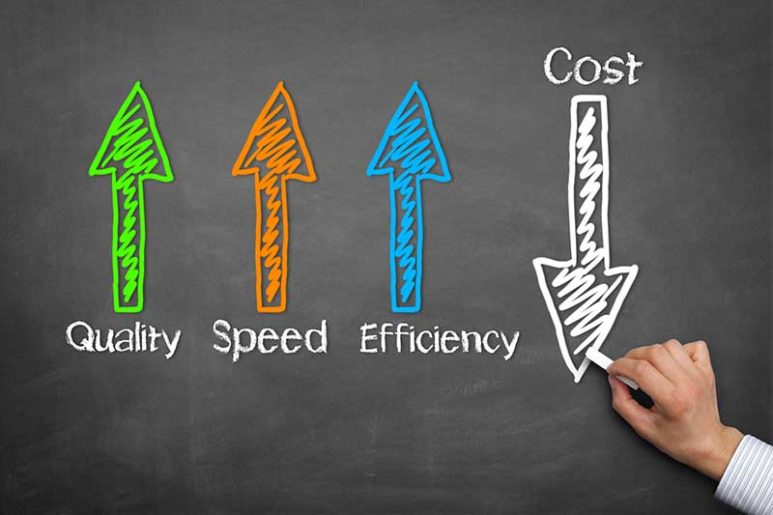
Next Steps: Direct User Benefits
Develop meaningful business analytics
Benchmark vascular laboratory performance
Meet accreditation and other reporting requirements

Slide 16
Broader Applications within VQI
Use objective data from VUR in analysis of data from other VQI modules
Validate existing and new vascular testing technologies
Conduct clinical trials (e.g. post-approval studies of devices/therapeutics)

Slide 17
Many Potential Study Ideas
Image analysis, machine learning, artificial intelligence
Vessel wall characterization (IMT)
Features of symptomatic vs. asymptomatic plaques
Risk prediction modeling
Inter-observer and inter-facility variability

Slide 18
Summary
Vascular Ultrasound Registry is joint initiative that has engaged SVU with the SVS PSO
Leverages existing informatics technologies to facilitate automated data capture
Medstreaming/M2S providing key support
End product will be vendor neutral
First VQI registry to incorporate imaging
Can be combined with the comprehensive clinical information gathered in 12 existing VQI registries

