Slide 1
Successful Continuation of EVAR Patient Compliance Utilizing VQI for Long Term Follow Up
Ali Arak, BS
Fern Schwartz, BS
UPP Vascular Surgery
University of Pittsburgh Medical Center (UPMC)

Slide 2
Objectives
Create a streamlined process that incorporates VQI data and tool sets to improve EVAR follow up compliance
Improve quality of patient care for EVAR patients

Slide 3
Problem Statement/ Background
Prior to VQI implementation, our center achieved a low EVAR LTFU rate (74%)
A low EVAR LTFU rate may affect patient care making patients susceptible to:
- Device failure, endoleaks, remote aneurysm formation, or aneurysm sac expansion including remote rupture

Slide 4
Improvement Strategy
Create an “assembly line” model to efficiently manage data and:
Simplify follow up effort
Increase EVAR LTFU compliance
Define distinct team member goals
and responsibilities

Slide 5
Process
Physicians capture EVAR procedures in VQI
Lead data coordinator completes and submits EVAR entries in VQI
Abstractor recalls LTFU in VQI and completes LTFU for patients who have complied with LTFU
Patients without follow ups completed or scheduled after 12 months are contacted by the VQI Team
12 months later

Slide 6
Assembly Line Process
Each month a follow up abstractor utilizes VQI LTFU tool to receive list of all follow ups required
Follow up abstractor completes the VQI follow up for patients missing LTFU
Electronic charts are reviewed and follow up submitted in VQI
Patients are seen in HBC. Imaging and office visit completed simultaneously
Patients without LTFU are entered into a local database, and are assigned to the VQI Team
Social security death index and obituaries investigated if patient cannot be reached
Postcards sent to patient if no phone contact is established
Follow up abstractor contacts patients and reschedules appointments. Reminds all patients of importance of imaging and LTFU.

Slide 7
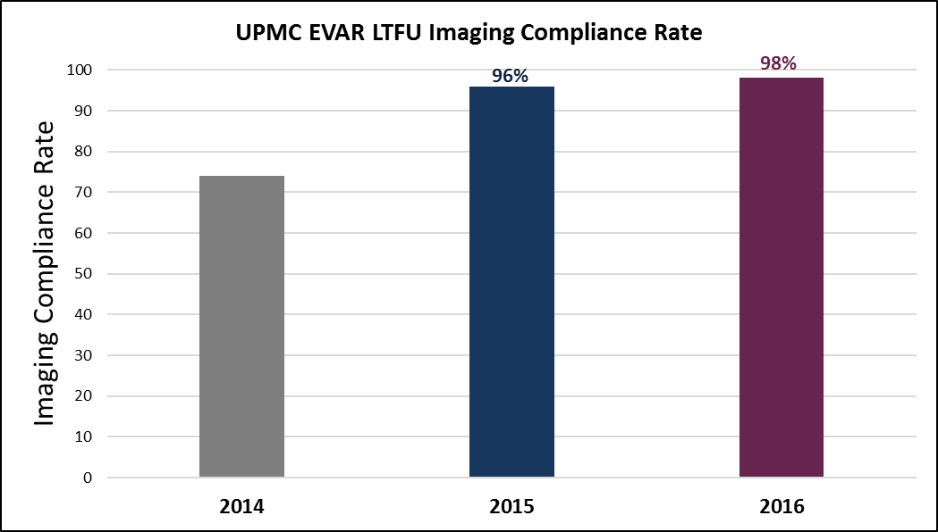
Results

Slide 8
Challenges/ Lessons Learned
Migration of patients between healthcare systems within the city
Relocation of patients to other states or countries
Comorbidities of patients

Slide 9
Conclusions/ Success Factors
Design of Clinic
Proper allocation of personnel and resources
Aggressive patient education and re-education
Department culture instilled into patients:
- “Once you become an EVAR patient, you are a vascular patient for life”

Slide 10
Questions?

