Slide 1
Improving EVAR Patient Compliance Utilizing VQI for Long Term Follow Up
Ali Arak, BS
Fern Schwartz, BS
UPP Vascular Surgery
University of Pittsburgh Medical Center (UPMC)

Slide 2
Objectives
Create a streamlined process that incorporates VQI data and tool sets to improve EVAR follow up compliance
Improve quality of patient care for EVAR patients

Slide 3
Problem Statement/ Background
LTFU is defined by VQI as patient contact 1 year after the procedure
- Captured between 9-21 months
Prior to VQI implementation, our center achieved a low EVAR LTFU rate (74%)
A low EVAR LTFU rate may affect patient care making patients susceptible to:
- Device failure, endoleaks, remote aneurysm formation, or aneurysm sac expansion including remote rupture

Slide 4
Improvement Strategy
Create an “assembly line” model to efficiently manage data and:
- Simplify follow up effort
- Increase EVAR LTFU compliance
- Define distinct team member goals and responsibilities

Slide 5
Process
Physicians capture EVAR procedures in VQI
Patients without follow ups completed or scheduled after 12 months are contacted by the VQI Team
Lead data coordinator completes and submits EVAR entries in VQI
Abstractor recalls LTFU in VQI and completes LTFU for patients who have complied with LTFU
12 months later

Slide 6
Each month a follow up abstractor utilizes VQI LTFU tool to receive list of all follow ups required
Follow up abstractor completes the VQI follow up for patients missing LTFU
Electronic charts are reviewed and follow up submitted in VQI
Patients are seen in HBC. Imaging and office visit completed simultaneously
Assembly Line
Model
Patients without LTFU are entered into a local database, and are assigned to the VQI Team
Social security death index and obituaries investigated if patient cannot be reached
Follow up abstractor contact patients and reschedule appointments. Remind all patients of importance of imaging and LTFU.
Postcards sent to patient if no phone contact is established

Slide 7
Results

Slide 8
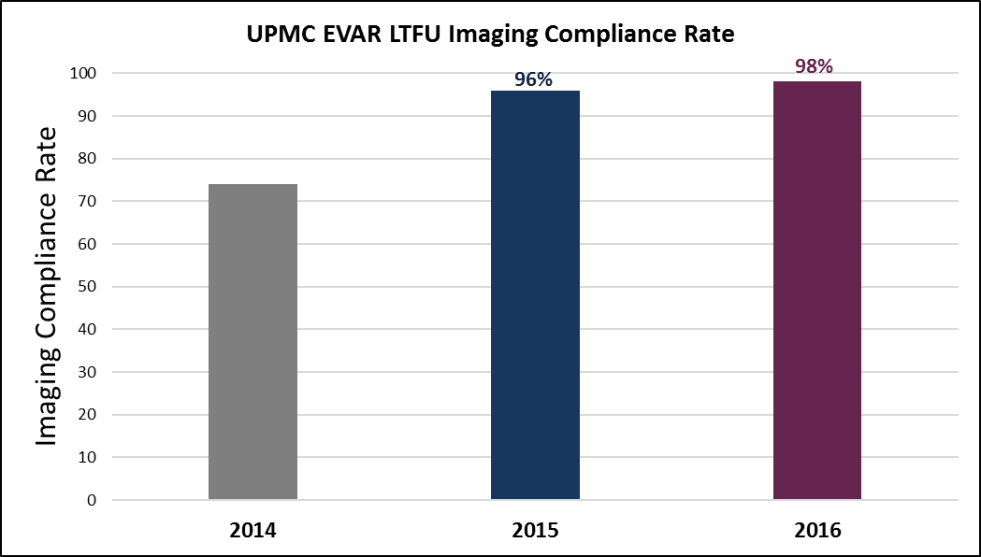
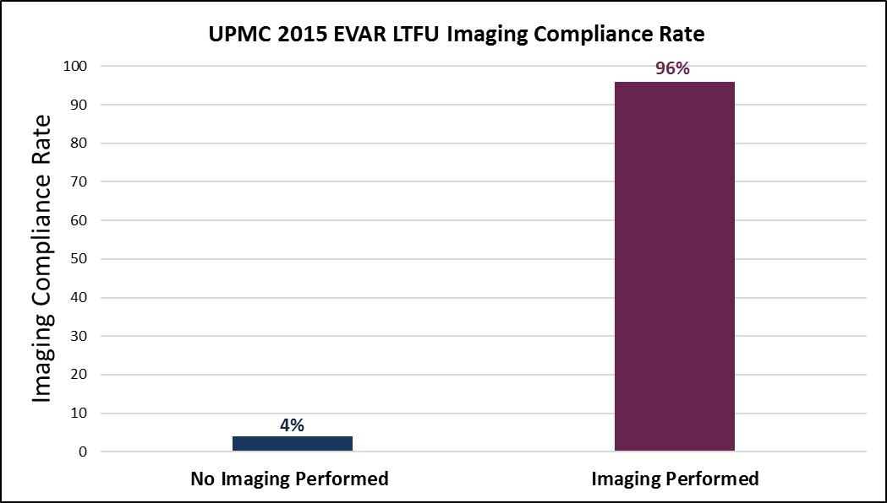
Results Continued

Slide 9
Challenges/ Lessons Learned
Migration of patients between healthcare systems within the city
Insurance market restrictions making follow-up costly for patients
Relocation of patients to other states or countries
Comorbidities of patients
Transportation and monetary conflicts

Slide 10
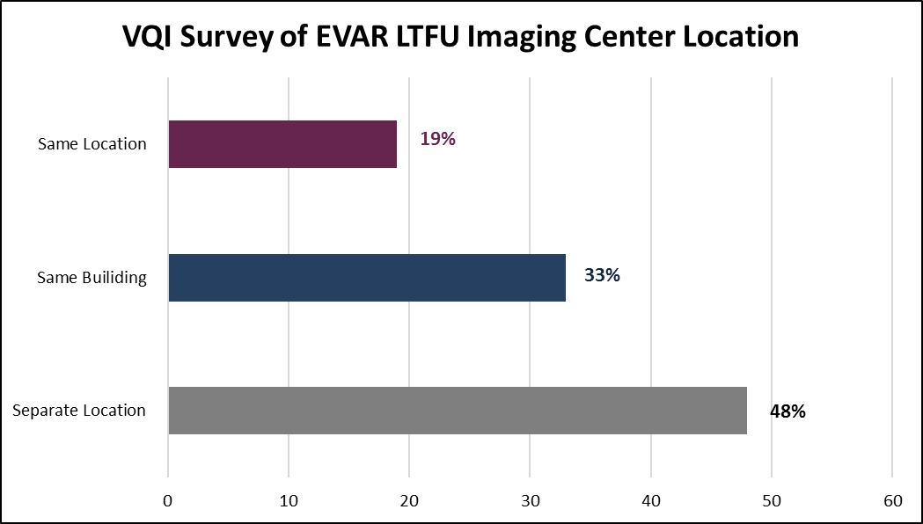
Results Continued

Slide 11
DMAIC Process
Define the problem, your goal, and or scope of the project
We defined our project: Improving EVAR Patient Compliance Utilizing VQI for Long Term Follow Up
Measure – Get baseline, compare to target
Our LTFU baseline measure was 74%, but our goal was 100%.
Analyze – Find the root cause (process map, fishbone)
We went through our processes to identify our problems.
Improve – Identify solutions and implement
We went through our processes to identify our problems. Our solution was the “Assembly Line Model”, which we implemented.
Control – Sustain/continue monitoring
Now we’re at the sustaining stage and working hard to maintain our goal.

Slide 12
Conclusions/ Success Factors
Design of Clinic
- Imaging performed during office visit before seeing a physician (19% of surveyed clinics have capability)
Proper allocation of personnel and resources
Aggressive patient education and re-education
Department culture instilled into patients:
- “Once you become an EVAR patient, you are a vascular patient for life”

Slide 13
Conclusions/ Success Factors
Assembly line model has:
- Produced 100% LTFU rate in 2015 (First year implemented)
- Increased EVAR patient imaging rate from 96% in 2015 to 98% in 2016
Increased work flow efficiency by quality team

Slide 14
Questions

