Slide 1
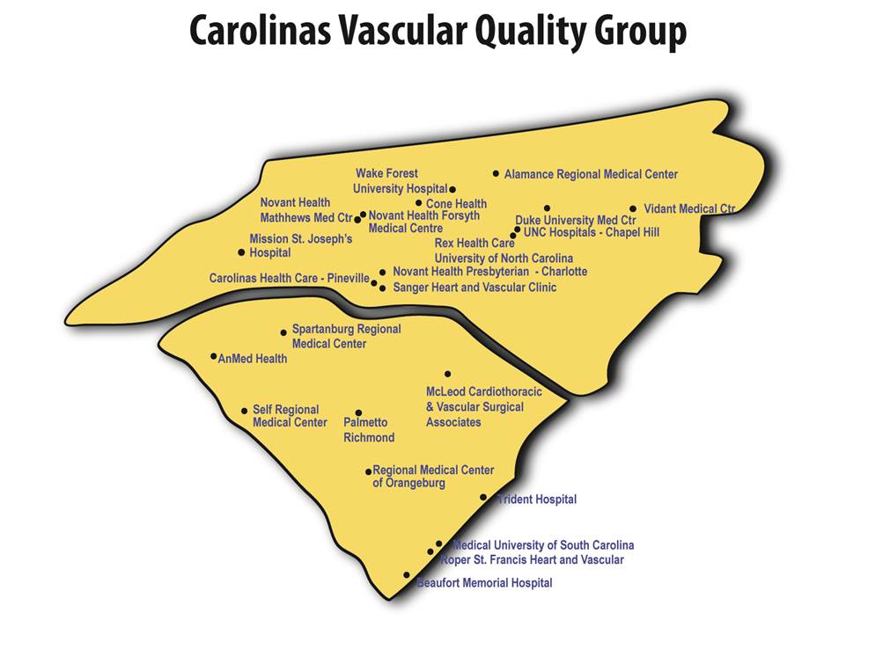
November 3, 2017
Roper St. Francis Hospital Charleston, SC

Slide 2
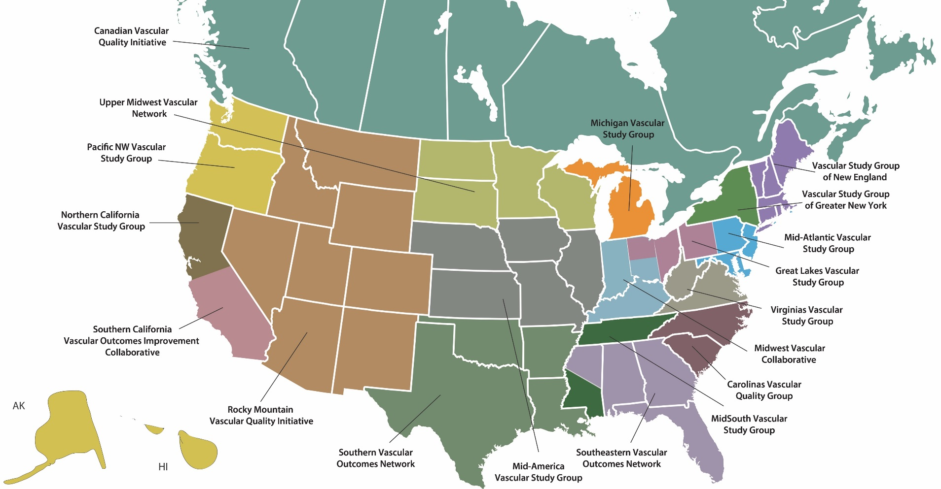
18 Regional Quality Groups

Slide 3
The VQI Mission—Our mission
Improving patient care….and outcomes
The VQI is designed to improve the quality, safety, and effectiveness and cost of vascular health care by collecting and exchanging information.

Slide 4
Agenda:
Welcome and Introduction Jeb Hallett, MD
Expanding Participation
Goals from Spring Meeting
National VQI Update Jens Jorgensen, MD
Regional Data Review Jeb Hallett, MD
Quality Improvement Project Discussion
Vascular Low Frequency Disease Consortium Peter Lawrence, MD
M2S:Medstreaming Update Wael Elseaidy, CEO
Next Meeting and Adjourn

Slide 5
Welcome and Introductions
AnMed Health
Beaufort Memorial Hospital
Carolinas HealthCare-Pineville
Carolinas HealthCare
Cone Health
Cone Health/Alamance Regional Medical Center
Duke University Medical Center
McLeod Regional Medical Center
Medical University of South Carolina
Mission Hospital
Novant Health Forsyth Medical Center
Novant Health Matthews Medical
Novant Health Presbyterian Medical
Palmetto Health Richland
Regional Medical Center- Orangeburg
Rex Healthcare
Roper St. Francis Healthcare
Self Regional Health
Spartanburg Regional
Trident Medical Center
University of North Carolina Hospitals
Vidant Medical Center
Wake Forest University Baptist Health Medical
WakeMed Health & Hospitals, Cary Campus
WakeMed Health & Hospitals, Raleigh Campus

Slide 6
https://www.vqi.org/components-of-the-vqi/regional-quality-groups/current-regional-quality-groups/home-2/
CQVSG Website:

Slide 7
Top Potential Members

Slide 8
To-do List for Us All From Spring 2017
Sustain our gains in statin/aspirin usage
Continue to hardwire one-year follow-up
Get EVARs back and sacs measured
Guide femoral puncture with ultrasound or fluoroscopy
Take a close look at your open AAA selection and performance

Slide 9
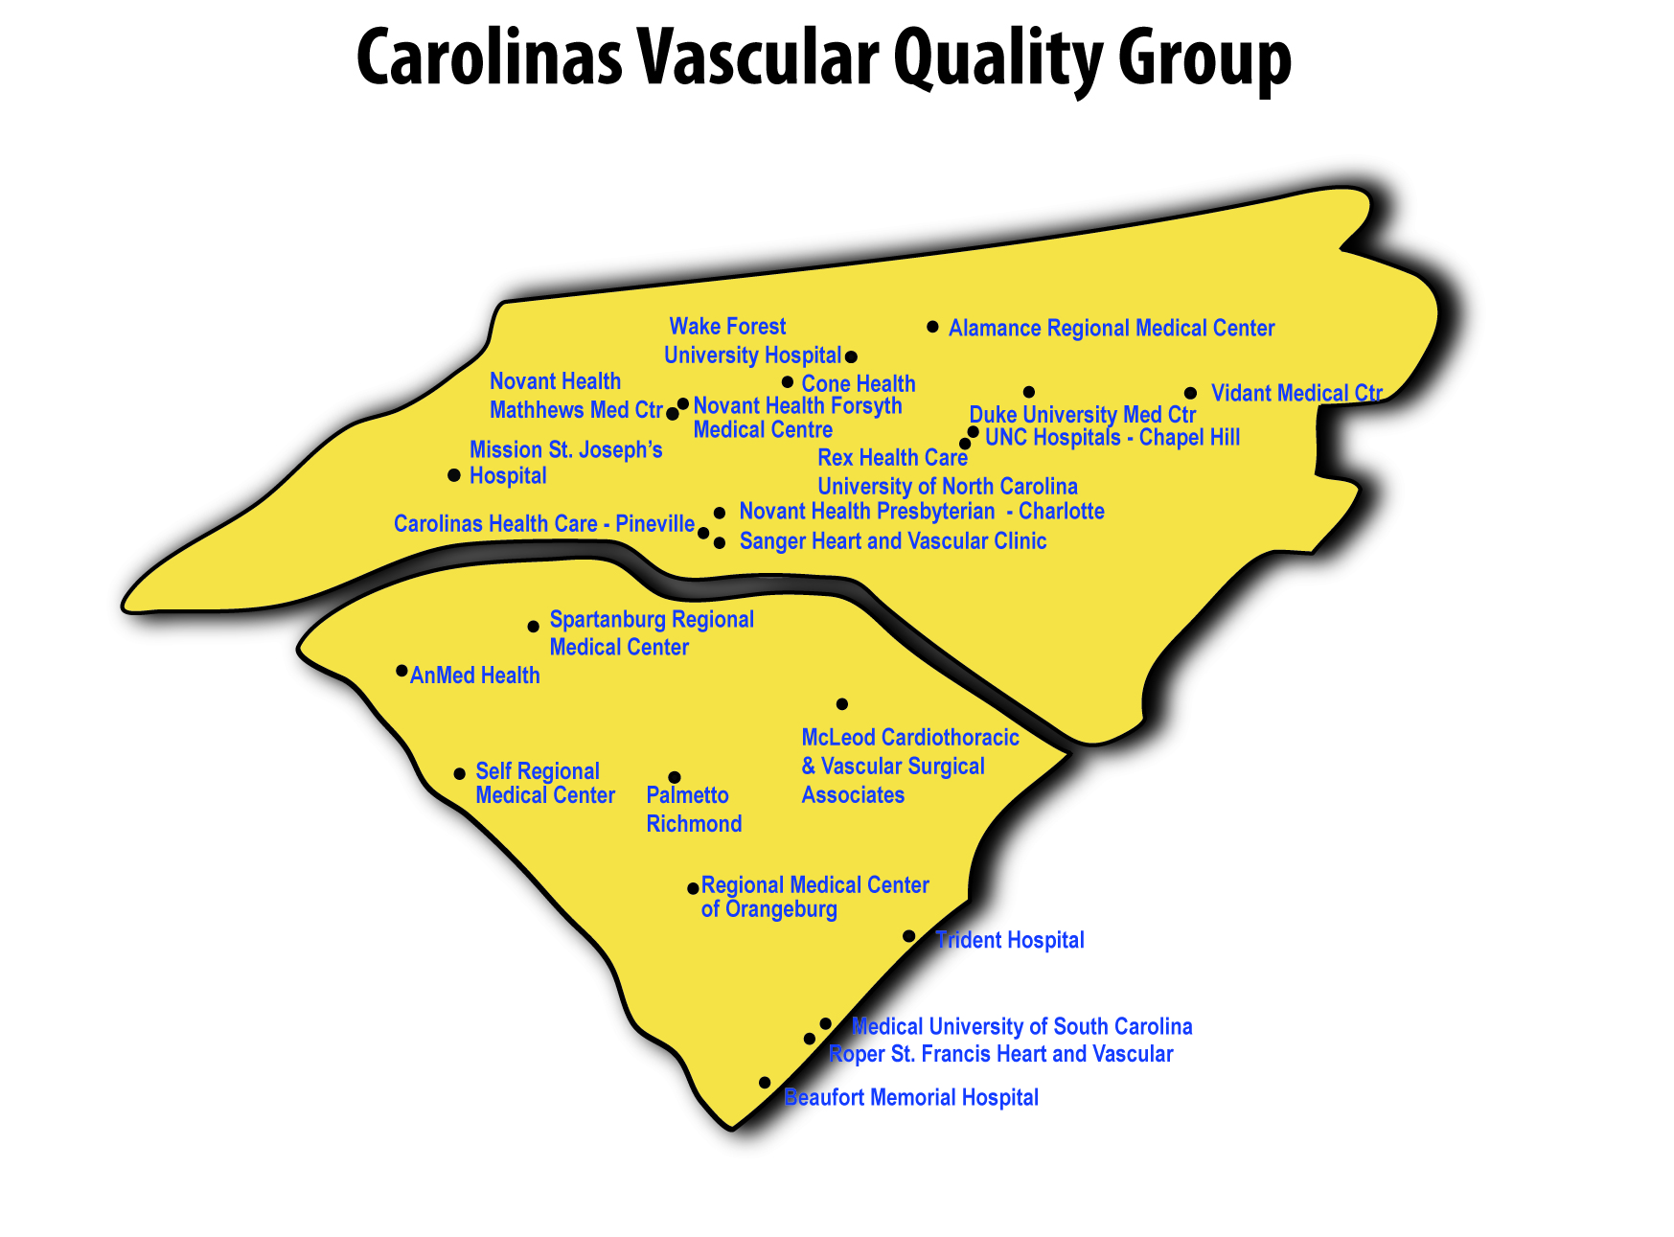
Playing every point in improving our care for our patients

Slide 10
Two National QI Project Resources
Discharge Medications (available at http://www.vascularqualityinitiative.org/vqi-resource-library/quality-improvement or the members only website)
Feb. 2017 webinar slides and transcripts (Randy DeMartino from Mayo and Cheryl Jackson from Central DuPage/Northwestern)
Posters (Gerard DuPrat/Catherine Bringedahl from Memorial Hospital South Bend, Yuming Lin from U of FL and Rosha Nodine from Baylor – winning poster)
Article highlighting poster winner – The Right Meds for the Right Outcomes in August 2017 Vascular Specialist.

Slide 11
Two National QI Projects
The SVS PSO is launching two national initiatives together with implementation tools aimed squarely at using data to improve patient care.
Prescribing anti-platelets and statins to appropriate patients to improve their long-term vascular health (discharge medications)
Increasing follow-up imaging rates at one year for endovascular aneurysm repair patients
The goal for both of these initiatives is 100% compliance. To support increased compliance, the PSO, working with the Arterial Quality Council and the Quality Improvement Workgroup, is developing implementation tools for members, issuing comparative reports and data on improvements over time.

Slide 12
Two National QI Project Resources
EVAR LTFU Imaging (available at http://www.vascularqualityinitiative.org/vqi-resource-library/quality-improvement or member only website)
April 2017 webinar slides and transcripts (Adam Beck from UAB and Salvatore Scali from U of FL)
Posters (Ali Arak/Fern Schwartz from UPMC and Nilima Lovekar and Olympia Christoforatos at Stonybrook)
Transcripts and slides from June 2017 VQI@VAM panel session: Increasing Follow-up Imaging Rates at 1 Year for EVAR Patients – moderated by Adam Beck and Salvatore Scali and panelists: Julie Beckstrom (U of Utah) Karen Heany (Sharp) Carlos Moreno (Stanford) and Megan Pepin (Ohio State)
Physician reports on EVAR LTFU: After Aug. 2, 2017

Slide 13
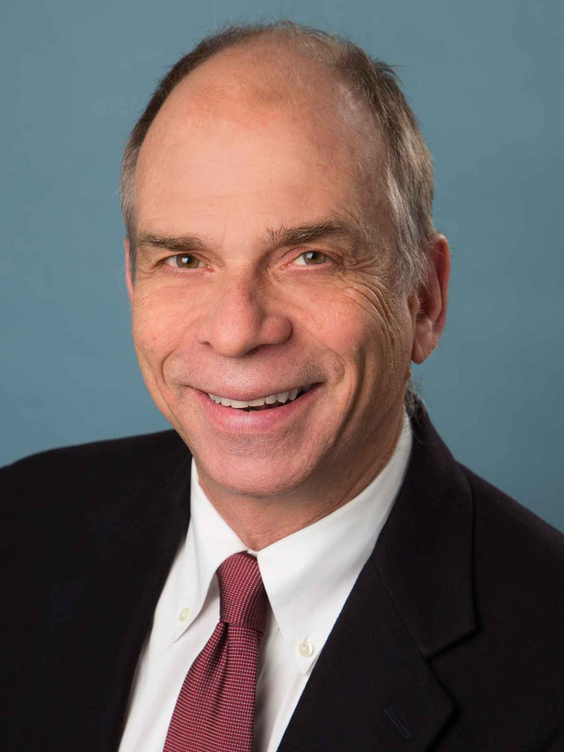
National VQI Update: Jens Jorgensen, SVS PSO

Slide 14
Jeb Hallett, MD, Chair of Carolinas VQI
Regional Reports:
Notes:
1) In all reports, regional data are not shown for regions with <3 centers participating in the applicable registry.
2) In “by Center” bar charts, unless noted, data are not shown for centers with <10 cases.
3) In all graphics, “*" indicates a p-value<.05.
4) This report includes all data that had been entered into the VQI as of May 2017.

Slide 15
November 3, 2017
Roper St. Francis Hospital Charleston, SC

Slide 16
To-do List for Us All From Spring 2017
Sustain our gains in statin/aspirin usage
Continue to hardwire one-year follow-up
Get EVARs back and sacs measured
Guide femoral puncture with ultrasound or fluoroscopy
Take a close look at your open AAA selection and performance

Slide 17
New Dashboard!!!!

Slide 18
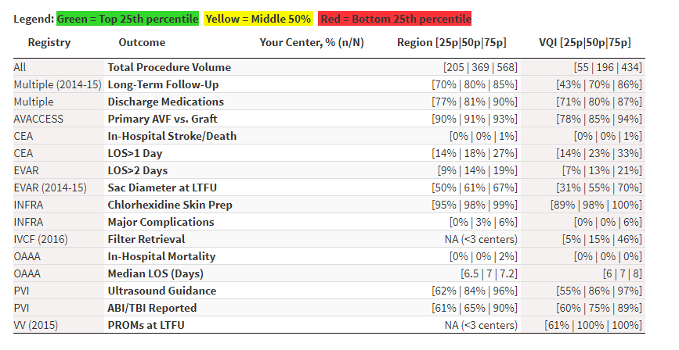

Slide 19
Total Procedure Volume, All Years (2003-May 2017)
29874

Slide 20
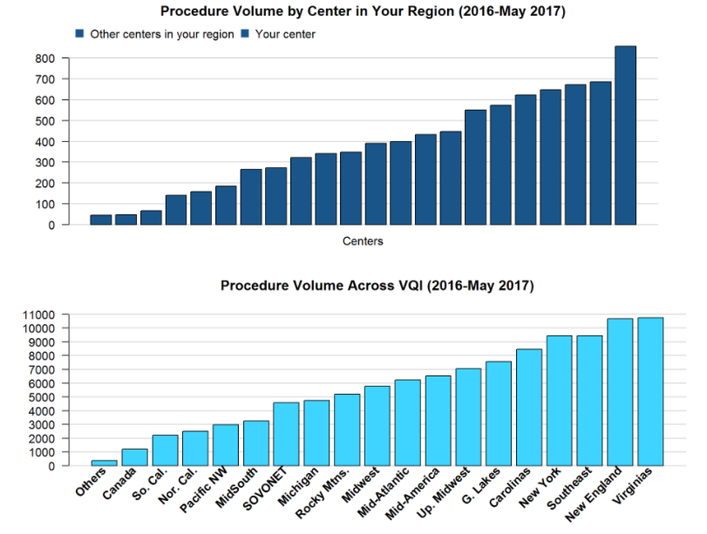

Slide 21
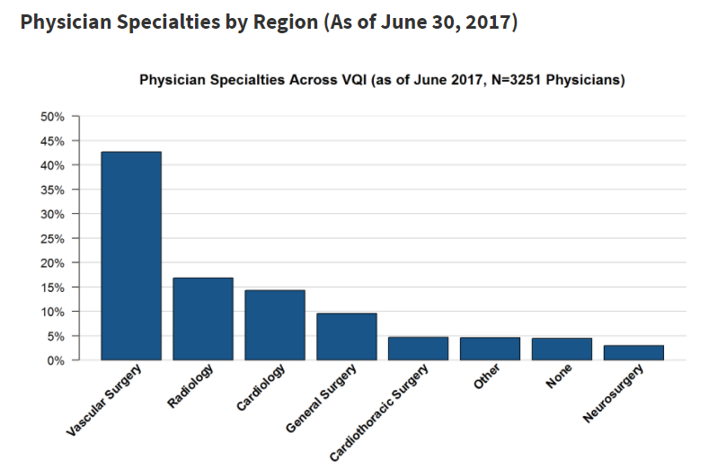
Truly Multispecialty Initiative

Slide 22
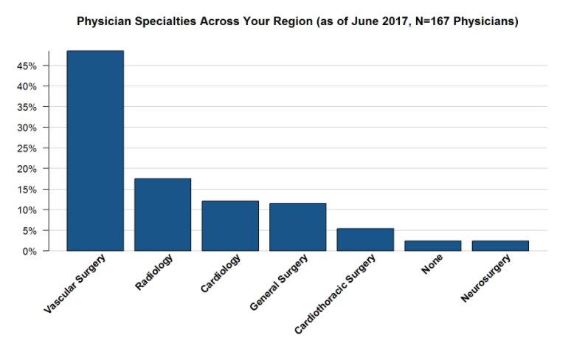
50%
Vascular Surgery Leads
In the Carolinas

Slide 23
Percentage of Procedures With 9 Months or Greater Follow-Up (Jan. 1, 2014-June 30, 2015)
Our goal is still >80%

Slide 24
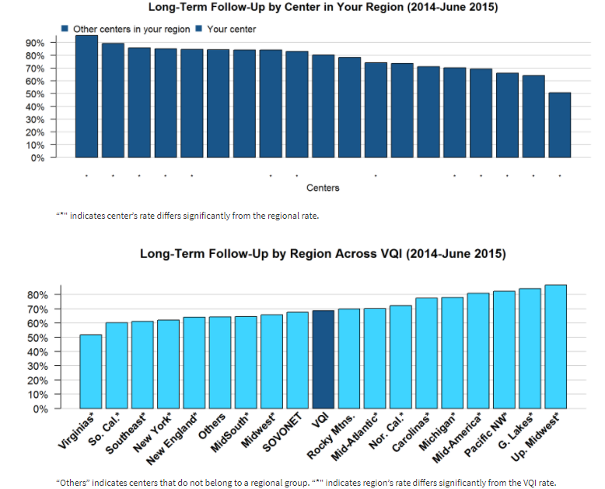
Great progress!!!

Slide 25
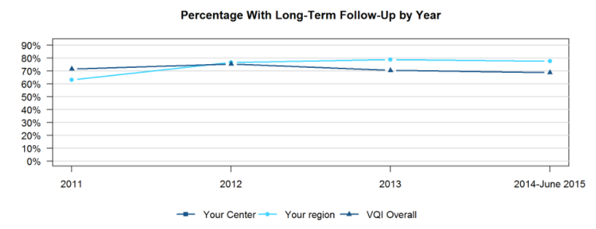
Carolinas breaking away!

Slide 26
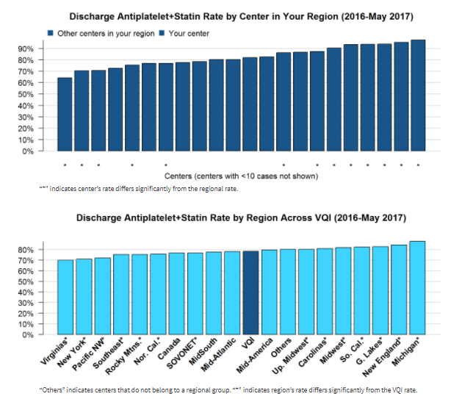
Discharge Medications (Jan. 1, 2016-May 31, 2017)
Excludes patients who died in hospital and patients who were not treated for medical reason or non-compliant
How can we do better???
* Note: “Discharge Medications” color codes green/red – colors reversed on Regional Reports.

Slide 27
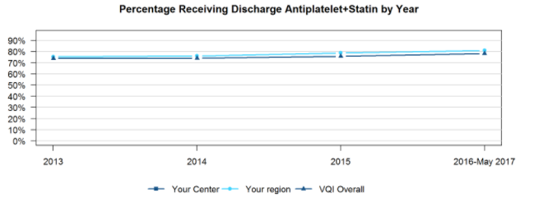
Everyone looks staled. Why?

Slide 28
Hemodialysis Access: Percentage of Primary AVF vs. Graft (Jan. 1, 2016-May 31, 2017) Excludes patients with previous access procedure in the same arm
91%
84%

Slide 29
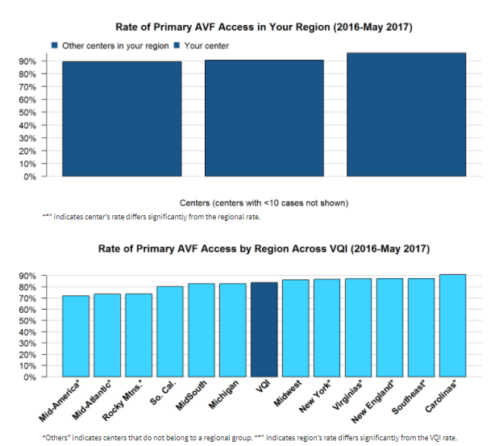
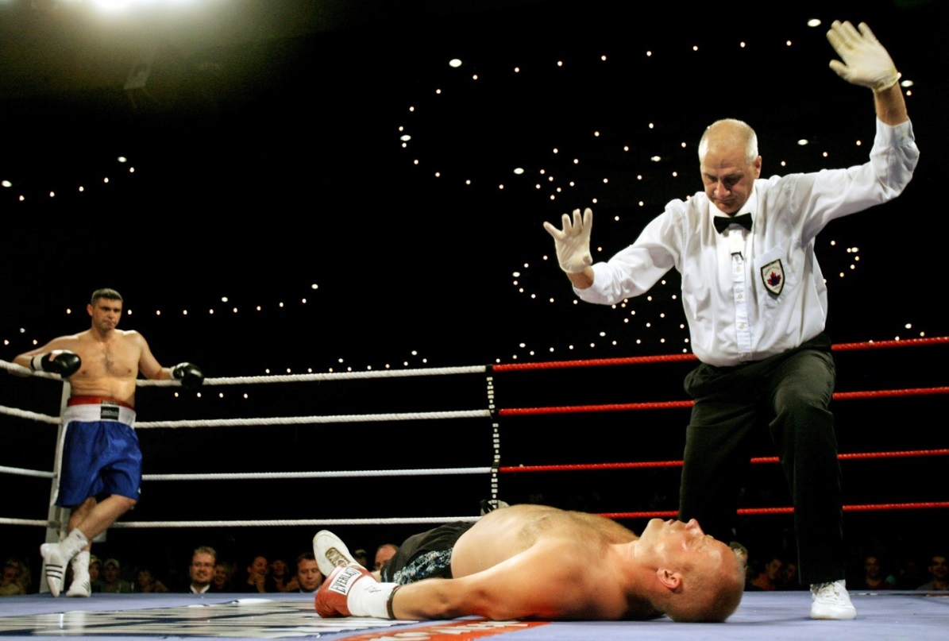

Slide 30
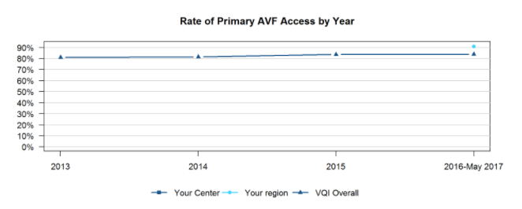
Rate of Primary AV Access by Year
Let’s stay in the lead!

Slide 31
Carotid Endarterectomy: Stroke or Death in Hospital (Jan. 1, 2016-May 31, 2017) Elective procedures, excluding prior ipsilateral CEA and concomitant CABG, endovascular or other arterial procedure
0.8%

Slide 32
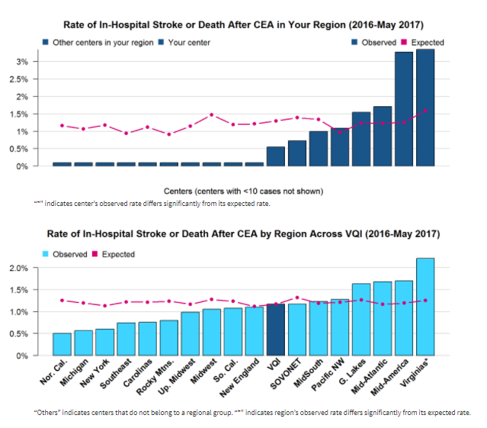

Slide 33
Results of the 4 Questions for the Membership from our May meeting…..
CEA

Slide 34
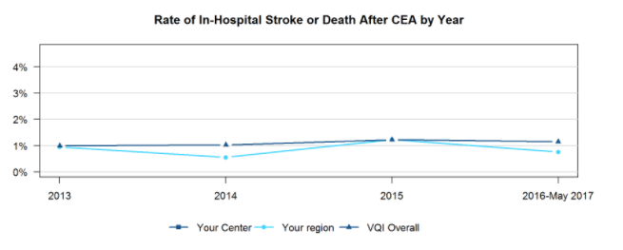
CEA is very safe nationwide

Slide 35
Carotid Endarterectomy: Percentage of Patients with LOS>1 Day (Jan. 1, 2016-May 31, 2017) Elective procedures, excluding prior ipsilateral CEA, concomitant CABG, proximal endovascular or other arterial operation, in-hospital death with LOS<=1 day, procedures done on weekends or not done on admission day.
About 25% still stay longer
than one day postop!

Slide 36
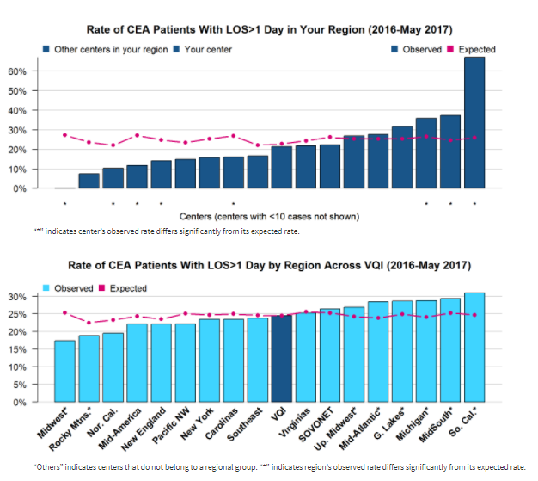
Look closely

Slide 37
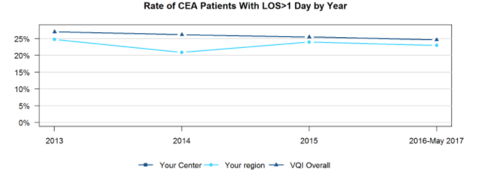
Rate of CEA Patients with LOS > I day
Can we do better?? If not, why not?

Slide 38
Endovascular AAA Repair: Percentage of Patients with LOS>2 Days (Jan. 1, 2016-May 31, 2017) Excludes ruptured aneurysms and in-hospital deaths with LOS<=2 days, patients with prior aortic surgery, procedures not done on day of admission and weekend procedures
15% looks reasonable

Slide 39
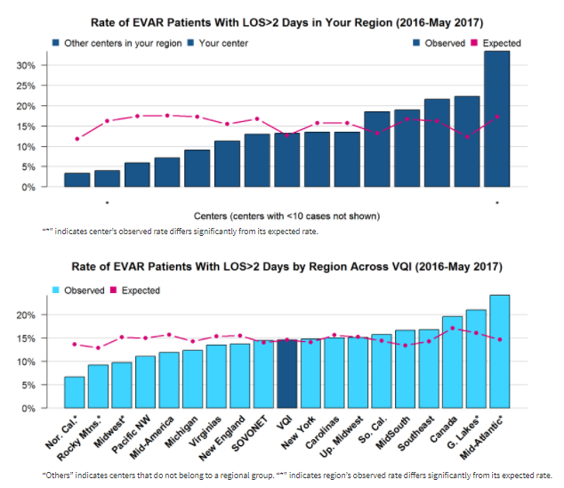

Slide 40
Results of the 4 Questions for the Membership from our May meeting….. Endo AAA

Slide 41
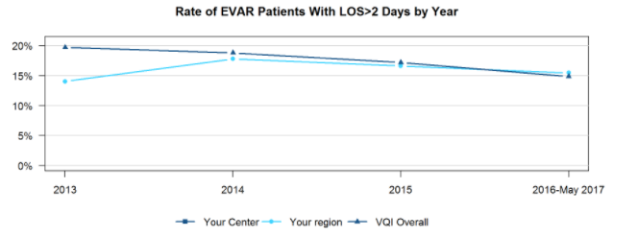
Rate of EVAR with LOS > 2 days
QI Methodology says “look at all
the steps” that can be improved

Slide 42
EVAR: Rate of Sac Diameter Reporting at Long-Term Follow-Up (Jan. 1, 2014-June 30, 2015) percentage of those cases in which the patient had a follow-up visit between 9 and 21 months post-surgery at which a sac diameter was recorded
Why are only 57% of EVAR getting AAA sac
diameter measured at follow-up?
Notes:
We used to exclude Lost to follow up; we include them now in the denominator

Slide 43
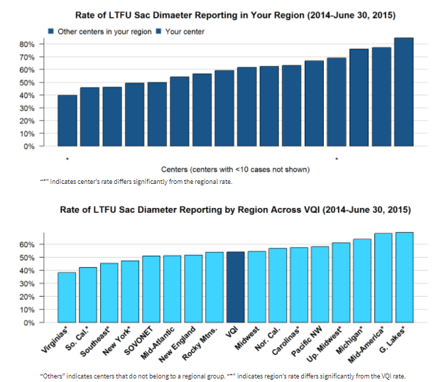
Could we set a goal of 70% ?

Slide 44
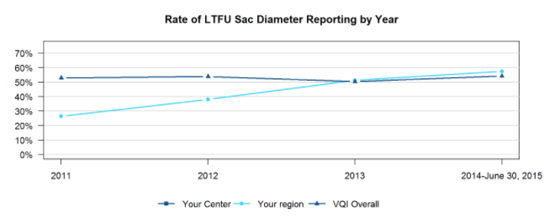
Rate of Sac Diameter at Followup
Let’s keep the pace!!!

Slide 45
Infrainguinal Bypass: Percentage of Procedures with Chlorhexidine or Chlorhexidine+Alcohol Skin Prep (Jan. 1, 2016-May 31, 2017)
In VQI patients, chlorhexidine and chlorhexidine+alcohol skin preps have been shown to reduce the surgical-site infection rate by 50% compared to iodine-based skin prep. Chlorhexdine+iodine and chlorhexidine+iodine+alcohol skin preps have not been shown to reduce the infection rate, but rates of their use are also reported in the table below.
3%
Notes:
Added use of all three just in the table not the graph; graph is still just rate of Chlorhexidine and Chlorhexidine with alcohol

Slide 46
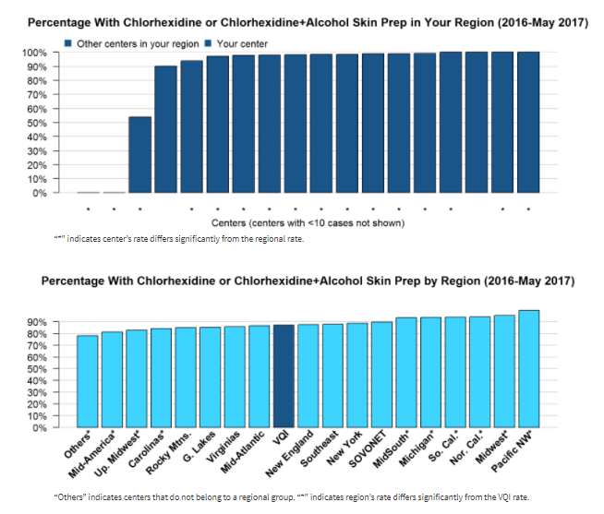
Are we stuck here?
Is it risky behavior?

Slide 47
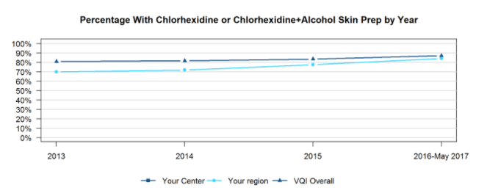
% with chlorhexidine or CH+alcohol Prep
Trending upward!

Slide 48
Infrainguinal Bypass: Rate of Major Complications (Jan. 1, 2016-May 31, 2017) Includes only patients with indication of rest pain or tissue loss. Major complications are defined as in-hospital death, ipsilateral BK or AK amputation or graft occlusion. percentage of those cases that resulted in in-hospital death, ipsilateral amputation or graft occlusion
3.6%

Slide 49
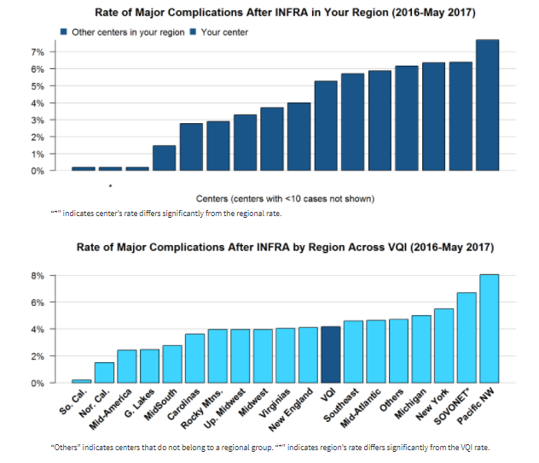

Slide 50
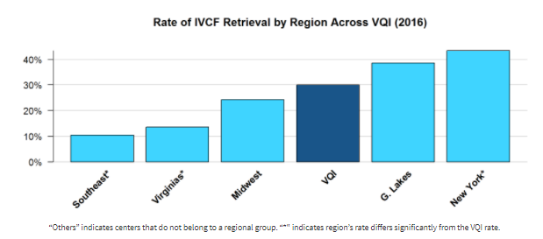
IVCF: Percentage of Temporary Filters With Retrieval or Attempt at Retrieval (2016) Excludes patients with permanent filters and patients who have died since discharge Carolina’s VSG did not have at least 3 centers with 10 procedures)
40%

Slide 51
Non-Ruptured Open AAA: In-Hospital Mortality (Jan. 1, 2016-May 31, 2017) Excludes ruptured aneurysms observed and expected rates of in-hospital death for those cases
5.7%
Suprarenal proximal clamp
10.7%
Notes:
Removed all exclusions of prior and concomitant procedures to increase the “N”

Slide 52
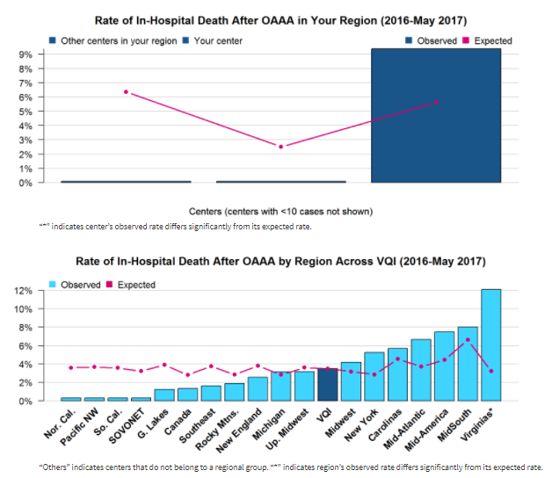
Ten or more open AAA repairs

Slide 53
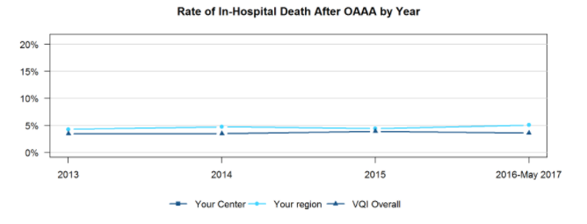
Rate of In-hospital Death after Open AAA Repair
Is 5% where we are stuck?

Slide 54
7 Days

Slide 55
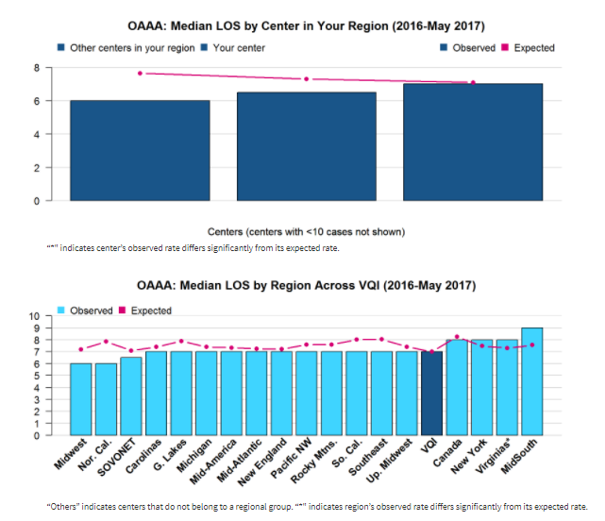

Slide 56
PVI: Percentage of Claudicants With ABI or TBI Reported Before Procedure (Jan. 1, 2016-May 31, 2017)
“ABI or TBI reported” indicates at least one measure was recorded for the side of the operation, or on both sides for bilateral and aortic procedures.
73%
Notes:
Only reporting on Claudicant patients now

Slide 57
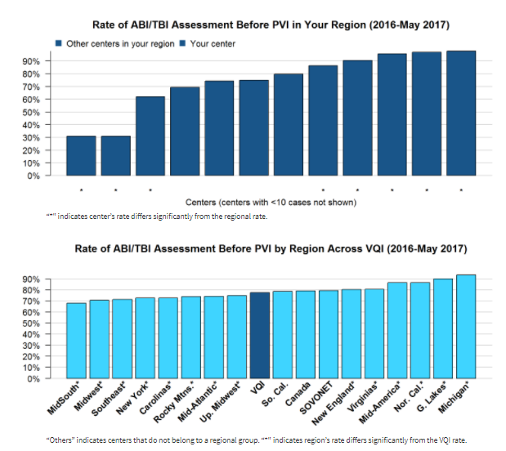
Are you not doing or
not recording?

Slide 58
PVI: Percentage of Percutaneous Femoral Procedures
Using Ultrasound Guidance (Jan. 1, 2016-May 31, 2017)
Excludes cut-down access guidance
72%
Rate of any hematoma: 2.1%
Notes:
Added closure devices

Slide 59
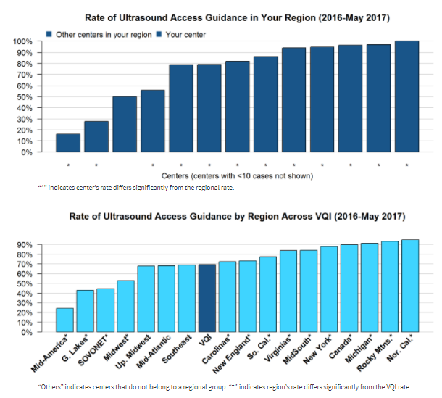
Can we all strive for >70%?

Slide 60
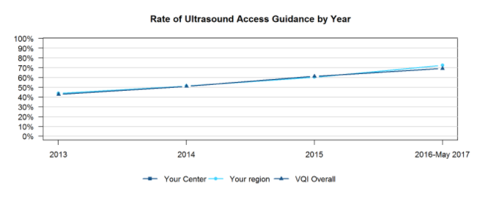
Keep up the pace!!!

Slide 61
Results of the 4 Questions for the Membership from our May meeting…..
Lower Extremity Bypass (Infra and Supra Inguinal)

Slide 62
To-do List for Us for Spring 2018
Statin/aspirin usage @ 90%
One-year follow-up > 80%
EVAR FU and sacs measured @ 70%
Ultrasound guidance for femoral puncture @ 70%
Take a close look at your open AAA selection and performance

Slide 63
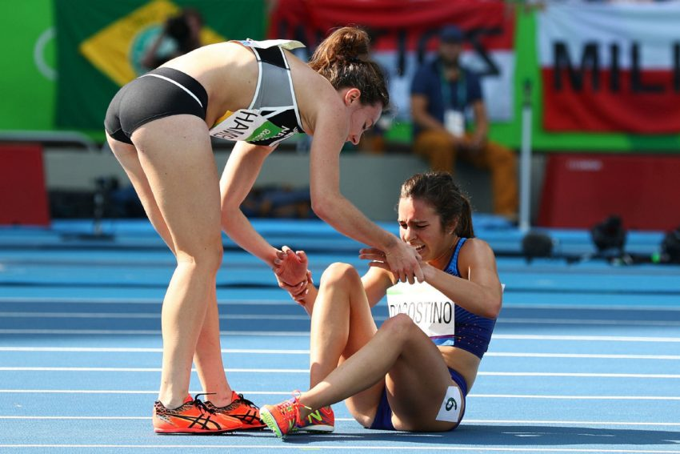
Help to lift up one another for 2018

Slide 64
Quality Improvement Projects
Thomas Brothers, MD, MUSC
Kate McGinigle, MD, UNC
Lorri Bennett, RN, MSN, Roper

Slide 65
Research Advisory Council Update Thomas Brothers, MD

Slide 66
National Research Process
Check Approved Project List:
http://www.vascularqualityinitiative.org/wp-content/uploads/VQI_Approved_Projects_List-6.22.17-for-Publish.pdf
To submit a proposal to be considered for the National RAC, please follow the link below: http://abstracts123.com/svs1/meetinglogin

Slide 67
National Research Process
Proposal Submissions
December 2017
Call for Proposals: October 11, 2017
Due Date: November 20, 2017
Meeting: December 11, 2017
Notifications Sent: December 12, 2017

Slide 68
Regional Research Projects:
Any new ideas?

Slide 69
Governing Council Update Jeb Hallett, MD

Slide 70
Peter Lawrence, MD, FACS
Professor and Chair of Vascular Surgery, UCLA
Co-Editor, Journal of Vascular Surgery

Slide 71
M2s/Medstreaming Update Anne Parker, M2S Wael Elseaidy, CEO, Medstreaming

Slide 72
To-do List for Us for Spring 2018
Statin/aspirin usage @ 90%
One-year follow-up > 80%
EVAR FU and sacs measured @ 70%
Ultrasound guidance for femoral puncture @ 70%
Take a close look at your open AAA selection and performance
PARTICIPATE IN THE

Slide 73
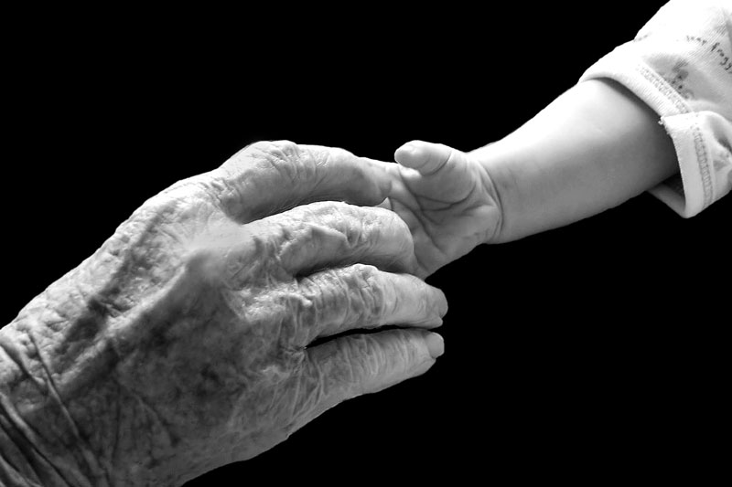
Passing the torch…..

Slide 74
Next Meeting
Grove Park Inn
Friday, May 4, 2018

Slide 75
Thanks for attending!!
Safe Travels and
Happy Holidays

