Slide 1
Members’ Only Introduction
Nancy Heatley
VQI Website Support

Slide 2
Members’ Only – Sharing QI
The purpose is to encourage members to share quality improvement and best practice information more easily between and within Regional Quality Groups.
Members’ Only is password-protected and searchable – responsive to members’ areas of interest
A National Shared Area and Regional Shared Area have been set up to capture QI developments on a rolling basis
Members’ Forums are set up by registry and other quality topics, such as LTFU.
No PPI data are used or referenced in the Members Only area, and PPI data must be kept with M2S PATHWAYS.

Slide 3
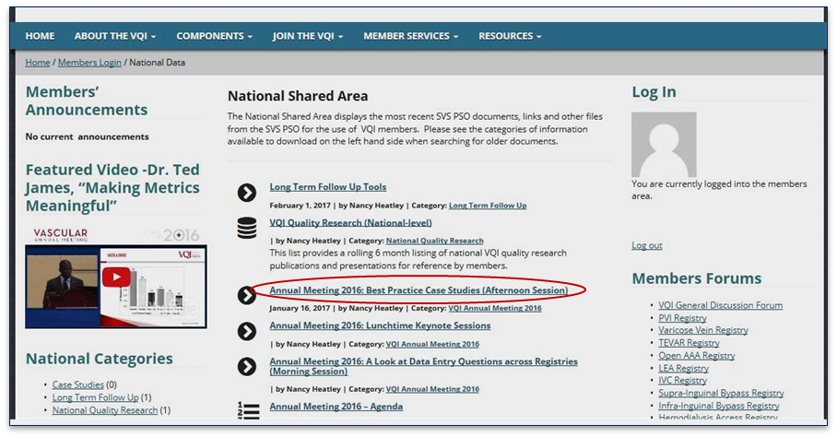
National Shared Area Detail
National content includes VQI Annual Meeting presentations, National QI Initiative content, case studies, LTFU and the QI Project Guide.

Slide 4
Structure of National Shared Area
Within the National Shared Area, you can drill down to see presentations, video or other documents. In the example below, the videos and presentation are shown from last year’s Annual Meeting.

Slide 5
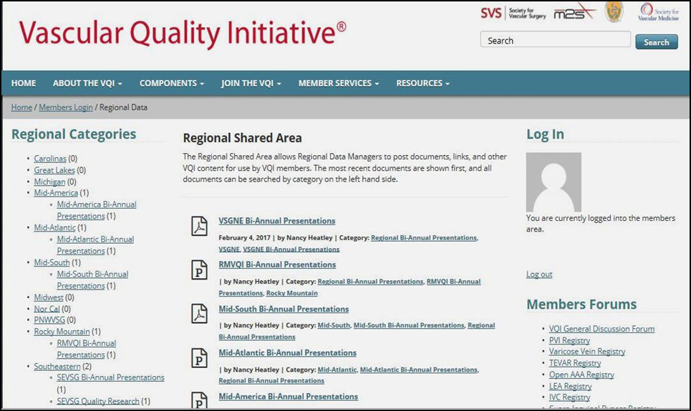
Regional Shared Area
The Regional Shared Area can include regional case studies, regional group presentations, and regional quality research

Slide 6
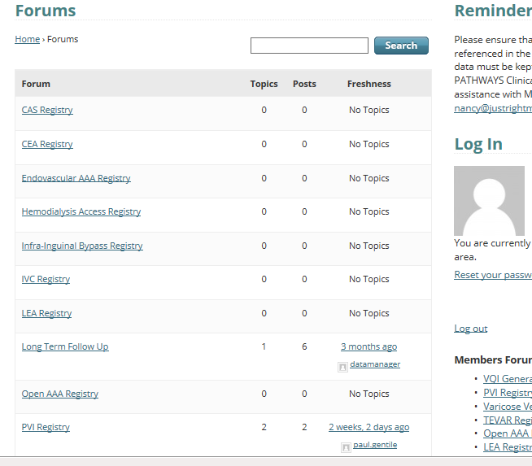
Includes Members’ Discussion Forums
Topics are searchable , set up by registry and other QI topics

Slide 7
Just a Starting Point…
There is great flexibility to Members’ Only, so this is a starting point
Forums and sub-forums can be added depending on the complexity of the subject
The SVS PSO will administer Members Only for consistency
Initial feedback from Regional Data Managers has been positive

