Slide 1
VQI and Quality Improvement: Our local experience
Naomi Eisenberg, PT, M.Ed, CCRP
Vascular Database Manager
Toronto General Hospital
31 May 2017

Slide 2
Conflict of Interest
None

Slide 3
Objectives
Who is TGH?
How we’ve used VQI for local QI
Examples of projects using different sources
Challenges/Lessons learned

Slide 4
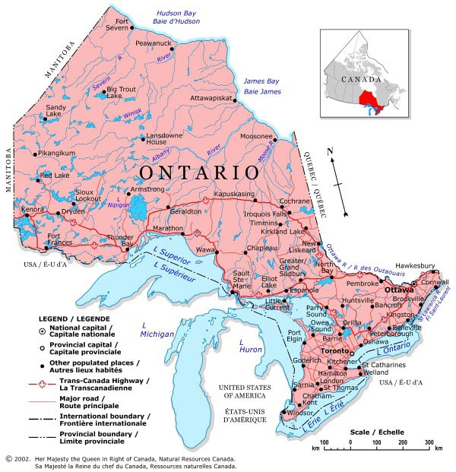
Who are we, anyway?

Slide 5
Vascular Surgery at Toronto General (University Health Network)
Department of Surgery
Peter Munk Cardiac Centre
Fully affiliated with University of Toronto Faculty of Medicine
8 Vascular Surgeons (4.4 FTE)
Quaternary care centre

Slide 6
Vascular Surgery at Toronto General (University Health Network)
Joined VQI in August 2010
Modules:
CEA
EVAR
Infra inguinal bypass
Open AAA
PVI
Supra
TEVAR

Slide 7
Challenges: Initial
Ethics approval
Anonymized data (federal/provincial law)
Creation of a system to de/anonymize data
Daily/Weekly notification for VQI numbers
Communication with clinical admin staff
No 3% reimbursement

Slide 8
Vascular Surgery at Toronto General (University Health Network)
> 2150 patients in May 2017
> 2600 cases
Follow up rate of > 90% consistently over our participation

Slide 9
Departmental Quality Initiatives
Improving risk factor modification (ongoing)
LOS following EVAR
Iodinated contrast
PVI outcomes (day)
Wound infection rates
EVAR > 80 yrs
Presentations at National Conferences

Slide 10
Departmental Quality Initiatives
Monthly Quality Rounds
COPI reviews
Discussion during teaching
Every trainee required to develop and complete a quality project

Slide 11
Hospital-wide Quality
VQI quality data presented to the research subcommittee of the Board of Trustees
VQI recognized as the prime example of using an international database to inform an understanding of the quality of care that we provide
Barry Rubin, MD, PhD
Medical Director, PMCC

Slide 12
Sources of Data
VQI COPI (Centre Opportunity for Improvement)
Analytics and Reporting Engine (Tab)
Data Download (Tools)
The question will determine the source

Slide 13
Project 1: EVAR LOS

Slide 14
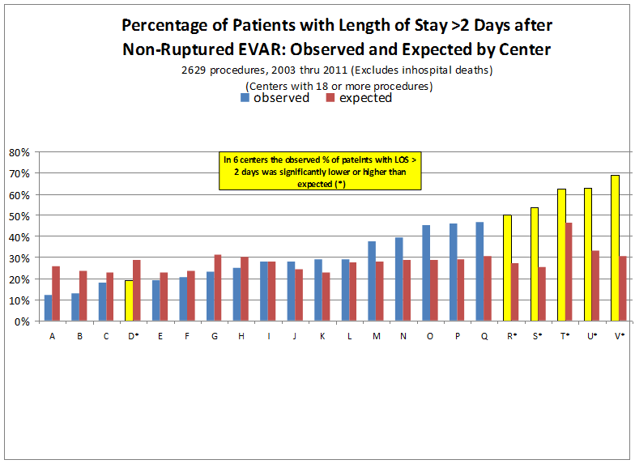
Project 1: EVAR LOS – early days
Notes:
In the days before COPI reports and analytics engine
Needed to do something
Chart reviews -- manual

Slide 15
Project 1: EVAR LOS
2013
Reviewed elective infrarenal EVAR to examine LOS issues (N = 113)
59% LOS > 2 days
Univariate factors: CV, wound, urology (retention)
Multivariate: CV, wound
Instituted
Patient/staff education re LOS expectations
Changes in surgical/anaesthesia/allied health culture

Slide 16
Project 1: EVAR LOS
2011 – 2012: EVAR LOS extends beyond VQI benchmark at UHN
**
*
OBSERVED > RISK-ADJUSTED EXPECTED LOS
** significantly higher than expected values
* significantly lower than expected values
Notes:
Chart reviews beyond the VQI variables
Delirium
Urinary retention
No fixed dc plan
Simple interventions within team
Fewer Foley catheters
Managing patient expectations

Slide 17
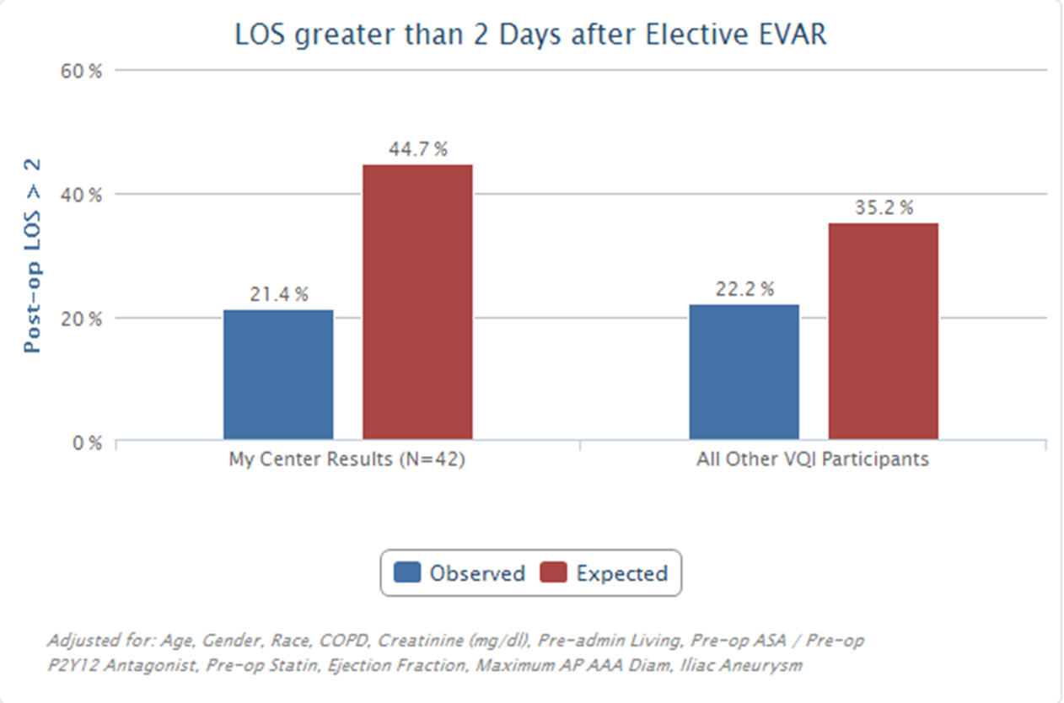
Project 1: EVAR LOS
2013: reversal of extended LOS- 6 months after intervention
**
OBSERVED LOS << RISK-ADJUSTED EXPECTED LOS
**Significantly lower than expected values
Notes:
Dramatic reversal in 6 months

Slide 18
2016 -- 2017: Still maintaining lower than expected LOS
New questions:
Have we saved $$?
What can analysis of patients with a markedly extended LOS (> =6 days) tell us?
Observed values (both groups) significantly lower than expected
Notes:
As part of the pdsa cycle
Clarify dates of analysis

Slide 19
Project 1: EVAR LOS

Slide 20
Conclusions
VQI allows for in-depth analysis in real-time and can act as a springboard other analyses
Sustained change in practice led to sustained benefit over time (6.6% decreased cost, ↓ LOS)
Some patients continued to stay longer
Should they have surgery?
Important data for Canadian surgeons/centres

Slide 21
Project 2: Use of iodinated contrast in EVAR
Radiologists/surgeons asked the question
Used the analytics engine
Full strength contrast changed to diluted, with no change in image quality
Change in practice has been maintained.

Slide 22
Pre 2014

Slide 23
2014 to date

Slide 24
Project 3: PVI Outcomes
Summer student project utilizing Analytics Engine/Data Download
Objectives:
Assess patient profiles
Assess technical outcomes (1 year)

Slide 25
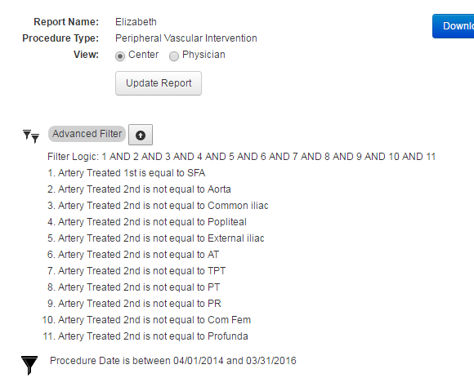
Project 3: PVI Outcomes
Retrospective review (2 years’ worth of data)
Analytics engine with advanced filters for baseline
Notes:
We talked to pathways support to work out what we hoped would be an easy solution
Question too detailed, so…

Slide 26
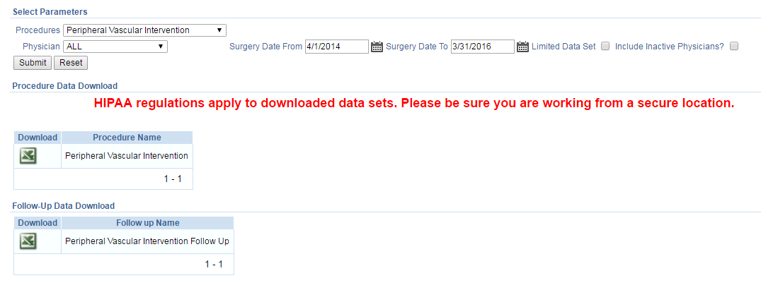
Project 3: PVI Outcomes
Data download for raw data analysis

Slide 27
Project 3: PVI Outcomes

Slide 28
Project 3: PVI Outcomes

Slide 29
Project 3: PVI Outcomes
TASC A/B did better than C/D
Females had lower primary patency than males
CIA/SFA: TASC, female gender and previous major amputation were predictors of worse patency
SFA group: longer fluoro time predicted worse outcome (marker of lesion complexity)
Iliacs: smoking = worse outcome
EIA: Younger age = worse outcome

Slide 30
Project 3 – Poster Presentation

Slide 31
Lessons Learned 1: Tips for Data Managers
Organization is key
Liaise with physician champion regularly
Liaise with physicians’ admin staff regularly
Keep them up-to-date
Know your own data
Ask questions
Keep learning
Rounds, journal clubs, conferences
Aim for low-hanging fruit!
Notes:
Liaise by whatever means necessary.

Slide 32
Lessons Learned 2:
Ongoing
Follow up system
Pulling anonymized data at 10 months, re-identifying for physician offices
Self-paying
Competitive databases*
NSQIP
Prov. Gov’t (MOHLTC)
Audits manually done
No ability to autopopulate
Notes:
Prov db – no f/u
NSQIP 30 days only

Slide 33
Follow up Management
10 months post op procedure
Forms pulled and patients re-identified
E-chart reviewed; date of appointment attached or due date indicated
Forms returned to offices to arrange f/u
Data entered into VQI
“overdue” list distributed to surgeon/admin assist
**monthly
Notes:
November – pulled january

Slide 34
Lessons Learned 3:
Engage your Data Managers
My role
More than data entry
QI training project led to change in role of EVAR coordinator
CCRP certification
Publications
Recognized team leader
The more engagement, the more what we do will matter to us, and you!

Slide 35
Success: The CVQI
CVQI: (May 2017)
Covenant Health, Edmonton, AB,
Thunder Bay HSC, Thunder Bay, ON
Toronto General & St. Michael’s Hospitals, Toronto, ON
CISSS de Gatineau, Gatineau, QC
Halifax Infirmary, Halifax NS
Notes:
Geography challenge

Slide 36
“My surgeons”

Slide 37
Questions and Thank You!

