Slide 1
Physician Dashboards
Susan Curtis, RN
Program Manager
Maine Medical Center

Slide 2
Agenda
Need for Dashboards
Type of Dashboards used at MMC
How the dashboards are created
How the dashboard are disseminated and used
Has the information in the Dashboards lead to any specific QI projects?
Are the Dashboards used to monitor progress of ongoing QI projects?
Tips and lessons learned

Slide 3
Audience Participation
Do you currently generate Dashboards using VQI Data?
a) Yes
b) No

Slide 4
Audience Participation
If you do not currently generate Dashboards using VQI data, what are the barriers:
a) Resources
b) Difficult to get data out of Pathways
c) No one has asked

Slide 5
Need For Dashboards
Identify Opportunities for Improvement
QA tool to support QI initiatives
Patient Safety
Peer Review/Peer Support
Accountability
Allows providers ability to compare outcomes to peers, center, regional and national benchmarks

Slide 6
Types of Dashboards
Monthly Volume Tracking and Trending
Best Practices
Length of Stay
SSI Prevention Bundle

Slide 7
How the Dashboards Were Created
2003 - 2010
Forms completed manually by nurse reviewers
Data entered into MS Access database
VSGNE Reporting –
Following cleaning and updating, Dartmouth-Hitchcock returns data to MMC for local reporting using local “working database” for report development
MS Access exports sent to regional database at Dartmouth-Hitchcock using “VSGNE Shuttle” SQL Query

Slide 8
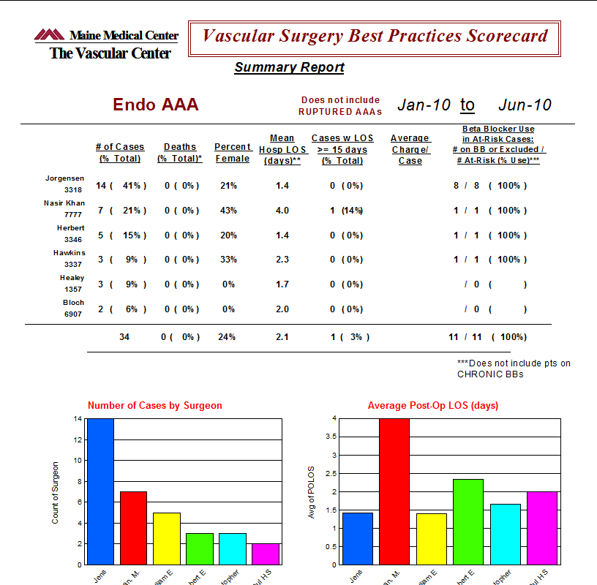
How the Dashboards Were Created
2003 - 2010
VSGNE Reporting
Crystal reports created from MS Access database by date range and surgeon for post-op outcomes and complications. Benchmark comparisons were made to local surgeon group:
Significant problems with “data type mismatch” and syntax errors

Slide 9
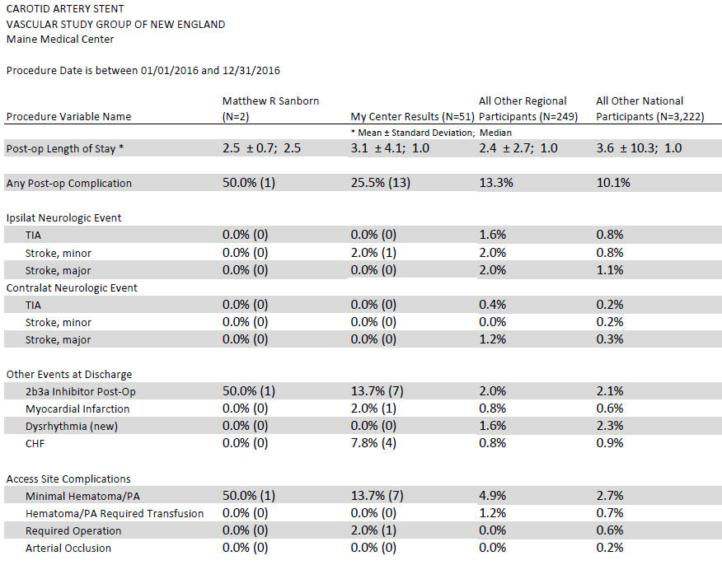
How the Dashboards Were Created
2011 - 2017
Data available online
Local, regional and national benchmarks
Requires customizing for user friendly appearance

Slide 10
How Dashboards Are Shared
Monthly Vascular QI/QA meeting
Office Provider meeting
Cardiovascular Service Line meeting
Annual Vascular Center Report

Slide 11
Audience Participation
Have the physicians at your organization “signed off” on having un-blinded data reports?
a) Yes
b) No
c) Not sure

Slide 12
Audience Participation
If no, what is the reason:
a) Not sure if we have discussed/asked them
b) Do not wish to use un-blinded data
c) There are concerns for confidentiality

Slide 13
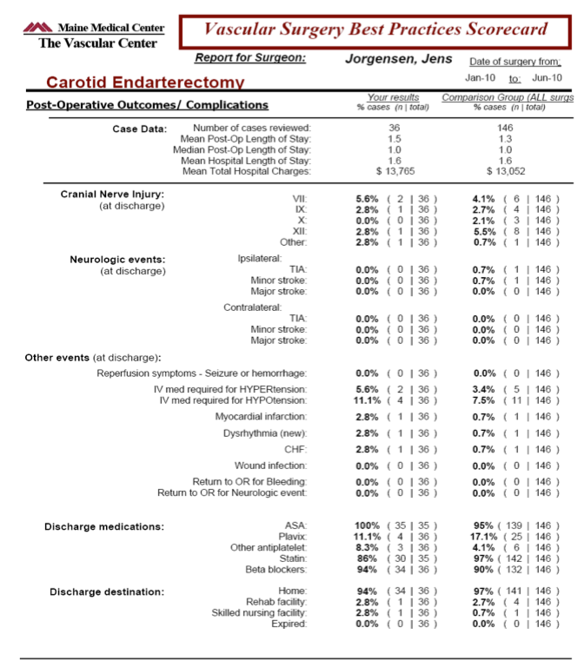
MMC Best Practice Dashboards
Provider versus group outcomes
Un-blinded data
Fosters open communication to facilitate best practice & outcomes

Slide 14
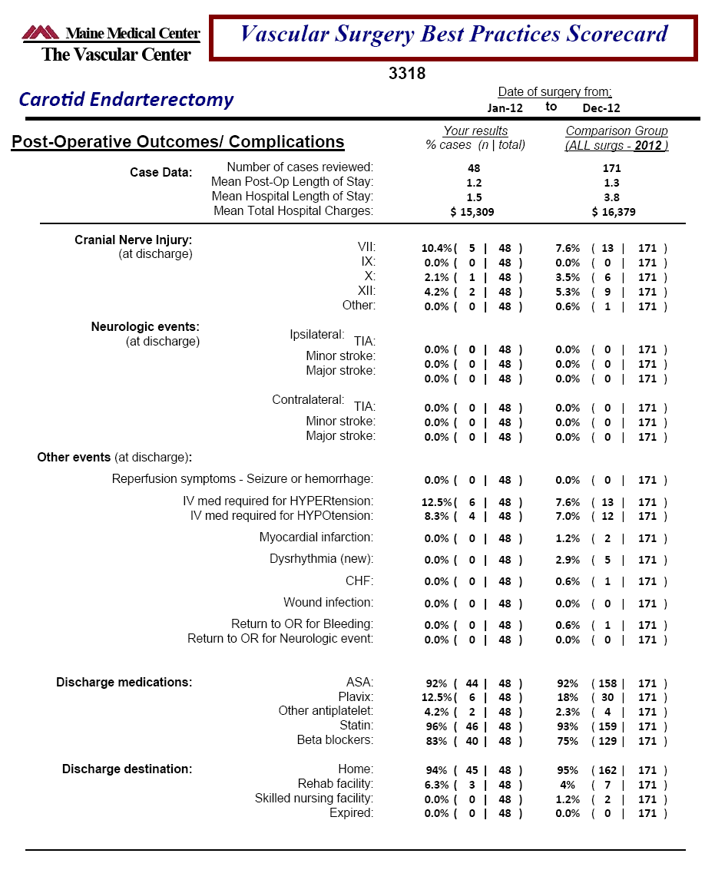

Slide 18
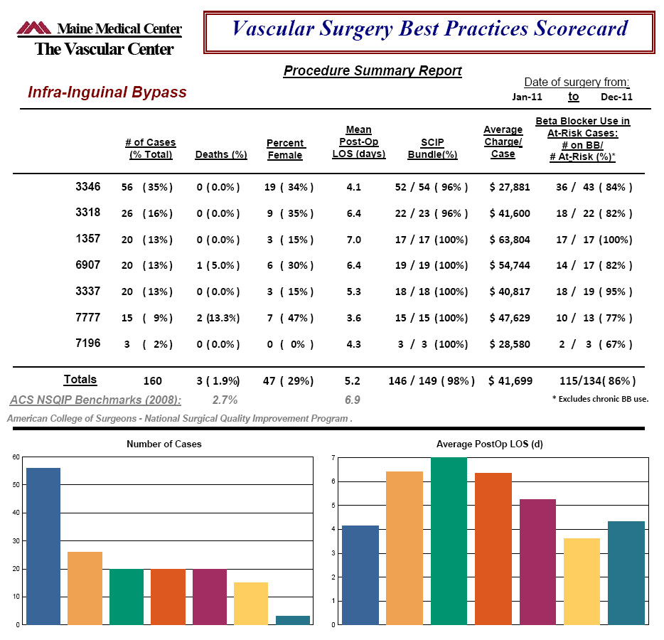
Identify variation by provider in POLOS, average charges.
Provide feedback on compliance with QI initiatives (in 2011 was SCIP Bundle and BB use)

Slide 19
M2S Analytics & Reporting Tool

Slide 20
Audience Participation
Does your site currently utilize the M2S online Analytics & Reporting Engine for any reports?
a) Yes
b) No
c) Unsure

Slide 21
Audience Participation
If yes, do the reports meet your organizations need?
a) Very much
b) Somewhat
c) Very little

Slide 22
Results of Dashboard QI/QA: Reducing LOS
Carotid Endarterectomy | My Center Results (N=127) | All Other Regional Participants (N=1,368) | All Other National Participants (N=13,723)
Post-op Length of Stay * | 1.1 ± 0.8; 1.0 | 1.7 ± 2.4; 1.0 | 1.8 ± 2.5; 1.0
Open AAA Repair | My Center Results (N=14) | All Other Regional Participants (N=146) | All Other National Participants (N=867)
Post-op Length of Stay * | 5.9 ± 1.9; 5.5 | 8.7 ± 6.9; 7.0 | 8.7 ± 7.3; 7.0
Endo AAA Repair | My Center Results (N=30) | All Other Regional Participants (N=423) | All Other National Participants (N=4,975)
Post-op Length of Stay * | 1.1 ± 0.4; 1.0 | 1.8 ± 2.1; 1.0 | 2.1 ± 6.3; 1.0
Supra-inguinal Bypass | My Center Results (N=20) | All Other Regional Participants (N=229) | All Other National Participants (N=1,643)
Post-op Length of Stay * | 7.0 ± 3.6; 6.0 | 6.2 ± 6.3; 5.0 | 6.5 ± 11.1; 5.0
Infra-inguinal Bypass | My Center Results (N=65) | All Other Regional Participants (N=581) | All Other National Participants (N=5,061)
Post-op Length of Stay * | 3.5 ± 1.7; 3.0 | 5.1 ± 4.1; 4.0 | 5.5 ± 7.6; 4.0

Slide 23
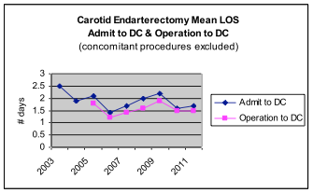
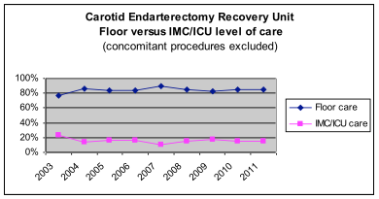
Carotid Artery Endarterectomy QI/QA
Identified almost all CEA complications occurred within 4 hours post-op. Patients remained in PACU 4 hrs (currently 3 hours)
Patients move from PACU to SSU. SSU nurse: patient ratio less than surgical unit.
Resulted in 85% reduction in the use of IMC beds
~ $212,000 savings annually
Identified/corrected CEA improper booking types: 1yr savings ~$60,000
92% D/C POD1 and 98% D/C POD2
Notes:
almost all CEA Cx occurred within 4 hours so they go to short stay unit (level of staffing less than surg floor)
improper booking discovered incidentally due to VSGNE work

Slide 24
Carotid Artery Endarterectomy QI/QA
Developed CAE Pathway for postop transfer

Slide 25
Carotid Artery Endarterectomy QI/QA

Slide 26
Tips & Lessons Learned
Need dedicated resources.
Creating reports “outside” of M2S is challenging. Requires ‘tweaking” each time a field is changed.
Use of the data in a meaningful format engages staff and allows demonstration of improvement over time.

Slide 27
Tips & Lessons Learned
Find some early “wins” to harness buy in.
Start small and build on successes.
You never know where a data path may take you. Be curious.
If you can’t measure it, you can’t improve it.
Notes:
did I mention I like short slides with only a couple points - would make this 2 slides
also having data and comparison to benchmarks engages staff and allows demonstration of improvement over time which engages staff and administration (data allowed us to look at outcomes and work on them "if you cant measure it, you cant improve it")

Slide 28
Physician Dashboards
QUESTIONS?

