Slide 1
Mid-America Vascular Study Group
April 10, 2017
10:00 am - 3:00 pm
University of Kansas Health System
Kansas City, KS

Slide 2
Agenda:
I. Welcome and Introduction Joe Schneider, MD
Follow up on Fall meeting Joe Schneider, MD
III. National VQI Update Nadine Caputo, PSO
IV. Regional Data Review Joe Schneider, MD
VI. AQC Update Todd Vogel, MD
RAC Update Andrew Hoel, MD
VQC Update Ravi Hasanadka, MD
VIII. Governing Council Committee Update Joe Schneider, MD
IX. M2S: Development Update Debbie MacAulay, M2S
X. Expanding Participation
XI. Next Meeting and Adjourn

Slide 3
Welcome and Introductions
Barnes Jewish Hospital
Carle Foundation Hospital
Iowa Heart Center at Mercy Medical Center
Mercy Hospital Springfield
Mercy Hospital St. Louis
NorthShore Hospital
Central DuPage Hospital
Northwestern Memorial Hospital
OSF Saint Anthony Medical Center
OSF Saint Francis Medical Center
OSF St. Joseph Medical Center
Saint Luke's Episcopal Presbyterian Hospital
Saint Luke's Hospital of Kansas City
Southern Illinois University School of
SSM DePaul Health Center
SSM Saint Louis University Hospital
SSM St. Clare Health Center
SSM St. Joseph Health Center
SSM St. Mary's Health Center
St. Mary's Hospital - Decatur
Nebraska Medicine
UnityPoint Health Des Moines
UnityPoint Health - Methodist
University of Chicago Medical Center
University of Kansas Hospital Authority
Columbia Surgical Services- Inc.
University of Missouri Medical Center
Weiss Memorial Hospital

Slide 4
Action Items from last Meeting
LTFU transparency

Slide 5
National VQI Update:
Nadine Caputo, SVS PSO ncaputo@svspso.org

Slide 6
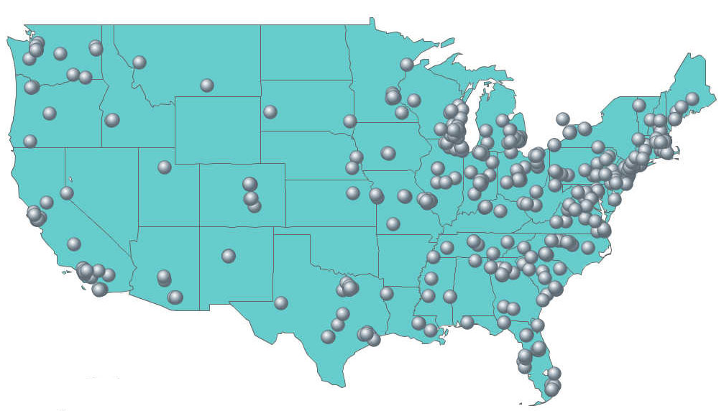
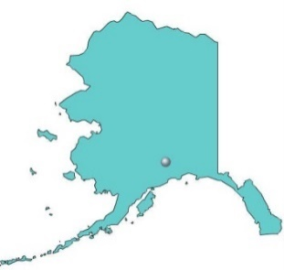
Participating Centers
VQI Participating Centers
VQI
412 Centers, 46 States + Canada

Slide 7
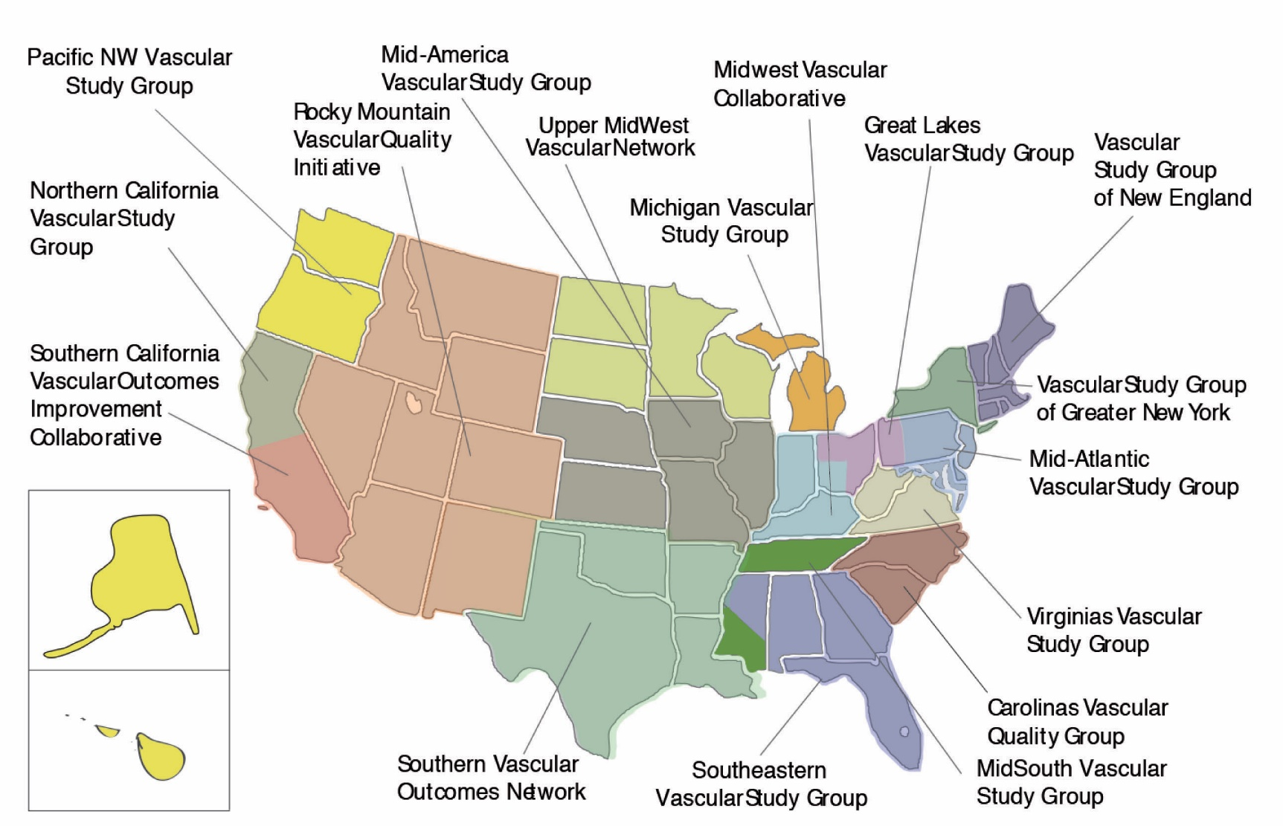
17 Regional Quality Groups
AK
HI

Slide 8
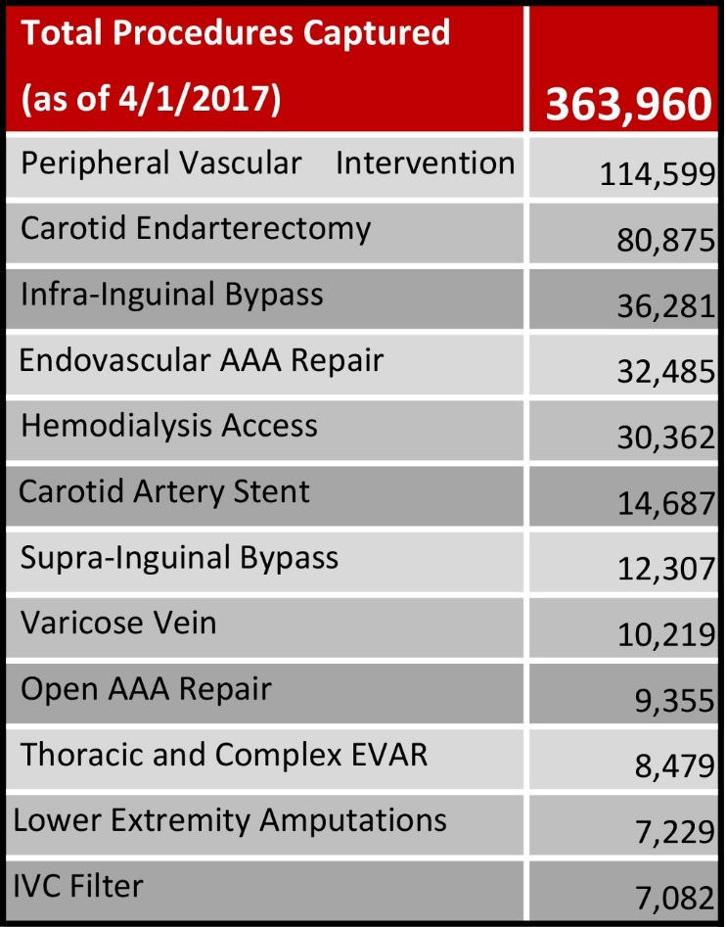
VQI Total Procedure Volume
Total Procedure Volume tab reflects net procedures added to the registry for the month

Slide 9
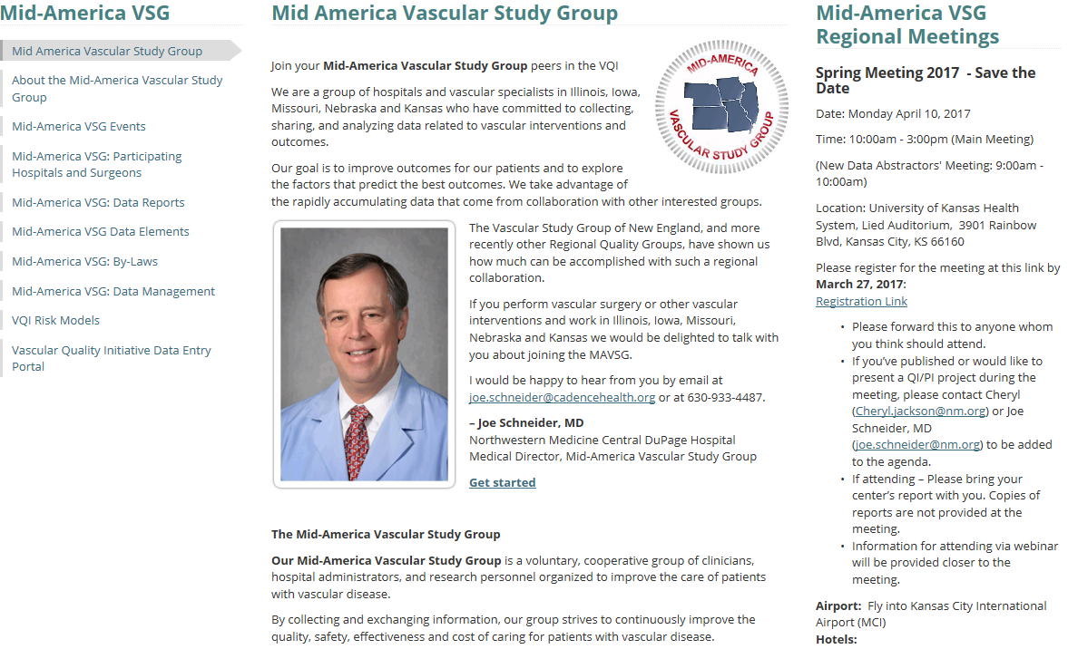
Mid-America VSG Website:

Slide 10
Member Only Website
Purpose: To help and encourage members to share quality improvement and best practice information more easily between and within Regional Quality Groups.
The site will include a new topical discussion forum for VQI members that is password protected.
Lead Regional Data Managers are currently pilot testing the site and we expect it to be operational 2nd quarter 2017.

Slide 13
VQI@VAM 2017 Is Coming to San Diego
Date: Tuesday, May 30, 2017 (half day) through Wednesday, May 31st (full day)
Place: San Diego Convention Center, San Diego, CA
Housing and Registration to open in early-March (Check the SVS website)
Notes:
For second annual VQI@VAM meeting, we have added a half day of programming on Tuesday, May 30th specifically for data managers. The half day program begins at noon on Tuesday May 30th and ends at 5:00pm with a Cocktail/Reception in response to member requests for additional time to network. The full day meeting on Wednesday May 31st for physicians and data managers is tentatively scheduled to begin at 8:00am through 5:00pm. A complete agenda will be available in February.
To support your attendance at VQI@VAM, we have developed a sample justification letter that you can use with your administrators. (Click here to download Sample Justification Letter)
The headquarters hotel is the Marriott Marquis San Diego Marina Hotel. The official housing website, complete with discounted room rates, will open in early March 2017. Please do not call the hotel directly for reservations. The VQI Annual Meeting is held in conjunction with the SVS VAM. When housing opens in March, you will be able to link to hotel registration at VQI@VAM Registration

Slide 14
VQI@VAM 2017 Is Coming to San Diego
Tuesday Afternoon will be concurrent sessions on the Registries
  Inclusion/Exclusion
  Difficult Definitions
  Case Abstraction Scenarios
Poster Session and Networking Reception from 5:00 – 6:30
  Abstract submission deadline March 15, 2017
  Notification of acceptance March 31, 2017
  Send Abstracts to Jim Wadzinski jwadzinski@svspso.org

Slide 15
VQI@VAM 2017 Is Coming to San Diego
Wednesday Sessions will Include the Following Topics:
  Registry Overview and Q&A
  QI Case Studies on Data and Reporting
  Physician Engagement in Data Collection
  Data Automation
  Keynote: VQI Quality Initiatives and Future Direction
  QI Case Studies on Process and Outcomes Measures
  Perspectives on VQI from the Hospital C-Suite
  ERAS, Fast Track and Strong for Surgery: Applying these concepts to Vascular
  Current Research Projects from Approved RAC Requests

Slide 16

Ne Newsletter
Volume 8
In the February 2017 issue we highlight the following topics:
VQI@VAM 2017 Is Coming to San Diego
Two New National QI Projects
Educational Webinars 2017
VQI Participation Awards Update
Welcome to New VQI Members
Vascular Nurses and Technologists to Attend SVN Annual Convention
Research Corner – PVI Studies
Latest VQI Participation and Volume Statistics
VQI@VAM 2017 Is Coming to San Diego
Date: Tuesday, May 30, 2017 (half day) through Wednesday, May 31st (full day)
Place: San Diego Convention Center, San Diego, CA
For second annual VQI@VAM meeting, we have added a half day of programming on Tuesday, May 30th specifically for data managers. The half day program begins at noon on Tuesday May 30th and ends at 5:00pm with a Cocktail/Reception in response to member requests for additional time to network. The full day meeting on Wednesday May 31st for physicians and data managers is tentatively scheduled to begin at 8:00am through 5:00pm. A complete agenda will be available later in February.
To support your attendance at VQI@VAM, we have developed a sample justification letter that you can use with your administrators. (Click here to download Sample Justification Letter)

Slide 17
Two New National QI Projects
The SVS PSO is launching two national initiatives together with implementation tools aimed squarely at using data to improve patient care.
Prescribing anti-platelets and statins to appropriate patients to improve their long-term vascular health
Increasing follow-up imaging rates at one year for endovascular aneurysm repair patients
The goal for both of these initiatives is 100% compliance. To support increased compliance, the PSO, working with the Arterial Quality Council and the Quality Improvement Workgroup, is developing implementation tools for members, issuing comparative reports and data on improvements over time.

Slide 18
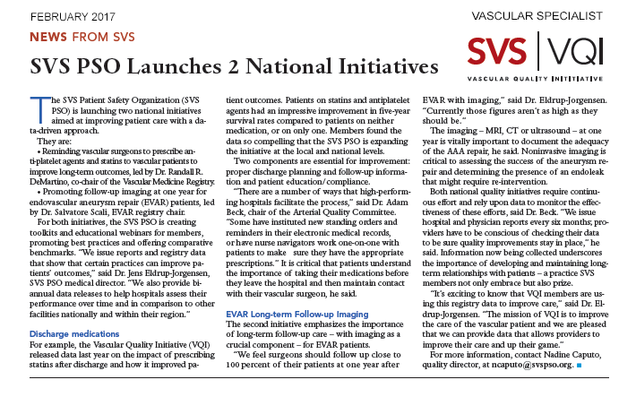
Vascular Specialist Article

Slide 19
VQI QI Resources
New on-line QI resources are available within VQI M2S PATHWAYS in the Resources Section:
Leading Change webinar slides and audio transcripts on change management by Dr. Ted James
Slides from all of the VQI@VAM 2016 presentations
Digital QI Project Guide – a ‘soup to nuts’ guide for QI project implementation.

Slide 20
QI Project Charter – Template
Project Overview
Problem Statement:
Goal:
Scope:
Deliverable(s):
Resources Required:
Key Metrics | Milestones
Outcome Metrics: | Milestone / Description: |  | Date (mm/yy):
Process Metrics:
Team Members
Exec Sponsor: |  | Clinical Sponsor:
Sponsor: |  | Process Owner:
Project Leader: |  | Team Members:

Slide 21
QI Project Charter
Project Overview
Problem Statement: Discharge Medication Example from Hospital A Only 61% of eligible vascular procedure patients at Hospital X are discharged on antiplatelets and statins. Increasing the prescribing rate of antiplatelet and statin therapy for vascular procedure patients at discharge increases graft patency and increases survival at one year and five years post procedure.
Problem Statement What is wrong with our current process? Why do we care? Create a statement that is specific, measurable and relevant. Include data or use placeholders until you get the data.
Goal: Example Twenty-five percent increase in prescribing rates at six months post project implementation. Verify that 76% of eligible vascular procedure patients are discharged on an antiplatelet and statin medication at six months after project implementation (June, 2015). Another 25% increase at one year post implementation. Verify that 95% of eligible vascular procedure patients are discharged on an antiplatelet and statin medication at one year after project implementation (January, 2016).
Goal: What do we want to achieve and when do we want to achieve it?

Slide 22
QI Project Charter
Scope: Example Educate vascular procedure providers on the importance of prescribing antiplatelets and statins to their vascular procedure patients and coordination with their primary care physicians Revise vascular discharge order sets Utilize the expertise of pharmacists and care coordinators The project will be tested for a 12-month period.
Scope: What areas will we improve and over what time period will we do the improvement? What are the limitations (e.g., limited to certain units or for a certain time period.
Deliverable(s): Discharge order medication templates Sample PCP letter templates
Deliverable(s) What new processes will we deliver in order to help reach our goals?
Resources Required: Example IT Care Coordinators Pharmacists
Resources Required What people, materials, and/or finances will be needed to conduct the project? Who must be kept informed?

Slide 23

Key Metrics | Milestones
Outcome Metrics: Example Increased one and five year survival rates for vascular procedure patients that were discharged on antiplatelet and statin medications. | Milestone / Description Example Confirm baseline information using VQI data Notify and educate all vascular procedure providers on the new initiative. Contact IT for guidance in adding templates Meet with care coordinators to identify programs to aid patients in obtaining medications, if needed. Revise 100% of provider discharge order sets to reflect AP and statin medication options. Milestone / Description: Complete ‘QI Project Overview’ Confirm baseline outcome metric Identify root cause / hypothesis Identify potential improvement(s) Implement improvement(s) Evaluate progress & confirm action plan | Date (mm/yy):
Outcome Metrics “How will you know the project is successful?” e.g., LOS, surgical site infections
Process Metrics: Example Verify that 76% of eligible vascular procedure patients were discharged on an antiplatelet and statin medication at six months after project implementation using VQI and/or EMR data. Verify that 95% of eligible PVI patients were discharged on an antiplatelet and statin medication at one year after project implementation using VQI registry data and reports using VQI and/or EMR data.
Process Metrics: “How will you ensure the interventions you implement are being completed?” e.g., % pts on progressive care unit, % discharged patients on statins and anti-platelets Rx

Slide 24
MACRA/MIPS
December 2016 webinar on MACRA/MIPS that was presented by Jill Rathburn and Brad Johnson https://drive.google.com/file/d/0B6sVggHY6rr5aVN0SnF0SDFVS00/view

Slide 25

MIPS Proposed Timeline for 2019 Payment
Why I should care NOW
SUBMIT
DATA
FEEDBACK AVAILABLE
PAYMENT ADJUSTMENT
PERFORMANCE YEAR
JANUARY 1 – DECEMBER 31, 2017
MARCH 31, 2018
JANUARY 1, 2019
What you do today, will impact your payment in 2019!

Slide 26
Pick your Pace – A way to ease in and minimize impact
DON’T PARTICIPATE
SUBMIT SOMETHING
One Measure
One Activity
SUBMIT A PARTIAL YEAR
Submit 90 days of 2017 data to Medicare
SUBMIT A FULL YEAR
If you don’t participate, you will receive a 4% negative payment adjustment
Avoid a negative payment
You may earn a neutral or small positive payment adjustment
You may earn a moderate payment adjustment
- $
+ $
FINANCIAL IMPACT
Notes:
Submit one measure and avoid a negative payment

Slide 27
Ideas for MIPS using VQI Data
Identify Quality Improvement Projects for your Center
Request National Blinded Data Sets to research specific questions
Support Certifications
Utilize data to understand practice variation using different devices or techniques
VQI is a specialty registry

Slide 28
Educational Webinars 2017
Topics for the educational webinars in the first half of 2017 include:
February 23: National QI Projects: Discharge Medications: Reaching and Sustaining our Goal of 100% by Randy R. De Martino, MD, MS and Cheryl R. Jackson, DNP, MS, RN, CPHQ
March: PVI Clone and CAS Registry/TCAR
April 25: National QI Projects: EVAR LTFU Imaging: Understanding Current Trends to Improve the Future
May: PVI – forum with users and developers

Slide 29
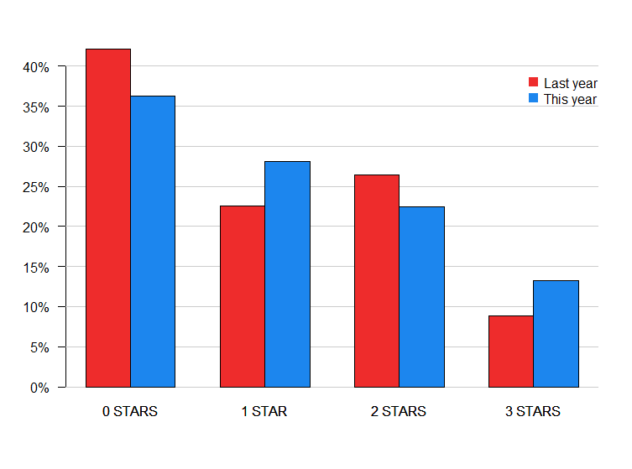
2016 Participation Award Results

Slide 30
Participation Award potential changes:
  Participation in National, Regional or Local QI project using VQI data
  Credit for attendance at the Annual meeting (data managers only)
  Penalty of not being able to get data for research if your attendance at the regional meetings is low over a certain number of years
  Should you get a star award at all if you are on probation for <50% LTFU
  Additional participation point if your site gives a presentation at a regional meeting

Slide 31
VQI Datasets for Research
Data discrepancies identified
Due to multiple revisions and coding
No significant errors in key outcome variables (SO FAR – audit not done yet)
Conclusion – Large complex data sets need periodic, regular review
Multiple new quality assurance measures instituted

Slide 32
Why?
Large Complex Database
Multiple revisions paper form access DB web based
Mapping old to new changed variables
Multiple modification of data fields (PCI &/or CABG changed to PCI, CABG or both)
Coding errors
Multiple changes in definitions

Slide 33
Results (so far)
No significant impact on clinical findings
No change in analysis (p values) or conclusions
No significant errors in key outcome variables
Most errors were in descriptive variables – H/O CAD

Slide 34
Data variability (References)
Understanding Differences in Administrative and Audited Patient Data in Cardiac Surgery: Comparison of the University HealthSystem Consortium and Society of Thoracic Surgeons Databases. Prasad A, Helder MR, Brown DA, Schaff HV. J Am Coll Surg 2016; 223: 551-8.
Variability in Data: The Society of Thoracic Surgeons National Adult Cardiac Surgery Database. Brown ML, Lenoch JR, Schaff HV. J Thorac Cardiovasc Surg 2010; 140: 267-73.
Data Variability and Validity: The Elephant in the Room. Grunkemeier GL, Furnary AP. J Thorac Cardiovasc Surg 2010; 140: 273-5.
The Society of Thoracic Surgeons National Adult Cardiac Database: A Continuing Commitment to Excellence. Shahian DM, Edwards F, Grover FL et al. J Thorac Cardiovasc Surg 2010; 140: 955-9.
Are Unaudited Records From an Outcomes Registry Database Accurate? Herbert, MA, Prince SL, Williams JL, Magee MJ, Mack MJ. Ann Thorac Surg 2004; 77: 1960-5.

Slide 35
Moving forward
New Quality Assurance Measures
New Data Quality Control Testing
New Sign off for Development Specifications and before release of new Code
New Software for Quality Assurance
New Code to ensure Consistency of BDS across Registries
New Data Warehouse

Slide 36
Regional Reports:
Joe Schneider, MD
New HTML format!!

Slide 37
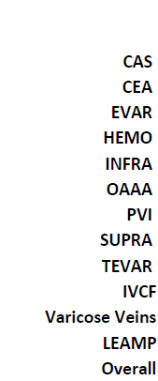
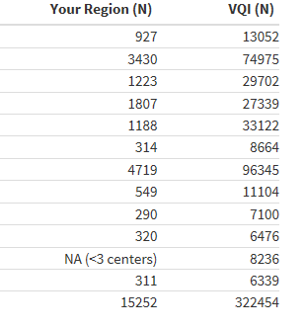
Total Procedure Volume, All Years
(2003-Dec 2016)

Slide 38
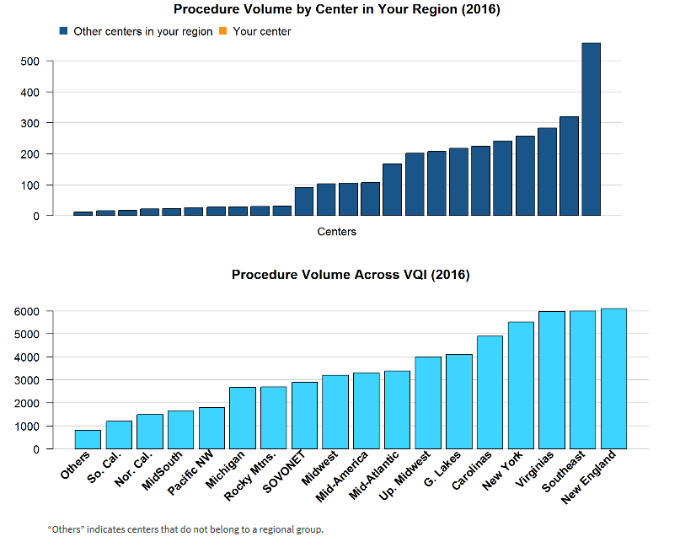

Slide 39
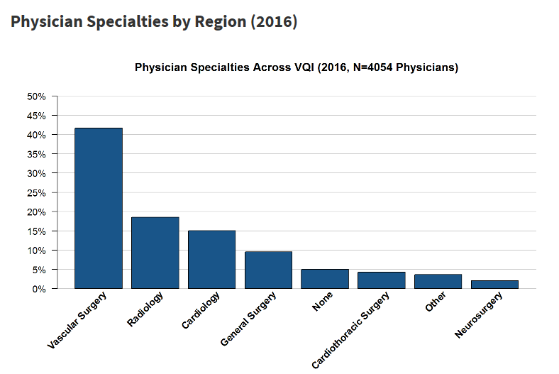

Slide 40
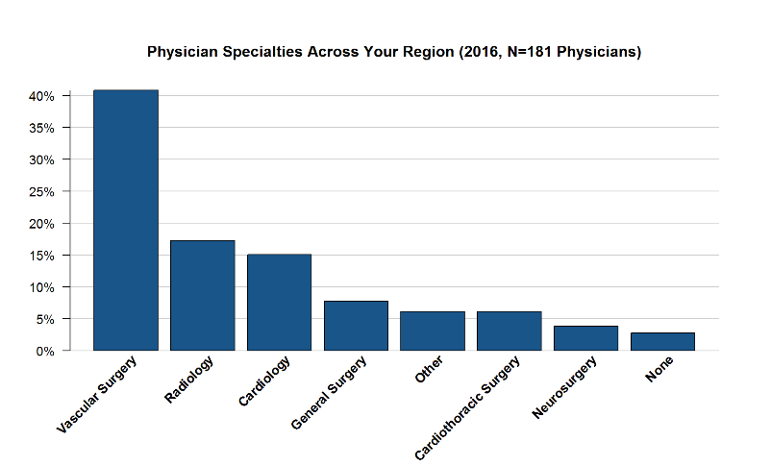

Slide 41
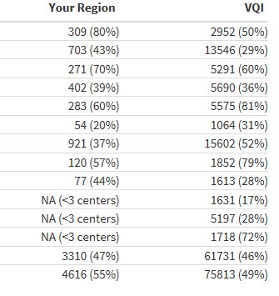
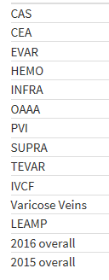
Percentage of Procedures Submitted
With Missing Data (2016)

Slide 42
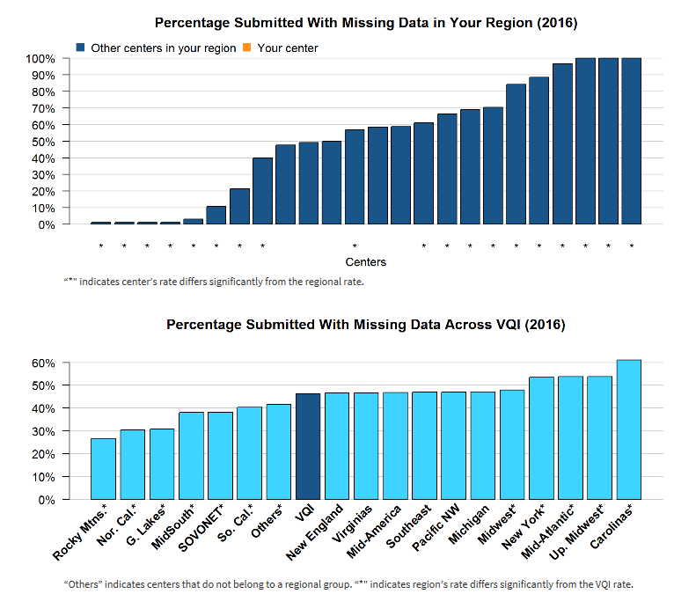

Slide 43
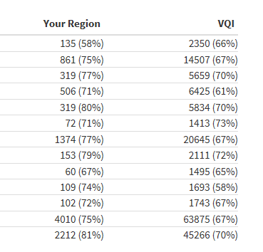
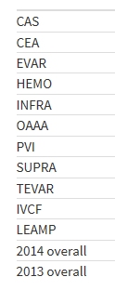
LTFU as of January 1, 2017

Slide 44
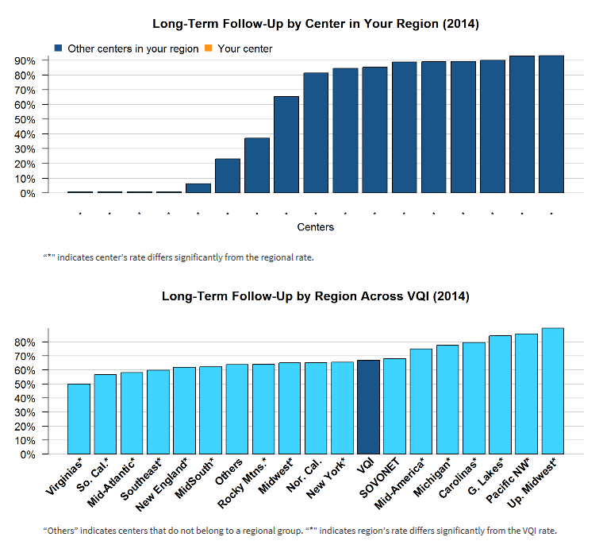

Slide 45
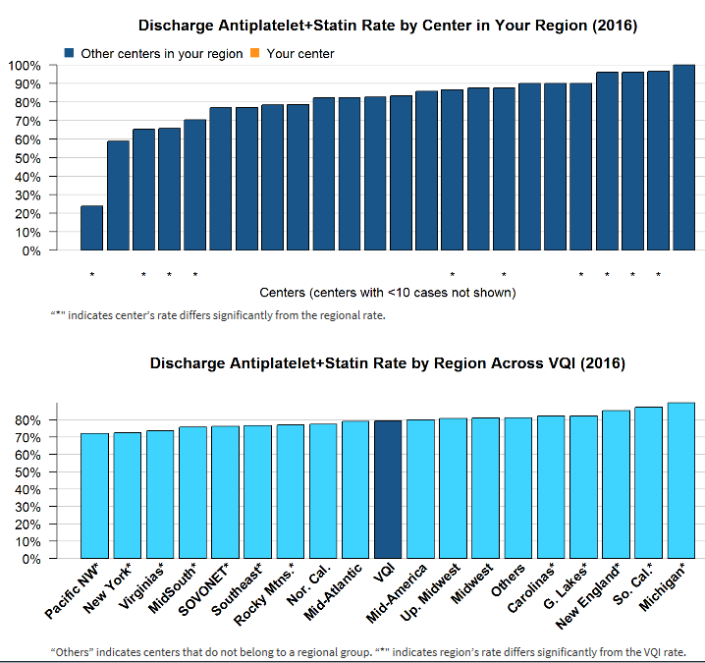
Excludes patients who died in hospital and patients who were not treated for medical reason or non-compliant

Slide 46
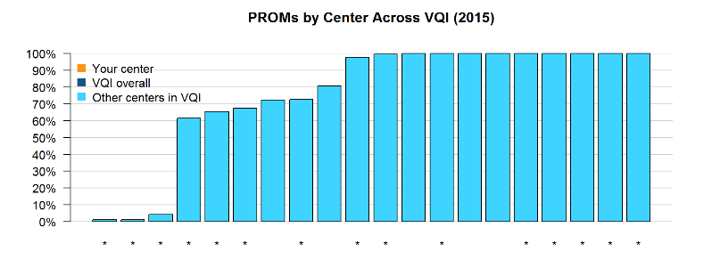
Varicose Veins: Percentage of Procedures with Complete Patient-Reported Outcome Measures Recorded at Follow Up procedures; includes only patients with any follow-up visit recorded. All regional data omitted because most regions have <3 centers. Patient-reported outcome measures (PROMs) include heaviness, achiness, swelling, throbbing, itching, appearance and impact on work in side of operation.

Slide 47
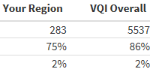

Infrainguinal Bypass: Percentage of Procedures
with Chlorhexidine or Chlorhexidine+Alcohol Skin Prep (2016)
The table below shows the number of INFRA procedures in the VQI as of Jan. 1, 2017, the percentage of those cases in which chlorhexidine or chlorhexidine+alcohol skin prep was used, and the rate of in-hospital surgical-site infection.

Slide 48
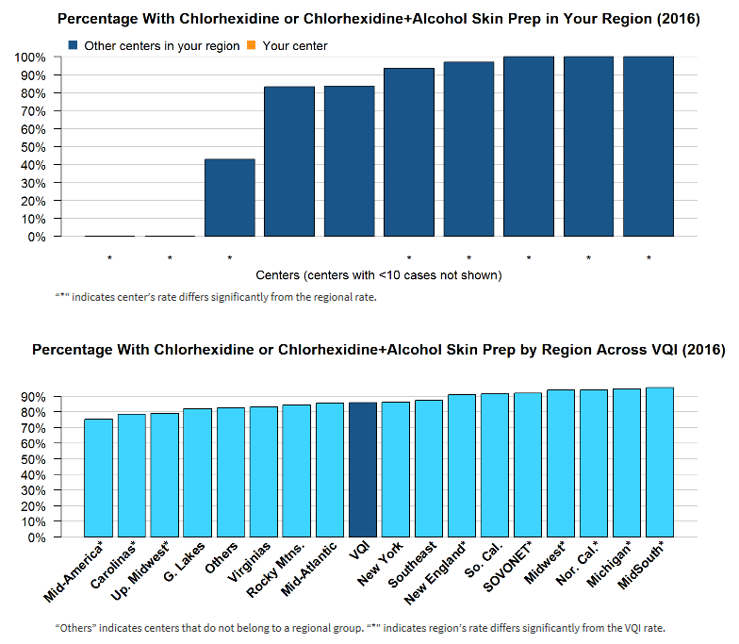

Slide 49
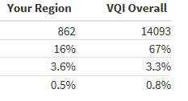
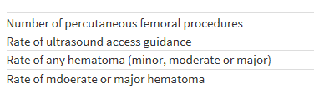
PVI: Percentage of Percutaneous Femoral Procedures
Using Ultrasound Guidance (2016)
Excludes cut-down access guidance
The table below shows the number of percutaneous femoral PVI procedures in the VQI as of Jan. 1, 2017, the percentage of those cases in which ultrasound access guidance was used, and the rate of hematoma.

Slide 50
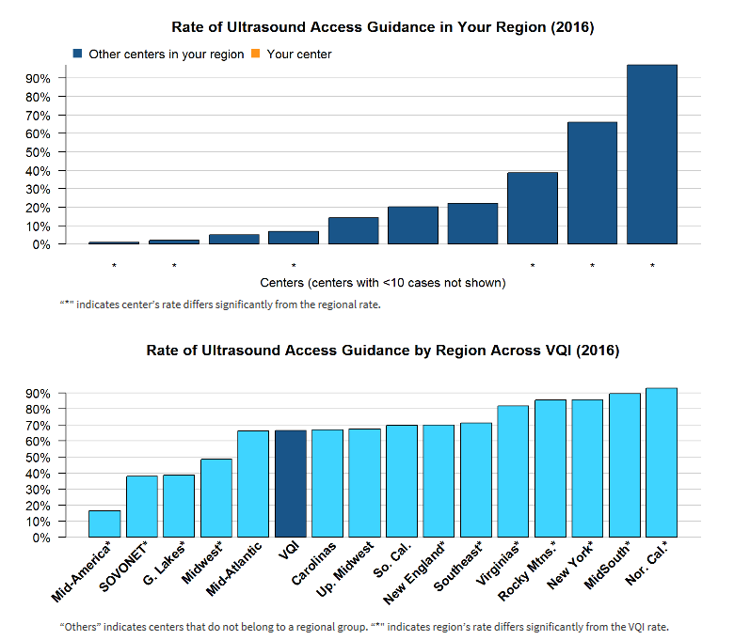

Slide 51
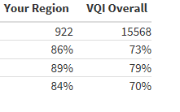
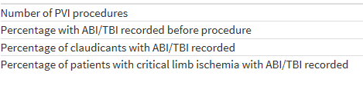
PVI: Percentage of Patients With ABI or TBI
Reported Before Procedure (2016)
“ABI or TBI reported” indicates at least one measure was recorded for the side of the operation, or on both sides for bilateral and aortic procedures.
The table below shows the number of PVI procedures in the VQI as of Jan. 1, 2017, and the percentage of those cases in which ABI or TBI was recorded.

Slide 52
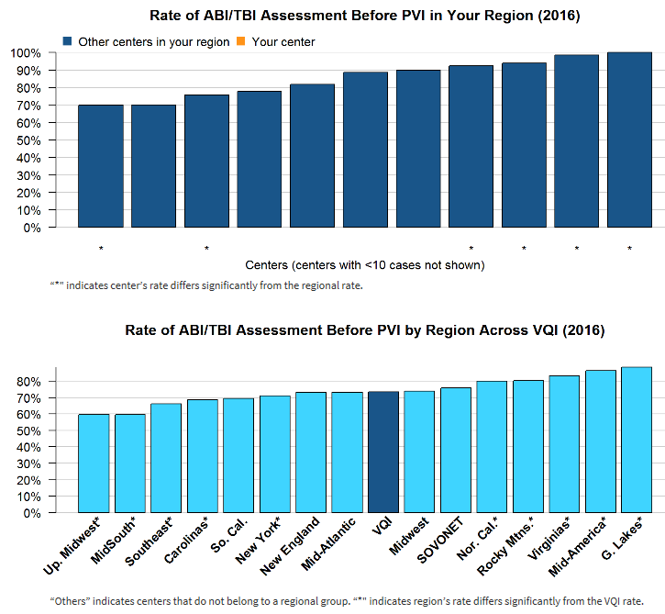

Slide 53


EVAR: Rate of Sac Diameter Reporting at Long-Term Follow-Up (2014)
Excludes patients without at least 9 months of LTFU
The table below shows the number of EVAR procedures with long-term follow-up that were in the VQI as of Jan. 1, 2017, and the percentage of those cases in which sac diameter was recorded at LTFU.

Slide 54
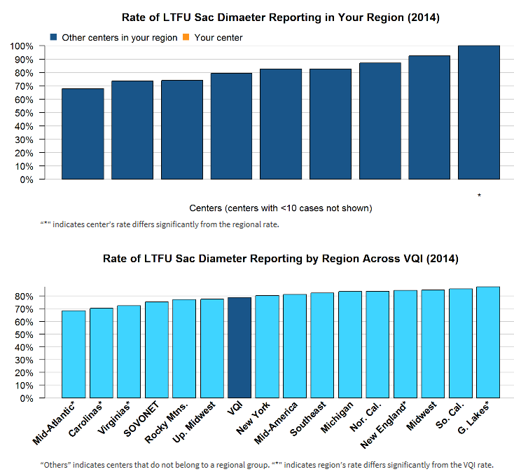

Slide 55
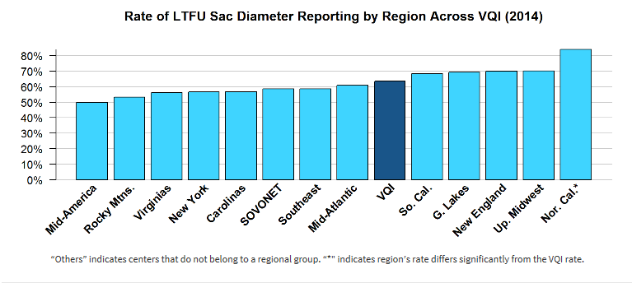
TEVAR: Rate of Sac Diameter Reporting at Long-Term Follow Up
2014, excluding patients without at least 9 month follow up
(your region did not have at least 3 centers with 10 procedures)

Slide 56
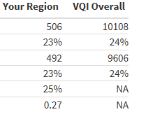
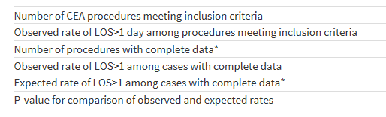
Carotid Endarterectomy: Percentage of Patients with LOS>1 Day (2016)
Elective procedures, excluding prior ipsilateral CEA, concomitant CABG, proximal endovascular or other arterial operation, in-hospital death with LOS<=1 day, procedures done on weekends or not done on admission day.
The table below shows the number of CEA procedures meeting inclusion criteria that were in the VQI as of Jan. 1, 2017, and the observed and expected rates of those cases with LOS>1 Day.

Slide 57
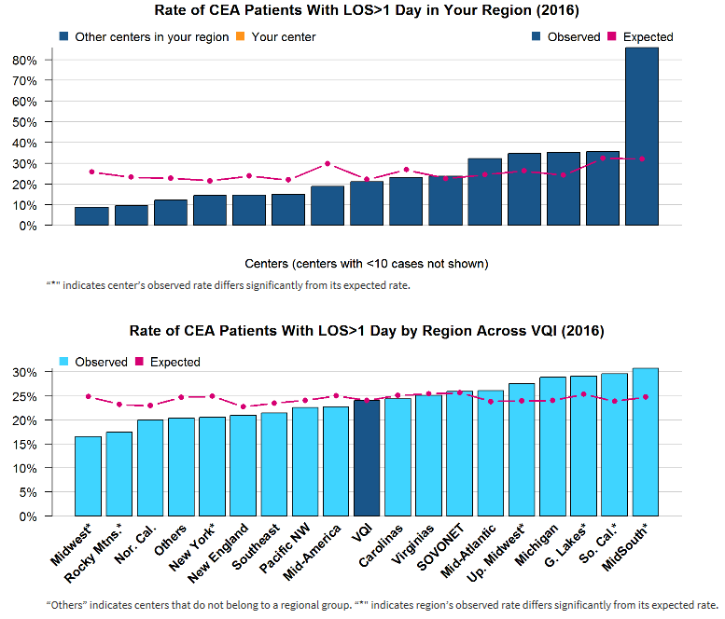

Slide 58
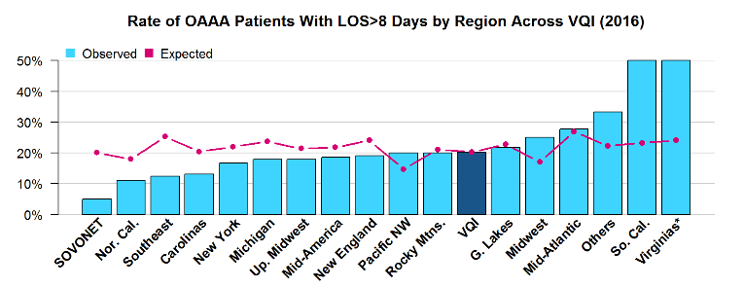
OAAA Repair: Percentage of Patients with LOS>8 Days (2016)
Excludes ruptured aneurysms and in-hospital deaths with LOS<=8 days, procedures not done on day of admission and weekend procedures
The table below shows the number of OAAA procedures meeting the inclusion criteria that were in the VQI as of Jan. 1, 2017, and the observed and expected rates of those cases with LOS>8 Days.
(your region did not have at least 3 centers with 10 procedures)

Slide 59
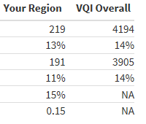
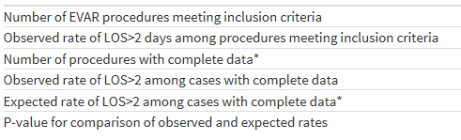
Endovascular AAA Repair: Percentage of Patients with LOS>2 Days (2016)
Excludes ruptured aneurysms and in-hospital deaths with LOS<=2 days, patients with prior aortic surgery, procedures not done on day of admission and weekend procedures
The table below shows the number of EVAR procedures meeting the inclusion criteria that were in the VQI as of Jan. 1, 2017, and the observed and expected rates of those cases with LOS>2 Days.

Slide 60
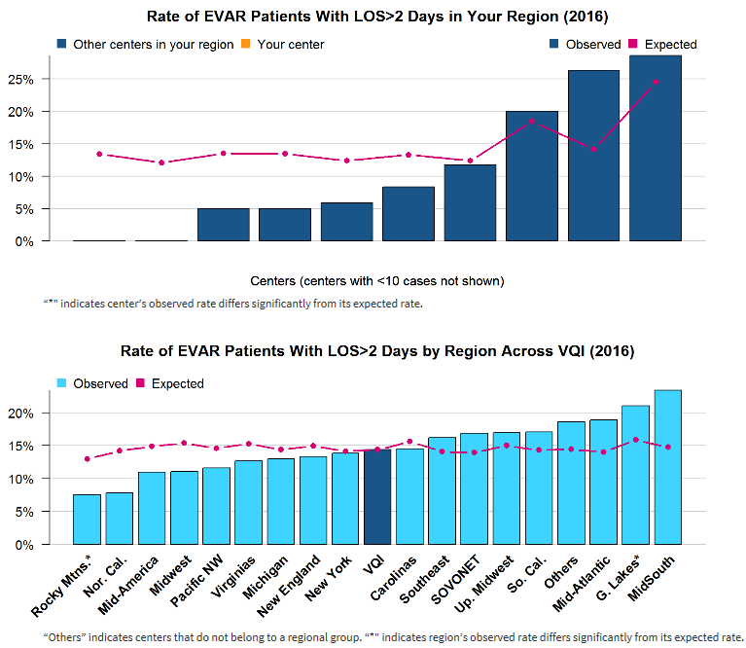

Slide 61
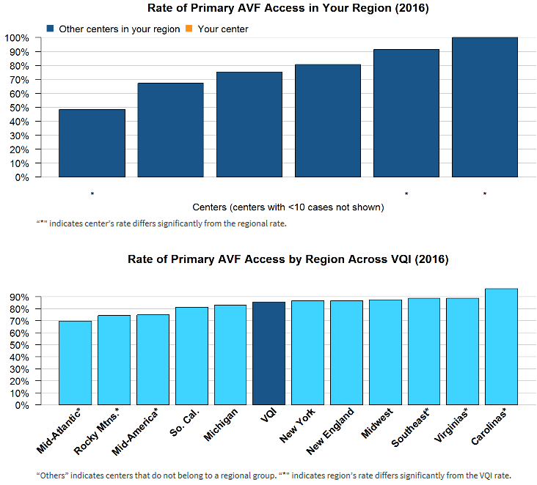
Hemodialysis Access: Percentage of Primary AVF vs. Graft(2016)
Excludes patients with previous access procedure in the same arm

Slide 62


IVCF: Percentage of Temporary Filters With Retrieval or Attempt at Retrieval (2015)
Excludes patients with permanent filters and patients who have died since discharge
The table below shows the number of IVCF procedures meeting the inclusion criteria that were in the VQI as of Jan. 1, 2017, and the percentage of those cases in which the filter was retrieved, or an attempt was made to retrieve it, at any time post-procedure

Slide 63
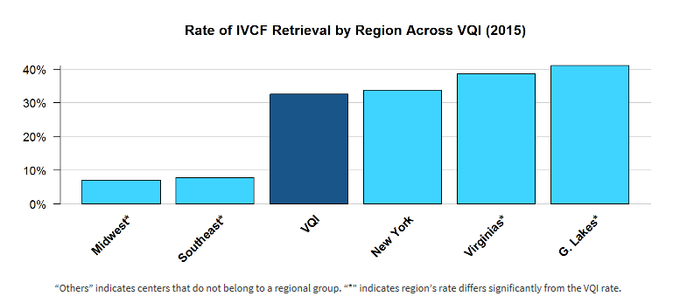
IVCF: Percentage of Temporary Filters With Retrieval
or Attempt at Retrieval (2015)
(your region did not have at least 3 centers with 10 procedures)

Slide 64
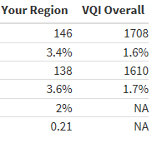
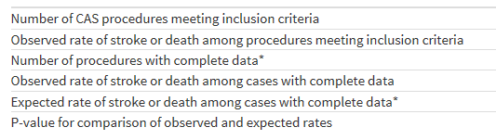
Carotid Artery Stent: Stroke or Death in Hospital (2016)
Elective procedures, excluding prior ipsilateral CAS, and dissection, trauma and “other” lesion types
The table below shows the number of CAS procedures meeting the inclusion criteria that were in the VQI as of Jan. 1, 2017, and the observed and expected rates of in-hospital stroke or death for those cases.

Slide 65
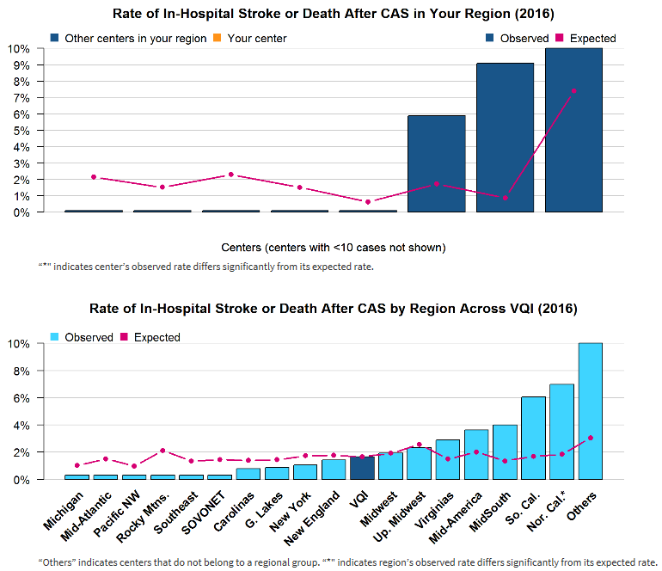

Slide 66
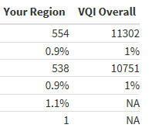
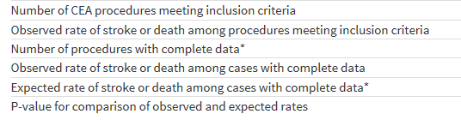
Carotid Endarterectomy: Stroke or Death in Hospital (2016)
Elective procedures, excluding prior ipsilateral CEA and concomitant CABG, endovascular or other arterial procedure
The table below shows the number of CEA procedures meeting the inclusion criteria that were in the VQI as of Jan. 1, 2017, and the observed and expected rates of in-hospital stroke or death for those cases

Slide 67
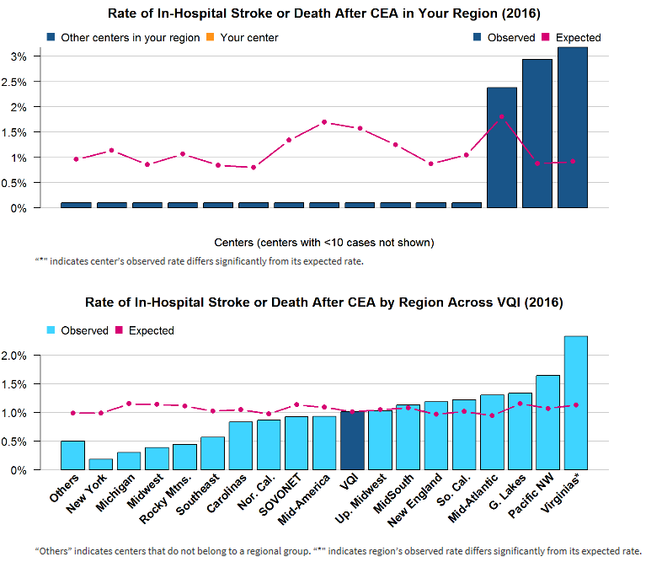

Slide 68


Infrainguinal Bypass: Rate of Major Complications (2016)
Includes only patients with indication of rest pain or tissue loss. Major complications are defined as in-hospital death, ipsilateral BK or AK amputation or graft occlusion.
The table below shows the number of INFRA cases with indication of rest pain or tissue loss that were in the VQI as of Jan. 1, 2017, and the percentage of those cases that resulted in in-hospital death, ipsilateral amputation or graft occlusion.

Slide 69
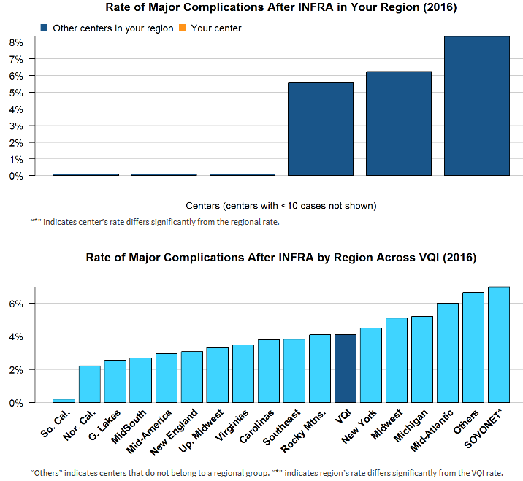

Slide 70
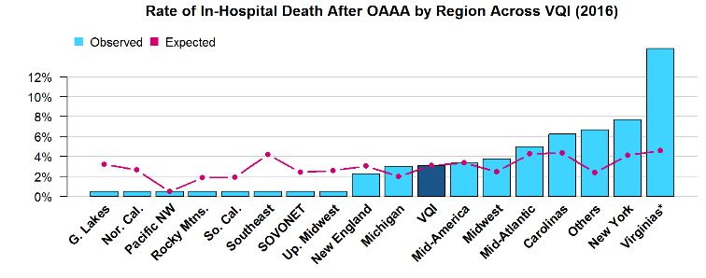
Open Non-ruptured AAA: In hospital Mortality
(2016)
Elective procedures, excluding patients with prior aortic surgery, concomitant renal, infrainguinal or other abdominal procedures, and procedures performed on the weekend.
(your region did not have at least 3 hospitals with 10 procedures)

Slide 71
Arterial Quality Council Update:
Todd Vogel, MD

Slide 72
VQI Committee Activities – Arterial Quality Committee
The Arterial Quality Committee (AQC) discussed term limits and succession planning for VQI Registry Chairs and Vice Chairs and recommended:
  • Three year terms renewable every year for one year
  • The Vice Chair should be prepared to accept the Chair position when the Chair steps down
  • The Chair can rejoin the committee after stepping down
  •The AQC Chair has the right to ask a Chair or Vice Chair to step down if the Registry Chair or Vice Chair is unable to fully participate
Registry Chairs were requested to examine existing research projects to help identify two to three quality improvement projects that may lead to best practice recommendations for procedures included in each Registry.

Slide 73
Implementation of National QI Projects:
Three VQI committees working on the National QI project rollout of improving discharge medication and EVAR LTFU imaging rates.
Provide physician specific reports and COPI reports for discussion at regional meetings
Identify high performing centers
Seek industry funding for EVAR LTFU imaging once a plan of work has been completed.
Publication of National QI projects in Feb 22nd issue of Vascular Specialist

Slide 74
PSO National QI Project
Committee Process
Arterial Quality Committee
Goals, measures, definitions, benchmarks
QI bundles ( recommended clinical practices)
Communications
Committee
Messaging to key stakeholders (providers, patients, administrators)
Oversight of articles, press releases
Quality Improvement
Workgroup
QI implementation tools
‘How-To’ presentations
Expert guidance for user groups
Analysis of results
Physician and hospital engagement
Outcomes of interest to payers, administrators
Recommended practices
SVS PSO
Identify high performing centers
Provide input to/from regional meetings
Develop educational resources
Develop COPI and Physician Reports
Align with MIPS/MACRA
Track successes

Slide 75
Implementation of National QI Projects:
Later Steps
Planned VQI publication describing outcomes of patients with and without EVAR follow-up and imaging
Registry changes: Automatic push reports that provide centers with information on patients needing follow-up imaging
Incorporate QI project participation as part of the Participation Awards. Inform VQI members that adding QI project participation as part of the Awards program is being considered.
Medicare integration/query to determine if imaging is being done elsewhere, but not entered in the VQI registry.

Slide 76
COPI and Physician Reports
In addition to the spring and fall regional reports, this year we have published three COPI reports:
  30-day stroke and 1-year mortality after CEA
  30-day stroke or 1-year mortality after CAS
  COPI report on hematoma after PVI
We have also published three surgeon-level reports:
  Percentage of high-risk patients receiving CEA
  Percentage of patients receiving follow-up imaging after EVAR
  Surgeon-level report on percentage of high-risk patients receiving CAS
2017 Plan to repeat previous reports:
  First one is CEA LOS

Slide 77
Research Advisory Council Update: Andrew Hoel, MD

Slide 78
National Research Process
http://www.vascularqualityinitiative.org/vqi-resource-library/quality-research/
Approved Project List – as of 12/13/2016
To submit a proposal to be considered for the National RAC, please follow the link below and select “PSO National RAC – MONTH Proposal Submission.
http://abstracts123.com/svs1/meetinglogin

Slide 79
National Research Process
Proposal Submissions
April 2017
Call for Proposals: February 14, 2017
Due Date: Midnight March 27, 2017
Meeting: April 10, 2017
Notification Sent: April 11, 2017
June 2017 – Dates Subject to Change
Call for Proposals: April 11, 2017
Due Date: May 29, 2017
Meeting: June 12, 2017
Notifications Sent: June 13, 2017

Slide 80
Regional Research Projects:
Any new ideas?

Slide 81
QI Projects
“National readmission rates in patients with critical limb ischemia” – Kamal Gupta, MD
“Role of a structured cardiac rehabilitation program in patients with PAD post revascularization” – Kamal Gupta, MD

Slide 82
Venous Quality Council Update:
Ravi Hasanadka, MD

Slide 83
Venous Quality Council
Venous Stent Registry: release 2018
Clinical Workgroup:
Marc Passman, MD (chair), William Marston MD, Tony Gasparis MD, Rabih Chaer MD, BK Lal MD, Lowell Kabnick MD
Industry and FDA Collaboration:
Bard, Cook, Gore, Medtronic, Veniti

Slide 84
2 venous registries 2016
 | MAVSG | National VQI
IVC filters | < 3 centers | 1631
TEVAR | 77 | 1613
Varicose Veins | < 3 centers | 5199
EVAR | 271 | 5291

Slide 85
Percent Missing Data 2016
 | MAVSG | National VQI
IVC filters | < 3 centers | 17% lowest
Varicose Veins | < 3 centers | 28% tied for 2nd
CEA | 43% | 29%
Open AAA | 20% | 31%

Slide 86
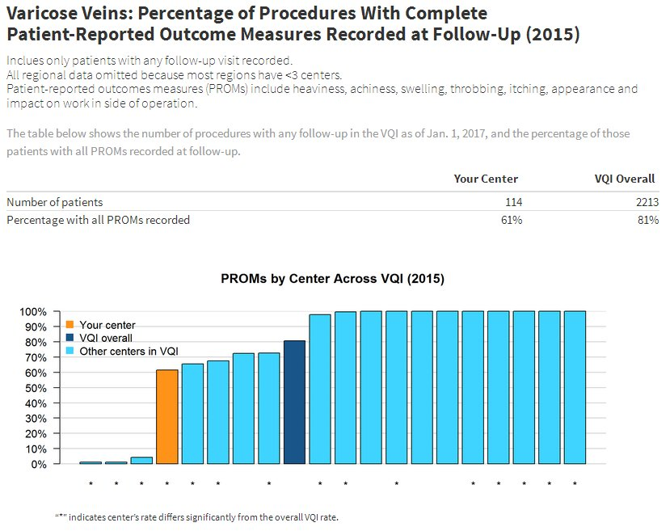

Slide 87
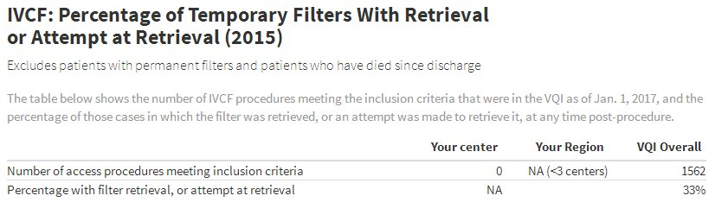
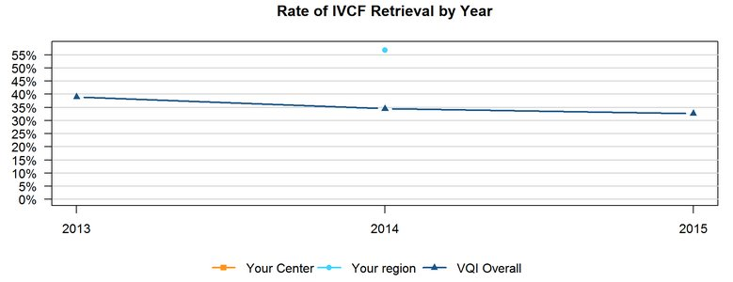
IVC Filter Retrieval

Slide 88

IVC Filter Retrieval

Slide 89
Venous Stent Registry
Release in 2018
Clinical Workgroup:
Marc Passman, MD (chair), William Marston MD, Tony Gasparis MD, Rabih Chaer MD, BK Lal MD, Lowell Kabnick MD
Industry and FDA collaboration:
Bard, Cook, Gore, Medtronic, Veniti

Slide 90


Veniti Vici Venous Stent

Slide 91

US Guidance with PVI 2016

Slide 92
Any Hematoma following PVI 2016
 | PVI cases | % US guidance | % hematoma
Region | 862 | 16 | 3.6
VQI | 14093 | 67 | 3.3
 |  | P = 0.0001 | P = 0.64

Slide 93
Regional Quality Project
NE VSG
  routine user (>80%) vs. infrequent user (<20%)
  0.8% vs. 4.5%
  Kalish et al. J Vasc Surg 2015;61:1231-8.
Our project
  Expanded outcomes:
    Hematoma
    Pseudoaneurym
    AV fistula
  Procedural and Patient Risk factors
    Includes Sheath size, procedure anticoagulation, protamaine usage, antiplatelets, Thrombolysis, closure device, length of case, etc.

Slide 94
Governing Council Update:
Joe Schneider, MD

Slide 95
GC meeting at VEITH
Strategic Planning Summary
  National Quality Projects
  Defining the Value of VQI to SVS Members
  Data Integrity
  Focus on MIPS
  Work with SVS and the Clinical Practice Committee on Appropriateness
M2S Update
  CAS Revisions
  Work with Medstreaming on Data Integration
  Work with the PSO on MIPS/MACRA

Slide 96
GC meeting at VEITH
Device Identification Sub-Committee
  New policy for the release of BDS files with Device Identifiers
  Would need an attestation that research was free of conflicts
  Research would need to be reviewed before Identifiers would be granted
  Need to work on Communications with Industry, prior to Publication
Potential New Projects
  EVAR Cost Study with MedAssets/Visient
  Venous Stenting Registry
  US News and World Report

Slide 97
Pathways Development Update
-Debbie MacAulay

Slide 98

PVI Clone Data
Release in Q1 of this year.
Functionality will allow users to generate a new PVI procedure based on an existing PVI procedure.

Slide 99

PVI Clone Data
• Certain data elements from the Demographics and History section are included and all have are time sensitive to the date of procedure.
• This should provide a large time savings to users who are entering repeat PVI procedures for a single patient.

Slide 100
PVI Post-Procedure Tab Revision
Redesign of the Post-Procedure tab of the PVI registry.
Goal of improving data collection and complication rate accuracy.
Streamlined the user experience and reduces the chance of information being missed.
Discharge Status is now being collected for every PVI procedure.

Slide 101

PVI Post-Procedure Tab Revision

Slide 102
TEVAR Dissection Postmarket Surveillance
Sponsors: Medtronic and W.L. Gore
Sites have received $854,100 as of 1/31/2017 as compensation for their time.
FDA has received 4 summary reports (non-identifiable data)
Steering Committee is drafting a abstract highlighting 30 day outcomes
Cohort | Enrolling new sites | Number of Sites | Number of Patients | Follow Up | Reimbursement
5 Year | No | 50 | 400 (389 patients enrolled) | At 30 days and annually for 5 years | Per Subject: $4,000 - $1300 Initial Treatment - $400 Each follow up visits - - $700 Final 5 year follow up $700 Add’ l intervention
1 Year | Yes | Up to 50 | 200 (143 patients enrolled) | Annually for 1 year | $400 for each procedure with a completed 1 year follow up

Slide 103
Lombard Aorfix Postmarket Surveillance
Sponsor: Lombard Medical
EVAR Registry
Sites have received $79,200.00 as of 1/31/2017 as compensation for their time.
Lombard has received 4 data reports (non-identifiable data)
Enrolling | Number of Sites | Number of Patients | Follow Up | Reimbursement
Yes | 50 | 234 (40 patients enrolled) | At 30 days and annually for 5 years | Per Subject: $4,000 - $1300 Initial Treatment - $400 Each follow up visits - - $700 Final 5 year follow up $700 Add’ l intervention

Slide 104
Medtronic IN.PACT DCB ISR Postmarket Surveillance
Sponsor: Medtronic
PVI Registry
The Medtronic IN.PACT® Admiral® DCB ISR Project is a prospective, non-randomized, multi-center, single arm post market registry surveillance of the clinical use of the Medtronic IN.PACT® Admiral® Paclitaxel-Coated PTA Balloon
The primary objective of this project is to assess the long-term safety and performance of the IN.PACT® Admiral® DCB in a U.S. population for the treatment of ISR lesions in the superficial femoral and popliteal arteries.
Enrolling | Number of Sites | Number of Patients | Follow Up | Reimbursement
Yes | 50 | 300 (2 patients enrolled) | At 12, 24 and 36 Months | Per Subject: $1,950 - $350 Initial Treatment - $500 1 and 2 year FU visits - $600 Final 3 year FU visit

Slide 105
Bard® LifeStent® Popliteal Artery Stent Project
Sponsor: Bard Peripheral Vascular, Inc.
PVI Registry
Objective: to conduct long term post-market surveillance of the safety (including fractures assessed at revision) and effectiveness of the Bard® LifeStent® Vascular Stent Systems for the treatment of symptomatic de novo or restenotic lesions in the popliteal artery.
Enrolling | Number of Sites | Number of Patients | Follow Up | Reimbursement
Yes | Up to 30 (5 currently enrolled) | 74 | 12 months and 24 months | Per Subject: $1400 $400 Initial Treatment $500 Each follow up visits $400 Additional TLR or TVR intervention

Slide 106
CREST 2 Registry Project
CAS Registry with Supplemental 1-page form
Enrolling
64 Physicians are participating through VQI
Objectives
  Promote rapid initiation and completion of enrollment in the CREST-2 trial
  Ensure that CAS is performed by adequately experienced operators within CREST-2 and C2R
  Closely monitor clinical outcomes of C2R patients
  Prevent inappropriate use of CAS outside of C2R
C2R Investigators have received 10 reports
  Patient-level data is non-identifiable per HIPAA
  Physician and center names are transferred IAW project data sharing agreement

Slide 107
Trans-Carotid Artery Revascularization Project
Collaboration with CMS to provide reimbursement for TCAR in medical high risk symptomatic or asymptomatic patients if entered into VQI CAS Registry + 1 Yr follow-up
Data will be compared with outcome of CEA procedures in VQI during the same time interval
Goal is to generate real-world data for future decisions about coverage of TCAR as distinct from trans-femoral CAS
Enter TCAR case using FDA approved stent/flow-reversal into Registry, submit Medicare claim using NCT 02850588

Slide 108
Trans-Carotid Artery Revascularization Project
VQI Information:
http://www.vascularqualityinitiative.org/vqi-resource-library/tcar-surveillance-project/
Clinical Trials Information:
https://clinicaltrials.gov/ct2/show/NCT02850588?term=TCAR&rank=1
CMS:
https://www.cms.gov/Medicare/Medicare-General-Information/MedicareApprovedFacilitie/Carotid-Artery-Stenting-CAS-Investigational-Studies.html

Slide 109
TCAR vs. CREST2
For physicians that are doing TCAR and are not in CREST2:
  Use the new CAS form, include the NCT# on the claim
For physicians that are doing just CREST2 or TCAR and ARE in CREST2:
  Use the original CAS form (not the new CAS form), and follow the CREST2 instructions. This ensures that the case is provided to the CREST2 team and the physician gets paid

Slide 110
Email Deliverability
Have you experienced problems receiving our email newsletters or PATHWAYS updates? Contact us at vqi@m2s.com if you are not receiving emails from the VQI or PATHWAYS.
Types of emails we are currently sending:
VQI Pulse eNewsletter
PATHWAYS product updates
VQI Registry news
Webinar events
and much more!

Slide 111
Potential Members

Slide 112
General Business:
  Round Table

Slide 113
Next Meeting
Fall 2017 – Chicago, IL – Wednesday, Sept 6, 2017 (In conjunction with MVSS – 9/7-9/17)
Spring 2018 – Peoria, IL
Fall 2018 – Accepting offers
Spring 2019 – Accepting offers

