Slide 1
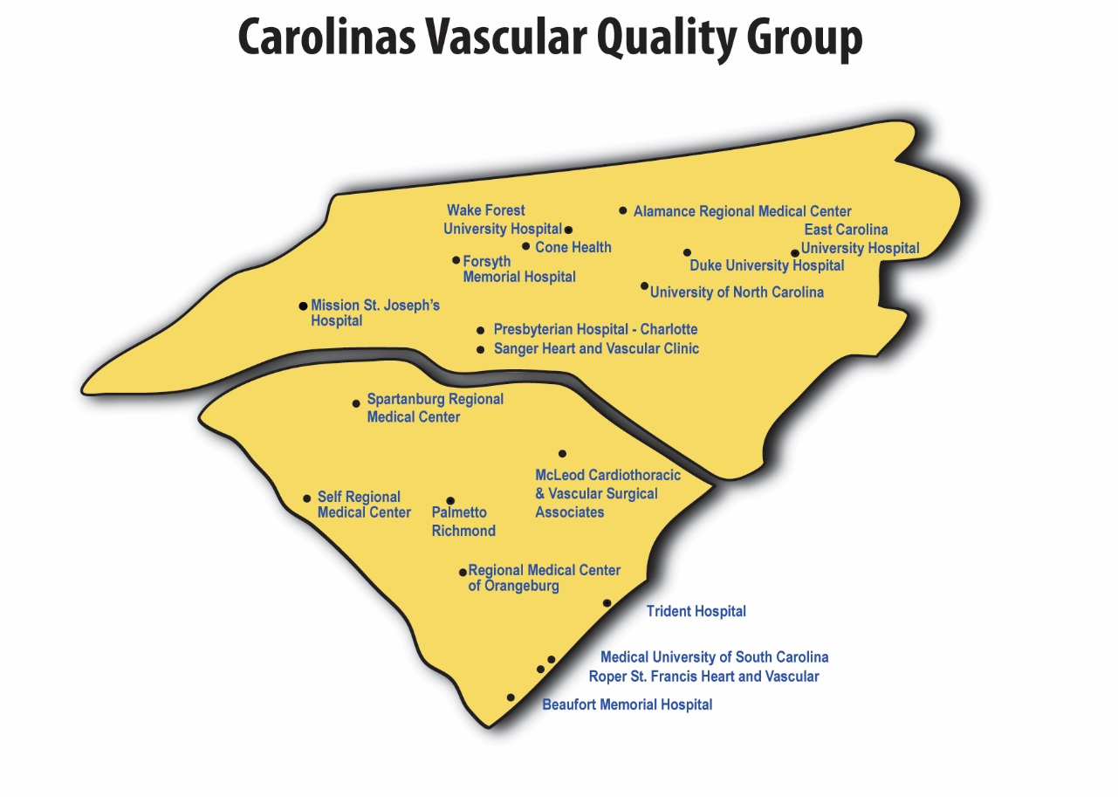
November 4, 2016
10:00 am- 4:00 pm
Roper St. Francis Hospital

Slide 2
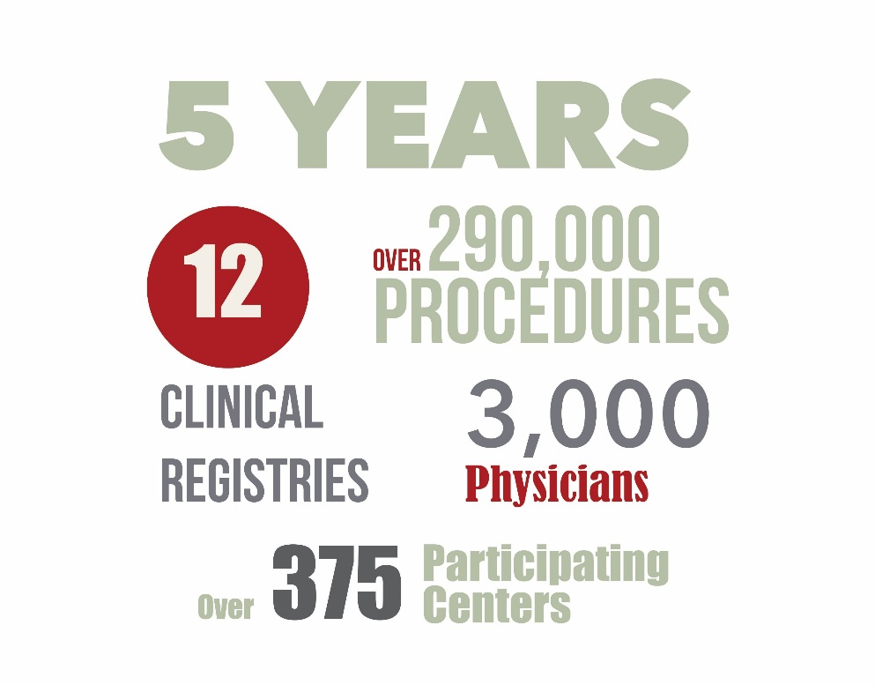
The VQI is celebrating its Anniversary!

Slide 3
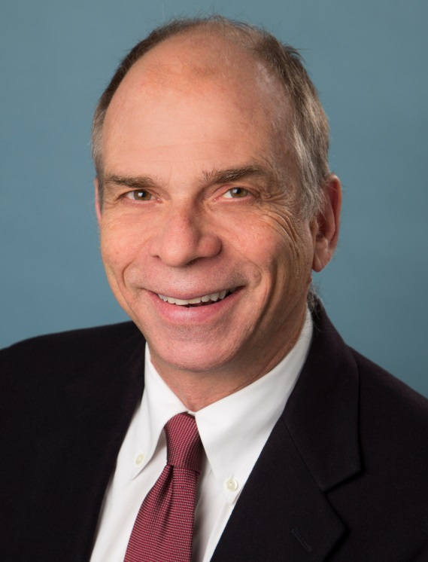
New Medical Director for the VQI
Jen Jorgensen, MD
Director of Maine Medical Center Heart and Vascular Program
One of the founding physicians of the VQI

Slide 4
“Please God, don’t let me(us) screw up!”
Alan Shepard, US astronaut
“The Carolina’s is the epitome of the best in regional vascular groups!!”
Carrie Bosela
SVS VQI National Leadership Group

Slide 5


Slide 6

Carolina's Vascular Quality Study Group
Fall Meeting, November 4, 2016
Charleston, SC
10:00am Welcome and Introduction ....................................................Dr. John "Jeb" Hallett
Approval of May Meeting minutes
10:15am National VQI Update...........................................................................Jim Wadzinski
SVS PSO General Manager
11:00am Regional Data Review............................................................ Dr. John "Jeb" Hallett
Discussion: New PVI Form
"Missing Variables" -Top 20 List
12:00pm Lunch
12:30pm Luncheon Discussion: EVAR Stent graphs- Opportunities for Revenue
1:00pm RAC Update................................................................................Dr. Thomas Brothers
Quality Improvement and Research projects
AQC Update
VQC Update
2:00pm Governing Council Committee Update................................. Dr. John "Jeb" Hallett
2:30pm M2S: Development Update...................................................................Betti Kerrigan
VP Sales and Marketing, m2s
Expanding Participation
3:00pm New Business/Closing Comments........................................... Dr. John "Jeb" Hallett
3:30pm Adjourn

Slide 7
Welcome and Introductions
Alamance Regional Medical Center
Beaufort Memorial Hospital
Carolinas HealthCare
Carolinas HealthCare-Pineville
Cone Health
Duke University Medical Center
McLeod Regional Medical Center
Medical University of South Carolina
Mission Hospital
Novant Health Forsyth Medical Center
Novant Health Matthews Medical
Novant Health Presbyterian Medical
Palmetto Health Richland
Regional Medical Center- Orangeburg
Rex Healthcare
Roper St. Francis
Self Regional Health
Spartanburg Regional
Trident Medical Center
University of North Carolina Hospitals
Vidant Medical Center
Wake Forest University Baptist Health

Slide 8
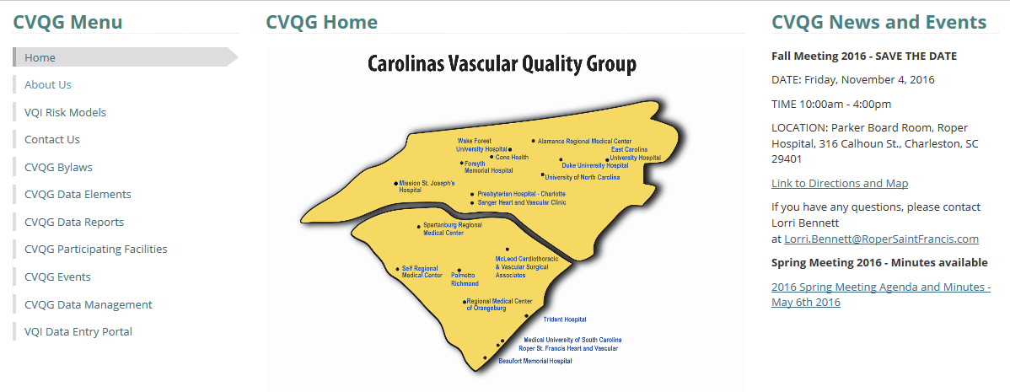
Carolina’s VSG Website

Slide 9
Action Items from Spring Meeting
Long Term Follow-Up
Talk About the New PVI Form
Discharge Meds
Ultrasound Guided Access

Slide 10
National VQI Update:
Jim Wadzinski, SVS PSO

Slide 11
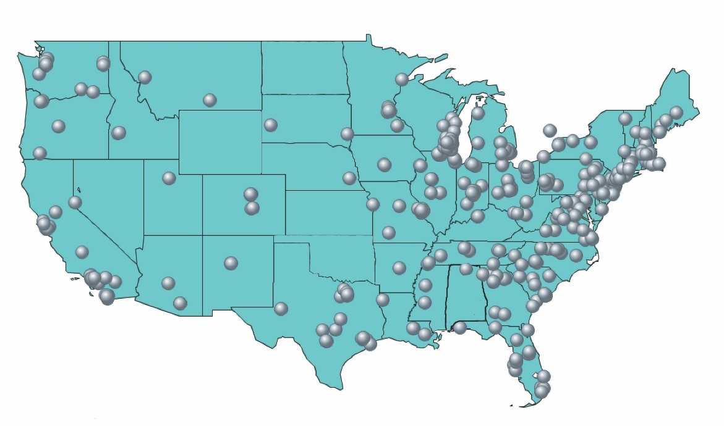
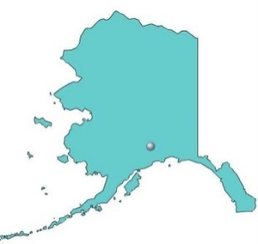
Participating Center Growth
VQI Participating Centers
395 Centers, 46 States + Ontario

Slide 12
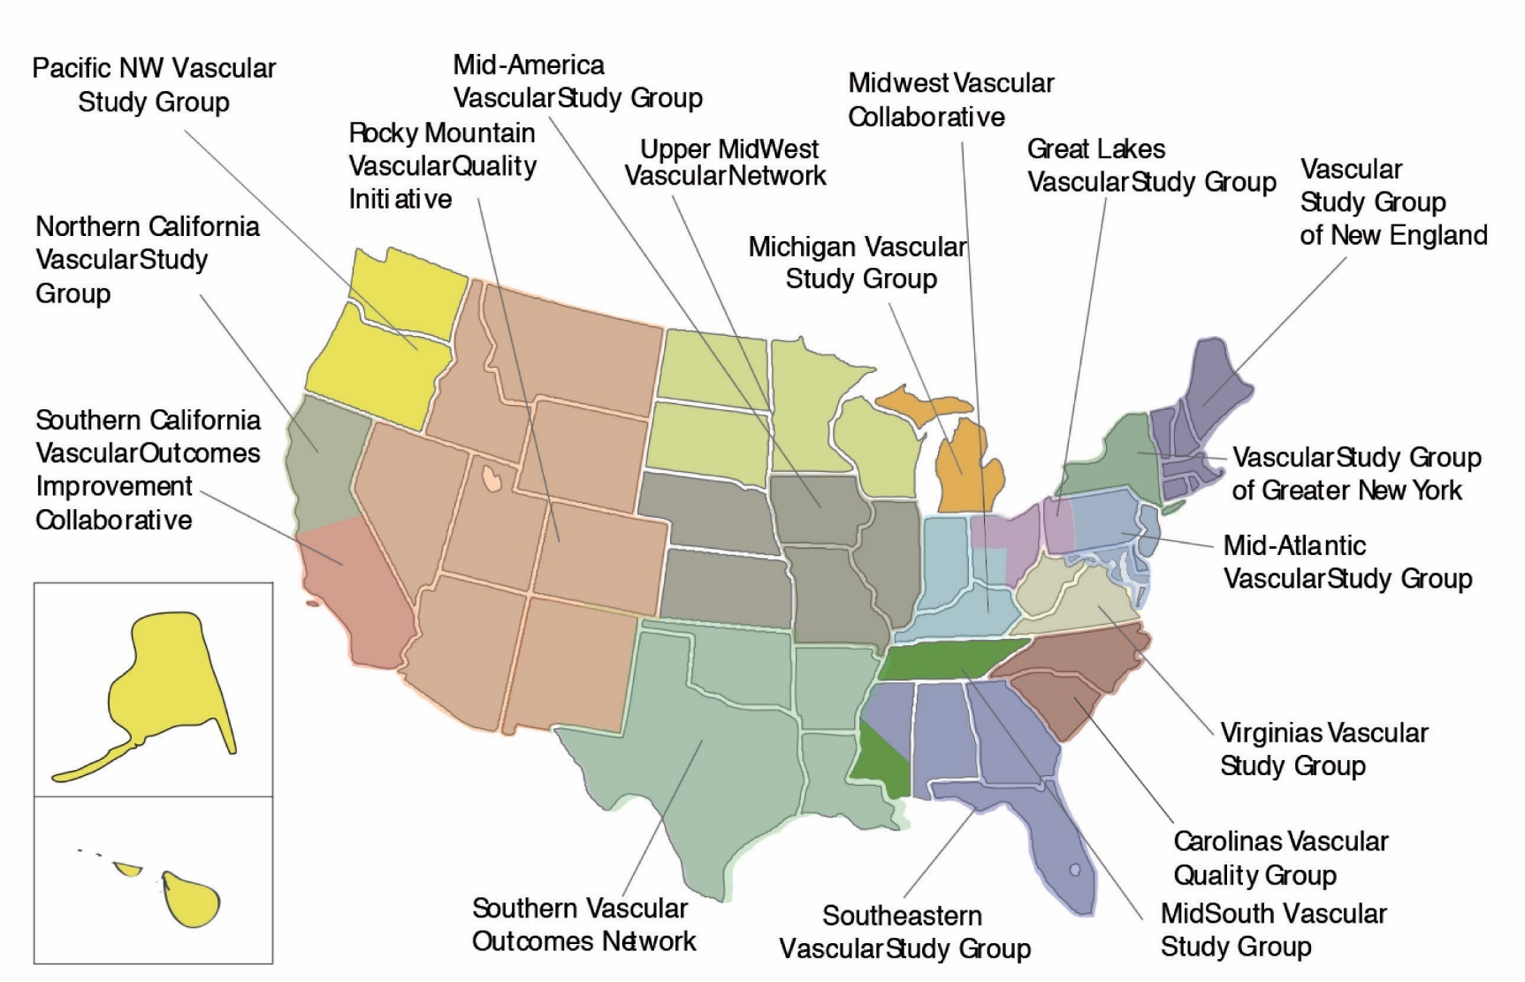
17 Regional Quality Groups
AK
HI

Slide 13
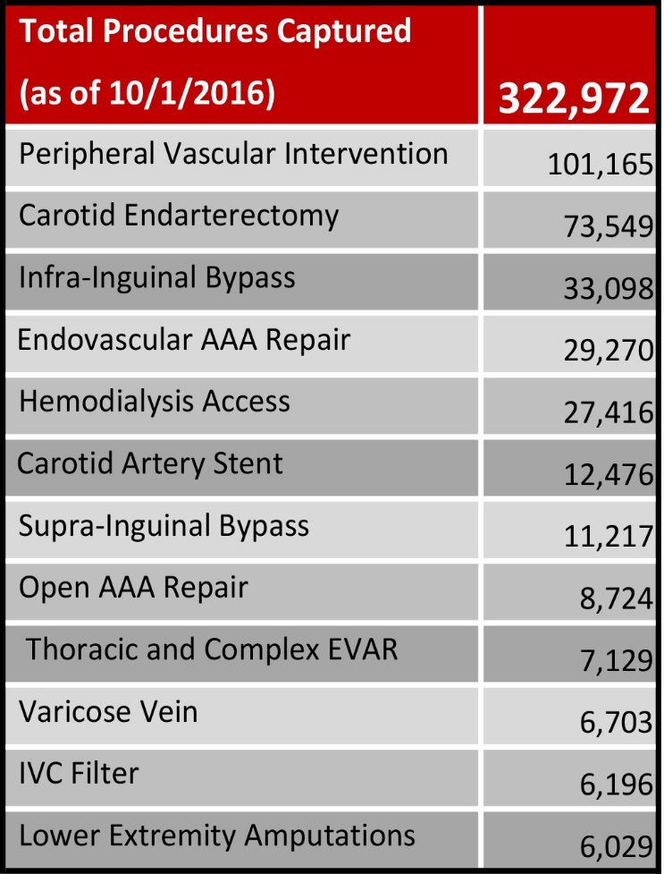
Total Procedure Volume tab reflects net procedures added to the registry for the month

Slide 14
VQI 1st Annual Meeting
Feedback from survey
  Longer, more interactive sessions
  Networking time needed
  Very informative and useful meeting
Suggestions for next year?
  1 ½ days with full day for data managers
  Topic requests?

Slide 15
Annual Overview
http://www.vascularqualityinitiative.org/successful-inaugural-vqi-annual-meeting-svs-pso-now-planning-next-year/
Annual meeting slides can be downloaded from the M2S PATHWAYS resource tab

Slide 16
VQI Participation Award

Slide 17
Participation Award
Results to be released early 2017
One change: Remote attendance awarded for Spring 2016 but not the Fall 2016 or going forward
Meeting-Participation Score*
  No MD from site attends = 0 points
  1 MD from site attends = 1 point
  2 MDs attend (or 1 MD if site has only 2 MDs) = 2 points
  3 MDs attend (or all MDs if site has <3 MDs) = 3 points
  *Additional health professional staff attendance (Data Manager, Admin, NP, PA, Fellow, etc.,) = one additional point if 1 MD attended

Slide 18
PVI registry update
Public comment VEITH 2015-VAM 2016
Specs and revisions sent July 25, 2016
  Allow time to review for any workflow changes
  Educational webinar/s to review all the changes
Released September 23, 2016
Lessons Learned from EVAR!!!!

Slide 19
Medicine Registry Update

Slide 20
Medicine Registry
Scope
  Medical management of:
    Lower extremity PAD
    Carotid stenosis
    AAA
  New outpatient consults that require follow up
  One year follow up required, longer possible

Slide 21
Medicine Registry
  Webinar for final comments Fall 2016
  Release Q2 2017

Slide 22
Inclusion Criteria:
This registry only includes New Outpatient Consults who are being treated medically for:
Peripheral arterial disease due to atherosclerosis
Atherosclerotic carotid artery occlusive disease
Abdominal aortic aneurysm
Exclusion Criteria:
Evaluation/diagnosis of pseudo or neurogenic claudication, peripheral arterial disease due to trauma, popliteal entrapment, medial adventious cystic disease, chronic compartment syndrome
Carotid disease due to dissection, infection, aneurysm, tumor, isolated common carotid lesion not thought to involve the bifurcation, disease of the carotid bifurcation due solely to vasculitis, and Moyamoya disease, and fibromuscular dysplasia
Isolated aortic dissection without aneurysm
Thoracic, thoraco-abdominal, and mycotic aneurysms

Slide 23
Webinar Schedule 2016
  August: PVI registry changes
  September: PVI registry changes
  October 25: QI Guide Implementation series
  November: TEVAR/Complex EVAR vs. EVAR
  December: QI Guide Implementation series
  All Sessions are Recorded and Available in Pathways

Slide 24
PSO Executive Committee Update
Strategic Planning Session
Major Themes for the Planning Sessions included:
  Improving Quality and Patient Outcomes
  Data Accuracy and Integrity
  Optimizing Participation and Engagement
  Long-Term Sustainability and Operational Effectiveness

Slide 25
SVS PSO QI Guide: Volunteer to complete charter and follow guide?
Access QI Guide on M2S pathways website using their member IDs under the Resource section
Identify data manager and physician leader to initiate QI process. Schedule of webinars on QI implementation to be released.

Slide 26
EPIC Update
Dr. Michael Stoner and Dr. Robert Steppacher discussed Epic-VQI integration on Monday, September 19th at the annual Epic Users’ Group Meeting (UGM) in Verona, WI.
o Slides and audio from the presentation will be available at userweb.epic.com approximately one month after the meeting
Smart Data Elements to capture VQI variables for CEA have been released.
o Ask your IT staff to contact their Cupid or OpTime TS and ask for SU package E8204331
o A guide to how to configure VQI note templates to use SDEs is available in the resource tab of VQI
Smart Data Elements for PVI are under construction, we expect these to be available Q4 2016.

Slide 27
  Improving Quality and Patient Outcomes
  Launch National QI projects, potentially Discharge Meds and EVAR LTFU
  Review and update the key quality measures for each registry and that these measures are reported to its members. These measures should also align to MACRA/MIPS and future APMs.
  Develop messaging on how the QCDR/PQRS measures can help compliance with MIPS for 2017/2018, prior to the creation of a vascular APM.
  Collaborate with SVS on the creation of Clinical Guidelines and Best Practices, inclusive of appropriateness of care.

Slide 28
Data Accuracy and Integrity
  Continued focus on improving LTFU
  Analyze data on “Cases Submitted Without Validation”
  Pilot Project Using Statistical Analysis to Determine if Variables can be Eliminated (CEA)
  Increase Audits by Frequency and Type
  Increase Training and Education for Data Managers
  Leverage Regional Meetings to Enhance Data Capture and Integrity

Slide 29
Optimizing Participation and Engagement
  Continued Interim Quality Reporting (COPI and Physician Reports)
  Repeat previously issues COPI and/or Physician Reports to show Change Over-Time
  Identify ways to Improve Regional Meeting Participation
  Provide Education on QI Project Guide
  Create and Disseminate Best Practice Case Studies, Featuring VQI Success Stories
  Engage Quality Personnel from VQI Sites in Improvement Efforts

Slide 30
Long-Term Sustainability and Operational Effectiveness
  Create an Infrastructure for Increased Audit Activity
  Prioritize Registry Maintenance and Development
  Continue to Improve Reporting and Analytics
  Expand VQI Annual Meeting to Include Additional Time for Data Manager Education and Networking

Slide 31
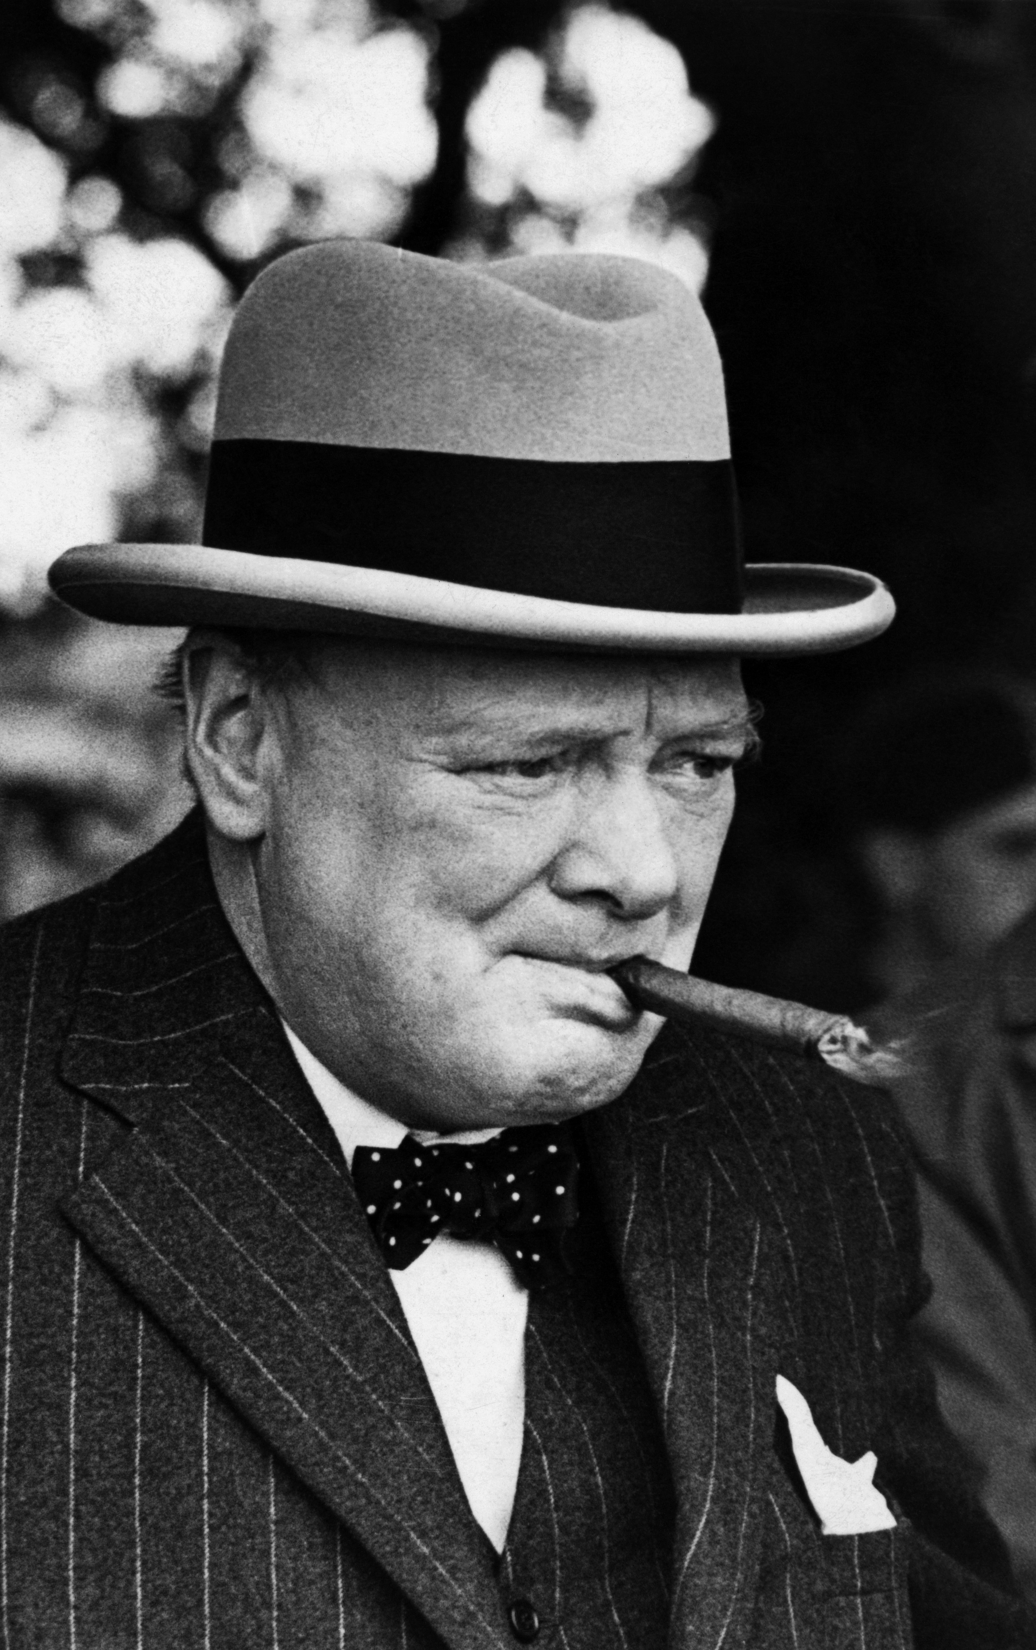
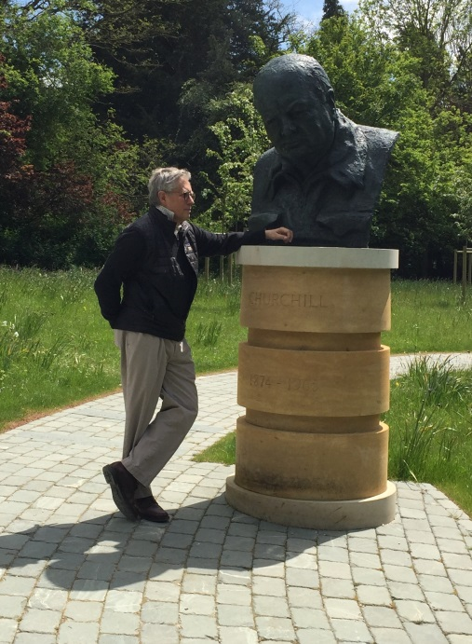
Regional Reports:
Jeb Hallett, MD
“Give us the tools, and we will get the job done!
Winston Churchill

Slide 32
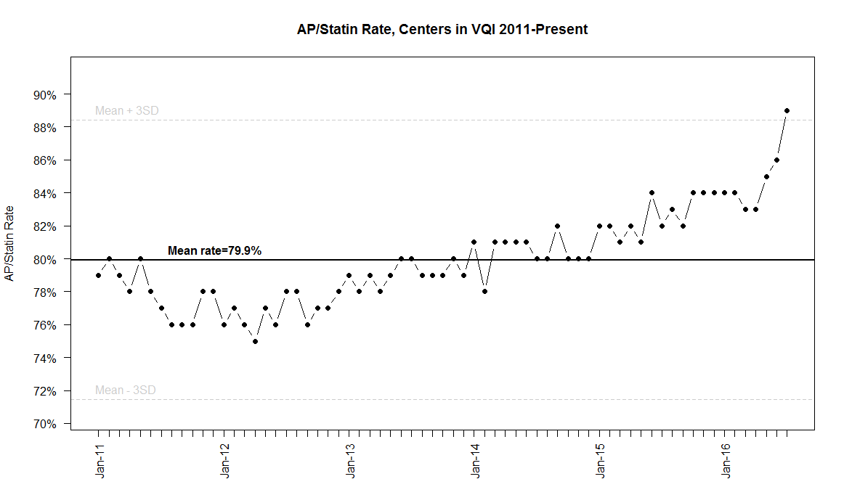
National QI Initiative to Increase Statin Use
Push Reports
Presentation
Publication

Slide 33
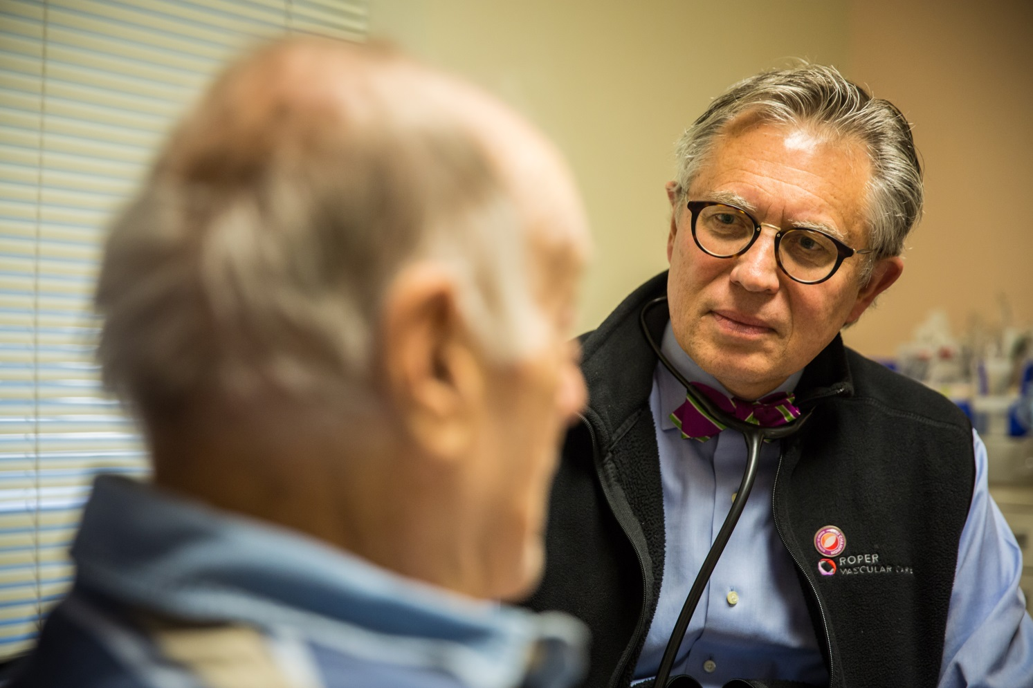
Play every point!!
Check every patient’s EMR
Ask every patient IF they are
taking their statin
Refill the Rx for statin
IF NOT on statin, why?
Explain three benefits
Start a statin

Slide 34
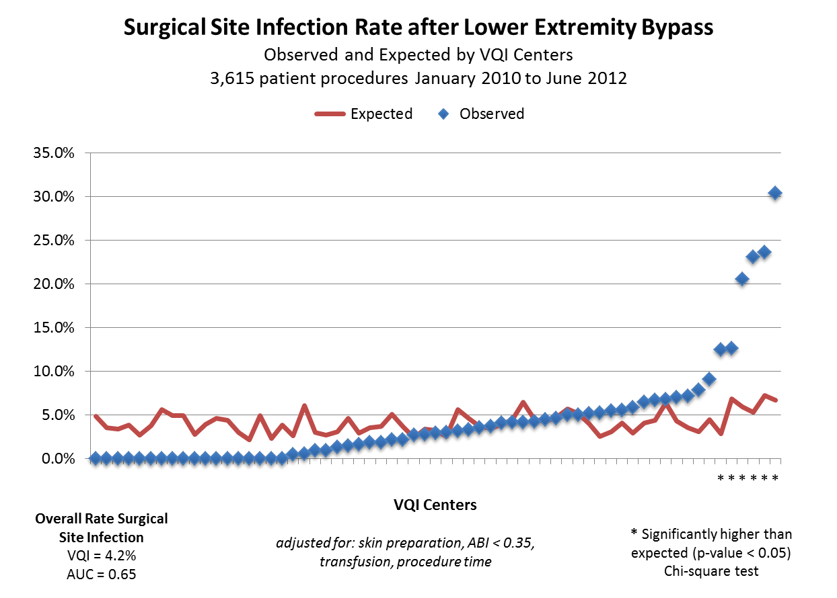
Value of VQI Participation –
Center Opportunity Profile for Improvement
Surgical Site Infection after Lower Extremity Arterial Bypass
Significant variation found across participating centers in VQI
Risk factors associated with Surgical Site Infection:
  Operation > than 220 minutes
  Transfusion > 2 units packed blood cells
  Pre-op skin prep not chlorhexidine
30%

Slide 35
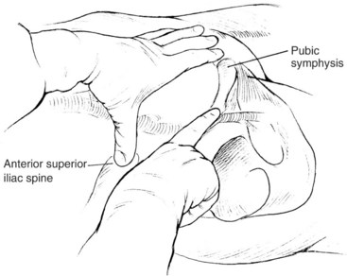
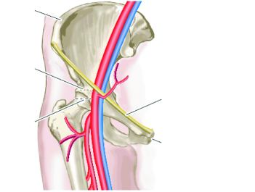
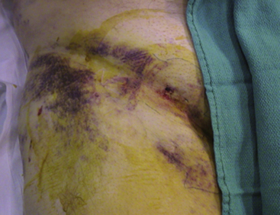
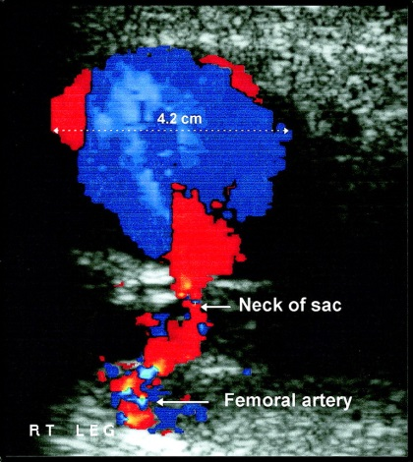
Current HOT local, regional, and national problem

Slide 36
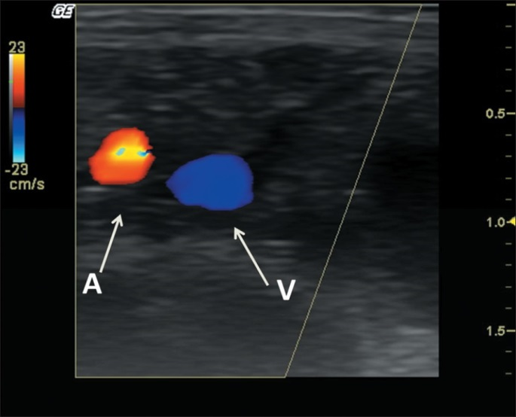
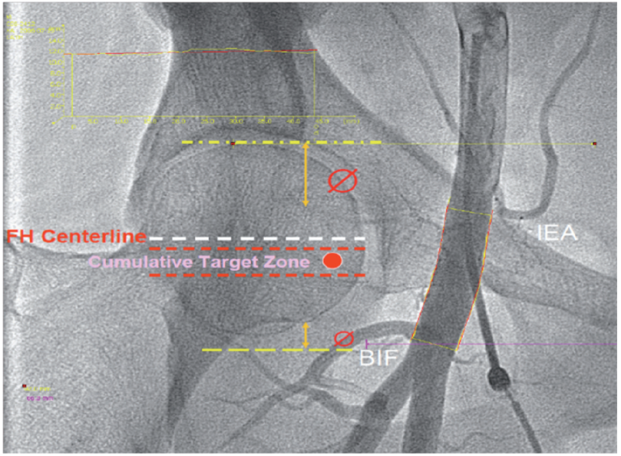
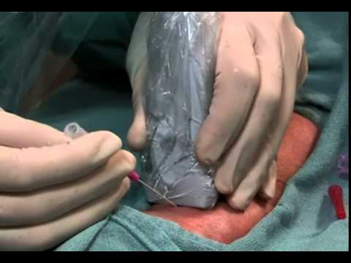
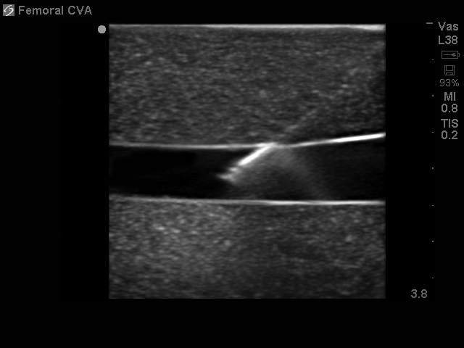
The question : does guidance decrease access
complications?
“When you know where you are, you know where you are.”
Yogi Berra

Slide 37
What have the best centers done?
Give the patient (and family) an explicit message that routine CEAs discharge by noon the first post-op day
No Foley Catheters (Preop IV Antibiotics and Preop Pee)
Judicious intraop IV fluids
No Routine ICU (four-hour recovery area)

Slide 39
Make the Carolinas Great Again!!
Play every visit for statin and aspirin
Finish our mission of CEA length of stay
Lead the nation in safe femoral access
Share our best techniques/care with other regions
Decrease LOS for EVAR (big $$$)
Improve long-term care of EVAR
Focus on decreasing open AAA mortality

Slide 40
Review of the Regional Reports comparing
Facility- Regional-National data.

Slide 41
Some aneurysm issues

Slide 42
What are the “best” doing
Place and equipment for procedure
Percutaneous access/closure devices
Post EVAR care pathway before discharge
Cost containment efforts (margin??)
Follow-up pathway and one-year FU plan

Slide 43
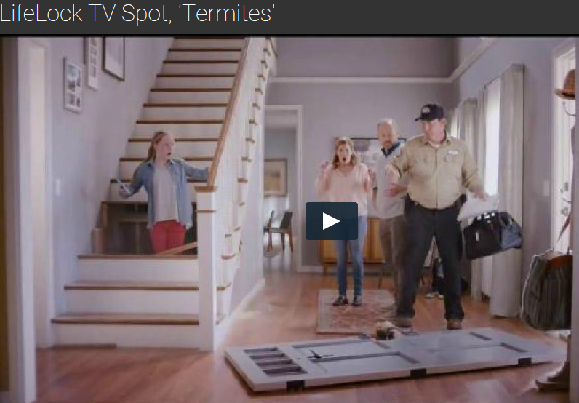

“If you have a problem, why not fix it.”
We have a problem!

Slide 44
What do we do about open AAA?
Are we operating on high-risk patients who should not be operated?
How are we assessing that risk?
What is killing these patients?
Should open AAA be centralized?
Should they be referred to “best” surgeons?

Slide 45
Research Advisory Council Update: Thomas Brothers, MD

Slide 46
National Research Projects:
This year the SVS PSO Research Advisory Committee (RAC) approved 64 national research projects submitted by 51 unique VQI investigators in 26 centers, representing diverse topics across multiple procedures. In addition, multiple research projects using regional data were performed at VQI sites.
http://www.vascularqualityinitiative.org/vqi-resource-library/research-advisory-committee/

Slide 47
Regional Research Projects:
Identify the processes and techniques of those with lowest rate for access complications
Disseminate those recommendations
Create a focus group of our “best” to lead us all to being the “safest” region in the USA
Access whether our QI process can reduce the complication rate in EVERY center

Slide 48
Actionable Reports
Physician-level Reporting : these comparisons allow sites to analyse blinded physician results between physicians at the same site as well as between facilities to understand detailed results and best practices
Site-level Reporting (Center Opportunity Profile for Improvement Reports): Similar to the physician data, the COPI Reports provide detailed national and regional benchmarking on quality improvement such as length of stay

Slide 49
COPI and Physician Reports
In addition to the spring and fall regional reports, this year we have published two COPI reports:
  30-day stroke and 1-year mortality after CEA
  30-day stroke or 1-year mortality after CAS
We have also published two surgeon-level reports:
  Percentage of high-risk patients receiving CEA
  Percentage of patients receiving follow-up imaging after EVAR
At least two additional reports are planned for this year:
  COPI report on hematoma after PVI
  Surgeon-level report on percentage of high-risk patients receiving CAS

Slide 50
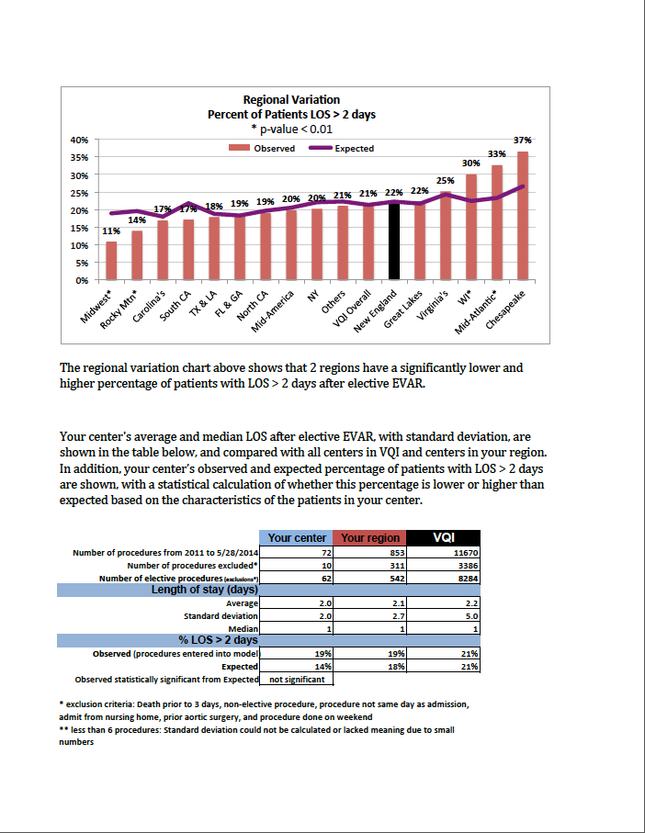
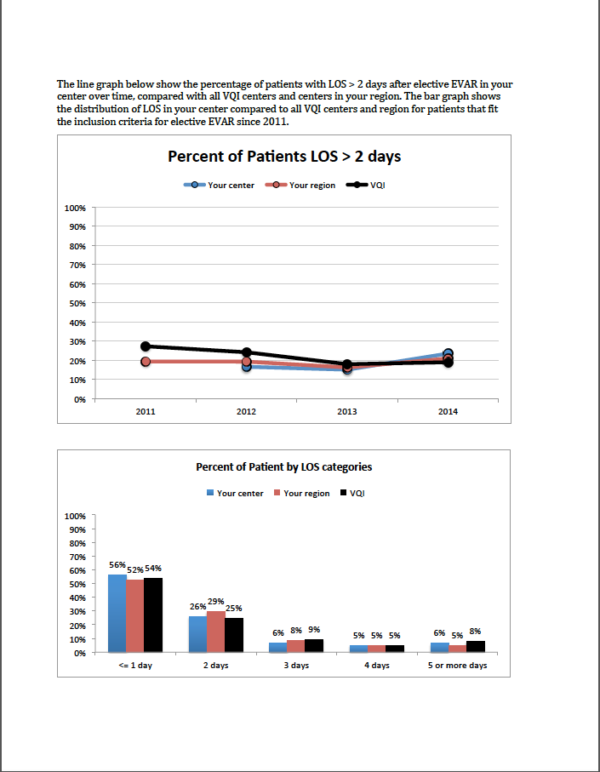
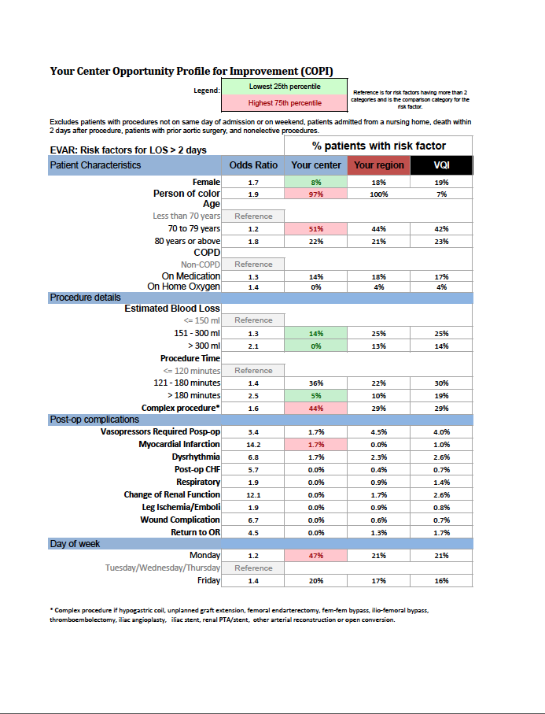
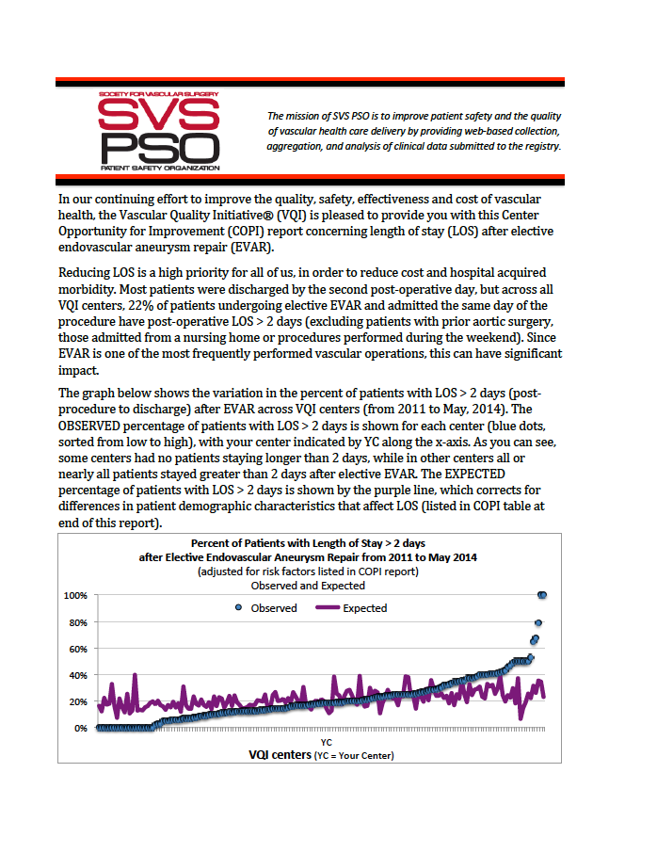
Improving vascular care at each center
Notes:
These reports are helpful to reduce LOS and cost in our efforts to improve quality of care for vascular patients.

Slide 51
Value of VQI Participation –
Center Opportunity Profile for Improvement
Surgical Site Infection after Lower Extremity Arterial Bypass
Significant variation found across participating centers in VQI
Risk factors associated with Surgical Site Infection:
  Operation > than 220 minutes
  Transfusion > 2 units packed blood cells
  Pre-op skin prep not chlorhexidine
30%

Slide 52
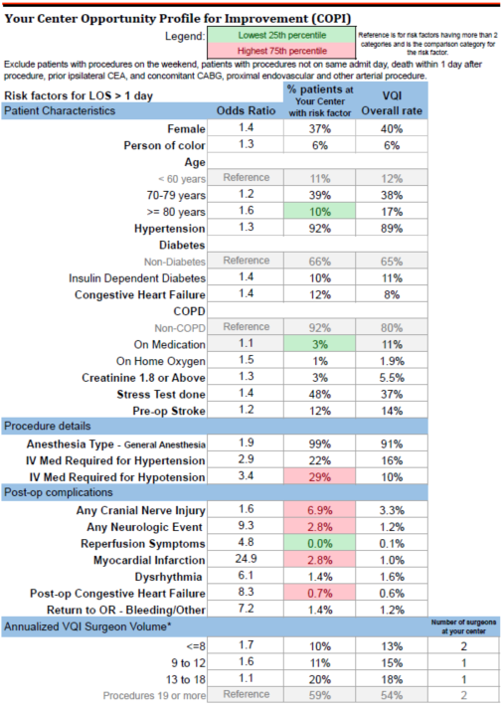
VQI COPI Report for each Center Showing Specific Opportunity for Improvement
Patient Characteristics
  Not modifiable, but could be used to focus discharge planning prior to procedure
Procedure Details
  Could be modified or investigated to improve current practice
Post-op Complications
  Key opportunities to investigate and improve to reduce LOS
Surgeon Volume
  Opportunity to change practice of low volume surgeons

Slide 53
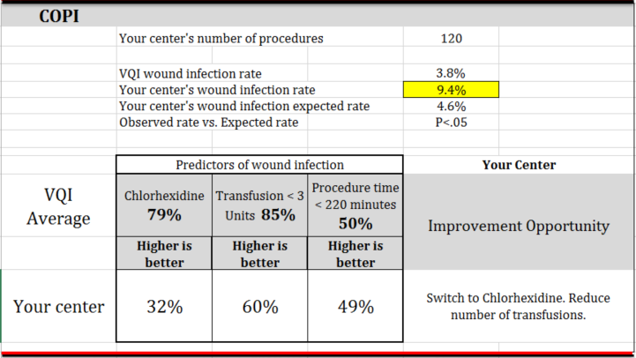
Improving vascular care at each center
  VQI Center Opportunity Profile for Improvement Report

Slide 54
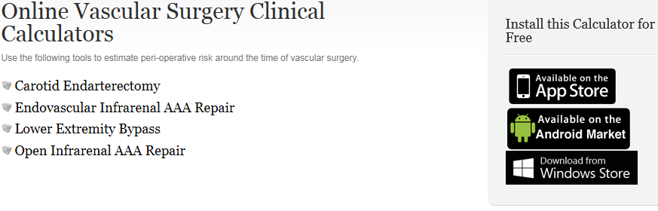
Cardiac Risk Calculators:
QXMD: http://www.qxmd.com

Slide 55
Current on going Arterial Quality Council work:
Finalized PVI registry updates
Updating CAS registry
Finalize New Medicine Registry
Determining variables per registry that negate the need for LTFU
Data Audits

Slide 56
Venous Quality Council Update:
Jeb Hallett, MD & Jim Wadzinski

Slide 57
Venous Quality Council
Less active than Arterial Quality Council
Increased # of procedures looking at data and QI opportunities
BCBS Opportunity

Slide 58
Arterial Quality Council Update:
Thanks to Jay Robison for his service!
Do we have a new “volunteer?”

Slide 59
Governing Council Update:
Jeb Hallett, MD

Slide 60
Governing Council
The Governing Council approved the policy of un-blinding LTFU Reporting Rates, if a majority of members of the regional group agree to un-blind the LTFU data.
M2S and Medstreaming provided the Committee with an overview on what the acquisition might afford VQI members:
  Enhanced Analytics
  Experience with data integration from EMRs
  Extensive experience with outpatient data that complements M2S experience with inpatient data.
Announcement of the new PSO Communications Committee
  Glen Jacobowitz from NYU Langone, Chair
  Leila Mureebe from Duke University Medical Center, Vice Chair

Slide 61
Pathways Development Update
Betti Kerrigan

Slide 62
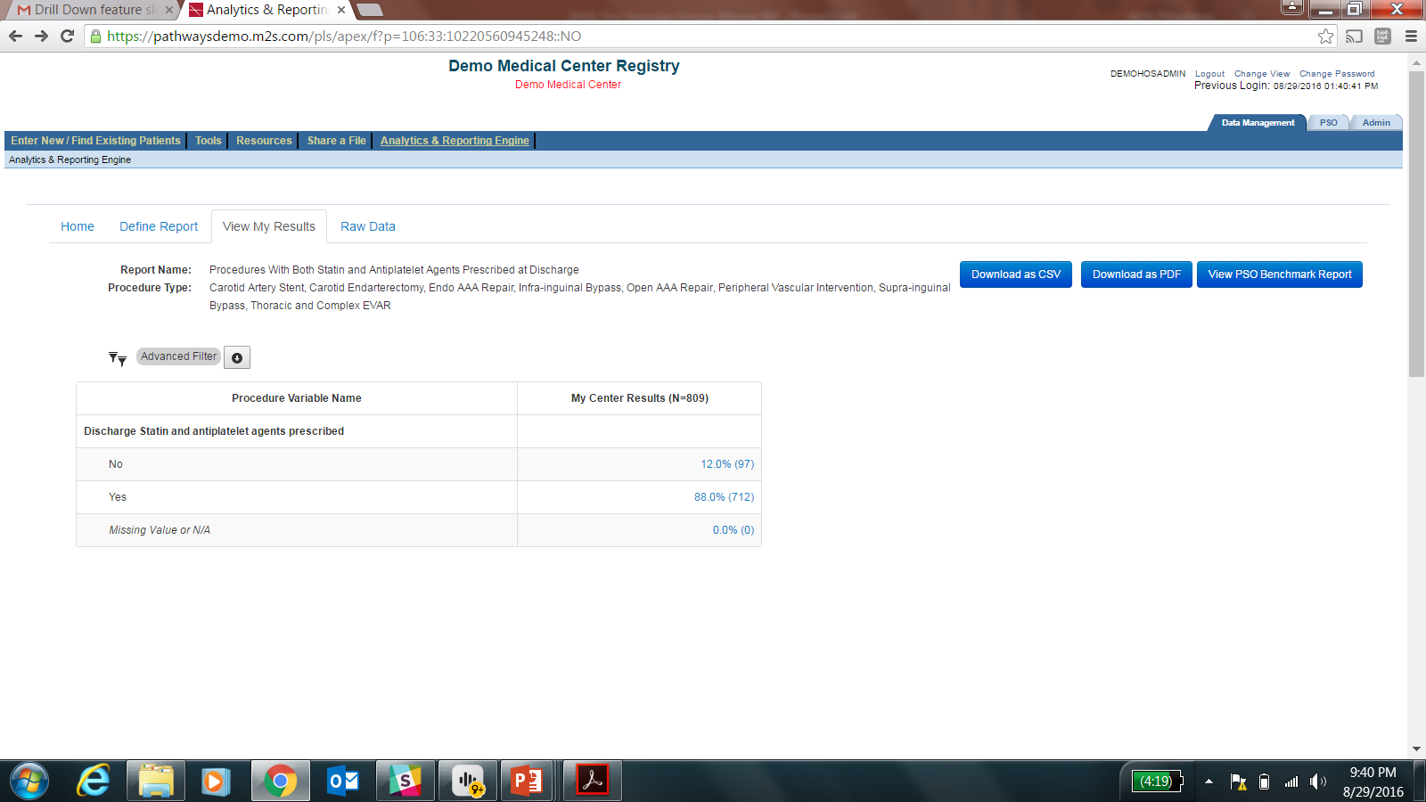
Drill Down – Procedures With Both Statin and Antiplatelet Agents Prescribed at Discharge
0.0%
Notes:
Report variables are now a clickable link to drill down to the specific patients contributing to the results.

Slide 63
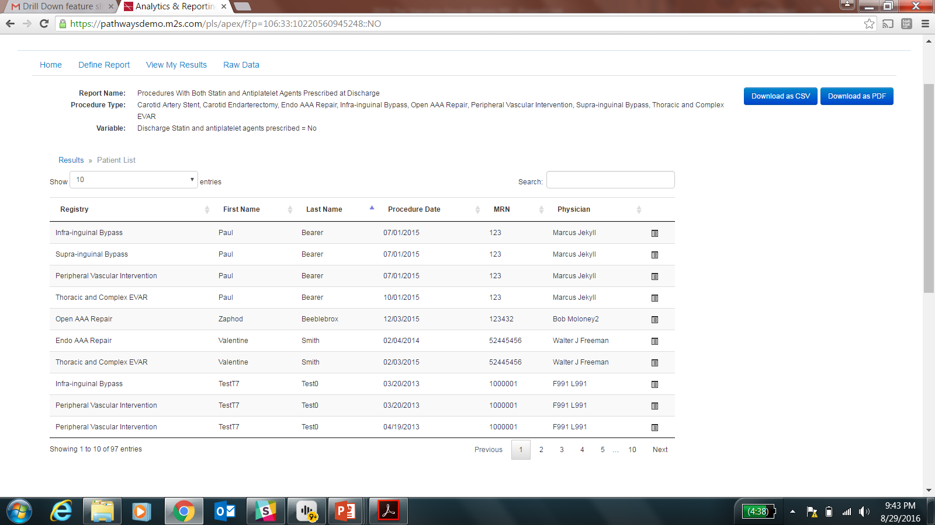
Drill down – Procedures With Both Statin and Antiplatelet Agents Prescribed at Discharge
Notes:
The link takes you to a list of patients that were used to make the outcome of that variable.

Slide 64
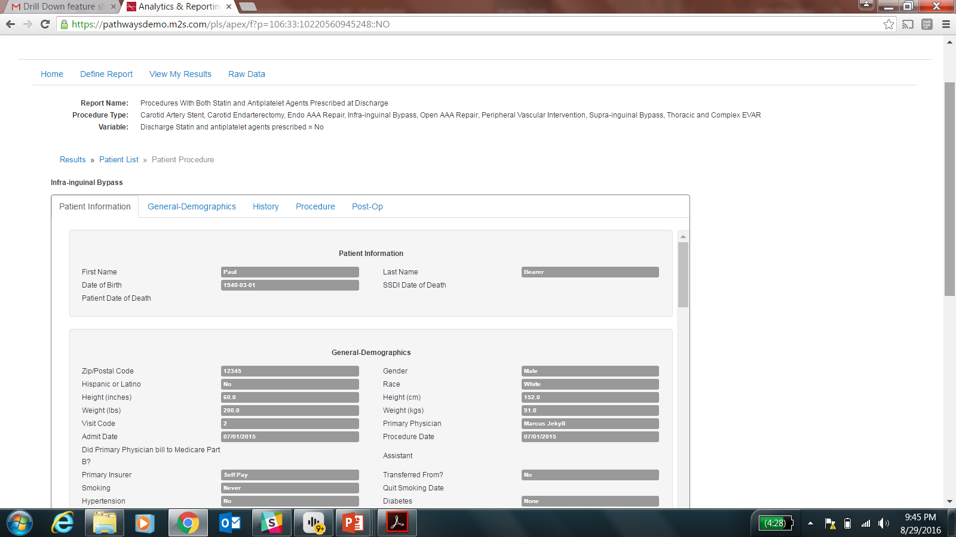
Drill down – Procedures With Both Statin and Antiplatelet Agents Prescribed at Discharge
Notes:
For calculated variables all variables that could have been used are highlighted to remind you what we used in our calculation.

Slide 65
Drill Down Permissions
Physicians can only drill down to their own patient level data
Hospital Manager and all other non-physician users can only drill down if they have permissions to the “procedure and follow up download reports” privilege (granted by M2S with hospital manager approval)

Slide 66
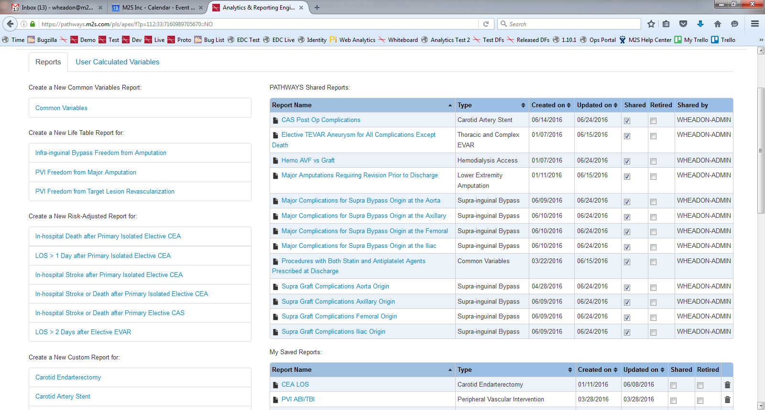
Shared Reports – Where to find them
Notes:
M2S is now able to share reports that are popular amongst users. If there are report recommendations/suggestions please pass them along (to you, Carrie for vetting?). The first 3 reports have been shared.

Slide 67
Shared Reports – What’s Available?
Reports Available in PATHWAYS Analytics | Registry
CAS Post Op Complications | CAS
Elective TEVAR Aneurysm for All Complications Except Death | TEVAR
Hemodialysis AVF vs Graft | Hemo
Major Amputations Requiring Revision Prior to Discharge | LEA
Major Complications for Supra Bypass Origin at the Aorta | Supra
Major Complications for Supra Bypass Origin at the Axillary | Supra
Major Complications for Supra Bypass Origin at the Femoral | Supra
Major Complications for Supra Bypass Origin at the Iliac | Supra
Procedures with Both Statin and Antiplatelet Agents Prescribed at Discharge | CAS, CEA, EVAR, Infra, Open, PVI, Supra, TEVAR
Supra Graft Complications Aorta Origin | Supra
Supra Graft Complications Axillary Origin | Supra
Supra Graft Complications Femoral Origin | Supra
Supra Graft Complications Iliac Origin | Supra

Slide 68
Shared Reports – Coming Up Q4
Available by Q4
Elective TEVAR Aneurysm for all complications including death | TEVAR
ICU Days >= 3 Days | Open, EVAR, TEVAR, Supra
Major Cardiac Event Composite | Open, EVAR, TEVAR, Supra, Infra

Slide 69
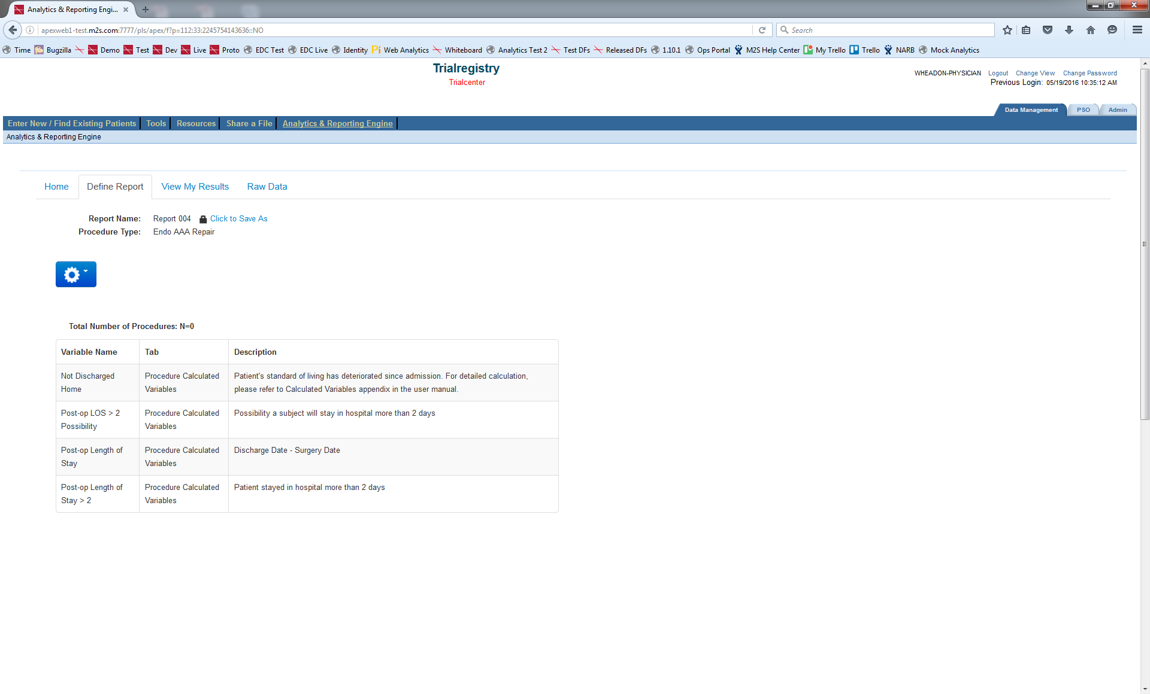
Shared Reports – Modify and Save to Meet Your Needs
Click to Save As
Notes:
Users can modify a shared report by saving it as their own.

Slide 70
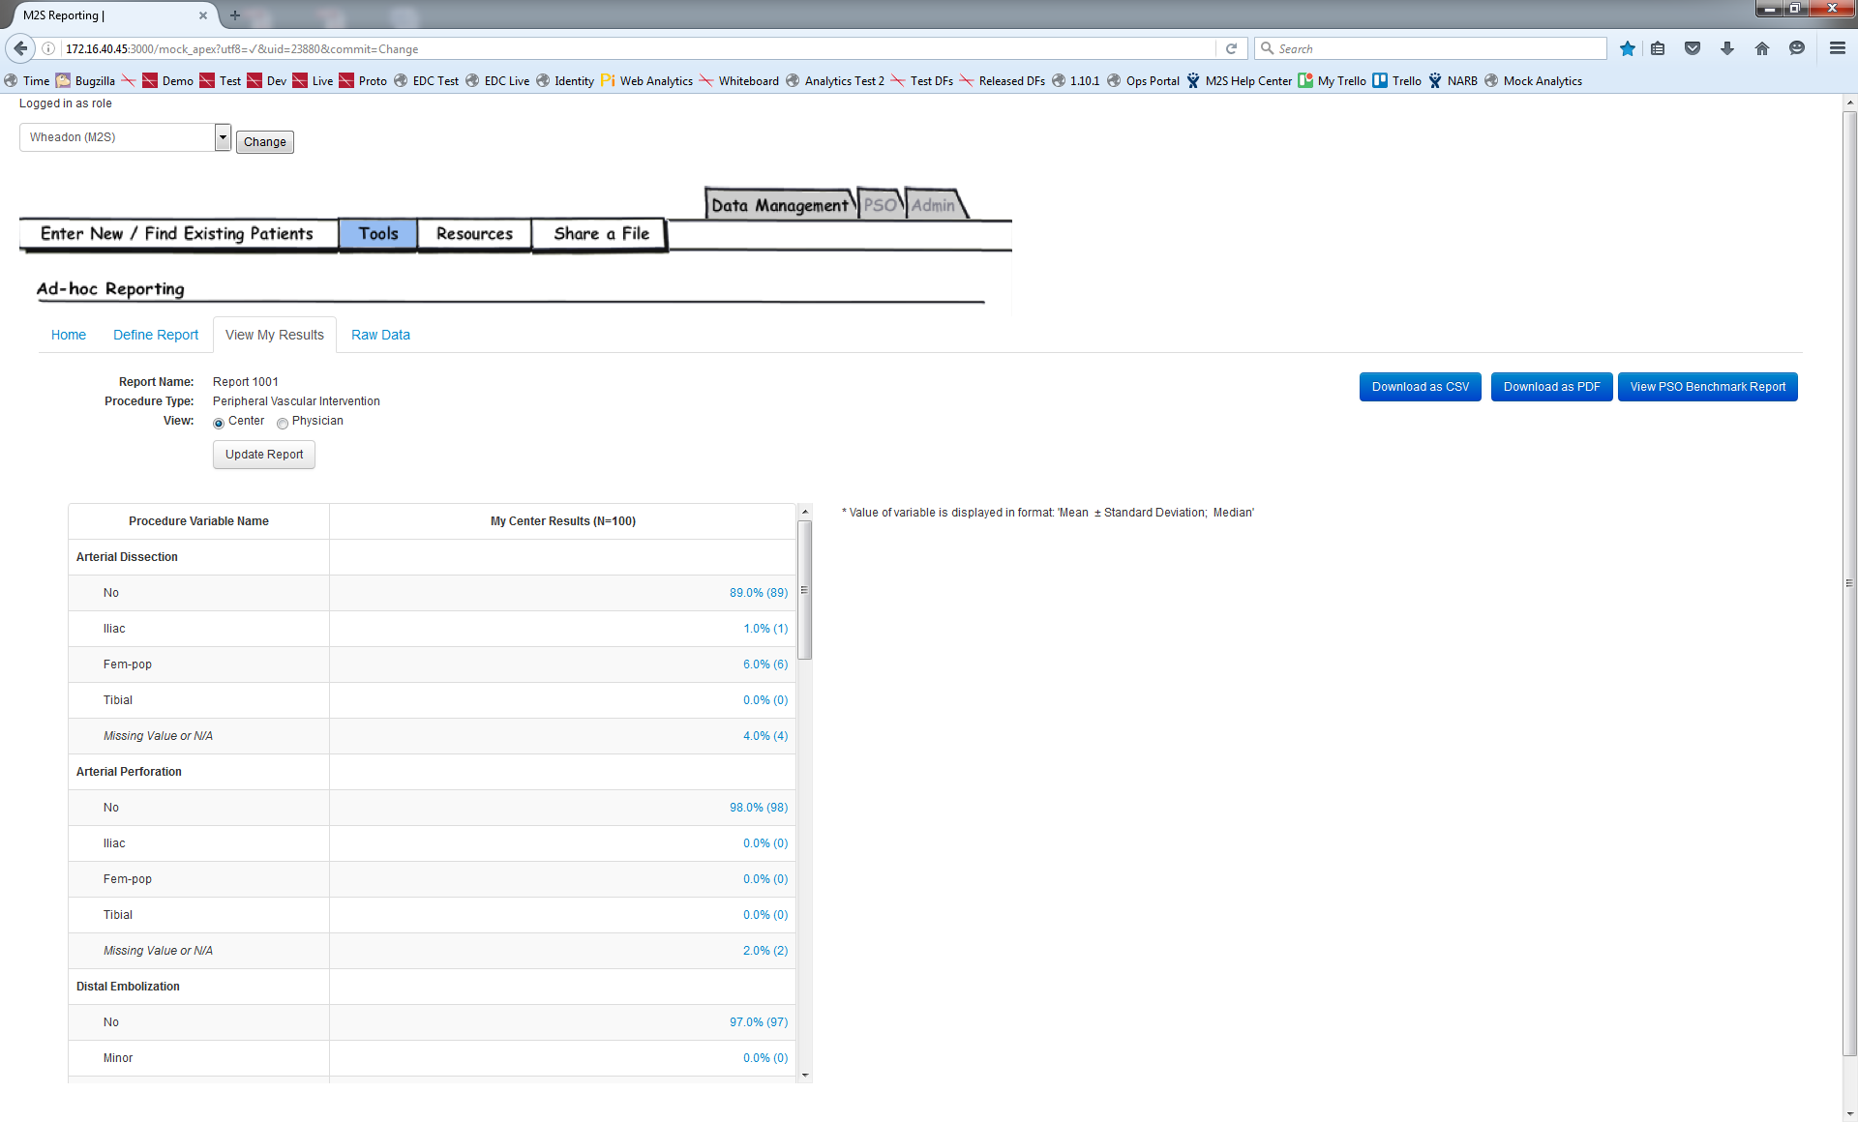
Physician-level Reporting – Choose Your View
Center or Physician?
Notes:
The physician-level reporting feature will allow users to toggle between a center view or a physician view. This screenshot is specific to a center user. Physicians will have the ability to toggle between their own data and the option to run a report that includes additional physicians in their center.

Slide 71
Release Order
Shared Reporting (released)
Drill Down (released)
Physician-level Reporting Q4
Modifying common variables – can be common across tabs Q4

Slide 72
EMR Integration Status Updates
Integration for Varicose Vein procedure form
  Released and officially certified 2 vendors
    Medstreaming
    Mtuitive
Integration for PVI procedure form
  Planned to be available in Q4 2016
Integration for procedure forms of other registries
  Planned to be available in 2017
Integration for follow-up forms
  Planned to be available in 2017

Slide 73
2016 QCDR Program
A QCDR is a CMS-approved entity that collects medical and/or clinical data for the purpose of patient and disease tracking to foster improvement in the quality of care provided to patients.
Individual EPs who satisfactorily participate in 2016 PQRS through a QCDR may avoid the 2018 negative payment adjustment.
26 Measures Available in 2016
To successfully participate:
  9 measures
  across 3 domains
  2 outcome measures
  reporting rate > 50% Medicare patients
  2015 procedures must be followed up by 12/31/2016

Slide 74
Email Deliverability…a problem for you?
Have you experienced problems receiving our email newsletters or PATHWAYS updates? Contact us at vqi@m2s.com if you are not receiving emails from the VQI or PATHWAYS.
Types of emails we are currently sending:
VQI Pulse eNewsletter
PATHWAYS product updates
VQI Registry news
Webinar events
and much more!

Slide 75
Bard Peripheral Vascular LifeStent
Bard has recently partnered with the VQI for a post approval project for the LifeStent® Vascular Stent System.
Invitations sent
Patients: 74 patients
Timepoints: Procedure, 1 yr, 2 yr
  Less than 5 custom VQI content
  Images sent to Imaging CoreLab at 1 yr. and 2 yr. if specific Adverse Events are reported

Slide 76
The VQI is celebrating its Anniversary!

Slide 77

^{New VQI Customers (Nov 18th)}
Give us a chance to show you the power of your data.
Choose FIVE or more registries and your site will save $2,500 off your first year!
Current VQI Customer (Dec 31st)
Thank you for playing such a big role in our success.
Add an additional VQI registry to your package, and receive a one-time $500 credit, per site, at the time of renewal.

Slide 78
Business Discussion:
Review redlined bylaw changes

Slide 79
Make the Carolinas Great Again!!
Play every visit for statin and aspirin
Finish our mission of CEA length of stay
Lead the nation in safe femoral access
Share our best techniques/care with other regions (e.g. lower limb bypass)
Decrease LOS for EVAR (big $$$)
Improve long-term care of EVAR
Focus on decreasing open AAA mortality

Slide 80

Next meeting: Friday, May 5, 2017
Grove Park Inn
Asheville, NC

