Slide 1
VQI Participation
Regional Breakdown
Canadian Vascular Quality Initiative | 7 Centers
Carolinas Vascular Quality Group | 41 Centers
Great Lakes Vascular Study Group | 63 Centers
Michigan Vascular Study Group | 37 Centers
Mid-America Vascular Study Group | 81 Centers
Mid-Atlantic Vascular Study Group | 95 Centers
MidSouth Vascular Study Group | 26 Centers
Midwest Vascular Collaborative | 50 Centers
Northern California Vascular Study Group | 27 Centers
Pacific NW Vascular Study Group | 38 Centers
Rocky Mountain Vascular Quality Initiative | 57 Centers
Southeastern Vascular Study Group | 141 Centers
Southern California VOICE | 41 Centers
Southern Vascular Outcomes Network | 116 Centers
Upper Midwest Vascular Network | 66 Centers
Vascular Study Group of Greater New York | 45 Centers
Vascular Study Group of New England | 50 Centers
Virginias Vascular Study Group | 44 Centers
Singapore | 1 Center
TOTAL CENTERS | 1 ,028 Centers
(VOICE)

Slide 2
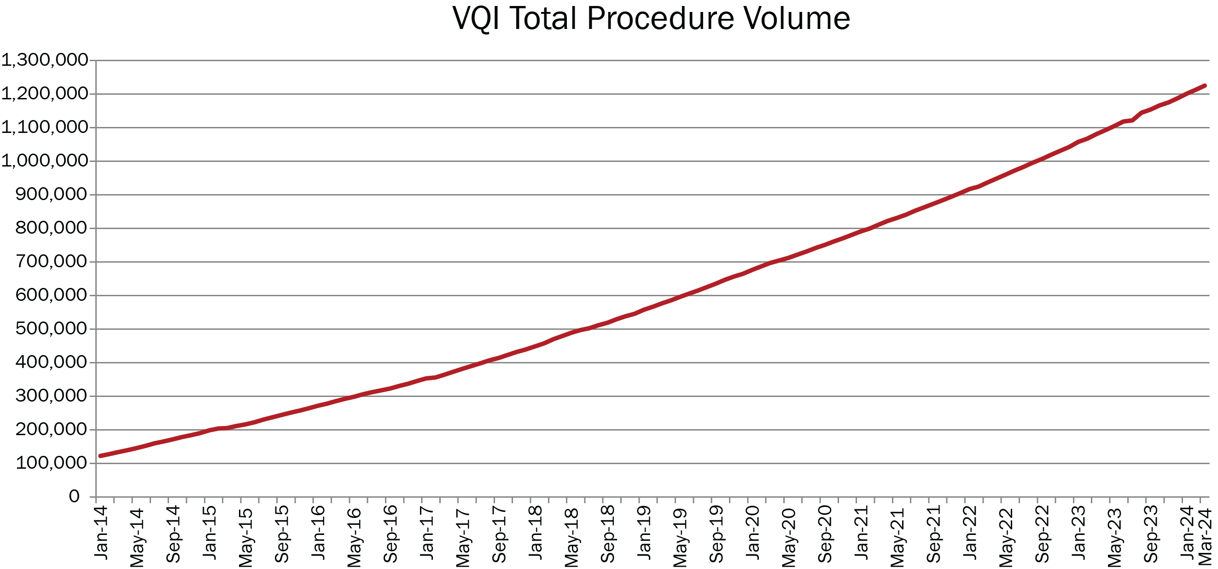
Procedures Captured
TOTAL PROCEDURES CAPTURED | 1,225,000
(as of 4/1/2024)
Peripheral Vascular Intervention | 425,809
Carotid Endarterectomy | 213,567
Infra-Inguinal Bypass | 88,450
Endovascular AAA Repair | 88,876
Hemodialysis Access | 82,219
Carotid Artery Stent | 125,589
Varicose Vein | 66,039
Supra-Inguinal Bypass | 28,018
Thoracic and Complex EVAR | 33,685
Lower Extremity Amputations | 32,249
IVC Filter | 19,226
Open AAA Repair | 19,146
Vascular Medicine Consult | 1,854
Venous Stent | 273
Total Procedure Volume reflects net procedures added to the registry for the month

Slide 3
Participation by Registry
SUBSCRIBED REGISTRY
VOLUME (as of 4/1/24)
Peripheral Vascular Intervention | 405
Carotid Endarterectomy | 498
Infra-Inguinal Bypass | 253
Endovascular AAA Repair | 368
Hemodialysis Access | 93
Carotid Artery Stent | 929
Varicose Vein | 37
Supra-Inguinal Bypass | 163
Thoracic and Complex EVAR | 187
Lower Extremity Amputations | 97
IVC Filter | 51
Open AAA Repair | 211
Vascular Medicine Consult | 7
Venous Stent | 11

