Slide 1
WELCOME
SOUTHERN VASCULAR OUTCOMES NETWORK
November 3, 2023
6:30 – 9:00pm CT
Houston, TX
Hybrid

Slide 2
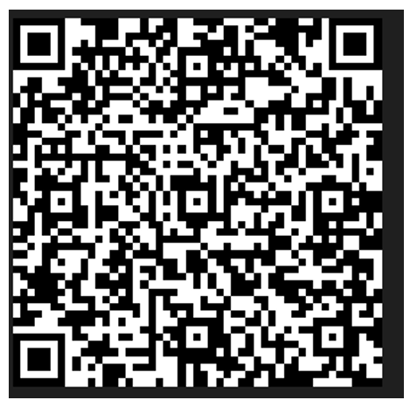
In-Person
Regional Registration
QR Code
REMOTE ATTENDEES - DO NOT USE THE QR CODE

Slide 3



Remote Meeting Attendance Credit
Before we get started, please sign in.
Click “Participants” in the box at the top or bottom of your screen.
If your full name is not listed, hover next
to your name and look for “rename”. Select & sign in.
Can’t sign in? Email Angela Churilla at achurilla@svspso.org & include the identifier you were signed in under (ex: LM7832) or phone number.
*NOTE: Credit is NOT given to any attendee or speaker that does not have an ACTIVE PATHWAYS user account.

Slide 4

Please Identify Yourself
Please provide your full name before we begin our data review.
Those that do not, you will be removed from the call due to compliance requirements.

Slide 5
Appreciation and Thanks
Thank you to everyone who helped make this event possible:
Sheila Coogan, MD - Regional Medical Director
Rana Afifi, MD - Regional Associate Medical Director
Renee Palmer - Regional Lead Data Manager
Kaity Sullivan - SVS PSO Analytics Team
Angela Churilla - SVS PSO Education & Quality Manager
Jennifer Correa – SVS PSO Marketing Manager
SVS PSO Staff

Slide 6
Today’s Agenda
6:30 pm | Welcome Regional Data Review – Sheila Coogan, MD, (Region) Medical Director Learning Objectives: Use the VQI regional reports to establish quality improvement goals for the vascular patients (outcomes) and for their center (process). Interpret and compare each centers’ VQI results to regional and national benchmarked data. Learn, through group discussion the VQI regional results to improve the quality of vascular health care by monitoring measurable performance indicators, SVS PSO evidence-based research, and outcomes. Identify high performing regional vascular centers to discuss variations in care and clinical practice patterns to improve outcomes and prompt quality improvement recommendations for vascular care patients. Sharing of best practices/pathways of care. | CE Credit
7:30 pm | Regional QI Proposal – Sheila Coogan, MD, (Region) Medical Director Learning Objectives: Use the VQI regional reports to establish quality improvement goals for the vascular patients (outcomes) and for their center (process). Interpret and compare each centers’ VQI results to regional and national benchmarked data. Learn, through group discussion the VQI regional results to improve the quality of vascular health care by monitoring measurable performance indicators, SVS PSO evidence-based research, and outcomes. Identify high performing regional vascular centers to discuss variations in care and clinical practice patterns to improve outcomes and prompt quality improvement recommendations for vascular care patients. Sharing of best practices/pathways of care. | CE Credit

Slide 7
Today’s Agenda - Continued
8:00 pm 8:10 pm | Break National VQI Update – Caroline Morgan, RN, PSO Clinical Operations Director Learning Objectives: Use the VQI regional reports to establish quality improvement goals for the vascular patients (outcomes) and for their center (process). Identify high performing regional vascular centers to discuss variations in care and clinical practice patterns to improve outcomes and prompt quality improvement recommendations for vascular care patients. Sharing of best practices/pathways of care. | No CE Credit CE Credit
8:40 pm | Council / Committee Updates AQC – Nathan Orr, MD VQC – Joseph Liechty RAC – Kimberly Zamor, MD Governing Council – Sheila Coogan, MD | No CE Credit
9:00 pm | Open Discussion/Next Meeting/Meeting Evaluation | No CE Credit

Slide 8
Disclosures
Sheil Coogan, MD
Boston Scientific
Rana Afifi, MD
None

Slide 9
Welcome and Introductions
Arkansas Heart Hospital
Arkansas Heart Hospital Encore
Ascension Providence Hospital (TX)
Ascension Seton Hays
Ascension Seton Medical Center Austin
Ascension Seton Williamson
Ascension St. John
Baptist Health Medical Center - Little Rock
Baptist Health Medical Center - North Little Rock
Baton Rouge General
Baxter Regional Medical Center
Baylor All Saints Medical Center
Baylor Jack and Jane Hamilton Heart and Vascular Hospital
Baylor Scott & White Medical Center - Centennial
Baylor Scott & White Medical Center - Irving
Baylor Scott & White Medical Center - McKinney
Baylor Scott & White Medical Center - Round Rock
BSA Hospital, LLC
Christus Highland Medical Center
CHRISTUS Ochsner St. Patrick Hospital
Christus St. Michael Hospital
Christus Trinity Mother Frances Hospital
Corpus Christi Medical Center
Covenant Medical Center
Dell Seton Medical Center at the University of Texas
Doctors Hospital at Renaissance
East Jefferson General Hospital
Harlingen Medical Center
HCA Houston Healthcare Clear Lake
HCA Houston Healthcare Conroe
HCA Houston Healthcare Kingwood
HCA Houston Healthcare Medical Center
HCA Houston Healthcare North Cypress
HCA Houston Healthcare Northwest
HCA Houston Healthcare Southeast
HCA Houston Healthcare West
Heart Hospital of Austin
Hill Country Memorial Hospital
Hillcrest Hospital South
Houston - Baylor St. Luke's Medical Center
Houston Methodist Baytown Hospital
Houston Methodist Clear Lake Hospital
Houston Methodist Hospital
Houston Methodist Sugar Land Hospital
Houston Methodist The Woodlands Hospital
Houston Methodist West Hospital
Houston Methodist Willowbrook Hospital
INTEGRIS Baptist Medical Center, Inc.
Jane Phillips Medical Center
John Sealy Hospital, UTMB
Lakeview Regional Medical Center
Little Rock - CHI St. Vincent's Infirmary
Medical Center Hospital
Medical City Dallas
Medical City Denton
Medical City Fort Worth
Medical City Plano
Memorial Hermann Cypress Hospital
Memorial Hermann Greater Heights Hospital
Memorial Hermann Katy Hospital
Memorial Hermann Memorial City Medical Center
Memorial Hermann Northeast Hospital
Memorial Hermann Southeast Hospital
Memorial Hermann Southwest Hospital
Memorial Hermann Sugar Land
Memorial Hermann Texas Medical Center
Memorial Hermann The Woodlands
Methodist Dallas Medical Center
Methodist Richardson Medical Center
Midland Memorial Hospital
NEA Baptist Memorial Hospital
Northeast Methodist Hospital
Ochsner Lafayette General Medical Center
Ochsner Medical Center
Oklahoma Heart Hospital South, LLC
Oklahoma Heart Hospital, LLC
Oklahoma Heart Institute at Hillcrest Medical Center
OU Medical Center
Our Lady of Lourdes Heart Hospital
Our Lady of Lourdes Regional Medical Center
Our Lady of the Lake Hospital, Inc.
Peripheral Vascular Associates
Rapides Regional Medical Center
San Antonio Vascular and Endovascular Clinic
Scott & White Memorial Hospital
Shannon Medical Center
Slidell Memorial Hospital
SSM St. Anthony Hospital
St. Bernards Medical Center
St. David's Medical Center
St. David's North Austin Medical Center
St. David's Round Rock Medical Center
St. David's South Austin Medical Center
Terrebonne General Medical Center
Texas Health Harris Methodist Fort Worth
Texas Health HEB
Texas Health Presbyterian Hospital Dallas
Texas Health Presbyterian Hospital Denton
Texas Health Resources Plano
Texoma Medical Center
The Heart Hospital Baylor Denton
THE HEART HOSPITAL Baylor Plano
The University of Texas Southwestern Medical Center
The University of Texas Southwestern Medical Center - Cerebrovascular Group
Tyler Regional Hospital
U of Texas Health Science Center, San Antonio
UMC El Paso Healthcare, Inc.
University of Arkansas for Medical Sciences
University of Oklahoma School of Community Medicine
Valley Regional Medical Center
Vanguard Vascular and Vein PLLC
Wadley Regional Medical Center
Washington Regional Medical Center
West Jefferson Medical Center
Willis-Knighton North

Slide 10
Fall 2023 SVS VQI Regional Report Slides
The VQI Regional Quality Report is produced semiannually to provide centers and regions targeted, comparative results and benchmarks for a variety of procedures, process measures, and postoperative outcomes.
Please note the following updates have been implemented to enhance and improve the report:
Ability to Download/Print Dashboard
The dashboard summary can now be downloaded as an Excel file or printed directly using buttons included above the dashboard table. Please note that printing allows you to save as PDF with the “Print to PDF” feature in your browser.
Interactive Plots
All graphics are now interactive.
https://www.vqi.org/wp-content/uploads/FALL_2023_REGIONAL_REPORT_SLIDES_REGION_SoVONet.html
****Ctrl + Click to follow link

Slide 11

Long Term Follow Up Charter
Renee Palmer, MSN, RN – Vascular Surgery Quality, VQI Data Manager
Date: 11/3/23

Slide 12
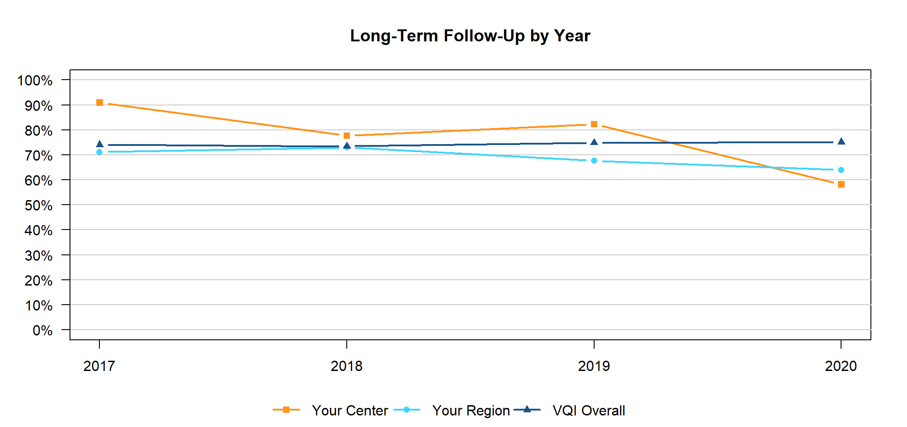
BSW Memorial LTFU Charter
Graph represents a 29% decrease in LTFU rates from 2022

Slide 13
BSW Memorial LTFU Charter
Problem Statement:
LTFU is important for patient outcomes tracking. By following up long term, we are able to verify that our patients are receiving the care and therapies which ensure their best health post vascular surgery. Our LTFU rate decreased from 87% to 58% in 2023 due to lack of communication between Q-Centrix contracted abstractors, Q-Centrix management, and the vascular surgery department. To ensure that our patient care is reflected accurately in our follow up scores, a plan is needed to improve communication.

Slide 14
BSW Memorial LTFU Charter
Goal:
Increase from 58% long term follow up to 80% long term follow up by February 2024.
Scope:
This project will include coordination between the vascular surgery department and Q-Centrix in monthly meetings beginning April 17, 2023 and concluding January 31, 2024. This will include monthly reports from Q-Centrix and independent follow up reports run monthly by the vascular surgery department. Reports will be provided monthly to division director.

Slide 15
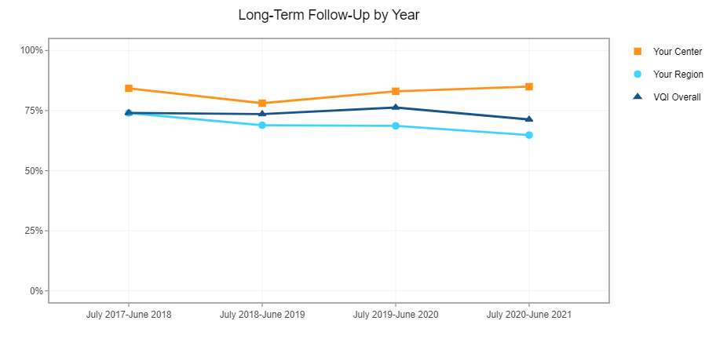
BSW Memorial LTFU Charter
G
Graph represents a 27% increase in LTFU rates from Spring 2023

Slide 16
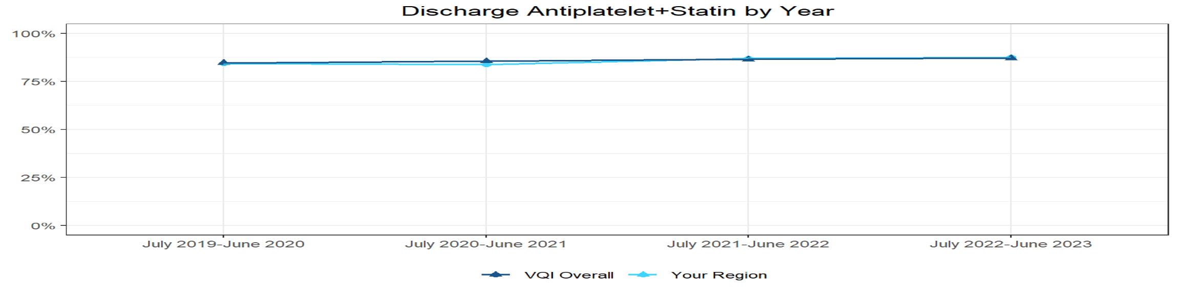
Discharge Medications
Procedures performed between July 1, 2022 and June 30, 2023
Includes CAS (TFEM CAS and TCAR), CEA, EVAR, INFRA, LEAMP, OAAA, PVI, SUPRA, and TEVAR procedures only. Antiplatelet is defined as ASA or P2Y12 inhibitor. Cases are excluded if (1) Discharge Statin = “No, for medical reason” OR (2) Both Discharge ASA = “No, for medical reason” AND Discharge P2Y12 inhibitor = “No, for medical reason” OR (3) An in-hospital death occurred.
The table below gives the number of procedures meeting the inclusion criteria, and the percentage of those procedures where patients received discharge medications.
Number of Procedures at Your Center Antiplatelet+Statin Antiplatelet Only Statin Only Neither
Your Region Overall | 7051 | 88% | 8% | 3% | 1%
VQI Overall | 112903 | 87% | 8% | 3% | 2%

Slide 17

Post Op Hypertension and Hypotension IV Meds for CEA/TFEM CAS/TCAR Patients
Rosha Nodine – VQI Data Manager
Carson Mansion – STS Data Manager
Date: 8/1/23

Slide 18


SBAR: Hypo-Hypertension in CEA/CAS Population
Primary Author: Rosha Nodine, BAAS; Secondary Author: Carson Mansion, MS; Team Members: Liza Singh, NP; Franklin Farid, MD; Executive Sponsor: Dennis Gable, MD
S | The use of post op hypertensive and hypotensive IV medications for carotid endarterectomy (CEA), transfemoral carotid artery stent (CAS) and transcarotid artery repair (TCAR) is higher than the national average within Vascular Quality Initiative (VQI). Looking into this will promote better patient care through possible unnecessary use of medication as well as relieving financial burden to the patient and the hospital.
B | In the VQI regional report published on 3/10/23, Baylor Scott and White The Heart Hospital – Plano (THHBP) average for IV medications to treat hypertension and hypotension postop for CEAs, CASs and TCARs was higher than the national average. Specific breakdown appendix. There was a concern for patients getting unnecessary medication therapy. This was discussed in Vascular POCMA to find possible reasons behind the high average comparative to the national average and possible solutions. Through entering data in VQI it was noticed by the registry site manager, that the parameters of the orders for the IV medication used to treat hemodynamic stabilization were not standardized.
A | Using VQI benchmarked data to support center level practice standards there is a need to reduce the hypertension/hypotension IV medications given to patients postop. Possible contributing issues that need to be addressed: Are orders for these medications appropriate Are these medication orders part of an order sets or are all of these orders individual orders Do we have too many different orders with different parameters that may cause patients to get medication when not medically necessary Are these different orders appropriate practice for each patient’s level of care Are there too many different orders used by practitioners in their practice Are Nurses following the parameters appropriately Is there a trend with a particular procedure or acuity To find this we will look at each case to find: How many orders are used within the hospital How many orders were used in one visit How many different orders each practitioner uses Are there specific orders where medication is given the most/least Future analysis: Analyze the correlation between number of times patient required IV medication therapy treatment for hemodynamic stabilization and the associated patient outcome Look into the medically necessity of the medications for higher risk cases Potential cost savings with reducing the use of these medications Was the patient already being optimized when sent to the floor Are nurses taking BP before administering medication Are nurses administering medication within the parameters
R | Standardize parameters and add to the postop order set Stabilization to optimization patients prior to procedure through ERAS or preop order set or at home medications Education practitioners/nurses on the use of these medications

Slide 19
CEA and TCAR – Hypertension
TFEM CAS - Hypotension

Slide 20
Meds Compared by Procedure
Pulled from VQI
Time period Jan 22 – Aug 23

Slide 21
Asymptomatic vs Symptomatic

Slide 22
VQI Dashboard Reports
Pulled from VQI

Slide 23
CEA Hypertension

Slide 24
CEA Hypertension IV Meds by Order
Time period Dec 22 – July 23

Slide 25
CEA Hypertension IV Medication
Number of Different Orders by Clinician
Time period Dec 22 – July 23
11 THH

Slide 26
CEA Hypertension IV Meds by Clinician
Time period Dec 22 – July 23

Slide 27
CEA Hypertension IV Meds by Clinician
Time period Dec 22 – July 23
Hypotension Meds Ordered and Received by Highest ordering Clinicians

Slide 28
CEA Hypertension IV Meds by Physician Performing Procedure
Pulled from VQI
Time period Jan 22 – Aug 23

Slide 29
TCAR Hypertension

Slide 30
TCAR Hypertension IV Med Orders
Time period Dec 22 – July 23

Slide 31
TCAR Hypertension IV Meds Ordered by Clinician
Time period Dec 22 – July 23
7 THH

Slide 32
TCAR Hypertension IV Meds Ordered by Clinician
Time period Dec 22 – July 23
Hypotension Meds Ordered and Received by Highest ordering Clinicians

Slide 33
TCAR Hypertension IV Meds by Physician Performing Procedure
Pulled from VQI
Time period Jan 22 – Aug 23

Slide 34
TFEM CAS Hypotension

Slide 35
TFEM CAS Hypotension IV Meds by Order
Time period Dec 22 – July 23

Slide 36
TFEM CAS Hypotension IV Meds by Clinician
Time period Dec 22 – July 23
11 THH

Slide 37
TFEM CAS Hypotension IV Meds by Clinician
Time period Dec 22 – July 23
Hypotension Meds Ordered and Received by Highest ordering Clinicians

Slide 38
TFEM CAS Hypotension IV Meds by Physician Performing Procedure
Pulled from VQI
Time period Jan 22 – Aug 23

Slide 39

CE/CME Meeting Attendance Credit
7 days to submit; no email reminder
PUT your FULL NAME in Zoom for remote attendees. Record of meeting attendance is required for CME/CE credit (no exceptions will be made)
SEND an email to achurilla@svspso.org with names of group members that are sharing 1 device
November 3, 2023 - Southern
OFFICALLY apply for CME/CE credit by clicking the URL or QR code provided

Slide 40
VQI National Update
Caroline Morgan, RN
Director of Clinical Operations, SVS PSO

Slide 41
VQI Participation
Regional Breakdown
Canadian Vascular Quality Initiative | 7 Centers
Carolinas Vascular Quality Group | 40 Centers
Great Lakes Vascular Study Group | 63 Centers
Michigan Vascular Study Group | 37 Centers
Mid-America Vascular Study Group | 74 Centers
Mid-Atlantic Vascular Study Group | 90 Centers
MidSouth Vascular Study Group | 27 Centers
Midwest Vascular Collaborative | 51 Centers
Northern California Vascular Study Group | 27 Centers
Pacific NW Vascular Study Group | 41 Centers
Rocky Mountain Vascular Quality Initiative | 58 Centers
Southeastern Vascular Study Group | 140 Centers
Southern California VOICE | 42 Centers
Southern Vascular Outcomes Network | 114 Centers
Upper Midwest Vascular Network | 66 Centers
Vascular Study Group of Greater New York | 47 Centers
Vascular Study Group of New England | 51 Centers
Virginias Vascular Study Group | 45 Centers
Singapore | 1 Center
TOTAL CENTERS | 1 ,022 Centers
(VOICE)

Slide 42
Procedures Captured
TOTAL PROCEDURES CAPTURED | 1,153,531
(as of 10/1/2023)
Peripheral Vascular Intervention | 399,362
Carotid Endarterectomy | 202,995
Infra-Inguinal Bypass | 84,711
Endovascular AAA Repair | 84,460
Hemodialysis Access | 79,600
Carotid Artery Stent | 110,945
Varicose Vein | 64,039
Supra-Inguinal Bypass | 27,063
Thoracic and Complex EVAR | 30,969
Lower Extremity Amputations | 30,369
IVC Filter | 18,770
Open AAA Repair | 18,485
Vascular Medicine Consult | 1,523
Venous Stent | 240
VQI Total Procedure Volume
Total Procedure Volume reflects net procedures added to the registry for the month

Slide 43
Regional Meeting CME/CE Credit
Des Moines University is the continuing education provider for this activity.
The attendance roster will be cross-referenced with those applying for CME/CE. Sign in correctly.
Each participant MUST COMPLETE BOTH the attendance attestation and the meeting evaluation from the URL site – one form.
You will have 7 days from the date of the meeting to complete the forms and SUBMIT.
Approximately 14 days from the meeting, Des Moines University will email you instructions on how to access your certificate.
PSO leadership is providing continuing education credit to you at no charge!
Notes:
If you do not complete and submit the online forms within 7 days, continuing education credit cannot be awarded

Slide 44
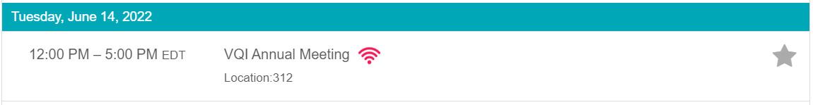
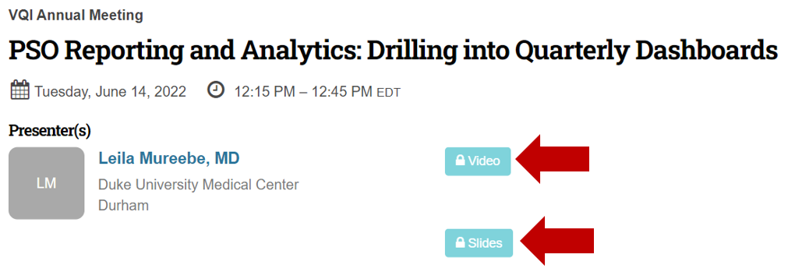
2023 VQI@VAM Wrap Up
Recordings & slides available on the VQI@VAM Planner
  Log into the Planner https://2023svsvam.eventscribe.net/
  Select Full Schedule
  Select your preferred day
  Select your session
Notes:
All VQI@VAM attendees can review the slides and recordings of the conference by logging into the VQI@VAM planner using the link provided. Select full schedule, the day of the session you would like to view and then the session. You will see a ‘view’ and ‘slides’ tile. Make you selection and enjoy.
The slides and videos will be available to everyone (regardless of VQI@VAM registration status) early 2024.

Slide 45

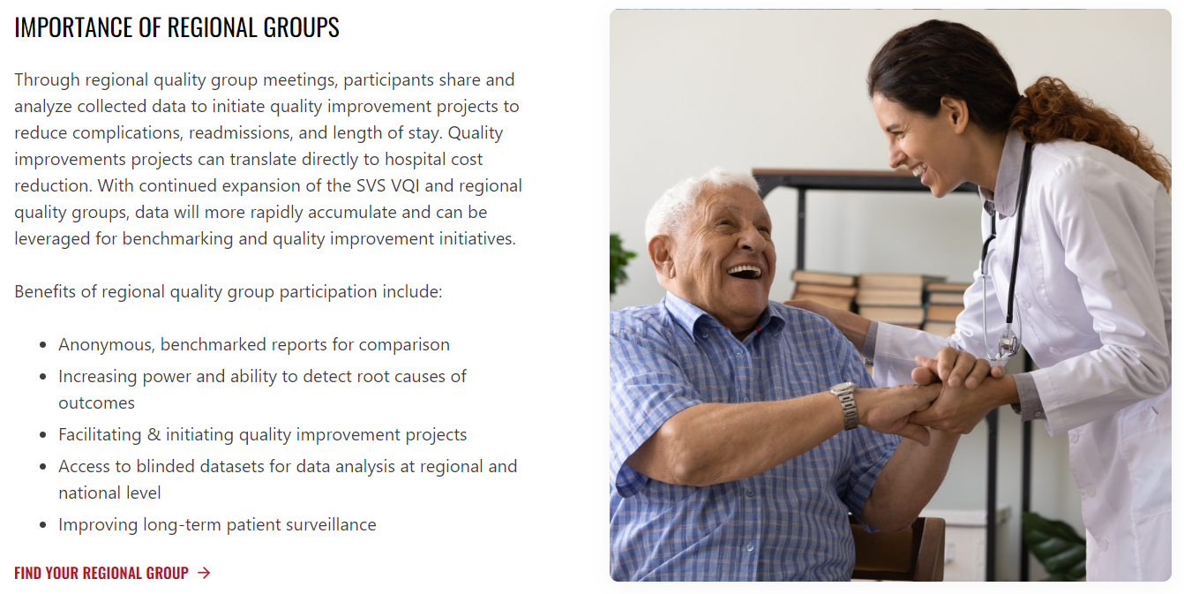
Have you checked out the new VQI Website?
If not, here’s just a peek at what you’re missing!
Registry specific pages – deeper dive into each of the SVS VQI’s 14 registries
The ability to view the VQI.org website in your preferred language! Don’t see your preferred language, reach out to see about getting it added to the site
New webinars & presentations added regularly – either on the main events page, or in Members Only
For more information about the VQI website, contact Jen Correa, SVS PSO Marketing Manager, at jcorrea@svspso.org.
Notes:
The new and improved VQI.org website has a variety of new features.
Registry specific pages providing a deeper dive into each of the SVS VQI’s 14 registries
The ability to view the VQI.org website in your preferred language! Don’t see your preferred language, reach out to see about getting it added to the site
New webinars & presentations added regularly – either on the main events page, or in Members Only
For more information about the VQI website, contact Jen Correa, SVS PSO Marketing Manager at jcorrea@svspso.org.

Slide 46

VQI Members Only
Find information that is not publicly shared on the VQI Website (ex: Quality Guide, Specific Registry Webinars, etc.…)
Find links and other information for upcoming Regional Group meetings
Remember, access to the Members Only area of the VQI Website requires a different login than your PATHWAYS user account
For account access, email Jen Correa at: jcorrea@svspso.org to receive your username and temporary password
Access to information exclusively available to members of the SVS VQI
Notes:
VQI Members Only provides:
Information that is not publicly shared on the VQI Website (ex: Quality Guide, Specific Registry Webinars, etc…
Links and other information for upcoming Regional Group meetings
Remember, access to the Members Only area of the VQI Website requires a different login than your PATHWAYS user account
For account access, email Jen Correa at: jcorrea@svspso.org to receive your username and temporary password

Slide 47
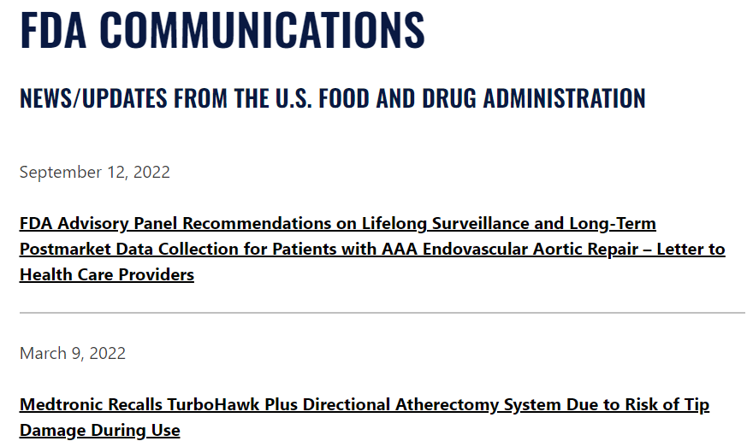
FDA Communications
https://www.vqi.org/resources/fda-communication/

Slide 48
Readmission Study University of Rochester
Benefits determined by the study include:
More accurate capture of complications after discharge/use of LTFU form for complications prior to 9 mos.
Track & trend unplanned readmissions
Identify the reason for unplanned readmissions
Evidence based data to identify at risk patient populations
Benchmark against Region and All VQI
30d Readmission rates
  Review of readmission cost
  Frequency of readmissions
  Frequency of reoperations & cost
Univ Rochester piloting 30D readmission project
To join the pilot or for questions contact Stacey Esposito at:
Stacey_Esposito@URMC.Rochester.edu
Notes:
Dr. Michael Stoner and Stacey Esposito, BSN, RN, from University of Rochester, decided to take a deeper look at their center’s 30-day readmission rates. They reviewed their center’s readmission rates by reviewing the costs for readmissions by the most extensive operation performed. This included the frequency of the operation, the percentage of readmissions, and the median cost per operation.
Ms. Esposito is piloting a project for 30-day readmission using the voluntary 30-day follow-up record for patients. There are only five additional variables to collect if there is no readmission within the 30-day window. If there was a readmission, there are ten additional variables to collect on the 30D form, which will populate a prompt to collect an associated long-term follow up record.

Slide 49

VQI Updates
Smoking Cessation launched as a new NQI June 2023 w/ variables added to all Arterial Registries – Early Q3 2023
Help Text Enhancement Tool – May 2023
Interactive plots for the Biannual Center and Regional Level Reports
Retirement of most COVID Variables
Retirement of >500 Opioid variables
Collection of Exercise Program variables in Lower Extremity Registries
In Development:
  Open Aorta Registry
  Infrainguinal/Suprainguinal Registry Follow-up reports
  Continued efforts for harmonization across registries
  Enhanced reporting measure for biannual reports
  EPIC integration into VQI. Looking for Center volunteers

Slide 50
CAS NCD
CMS made it clear in the ruling that centers must establish and maintain institutional and physician standards to support a dedicated carotid stent program, including processes to ensure continuous quality improvement by assessing procedural outcomes and making necessary programmatic adjustments to assure patient safety.

Slide 51
CAS Shared Decision Making
As mandated by CMS, the shared decision-making interaction should include:
Discussion of all treatment options for carotid stenosis to ensure the patient is familiar with and aware of all treatment options. Including Carotid Endarterectomy and endovascular Carotid Artery Stenting (Transfemoral and TCAR) and optimal medical therapy
Explanation of risks and benefits for each option specific to the beneficiary’s clinical condition.
Integration of clinical guidelines (e.g., patient comorbidities and concomitant treatments).
Discussion and incorporation of the patient’s personal preferences and priorities in choosing a treatment plan
https://www.aan.com/Guidelines/home/GuidelineDetail/477
https://www.ahajournals.org/doi/full/10.1161/01.cir.91.2.566
https://www.jvascsurg.org/article/S0741-5214(21)00893-4/fulltext
https://www.escardio.org/Councils/Council-on-Stroke/News/new-eso-guideline-released-on-endarterectomy-and-stenting-for-carotid-artery-ste
https://www.cms.gov/medicare-coverage-database/view/ncacal-decision-memo.aspx?proposed=N&ncaid=311
For questions related to the CAS NCD, please contact Sarah Fulton at sarah.fulton@cms.hhs.gov

Slide 52
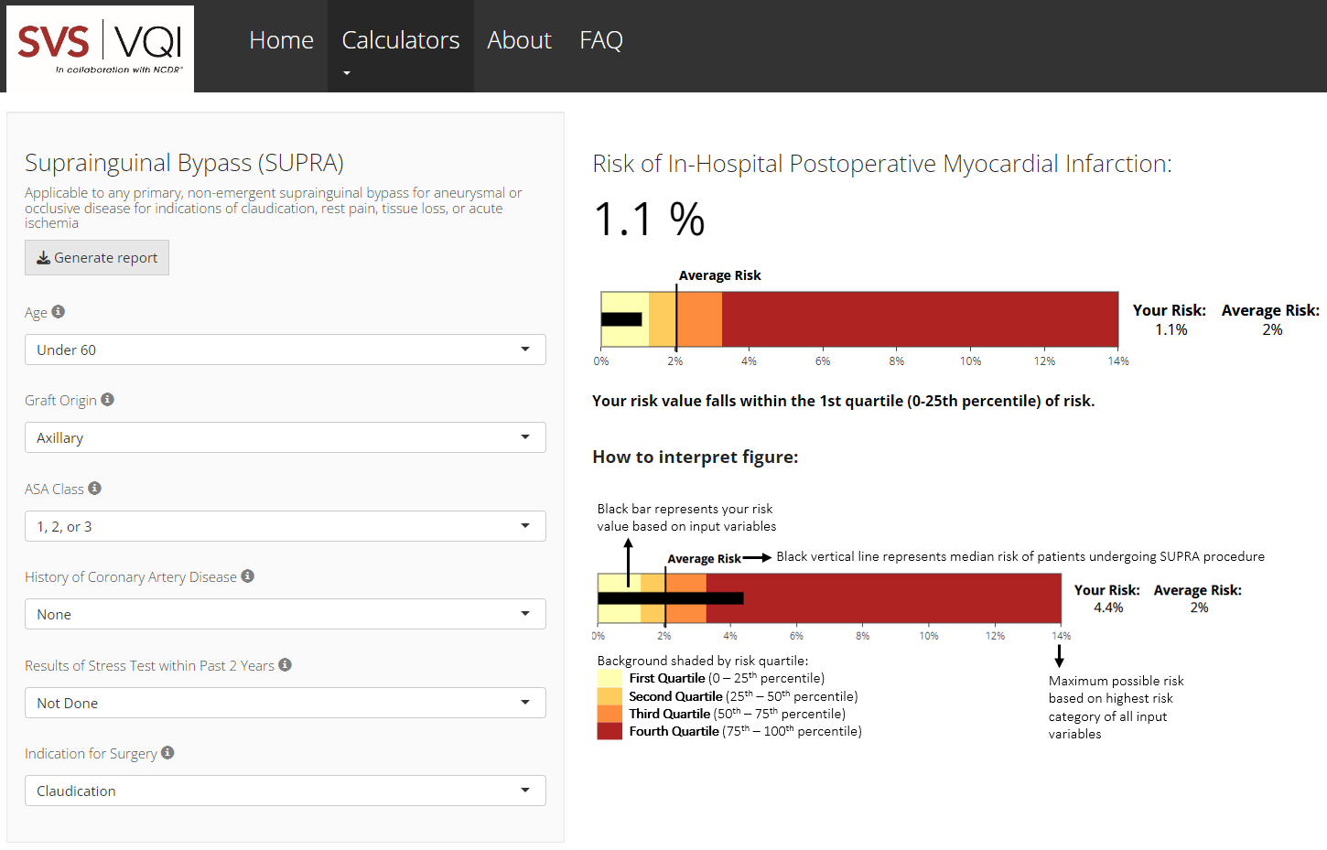
Cardiac Risk Index
https://www.vqi.org/risk-calculators/
Notes:
The VQI Cardiac Risk Index (VQI-CRI) was originally constructed using VQI data collected over a 5 year period from 2012 to 2016 and has since been updated and reconstructed using VQI data collected from the 5 year period from January 2017 to December 2021.
The current VQI-CRI is based on approximately 160,000 procedures collected from 491 centers participating in the VQI from 2017-2021.

Slide 53
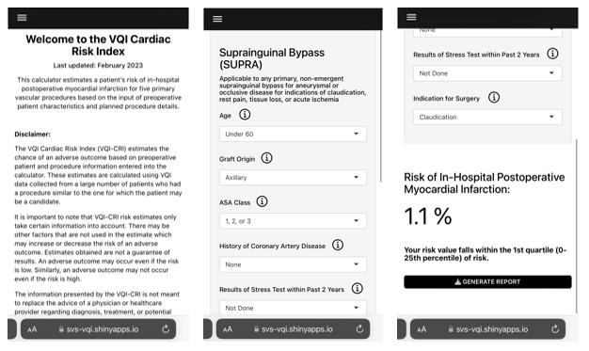
The VQI-CRI is also available in a mobile-friendly format
Notes:
The VQI-CRI also has a mobile format Including the option to navigate between calculators and sections
Going forward, the VQI-CRI calculators’ statistical models will be updated every year with a new year’s data.
The 5-year time frame will shift to exclude the earliest data and include the most recent calendar year.
This year’s data update will be conducted using VQI data from 2018 to 2022, removing 2017.

Slide 54
Physician Snapshot Report Discussion

Slide 55

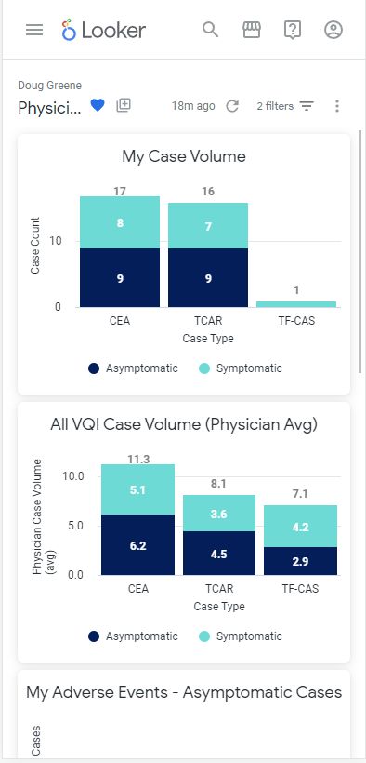
Introducing Physician Snapshot Reports for Carotid Treatment
Individual Physician Reporting for individual physicians to compare key outcomes against all VQI cases
Key features
  Flexible access: Available on your smart phone or through Pathways reports on your desktop
  Near real time data with nightly updates
  CEA, TCAR and TF-CAS available on the same report
  Flexible time interval views- default view is the last 365 days with options to adjust the date range
  Secured- viewable only by you via your VQI PATHWAYS password
Notes:
Talking points:
-We hope that you have seen the email communication and the notifications in the VQI newsletter or in Pathways – or perhaps heard about it at VQI at VAM
-Our goal today is to provide an overview of the first Physician Snapshot report and solicit input and feedback.
This initial pilot focused on Carotid treatment- you feedback and participation will help shape the go forward strategy. TODAY this view is intended for PHYSICIAN only. We expect future development to include hospital manager views. Emphasize that today it is only for physician log ins
By show of hands (or virtual hand raise) how many of you have looked at your snapshot report?
Speak to what it is and highlight key features- Transition: Let’s do a quick walk through

Slide 56
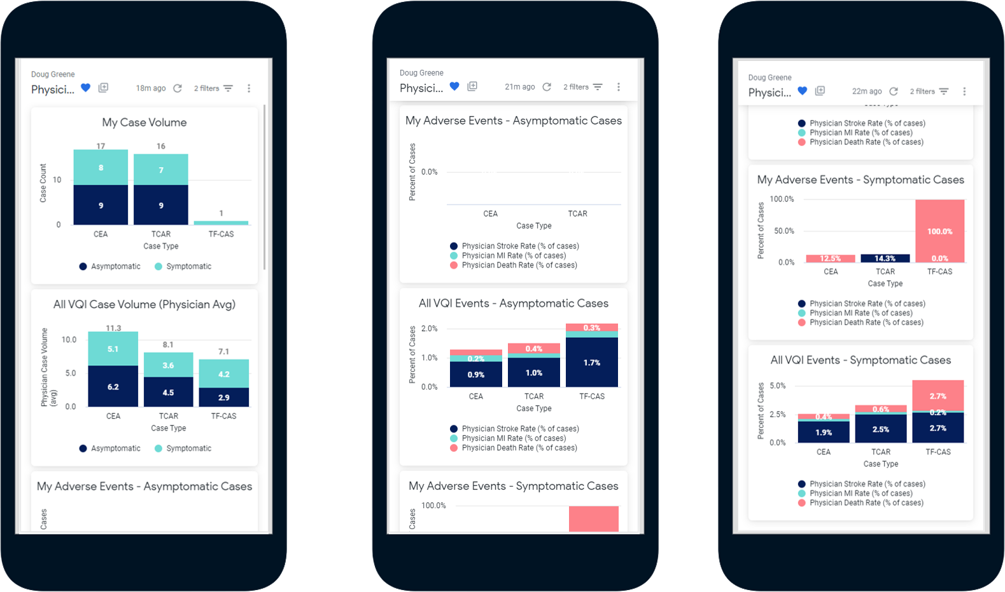
Compare Physician with VQI Average Annual Case Volume and Key Outcomes
CEA vs TCAR vs TF-CAS, Asymptomatic vs Symptomatic Cases,
Stroke, Death, MI
Notes:
Walk through the screens-
For all views you can view it symptomatic vs asymptomatic cases
All views show counts by procedure performed
Remember the default is the last 365 days
You do also have the ability to click on value and drill down to see the primary procedure identifier
First view is case volume comparison- a view of how many cases you are performing of each procedure type, broken out for asymptomatic vs symptomatic patients as compared to the average case counts for all other VQI physicians
The next view displays the percentage of your cases with adverse events, Stroke, MI or Death compared to the average percentages of your peer physicians for Asymptomatic cases
View 3 is the same breakdown of adverse events vs your peers for Symptomatic cases

Slide 57
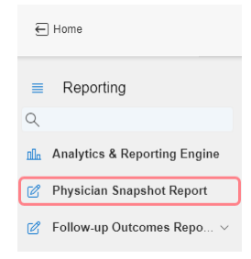
How do I access my Carotid snapshot?
Two Options:
1. An email with your URL entitled View my Carotid Snapshot was sent to the email on file for you in PATHWAYS- simply click the link and enter your PATHWAYS password
2. From a desktop computer- URL Access: https://pathways.m2s.com
-From the reporting menu in the top right, click the option for the Physician
Snapshot Report
Note: You will need your VQI PATHWAYS password to the view the report
                If you do not know your VQI PATHWAYS password, please see your VQI hospital manager
              You may also email PATHWAYS support for assistance at PATHWAYSsupport@fivoshealth.com

Slide 58
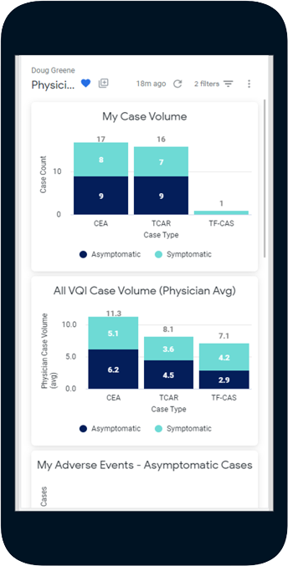
Physician Snapshot Report Feedback
Polling Questions:
How many of you have viewed your report?
If you have not viewed the report, why?
Can you share your initial reaction or feedback if you
have used it?
Note: In order to obtain future feedback, we may send a very brief email survey.
Your participation is greatly appreciated!

Slide 59
General RAC Submission Guidelines
Active Pathways Account w/ ‘Share a File’ privileges
Center Registry Subscription
Regional RAC approval required for all regional proposals
Notes:
PRIOR to submission for a RAC proposal:
All researchers requesting data sets need have an ACTIVE pathways account. Privileges to ‘Share a File’ is required in order to receive your requested Blinded Data Set (BDS). Contact your Hospital Data Manager to verify your account status.
Researchers requesting data must also subscribe to the registry related to the requested dataset(s), i.e. IVC Filter or Hemodialysis.
Limit the number of registries per RAC proposal.
All regional RAC proposals must have regional RAC approval before submission. It is highly recommended that Regional RAC approval is obtained before submitting a national RAC proposal.

Slide 60
General RAC Submission Guidelines
Cont.
Check email for approval status from Melissa Latus
mlatus@svspso.org
Check email notification from FIVOS health that data set is available in ‘Share A File’
Data in ‘Share A File’ will expire after 30 days of receipt
Notes:
After you receive your approval email notification from Melissa Latus, check your email frequently starting the first of the month after approval notification. The data in ‘Share a File’ is only available for 30 days once you receive the Pathways email notification that the file had been delivered and is now available.

Slide 61




2022 SoVONet Participation Award Winners
Baylor Jack and Jane Hamilton Heart and Vascular Hospital
Memorial Hermann Greater Heights Hospital
Memorial Hermann Katy Hospital
Memorial Hermann Memorial City Medical Center
Memorial Hermann Northeast Hospital
THE HEART HOSPITAL Baylor Plano
Baylor All Saints Medical Center
Baylor Scott & White Medical Center - McKinney
Baylor Scott & White Medical Center - Round Rock
Christus Trinity Mother Frances Hospital
Memorial Hermann Southeast Hospital
Memorial Hermann Southwest Hospital
Memorial Hermann Sugar Land
Memorial Hermann Texas Medical Center
Memorial Hermann The Woodlands
Ochsner Medical Center
The Heart Hospital Baylor Denton
Willis-Knighton North
Houston Methodist Clear Lake Hospital
Our Lady of Lourdes Heart Hospital
Scott & White Memorial Hospital
Shannon Medical Center
SSM St. Anthony Hospital

Slide 62
Quality Improvement Updates
Betsy Wymer, DNP, RN, CV-BC
Director of Quality, SVS PSO

Slide 63

Quality Improvement:
National Quality Initiative - Smoking Cessation
Introduced at VQI@VAM 2023
CAN-DO Program
  Choosing Against combustible Nicotine Despite Obstacles
Arterial registries only
Reporting measures added Spring 2023
  Preop Smoking – Elective procedures
  Smoking Cessation – Elective, Urgent, Emergent procedures
Currently have smoking variables
  Minimal addition of variables
  Go LIVE August 2023
Webinars
  July and August (register at www.vqi.org)
Education https://www.vqi.org/quality-improvement/national-qi-initiatives/
  Physician and Patient
  Toolkits
  Billable codes and sample dictation
  Resources

Slide 64
Active Regional Charters
LTFU Renee Palmer Lead DM; Todd Bohannonn, MD Physician Champion Palmer, Scott & White Memorial Hospital
Access Site Complication Renee Palmer Lead DM; Todd Bohannonn, MD, Physician Champion
Palmer, Scott & White Memorial Hospital
3. Post Op Meds CAS/CEA/TCAR Rosha Nodine, Lead DM; Dennis Gable, MD, Physician Champion
The Heart Hospital, Baylor Plano

Slide 65
2023 Charters By Region

Slide 66
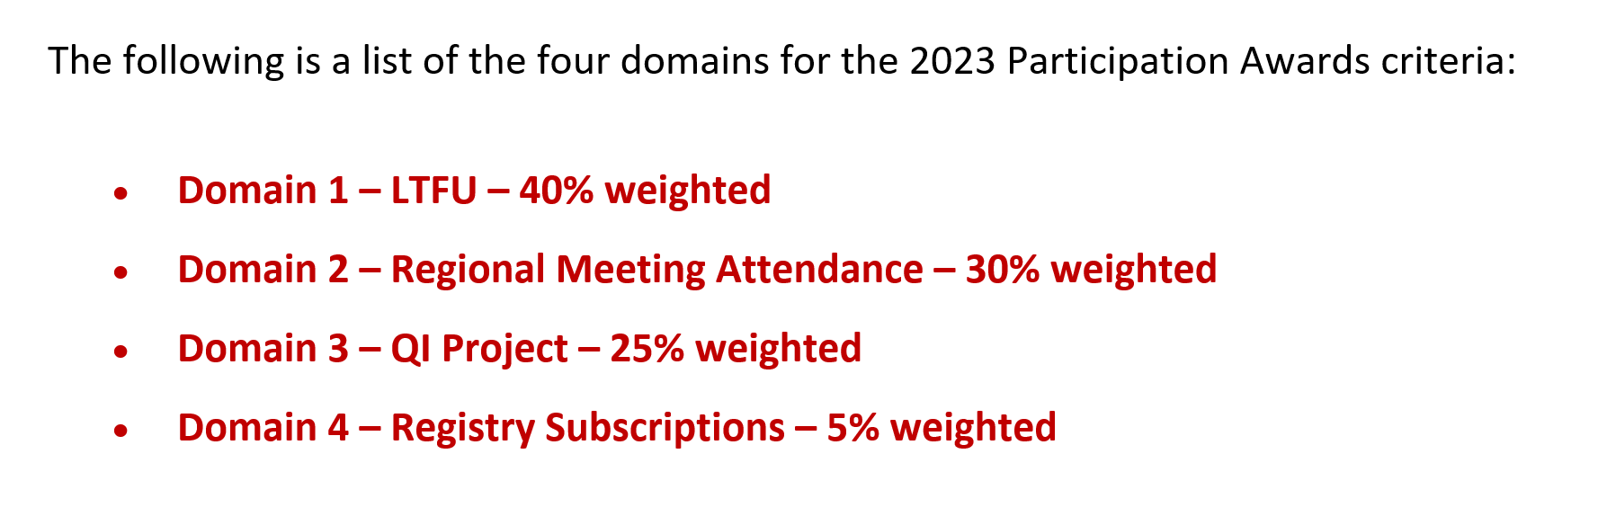
Quality Improvement – Participation Points

Slide 67
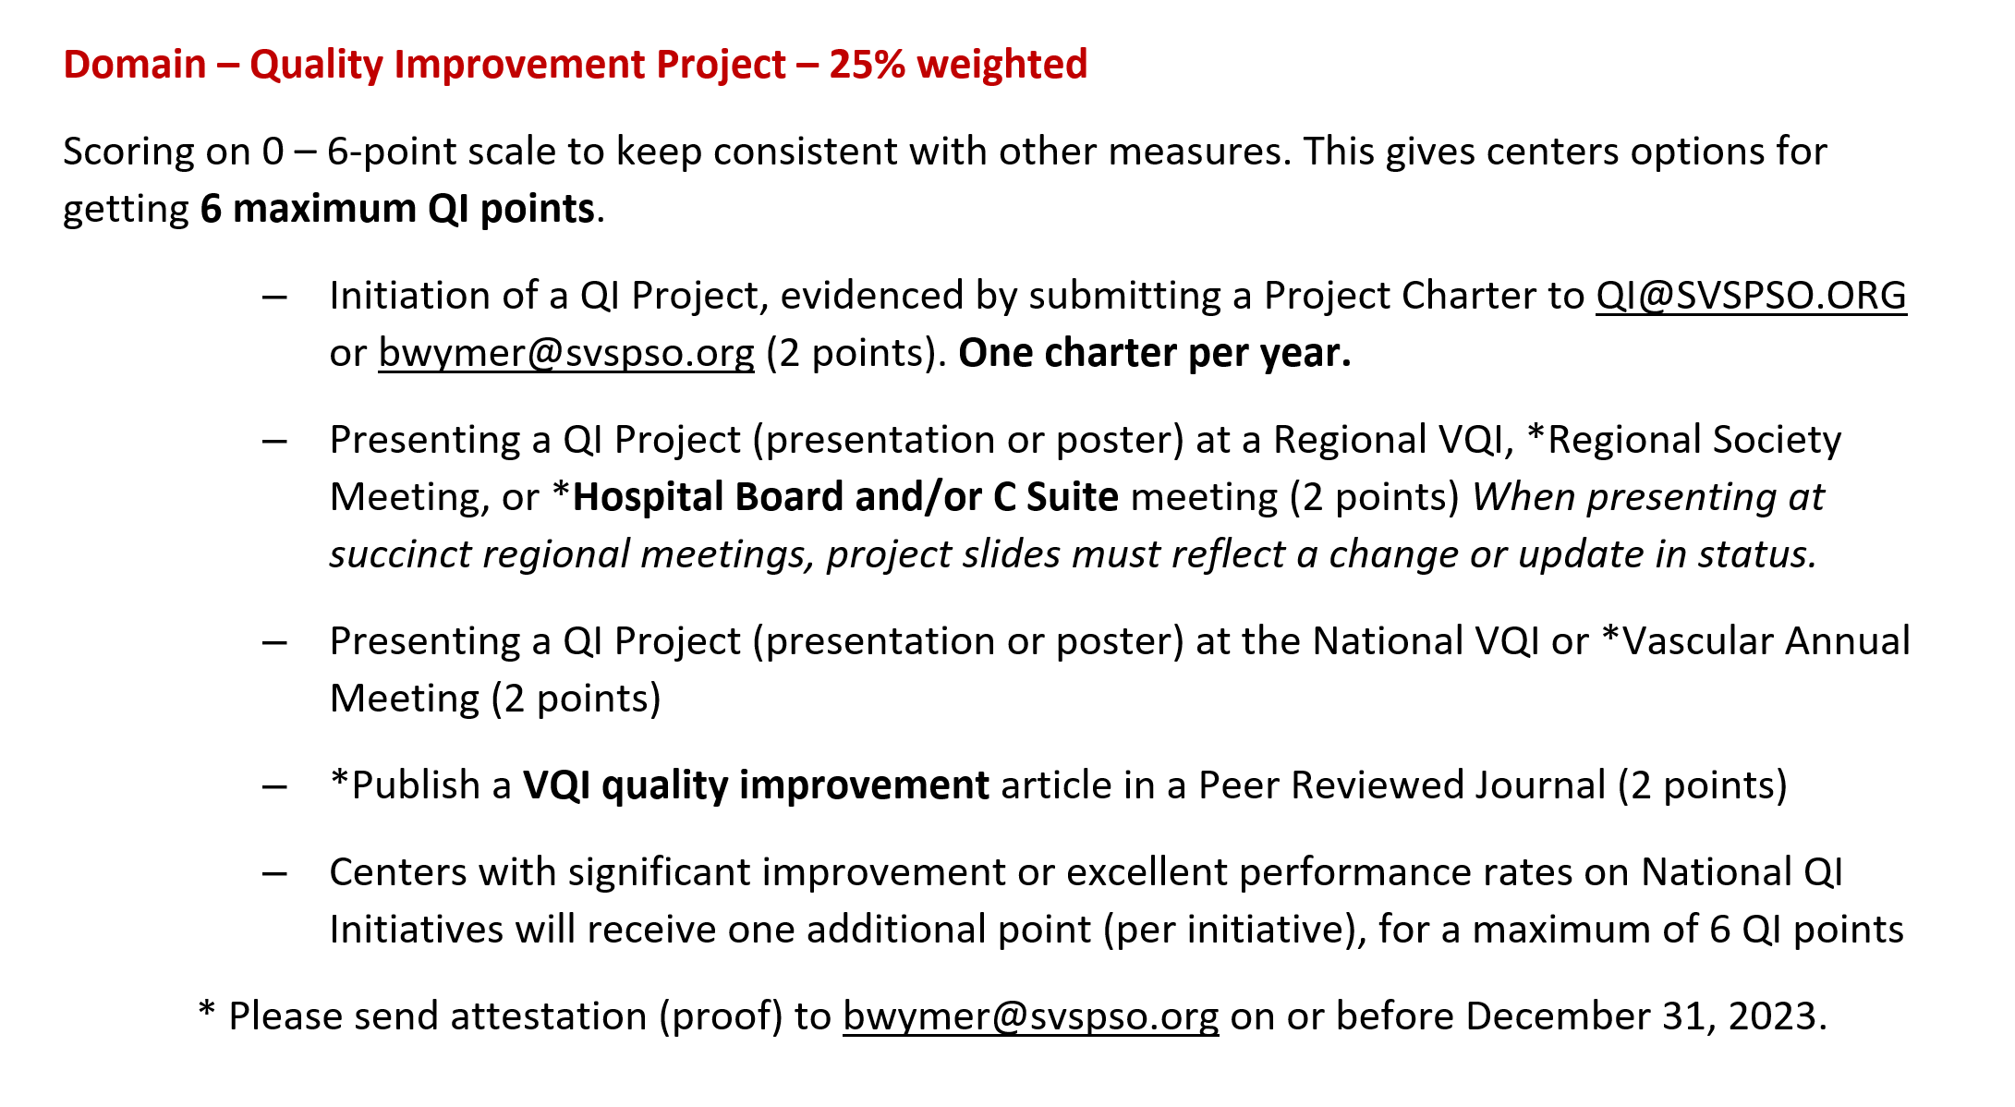
Quality Improvement – Participation Points
QI Project Domain

Slide 68
Quality Improvement –
QI Project Domain Requirements
Present VQI data to C-Suite (leadership, CNO, COO, Chief Vascular Surgeon, etc.)
Contact Betsy at bwymer@svspso.org
Provide the following
  Agenda/Meeting Minutes (date, your name and presentation, attendees)
  Copy of presentation (feel free to cover center data)
  Maximum of 2 presentations per year – slides must present a change or an update in status
You will receive an email confirmation from Betsy which verifies participation points

Slide 69
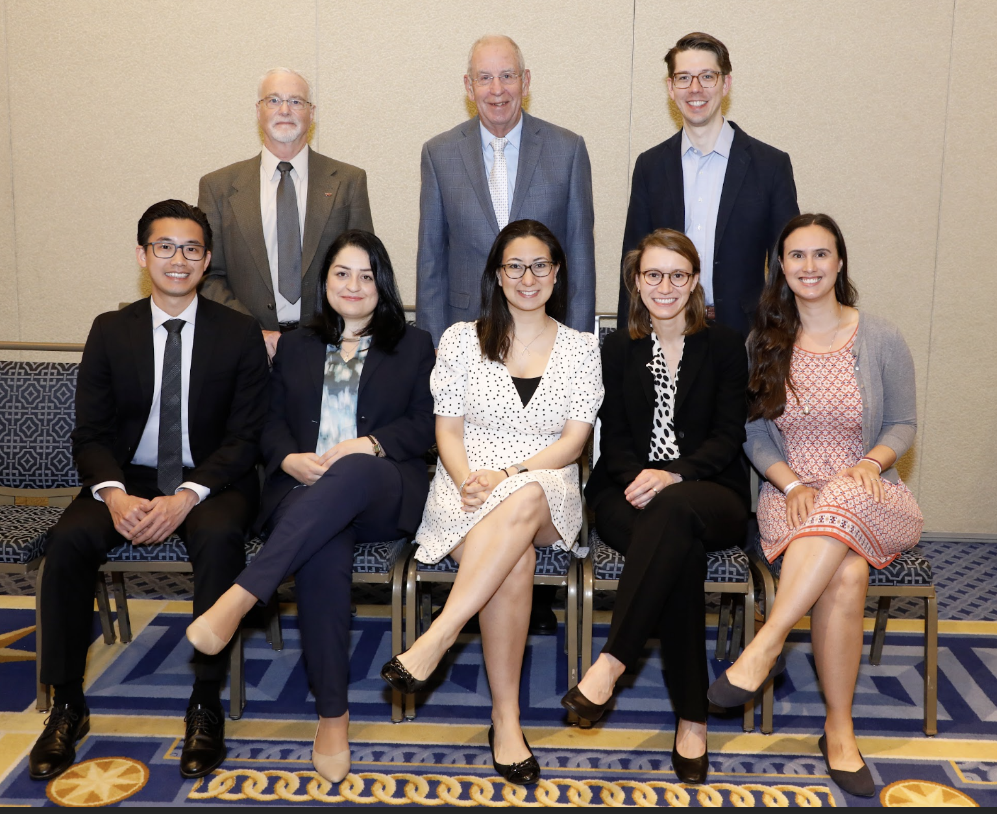
Fellows in Training (FIT) Program 2022-2023 Jack Cronenwett Scholarship Winners
Quality
  Dr. Christine Kariya
    FIT Mentor Dr. Danny Bertges
    University of Vermont Medical Center
  Dr. Hanna Dakour Aridi
    FIT Mentor Dr. Michael Murphy
    Indiana University Health – Methodist
Research
  Dr. Ben Li
    FIT Mentor Dr. Graham Roche-Nagle
    Toronto General Hospital
  Dr. Brianna Krafcik
    FIT Mentor Dr. Phil Goodney
    Dartmouth Hitchcock Medical Center
  Dr. Caronae Howell
    FIT Mentor Dr. Benjamin Brooks
    University of Utah Hospital and Clinics/The University of Arizona
Notes:
These winners will be continuing their work as FIT Scholars for the 2023-2024 class.

Slide 70
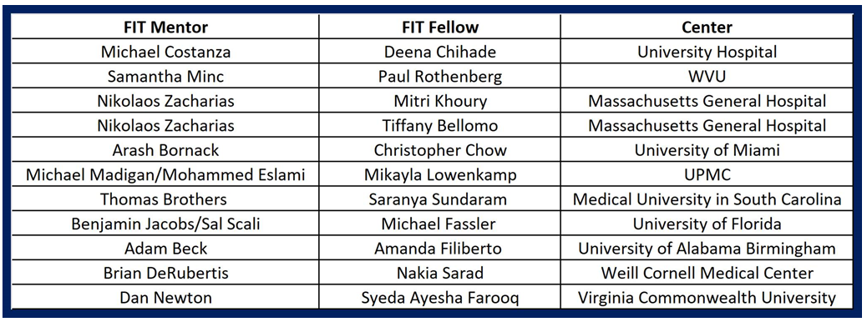
Quality – Fellows in Training (FIT) Program
2023-2024 FIT Mentor, FIT Fellow, and Center

Slide 71

Improve Your Quality of Care in Vascular Surgery and Interventional Care
Introducing a new quality program developed by the American College of Surgeons and the Society for Vascular Surgery: a standards-based framework designed to meet the unique needs of vascular programs
facs.org/vascular
Email vascular@facs.org for information

Slide 72
Committee Updates

Slide 73
AQC Update
Committee meets every other month
  Jan, March, May………
Re-engagement of registry committees
  New reporting measures for ea. registry
  Review of variables for possible retirement
  One committee each Mtg. will give progress update
Review & discussion of proposed registry revisions
  LE/VMC SET variables to align w/guidelines
  Pilot ERAS Variables
  Initial discussion of required vs non-required procedure variables
Nathan Orr, MD

Slide 74
VQC Update
Committee meets bi-annually
Re-engagement of registry committees
  New reporting measures for each registry
  Review of variables for possible retirement
  Each committee will give updates during the VQC meetings
Active review of Venous Stent to decrease registry burden
Discussion on how to increase venous registry presence w/in the venous community
Next Meeting VEITH (hybrid)
  November 12-17, 2023
Joseph Liechty, MD

Slide 75
Arterial RAC Update
The proposal review committee meets every other month
Comprises of all RAC chairs nationally and some other members
Reviews about 20-30 abstracts each cycle
The process is fair and open with the aim of approving most proposals
The committee advises investigators on how to improve the proposals
Kimberly Zamor, MD

Slide 76

Arterial RAC
When requesting a Data Set, the investigator must have an ACTIVE PATHWAYS account.
Once approved, the Data Set will be transferred through the “SHARE a FILE” function in PATHWAYS.
The Data Set will be available through “Share a File” for 30 days

Slide 77
Arterial RAC
Components of a VQI proposal.
For more information:
Podcast: Requesting Data presented by Dr. Leila Mureebe, MD
  https://drive.google.com/file/d/1tBsYrzh0Pu-Oz5gu_eHhMmrVvyEtk5i2/view
Abstract
Research question/Hypothesis
Background/significance
Approach
Analytic plan
Mock Tables
Potential problems/solutions
IRB approval/exemptions.

Slide 78
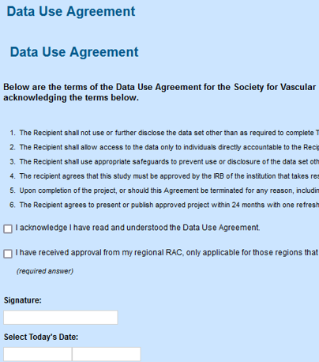
RAC Data Use Agreement
The Data Use Agreement needs to be signed by the Attending Physician when submitting in Abstract 123
https://abstracts123.com/svs1/

Slide 79
RAC Proposal Process
Review list of projects:
https://www.vqi.org/data-analysis/rac-approved-project-search/
2. Submit proposal online:
http://abstracts123.com/svs1/meetinglogin
3. Deadlines for submissions:
https://www.vqi.org/svs-vqi-national-arterial-rac-schedule/
Your Regional RAC chair is available to help answer questions or help with proposal writing

Slide 80
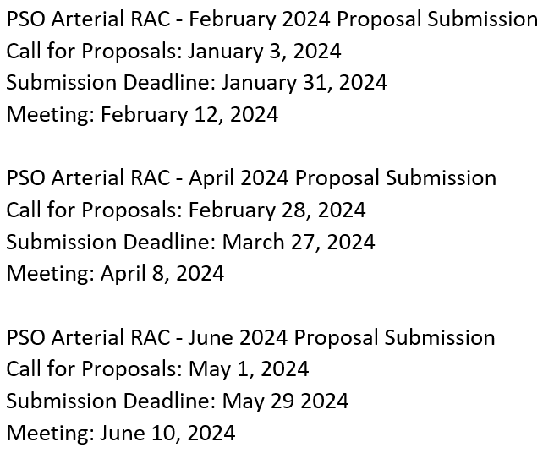
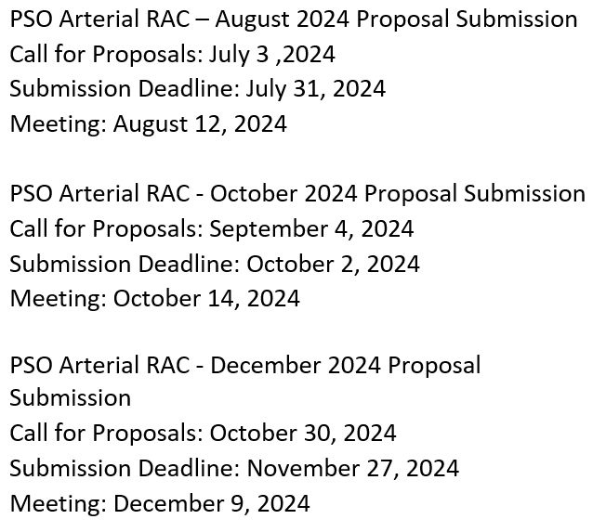
Arterial RAC Schedule 2024

Slide 81
Venous RAC Update
The July Venous RAC had 4 venous proposals submitted
Podcast: Requesting Data presented by Dr. Leila Mureebe, MD. Follow link below
  https://drive.google.com/file/d/1tBsYrzh0Pu-Oz5gu_eHhMmrVvyEtk5i2/view
The current venous registries with blinded data sets
  Varicose Vein
  IVC Filter
Types of information available:
  Demographics
  Comorbidities
  Operative characteristics
  Post-operative characteristics
  Follow-up
Joseph Liechty, MD

Slide 82
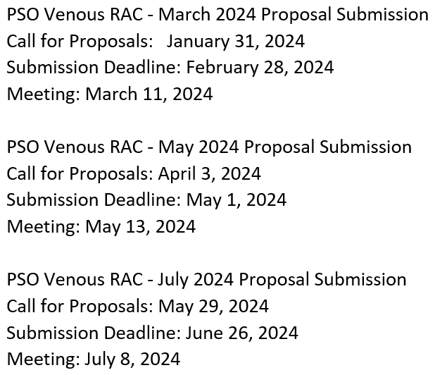
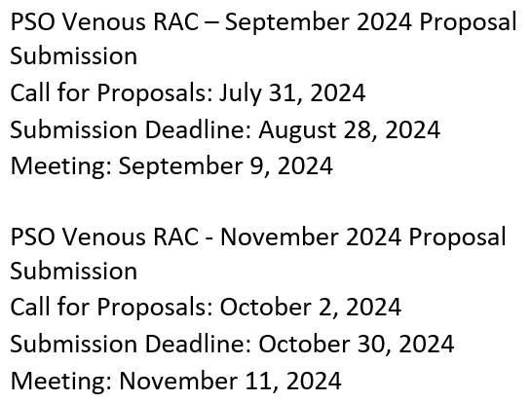
Venous RAC Schedule 2024

Slide 83
Governing Council Update
Meets twice a year
Last meeting: June 16, 2023
Committee designation:
  Each region represented by the Regional Lead Medical Directors
Adam Beck – newly appointed GC Chair; Grace Wang – newly appointed Vice Chair
All Regional RAC requests must have regional RAC approval; committee highly recommends that the Regional RAC also approve national requests
Next meeting VEITH; November 2023
Sheila Coogan, MD

Slide 84
Updates for Fall 2023 VQI Regional Meetings

Slide 85
2023 Technology Updates for VQI

Slide 86
Released in Q1 2023
TEVAR Fenestration Treatment Minor Revision
  “Fenestration Type”, a new field was added to the nine different branches in the branches tab
CAS Minor Revision
  Modified the “Approach” field and dependencies
  Updated “Lesion 2 Side” to auto-populate the value entered for “Lesion 1 Side”
PVI Minor Revision
  The PVI registry was modified to align with changes made during the INFRA/ SUPRA major revision
Infra-inguinal Bypass and Supra-inguinal Bypass Revision
  Major revisions were made to the lower extremity bypass registries

Slide 87
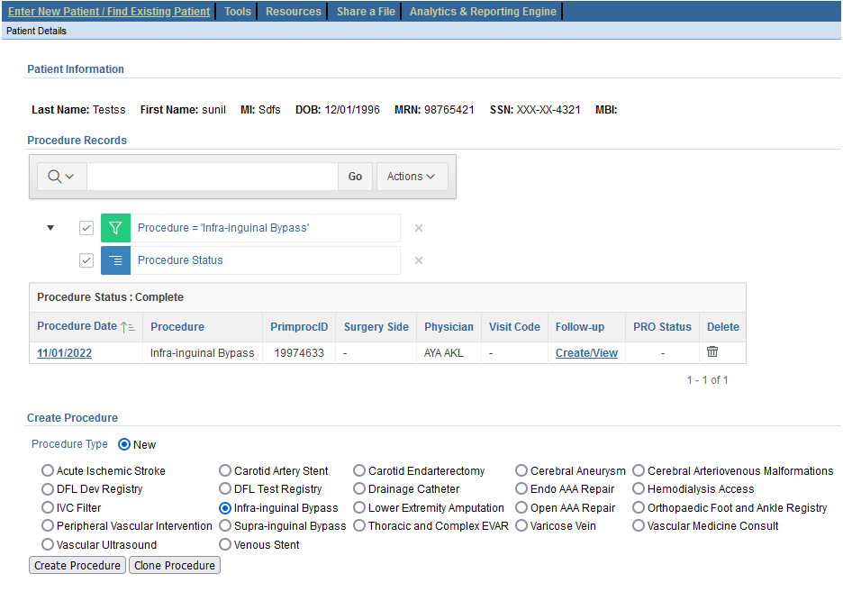
Released in Q1 2023
Same Registry Cloning for Infra/Supra-inguinal Bypass
The ability to copy data from existing procedure records to a new procedure record for the same patient and registry has been added

Slide 88
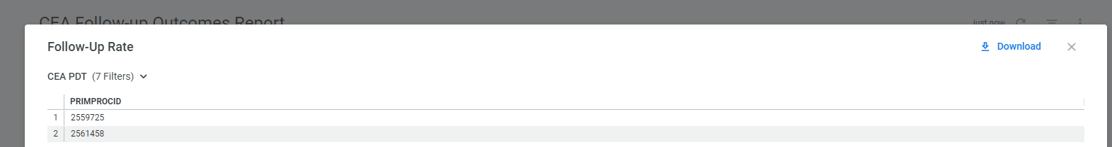
Released in Q1 2023
Follow-up Outcome Report Drilldowns
  Drilldown option has been provided to list the PRIMRPCID for procedures included in the calculator for My Center. This option is available for outcomes employing Mean/ STD and Median/IQR calculations.
  Outcomes reports impacted include:
    CEA
    HDA
    VV

Slide 89
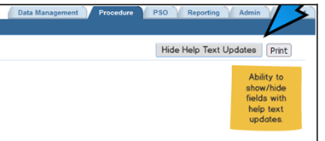
Released in Q2 2023
Help Text
  Enhancement to highlight fields with
  recently updated help text to alert
  abstractors to revised definitions
Support Tab Enhancements
  Addition of "Useful Links" section
  "Training Schedule" page has been renamed to “Upcoming Trainings”
  "Video Library" added on the Support tab

Slide 90
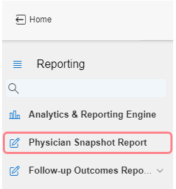
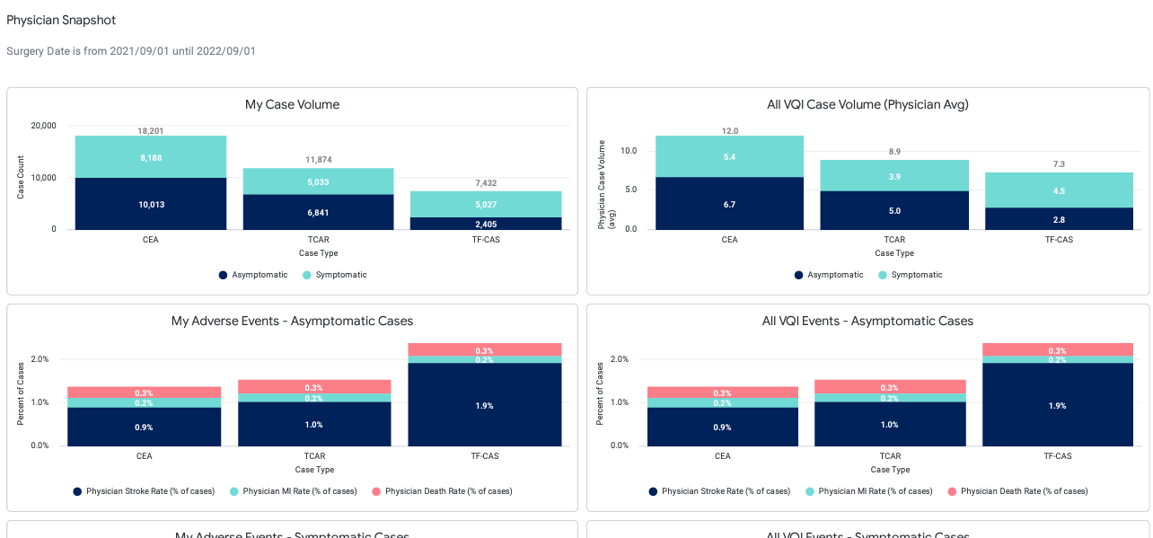
Released in Q2 2023
Physician Snapshot Report
  Introduced new Carotid Physician Snapshot Report.
    New report privilege added to the Users and Permissions Report

Slide 91
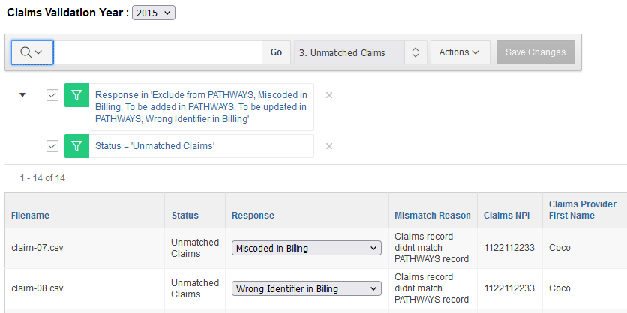
Released in Q2 2023
Claims Validation
  Sort by Response Provided in the Unmatched Claims – You can now sort or filter the “Unmatched Claims” report by the Response column

Slide 92
PATHWAYS Support

Slide 93

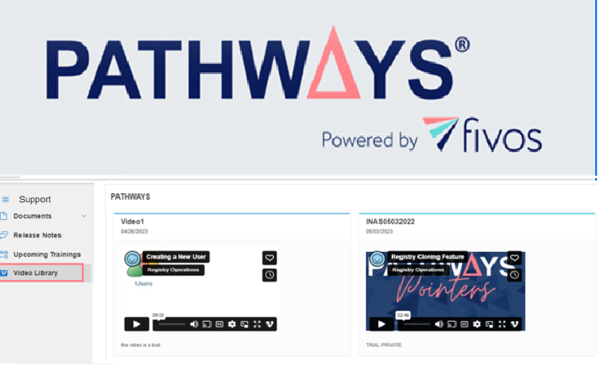
PATHWAYS Support
Need help?
Check out the PATHWAYS Support tab.
Documents – List of essential documents necessary for new staff and experienced abstractors to assist with data abstraction.
Release Notes – Listing of release announcements highlighting changes and improvements to the registries.
Upcoming Trainings– List of upcoming training opportunities with registration links for new staff and experienced abstractors.
Video Library – Listing of video tutorials to help you learn at your convenience.

Slide 94
PATHWAYS Support Updates
Announced in the spring:
PATHWAYS Hospital Manager Guide
Added to the Resources Tab
Helps users better understand role responsibilities
NEW announcement:
PATHWAYS Administrative Training Video
Added to the Support Tab Video Library
Provide even more support to assist new centers and new HMs
In beta > we welcome feedback on its usefulness during onboarding

Slide 95
PATHWAYS Support Updates
Claims Validation
Recent news:
The 2022 Claims Validation process was launched in April 2023 and closed in July
Powerful testimonials about ROI projects during VQI at VAM
  Direct result of the claims validation audit
This process can provide even more centers with opportunities to expose revenue leakage and mitigate financial loss (a great opportunity to WOW your administrative team)
Up next:
We are looking forward to launching the 2023 Claims Validation cycle in the Spring of 2024!

Slide 96
Coming Soon
The Support Team continues to develop brief training videos to assist with specific functionality and tasks.
We appreciate feedback we received during our recent VQI@VAM Support Update webinar. We will be sure to use this information for future development!

Slide 97
PATHWAYS Support – A Closing Note
A friendly reminder…
The following registries are all available in VQI. Reach out to our Sales team for assistance with additional VQI registry opportunities at your center.
Carotid Artery Stent Open AAA Repair
Carotid Endarterectomy Peripheral Vascular Intervention
Endovascular AAA Repair Supra-Inguinal Bypass
Hemodialysis Access Thoracic and Complex EVAR
Infra-Inguinal Bypass Varicose Vein
IVC Filter Vascular Medicine Consult
Lower Extremity Amputations Venous Stent

Slide 98
Registry Projects

Slide 99
SVS Post-Market Surveillance Projects
The following projects are conducted within the SVS PSO, and only non-identifiable data (removal of patient, center and physician information) will be provided to Medtronic/BARD/Cook/Gore or the FDA. Only standard of care practice is being evaluated. For such PSO activities, patient informed consent and Institutional Review Board review are not required.
Sites must follow their institutional guidelines.

Slide 100
TEVAR Dissection Surveillance Project
The SVS PSO is excited to announce the continuation of the TEVAR Dissection Surveillance Project to evaluate the Cook Zenith Dissection Endovascular System. FDA approval was granted for this device after safety and effectiveness were demonstrated in pre-market studies of complicated dissection with the proviso that the efficacy of TEVAR treatment of descending aortic dissection would be more fully analyzed through post-market surveillance, as was done through VQI for the W. L. Gore and Medtronic devices after their approval.
Patients will have 30 day, and annual visits for 5 years.
Total reimbursement of $4,000 per patient for a patient followed annually for 5 years.
For enrollment information: Sarah Van Muyden | sarah.vanmuyden@fivoshealth.com

Slide 101

TEVAR Dissection Surveillance Project – Cook Only
122 of the 180 required patients enrolled (14 potential cases in process)
60 Chronic Cases Enrolled - Enrollment Complete
62 Acute Cases Enrolled Currently -52% of total Acute Cases Enrolled
Retrospective enrollment allowed- All eligible cases from December 31, 2018 (protocol FDA approval date)
(76) 30-Day visits completed, (66) 1-year follow-up visits completed, (40) 2-year follow-up visit completed and (12) 3-year follow up visits completed
28 sites currently participating
This project is conducted within the SVS PSO and only non-identifiable data (removal of patient, center and physician information) will be provided to Cook or the FDA. Only standard of care practice is being evaluated. For such PSO activities, patient informed consent and Institutional Review Board review are not required.

Slide 102

Gore TBE Project
Gore is collaborating with the Society for Vascular Surgery Vascular Quality Initiative (VQI) to collect data and images from the TEVAR registry for a 10-year follow-up project.
Project Objective: To ensure that the clinical outcomes during the commercial use of the GORE® TAG® Thoracic Branch Endoprosthesis are as anticipated.
Patient Population: Patients who undergo treatment with the GORE® TAG® Thoracic Branch Endoprosthesis device.
Number of Patients
Max number of patients: 350
Start Date 01/15/2023

Slide 103
About the Gore TBE Project
Project specific dynamic content has been added to the TEVAR registry.
Project Timeline:
Phase I: Start-up, development, enrollment (3 years) Current Phase
Phase II: Surveillance period (10 years)
Total expected duration of the project: (13 years)
Project Imaging Requirements: Procedure + 1 Month + Annually

Slide 104
Gore TBE Project
23 fully executed addendums
22 sites full trained
Current enrollment as of 8/14/23 = 58 patients
For enrollment information:
Megan Henning
megan.henning@fivoshealth.com

Slide 105
Please contact
PATHWAYSSUPPORT@fivoshealth.com
for questions

Slide 106
Fall Report Reminder
Reminder:
Spring 2024 Report Cut Date = February 1, 2024, for procedures CY 2023

Slide 107

Spring 2024 Regional Meeting
TBD

Slide 108
CE/CME Meeting Attendance Credit
7 days to submit; no email reminder
PUT your FULL NAME in Zoom for remote attendees. Record of meeting attendance is required for CME/CE credit (no exceptions will be made)
SEND an email to achurilla@svspso.org with names of group members that are sharing 1 device
November 3, 2023 - Southern
OFFICALLY apply for CME/CE credit by clicking the URL or QR code provided

Slide 109
Thank you to our members for your continued participation and support of VQI

Slide 110
Thank you to COOK and GORE for your contributions and making these meetings possible
Thank you to Des Moines University for providing CE/CME credit for today’s meeting

Slide 111
Thank You

