Slide 1
VQI/PSO Fellow in Training A Pilot program
Next Generation VQI Member Alliance
Gary W Lemmon MD,FACS
Associate Medical Director- VQI, Quality
Aug 18,2021

Slide 2
Work Group Objectives
Fellow in Training (FIT) defined as Resident or Fellow in Training Program
Governing Council directed program- subcommittee
Mentor recruitment and selection
Define FIT duration in program and number of trainees in Tier 1 and Tier 2 level
Establish FIT application and selection process
Define Learning objectives- compliance with ACGME Milestones
Establish Certificate of FIT participation
Evaluate ‘Work Products’ for Scholarship award

Slide 3
Fellow in Training (FIT) Work Group
Representation:
Governing Council - Jeff Indes, Faisal Aziz and Ashley Vavra
APDVS - Jess Simons, Bridgitte Smith and Gabriela Velazquez
SCAI - Beau Hawkins
SVM - Herb Aronow, Dimitriy Feldman
VQI DE - Mina Boutros
0-5 Resident rep - Ashley Gutwein
PSO Staff - Jens Jorgensen, Betsy Wymer, Jim Wadzinski ,
Gary Lemmon

Slide 4
Selection Criteria for Mentors
GC approval of Mentors meeting one or more criteria:
VQI Member active in presentation or publication experience with activity in
Clinical research
Outcomes research
Cost and comparative effectiveness
Health equity
Quality and process improvement
Statistical support

Slide 5
Selection Criteria for Mentors
Local collaboration preferred with remote assistance accepted
Allows familiarity with QI team including data manager
Mentor agrees to a minimum quarterly meetings with FIT to:
encourage FIT participation in regional meetings
review and approve project design and plan
review and facilitate RAC proposal
interpretation of project results
review and approve any abstract, presentation or publication

Slide 6
Fellow in Training Selection Process/Eligibility
Any year resident/fellow in following specialties with vascular interest:
General Surgery
Vascular Surgery- 0-5, 0-7 (research), 5+2
Vascular Medicine
Cardiology- General (4-6), Interventional (7-8)
*During Pilot program, FIT candidates in last years of training will be preferred or those who have demonstrated prior vascular disease research

Slide 7
Fellow in Training Selection Process/Eligibility
Application:
Personal statement- reasons for applying, career goals
Must be in good standing as verified by Program Director
CV
2 Letters of reference
Area of interest- if known
Proposed mentor
Call for Application in 2nd and 3rd Quarter of year
Deadline submission Oct 31st
GC Applications review last quarter of year
Program acceptance/start January

Slide 8
FIT Learning Objectives
Tier 1 FIT intro to VQI and PSO via educational materials
Members Only section of website: VQI.org
Defined parameters consistent with ACGME Milestones-graduated measures
Goals based on levels of Systems Based Practice for Quality Improvement and Patient Safety
Standardized ‘Certificate’ of participation to training program
Establish Timeline for FIT participation and performance
Scholarship eligible products for Tier 2 advancement

Slide 9
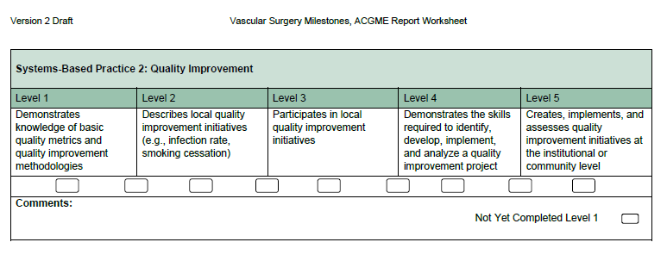
ACGME Vascular Surgery Milestone 2.0

Slide 10
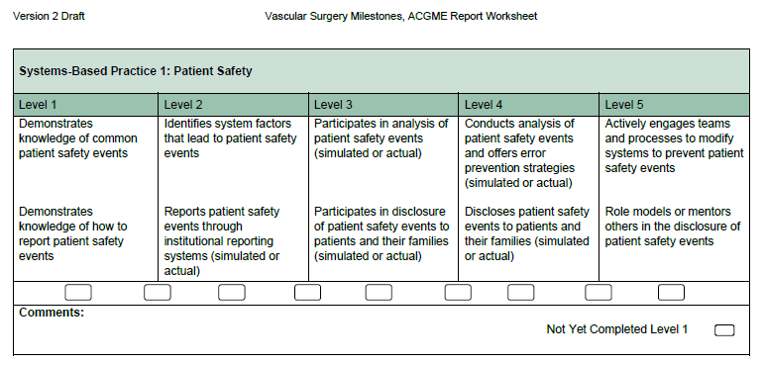
ACGME Vascular Surgery Milestone 2.0

Slide 11
Quality Improvement Checklist
Level 1 | Level 2 | Level 2 | Level 3 | Level 3 | Level 4 | Level 5
Introduction VQI-Web Portal info (members only login) Mentor led review of variables/definitions LTFU parameters and mandatory fields Local Data Manager introduction | Acquire Knowledge Review of local data/QI with Mentor and DM Knowledge of Quality Charter build Regional meeting prep call (ad hoc) | Review of local data/QI with Mentor and DM Knowledge of Quality Charter build GC committee attendance (ad hoc | Familiarity with VQI Existing Quality Charters and QI projects (website) Participate in Quality Charter build at local/regional level | Review existing Quality Charters and QI projects (website) Participate in QC build at local/regional level | Participates Demonstrate skills for use of Registry data to develop QI project Initiate Quality Charter or QI project Publication with VQI data (minor role) | Leads National QI at center/regional level Presents QI/QC at regional/national meeting Publication with VQI data (major role)
Comments: VQI web Portal info includes “Why Should I Join the VQI”; 2021 Annual Report; VQI: “Past, Present and Future”; AHRQ PSO guidelines; ‘Members Only’ info topics

Slide 12
Patient Safety Checklist
Level 1 | Level 2 | Level 2 | Level 3 | Level 3 | Level 4 | Level 5
Introduction PSO Organizational Chart Pathways website and Analytic Engine Reports Audible bleeding: RAC introduction | Acquire Knowledge Interpret Registry reports for Quality Improvement Review existing RAC projects GC meeting attendance (ad hoc) Attend Regional Study Group | Review of local data/QI with Mentor and DM Knowledge of Quality Charter build GC committee attendance (ad hoc | Familiarity with PSO Present comparative data at Regional Study Group SQUIRE 2.0 guidelines and RAC requirements for research RAC journal club | Review existing Quality Charters and QI projects (website) Participate in QC build at local/regional level | Participates Regional Project for Venous or Arterial RAC-new Join existing RAC project-analysis | Leads Abstract submission for VQI@VAM Podium presentation of RAC research RAC research publication (major role)
Comments:

Slide 13
Certificate and Timeline
PSO - Standardized certificate of FIT participation in program with Milestone level achieved for use by Trainee’s residency/fellowship records
Timeline:
FIT application/selection last quarter of year
Begin 1st quarter ensuing year- minimum duration one year
Quality Charters/Improvement/Research (9-15+M) during Tier 1 involvement
Presentations/Awards (18+M) at June VQI@VAM

Slide 14
Program Limits
Tier 1:
Center level may have more than 1 FIT applicant
Preference given to include FITs in all regions
Program duration a minimum of 12M; most expected to complete 18M cycle or greater
GC and PSO to determine capacity of program
Tier 2:
Limited to Scholarship recipients- 5/year
One year duration with PSO staff

Slide 15
Scholarship Eligibility for Tier 2 progression
GC oversight and approval subcommittee
Review process of FIT ‘work products’
Nominal ranking of proposals- (Name/ gender/ site- blinded)
Eligible work products include:
Poster abstract and presentation at VQI@VAM with FIT direction
QI project presentation at national meeting with FIT involvement
Manuscript publication using VQI data with FIT involvement
RAC research submission
FIT directed Quality Charter

Slide 16
Next Steps
Create GC subcommittee
Member survey for recruitment of interest
Determine Program Capacity
Develop Application review process
Define Scholarship ranking for awards
Recruitment of FIT applicants- Fall Qtr. 2021 during Fall regional meetings
Mentor- candidate matching
Initial roll out of program Jan 2022
Scholarship presentations slotted for VQI@VAM 2023

Slide 17
What do they have in common?
Cher
Bono
Sting
Madonna
Arnold
Twiggy
Diana
Oprah
Fabio
Liberace
Prince
Frank
Elvis

Slide 18
Scholarship Award for VQI Trainees
Call him profoundly influential but call him ”Jack”
2002 - Led the formation of the Vascular Study Group of Northern New England
Biannual regional meetings
One year follow up
2007 – Expanded to Vascular Study Group of New England
2011 – Expanded again to Vascular Quality Initiative
2011 – VQI organized under Patient Safety Organization - Medical Director

Slide 19
Scholarship Award for VQI Trainees
2003 – SVS President – merger of SVS and AAVS
2003-2008 – Co-editor of Journal of Vascular Surgery
2010, 2014 – Co-editor of 7th and 8th Edition of Rutherford’s Textbook of Vascular Surgery
APDVS President

Slide 20
Scholarship Award for VQI Trainees
Transformed the Division of Vascular Surgery at Dartmouth
Created the first Vascular Residency 0+5 program
Strong interest in education and training vascular surgeons
2016 - SVS Lifetime achievement award
2021- APDVS Lifetime achievement award
Golf - Lifetime achievement award - enthusiasm

Slide 21
Jack L Cronenwett Scholarship Award for VQI Trainees
VQI Trainee program - Lemmon and Wadzinski
Goals – encourage trainees to learn about quality improvement
Engage trainees in VQI
Engage trainees in Quality projects
Engage trainees in data analysis
Engage trainees in manuscript preparation
Participation will be selective and competitive
Scholarship to be named the
The Jack L Cronenwett Scholarship

